Slide 1

THE PLATFORM
INTRODUCTION
A branded corporate padel platform
built for young professionals.
PadelLive brings corporates, players and sponsors together through a structured multi-week league — combining sport, social connection and live brand experience in one repeatable proposition.

Slide 2
THE PLATFORM
ONE PLATFORM · THREE AUDIENCES
More than a tournament — a modern participation platform.
For Corporates
For Players
For Sponsors
A fresh way to build belonging
A fun, accessible weekly fixture
Repeat access to a valuable audience
Weekly ritual that strengthens early-career networks and makes work feel social again.
Low-barrier entry, familiar faces, visible improvement — the rhythm of a university team, restored.
Live, positive context. Same young professionals, week after week — not a one-off activation.

Slide 3


SECTION 02 · MARKET
02 / 06
Why padel?
Why now?

Slide 4
WHY PADEL
MARKET · UK & GLOBAL
The fastest-growing racket sport in the world — and the UK has just caught up.
PADEL IN GREAT BRITAIN · LTA, 2025
1M
1,825
57%
10M+
Players in UK
Courts across 551 venues
Of UK adults aware of padel
Adults who want to try it
GLOBAL PICTURE
30M
50,000+
130+
2×
Players worldwide
Courts globally
Countries playing padel
UK player growth, year on year
PADEL LIVE · MASTER DECK

Slide 5
WHY NOW
GENERATIONAL SHIFTS IN HOW YOUNG PROFESSIONALS SOCIALISE
The way young professionals connect, move and unwind has fundamentally changed.
01 · Belonging
02 · Wellness
Connection is the new compensation
Fitness has become identity
Gen Z and millennials prioritise belonging at work — but the gap between expected and actual engagement is widening.
Wellbeing is now a core social system for young professionals — shaping how, when and with whom they spend time.
03 · Sober-curious
04 · Loneliness
The drinks-led night out is fading
Friendships need scaffolding
28% of young people don't drink at all; 45% are actively cutting back. Movement-led socials are filling the gap.
Up to 31% of young adults experience loneliness. A weekly, recurring, low-effort fixture is the antidote.

Slide 6
WHY NOW
THE IMPLICATION
PadelLive meets these generational needs by combining sport, social connection and wellbeing in a weekly, fun, flexible format.

Slide 7
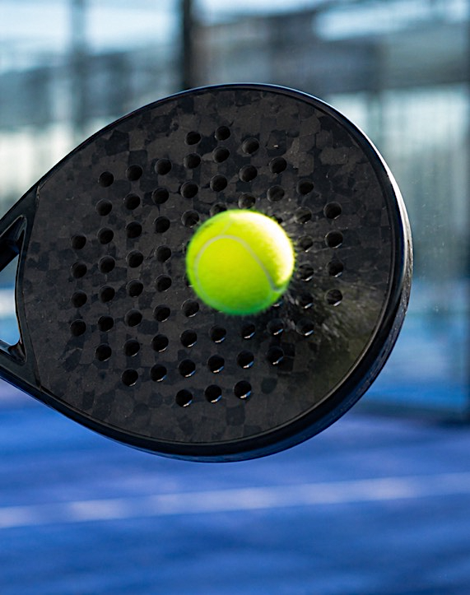
SECTION 03 · OPERATOR
03 / 06
Why Whitewall.

Slide 8



WHY WHITEWALL
THE WHITEWALL DIFFERENCE
We understand what resonates with early-careers intakes
01 · Onboarding
02 · Employee Engagement
03 · Repeat Value
update
update
Built as a season, not a stunt
update
update
Repeating fixtures, standings and rituals create the compound effect that single events can't.

Slide 9





WHY WHITEWALL
THE WHITEWALL DIFFERENCE
We build branded participation platforms — not one-off events.
01 · Format-first
02 · Brand-native
03 · Content-engineered
Built as a season, not a stunt
Sponsorship designed in, not bolted on
Each match night is a content shoot
Repeating fixtures, standings and rituals create the compound effect that single events can't.
Every touchpoint — from team kit to match-night moments — is a deliberate, native brand surface.
Hero film, weekly recaps, player profiles. Sponsors leave with a season's worth of usable content.

Slide 10

SECTION 04 · FORMAT
04 / 06
How does it work?

Slide 11
HOW IT WORKS
FROM KICK-OFF TO FINALS
A six-to-eight-week season — manageable to commit to, long enough to compound.
01 · Week 0
02 · Weeks 1–6
03 · Every week
04 · Always-on
05 · Finals night
Teams enter
Match nights
Post-match social
Content & social
Season culminates
Corporates buy entries for early-career cohorts. Squads, captains and kit confirmed.
Weekly fixtures, standings tracked, familiar faces compound week on week.
Themed drinks, micro-challenges, light awards. Optional, but it's where loyalty is built.
Player profiles, weekly recaps and standings shared internally and across league channels.
Awards, hero content capture, sponsor exposure — the moment the season pays back.

Slide 12

SECTION 05 · FOR CORPORATES
05 / 06 · A
For corporates.

Slide 13
FOR CORPORATES
WHY CORPORATES WIN
Belonging, retention and brand — funded by your People budget.
01 · Belonging
02 · Retention signal
A weekly anchor for early-career cohorts
A reason to stay, beyond comp
Cross-team relationships form on the court — the kind of connective tissue off-sites can't manufacture.
A recurring social fixture is what new joiners cite when they explain
why they stayed past year two.
03 · Talent brand
04 · Turnkey delivery
Visible, share-worthy proof
One operator, one invoice
League content surfaces on team accounts and personal feeds —
the modern recruitment loop.
Whitewall handles courts, fixtures, kit, content and finals. HR sponsors it; Whitewall runs it.

Slide 14
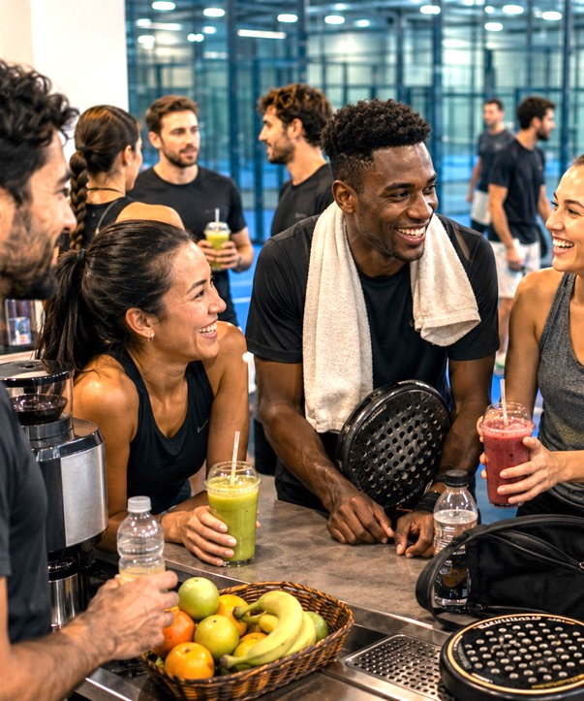
SECTION 05 · FOR PARTICIPANTS
05 / 06 · B
For participants.

Slide 15
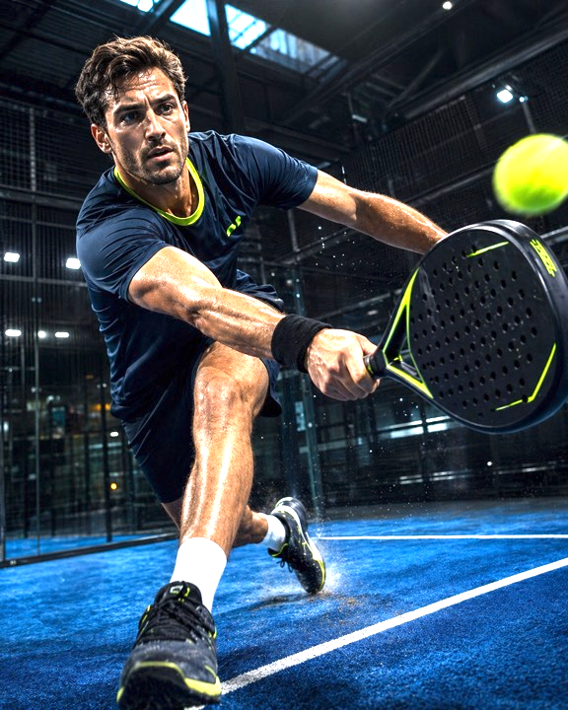
FOR PARTICIPANTS
WHY PARTICIPANTS WIN
The rhythm of a team — restored.
01 · Social structure
Weekly fixtures, familiar faces
02 · Inclusive play
Visible improvement within two sessions
03 · Friendship & network
Cross-company relationships, on neutral ground
04 · Low-stakes motivation
Friendly competition + ritualised post-match social
PADEL LIVE · MASTER DECK

Slide 16
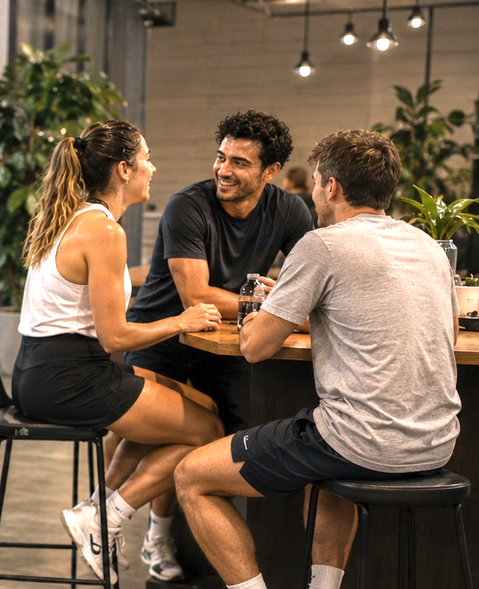
SECTION 06 · FOR SPONSORS
05 / 06 · C
For sponsors.

Slide 17
FOR SPONSORS
WHY SPONSORS WIN
Five things PadelLive gets right
that one-off activations don't.
1.FREQUENCY
Present every week, not just once.
4. ACTIVATION
Natural brand integration through useful moments like hydration, coaching, awards and recovery.
2.AUDIENCE
Urban young professionals
in employment.
5.MEASUREMENT
Attendance, opt-ins and content engagement can be tracked.
3.CONTEXT
Participants are active, social, emotionally open.
PADEL LIVE · MASTER DECK

Slide 18
FOR SPONSORS
WHY PADEL LIVE IS BUILT FOR SPONSORS
Becoming a PadelLive sponsor
TITLE PARTNER
CATEGORY PARTNER
MATCH-NIGHT + CONTENT
Name the season.
Own a vertical.
Test, then scale.
Every fixture, every comm, every piece of content carries your identity for 6–8 weeks — same audience, week after week.
Exclusive by category — no competitor shares the space. Native moments built into the format, not bolted on.
A single match night, or a recurring content format — a flexible entry point before committing to a full season.
Season naming rights across all fixtures and comms
Presence at every match night and post-match social
Headline at finals night — awards and hero content
Top-tier hospitality and first-look content rights
One brand per vertical — drinks, fintech, apparel, wellness, food
Activation around useful moments: hydration, coaching, rewards
6–8 weekly touchpoints with a cross-company audience
Co-branded content drops each week
Own a weekly ritual: player of the week, recovery zone, recap
Content captured and shared each week
Sponsor moments integrated naturally — not interruptive
Scale up to category or title partnership at any point
PADEL LIVE · MASTER DECK

Slide 19
FOR PARTICIPANTS
WHY SPONSORS WIN
Why sponsors belong here.
01 · Repeat exposure
Present every week, not just once
02 · Right audience
Urban young professionals in employment
03 · Natural brand integration
Activation through useful moments like hydration, coaching, awards and recovery
04 · Clear measurement
Attendance, opt-ins and content engagement can be tracked
PADEL LIVE · MASTER DECK

Slide 20
SECTION 06 · FOR SPONSORS
06 / 06
Commercial Model

Slide 21
COMMERCIAL
COMMERCIAL MODEL
A two-sided model — commercially stronger from day one.
SIDE A · EMPLOYER REVENUE
SIDE B · SPONSOR REVENUE
Per-team entry fees
Season rights & activations
Paid from HR / People budget
Anchors the league as a real product, not a speculative media play
Predictable, recurring season-on-season
Title and category partnerships
Weekly activations and finals event
Content partnerships, owned across team and league channels
Padel Live turns a fast-growing sport into a repeat brand experience platform.

Slide 22
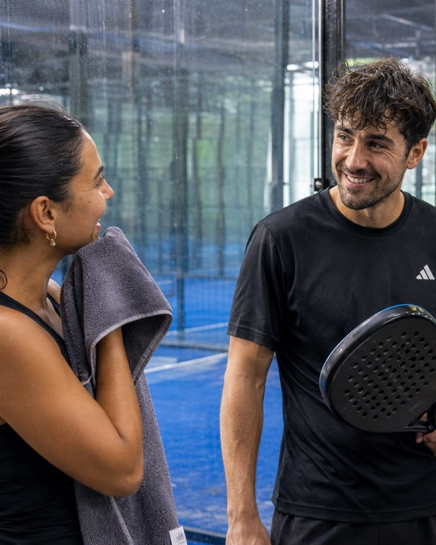

END
LET'S TALK
Get in touch.
CONTACT
REACH OUT
Sebastian White
Whitewall Originals
seb@whitewallcreative.com
+44 (0)7516 100 689

