Slide 1
Whitewall
Supplier Business Review – FY26 Requirements Overview
Aakansha Negi
Lead Category Manager – Marketing Services
Oracle Global Procurement
June 18, 2026

Slide 2
Supplier Business Review (SBR) Objectives
Promote and strengthen strategic partnership
Track, Trend and Trim to drive greater efficiencies and business performance
Discuss opportunities that are mutually beneficial for Oracle and preferred suppliers

Slide 3
SBR Topic Overview and Guidelines

Slide 4
SBR Topic Overview
Business Updates
Financial Reports
Key Performance Indicators (KPIs)
Innovation
Cost Savings
Strategic Assessment

Slide 5
Guidelines for Suppliers
This brief is designed to outline the expectations for your SBR presentation
Please address all topics in your presentation
Add supporting charts and graphs for the requested data
This review is focused on the full scope of your engagements with Oracle during the year dated (01-JUN-2025 to 31 MAY, 2026)
Your final presentation should be sent to Oracle Global Procurement (Aakansha.negi@oracle.com) upon completion of the scheduled SBR

Slide 6

Business Update

Slide 7
Business Update
Company news
  Please include recent updates regarding your company which would be pertinent to Oracle
Policy and procedure changes
  Are there any new project management procedures?
  Are there any new compliance or audit policies?
  Has any new software/technology been implemented which is used to help manage the Oracle business?
Organizational chart
  Include a current organizational chart or list of employees responsible for the Oracle account
Key market updates
  Recent developments in the marketplace relevant to your service offering
  Are there any new trends in the services that you provide?

Slide 8
Our story with Oracle
For over two decades, Whitewall has been a trusted creative partner to Oracle, transforming complexity into clarity through intelligent creativity. What began as reliable campaign and event support has evolved into a strategic partnership built on trust, creative excellence and a shared commitment to world-class work.
We’ve contributed across nearly every aspect of Oracle’s brand from welcoming new employees
to creating scalable campaign platforms and crafting executive communications that influence perception and drive engagement. Our focus remains on distilling complexity into clarity, creating work that makes every moment count.
Today, we work as an extension of Oracle’s internal teams, delivering end-to-end creative services across live and virtual events, motion design, film, branded content, and scalable systems - offering both consistency and adaptability.
From onboarding new hires for Oracle Global Tech, to major moments like AI World, to creating design systems for OCI or driving growth with NetSuite, we’re there behind the scenes, ensuring every detail is designed and delivered with impact.
Our relationship is more than a partnership. It’s a creative alliance, strengthened by shared vision, strategic insight and creativity that continues to evolve and delivering tangible results.

Slide 9
Company news
Whitewall continues to grow as a strategic creative partner for Oracle. Over the past year, we have expanded our expertise and services in the following areas:
Subject Matter Expertise: Clearly defined areas: brand evolution and growth readiness, customer/partner engagement, employee engagement, and tech/product storytelling.
  Geo-Intelligence Presence: Established reputation and client base in the geo-intelligence sector, especially relevant to defense and analytics.
  Analytics: Strengthened our marketing experience in the analytics sector, building on our geo-intelligence expertise to support more data-led storytelling, engagement, and campaign work.
  Strategic Digital Comms: Newly offered as a service, now delivered to multiple clients; upcoming discussions with Oracle stakeholders.
Looking ahead, we’re implementing more AI-powered workflows to increase speed, precision, and consistency, enabling smarter scaling without compromising quality.

Slide 10
Policy & procedure changes
  Project management procedures & workflow innovations:
  Frame.io Technology: Adoption of a smoother approval and workflow system using Frame.io, streamlining project delivery.
  AI-Driven Tagging and Approvals: Implementation of AI-supported tagging processes to improve asset organization, searchability, and workflow efficiency.
  Design AI Tools for Workflow: Use of design-based AI tools to support project management tasks, streamline approvals, and improve workflow efficiency.
  Project Budget Updates: Developed real-time budget updates and approval templates for a large-scale NetSuite program, enabling efficient production of thousands of assets.
  Contractor Integration: Used contractors under the project management team for NetSuite, optimizing resource allocation.

Slide 11
Policy & procedure changes (cont.)
  Compliance & policy updates:
Brand Compliance Conversations: Direct engagement with Oracle’s brand team, such as for OCI, to ensure brand compliance.
Social Media Guardrails: Developed crisis management and compliance policies for client social media channels.
New software/technology:
  AI for Content Creation: Dramatically reduced visualization and rendering times from days to minutes, enabling rapid client feedback and iteration.
  Meta Tag Automation: Leveraged AI to automate meta tagging, reducing hours of manual work to minutes, especially benefiting Oracle.
  Analytics Dashboards: Introduced integrated dashboards for tracking on- and offline activity and engagement, enhancing reporting and decision-making.

Slide 12
Organizational chart
Matthew Wall
Chief Creative Officer
Matt Hubbard
Chief Operating Officer
Rod Lee
SVP Client
Success
Jon Dix
VP Experience and Digital
John Garett
VP Creative and Design
Leonard Smit
Design Director
Giles Stoakley
Senior Program Manager
Pete Blunt
Executive Producer
Lili White
Senior Program Coordinator
Contracted
Associates
Katelyn Ewen
Snr Multimedia Designer
Bess Poon
Senior Digital Designer
Contracted
Associates

Slide 13
Key market updates
Market trends & strategic insights
  Evolving Tech Messaging: There is an increasing need for refined, buyer-oriented messaging as tech offerings become more complex and competitive.
  Integration of On/Offline Experiences: There is growing importance around integrated, not just parallel, online and offline brand experiences, supported by analytics and data.
  Storytelling as Differentiation: The increased importance of powerful tech storytelling means Whitewall is uniquely to help tech clients cut through market noise, connecting with a wide range of audiences on a global scale.

Slide 14
Financial Reports

Slide 15
Oracle Spend on the Supplier’s Services
Provide data on Oracle’s global spend with your company in the last 12 months
Please review the data below – along with our cost savings statistics (total spend with Oracle)
referencing Q4 FY24 thru Q3 FY25.
Comment on the pricing trends over the last 12 months
        What are the cost drivers for your industry pricing trends currently? The following answers are specific to design based work.
            Wages
            Software
            Hardware
        What drivers will help us yield savings or avoid any potential cost increases?
            Volume / campaigns and commitment
            Strategic & programmatic approach to work

Slide 16
Oracle Spend by Fiscal – Last 12 Quarters
FY26Q2 includes $4,633,891.47 of 3rd party pass through costs for NetSuite SuiteConnect FY 26 program.

Slide 17
Oracle Spend by Fiscal
FY26 includes $5,680,100.88 of 3rd party pass through costs for NetSuite SuiteConnect FY 26 program.

Slide 18
Oracle Spend by Bucket

Slide 19
Oracle Top 5 Category Spend

Slide 20
Oracle Top 5 PO Category Market Share %

Slide 21
Key Performance Indicators

Slide 22
KPIs
Oracle requires KPI reporting from preferred marketing suppliers to assist with overall performance evaluation
Key Performance Indicators (KPIs) monitored to determine SLA health
  Examples of KPIs/Core Metrics:
    On-time services delivery
Discuss overall progression
How do Oracle’s overall metrics compare year over year?
  Changes seen in volume or services purchased
  Company business revenue
    Oracle volume as a percentage of revenue

Slide 23
KPIs/Core Metrics
Creative approval rate – 95% of concepts approved, with design revisions
Customer satisfaction (CSAT) – 75 customer surveyed CSAT 97.3%.
On-time delivery rate – 100% of projects/deliverables submitted by agreed deadlines.
Brief-to-first-time resolution rate – 98% issues resolved without the need for escalation or follow-up.
Response time to comms – 98% of service requests responded to within 24 hours on working days.
Crisis response resolution time – Last-minute shift or urgent change requests resolved within
7 working days.
Uptime/availability – 99.9% availability.
Scope change clarity – 100% of scope changes formally documented.
Meeting participation & preparation – 100% of key meetings attended, well-prepared and added value with AI ready content approach.

Slide 24


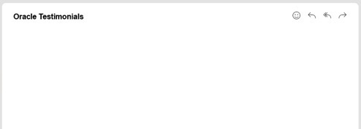
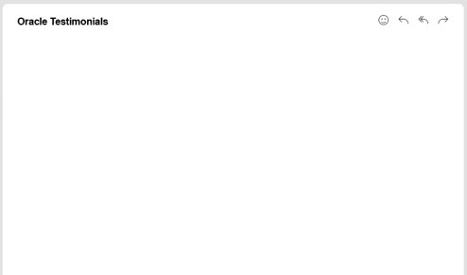



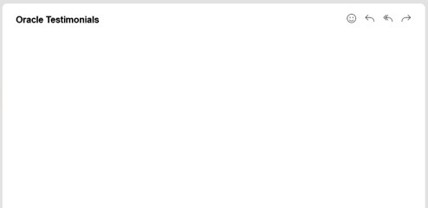

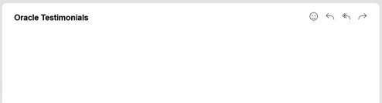

KPIs – Overall Performance
The feedback below offers a valuable lens through which to view our strategic relationship, with examples of our KPIs/Core Metrics, with Oracle. They demonstrate not only timely delivery, but to how we anticipate needs, elevate expectations, showing dimension to what high-performance design feels like.
We are very happy with AI World work.
Love the new unified platform graphic -much cooler!
Thanks for all your work on these.
The videos look great too!
Emily Cikovsky – Director, Product Strategy, Oracle Analytics
Now that I've had a nap, just wanted to send a quick message of "thanks" to you all for your pre-planning and onsite support of SuiteConnect New York.
From the creative perspective, we are thrilled with how everything came together and really enjoyed our collaboration on-site.
The printers, installers, and fabricators included. I hope you all have a restful weekend and are ready to tackle Chicago and beyond!
Much love and appreciation,
Danielle Jackson – Executive Creative Director, NetSuite
Thank you, Giles.
I appreciate your support and enjoyed the kick-off event this
week! It turned out wonderfully, and we have been getting really positive feedback.
I’m looking forward to seeing the photos.
Chat soon,
Melissa Eyeington – Director, Global Early Talent Programs
Hi John,
Ben really likes it and is asking when we can use it. Thanks.
Isabelle Nuage – Sr Director Product Strategy, Oracle Analytics

Slide 25
How do Oracle’s overall metrics compare year over year?
Service Engagement Volume
Strategic Adoption Growth
Overall metrics comparison (YoY):
Oracle’s service engagement remains strong, with year-on-year growth and consistently high scores for on-time delivery and customer satisfaction. We continue to integrate as a strategic partner for better budget controls.
Changes in volume or services purchased:
There's been a shift from one-off projects to larger, more complex programs, where our value has more impact. Each engagement has grown in scope, reflecting a deeper, long-term reliance on strategic support.
1.
FY25
FY26
FY27
FY25
FY26
FY27
Service Engagement Shift
Strategic
Projects
Strategic
Projects
Strategic
Projects
Tactical
Projects
2.
Tactical
Projects
FY25
FY26
FY27

Slide 26
How do Oracle’s overall metrics compare year over year?
Company Business Revenue Growth
Company business revenue:
Revenue grew year-over-year, driven by enterprise expansion, new markets and increasing demand for analytics in digital transformation. Our integrated strategic approach has not only seen an increase in more efficient delivery it has also enabled Oracle to expand scope and introduce other projects.
Oracle volume as a percentage of revenue:
This is difficult to measure as significant pass-through costs flow through the business from our M & E based work. However, Oracle related services represent a larger share of overall revenue than the previous year. This growth reflects our deeper integration and strategic approach.
3.
FY25
FY26

Slide 27
Innovations

Slide 28
Innovations
Summarize how your company is helping to support Oracle as an innovation leader
Best Practices
  Discuss best practices that you have developed in working with Oracle (or other clients), and how you have used those best practices for Oracle’s benefit
Summarize the future direction for your services or products
Comment on specific innovations that have resulted in cost savings and/or other positive impacts to activities

Slide 29
Supporting Oracle as an innovation leader
Our knowledge and processes support Oracle as an innovation leader.
Brand Innovation within Guidelines: With our deep knowledge of Redwood, we enhance Oracle’s brand expression without violating corporate brand guidelines.
Strategic Workshops: We hold regular Blue-Sky meetings, sessions, and workshops with our Oracle clients. We come with ideas to help our clients drive innovation in their marketing efforts.
Digital Content Capture and Distribution: We have created systems for near-instant capture and broadcast of event content in authentic, influencer-style formats.
We consistently deliver faster, smarter, and more strategic results for Oracle, maintaining world-class standards and making every moment count.

Slide 30
Best practices
Our best practices consistently drive better outcomes through business-focused creativity.
Weekly Budget updates: We provided clients like NetSuite with real-time financial tracking over the course of our 7-month engagement delivering the SuiteConnect global event series. Our financial dashboards enabled our clients to make the best use of their budget.
Streamlined Approvals: Implemented smoother, AI-assisted approval processes.
Rapid Visualization: Used AI assisted workflows to quickly generate concepts for client review.
Participation Platforms: Developed frameworks and platforms to standardize and scale design work across multiple locations.

Slide 31
Future Direction for Whitewall Services
We continue to focus on integrated storytelling, creative excellence, and operational efficiency.
Key areas of focus:
Continued Innovation in Storytelling: Commitment to remaining at the forefront of narrative and media evolution, leveraging AI and new platforms.
IP Development: Focus on creating proprietary programs for communication and engagement.
Staying Market-Relevant: Ongoing adaptation to market trends and generational shifts, ensuring services remain cutting-edge and impactful.

Slide 32
Strengthening the brand partnership
We don’t just apply the brand. We help shape how it shows up.
The relationship between the Oracle Brand Team and Whitewall allows important brand conversations to happen earlier, when they can have the greatest strategic and creative impact. This has been strengthened through our work on OCI, which has been instrumental in forming a more connected and collaborative relationship with the brand team.
Whitewall now holds regular bi-monthly meetings with the Oracle Brand Team, giving us the opportunity to align earlier on brand direction, messaging, visual expression, and creative intent before work moves into production.
As we move forward together, our vision for this partnership is to:
  Involve brand thinking earlier in the creative development process.
  Make key brand decisions before production, not during it.
  Build stronger alignment between Oracle’s brand standards and campaign ambitions.
  Create space for more strategic, considered creative work without adding friction.
When brand and creative align early, the work gets stronger, the process gets smoother, and the final output feels more intentional, consistent, and impactful.

Slide 33
Specific Innovations resulting in cost savings and/or other positive impacts to activities
The strength of our partnership with Oracle is best seen in the work, with each project reflecting our strategic thinking and design craft. On the following slides, we will show specific innovations.
Our work spans four core areas. We will highlight innovations under each:
Tech & Product Storytelling
We design content that moves with your audience, engaging, scalable, and always on-brand. From motion graphics to interactive assets, we bring clarity and consistency to every channel.
Customer & Partner Engagement
We turn insight into impact, creating campaigns that drive awareness, action, and advocacy. From product launches to employer branding, we align messaging and execution across regions and platforms.
Impactful Experiences & Brand Activations
We craft environments that bring Oracle’s brand to life. Across live, virtual, and hybrid spaces, we design every touchpoint to be intentional, immersive, and memorable.
Employee Engagement
Working closely with Oracle teams, we shape internal stories, experiences, and communications that keep employees informed, inspired, and part of something bigger.

Slide 34

Tech & Product Storytelling
Our storytelling begins with insight and ends with measurable impact.
Working closely with Oracle teams, we shape complex technologies and product narratives into clear, compelling stories that build awareness, understanding, and advocacy.
From emerging innovations to product launches, we translate technical detail into meaningful storytelling that resonates across audiences, regions, and platforms.
Every story becomes a catalyst for connection, engagement, and a clear signal of what Oracle stands for.

Slide 35






Oracle AI World Tootlkit
A scalable suite of toolkits and master assets designed to strengthen identity consistency across every creative touchpoint.

Slide 36
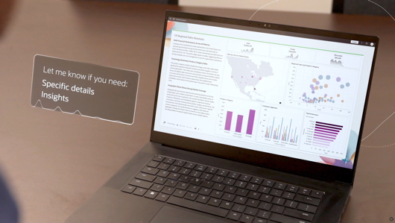
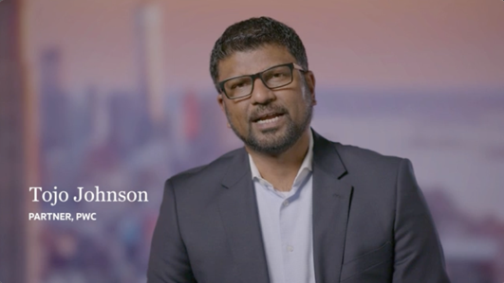

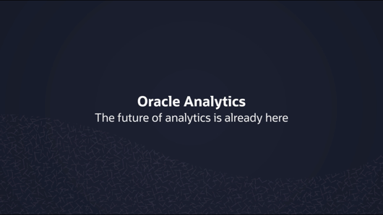
Oracle AI World Product Launch & Demos
Product launch films crafted from storyboard to screen, combining on-set production, post-production, testimonials and demo reels into one clear narrative.
Click to view the launch demo reel
Click to view the testimonial reel
Click to view the highlights reel
Click to view the demo reel

Slide 37
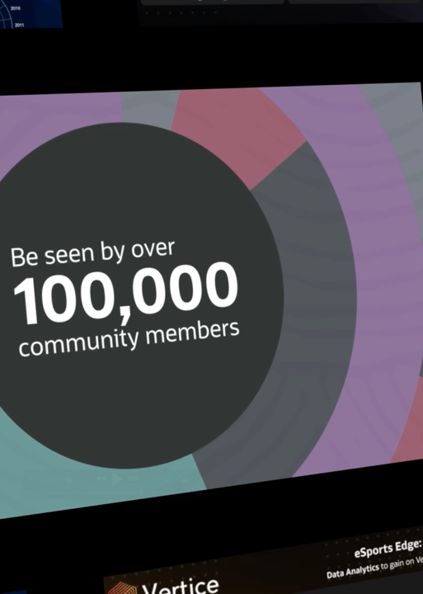
Customer & Partner Engagement
Our engagement begins with understanding and ends with meaningful connection.
Working closely with Oracle teams, we create content that reaches customers and partners across platforms, webinars, events, and social channels.
From motion graphics and explainer videos to interactive modules and digital storytelling, we turn complex messages into engaging experiences that build awareness, understanding, and advocacy.
Every touchpoint is designed to strengthen relationships, extend reach, and create clearer, more consistent engagement across every channel.

Slide 38
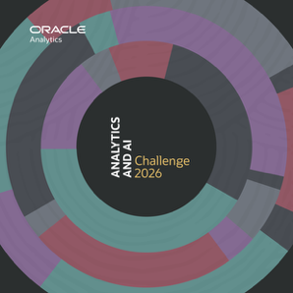


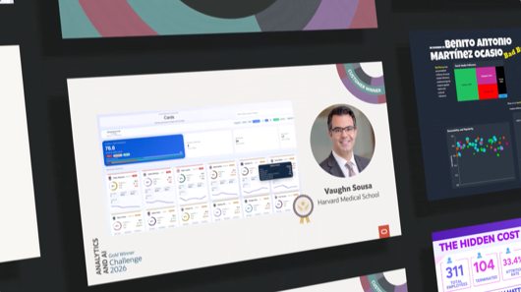


Analytics and
AI Challenge 2026
Emerging talent brought to life through storytelling shaped around innovation, data fluency and future leadership.
Click to view the highlights reel

Slide 39
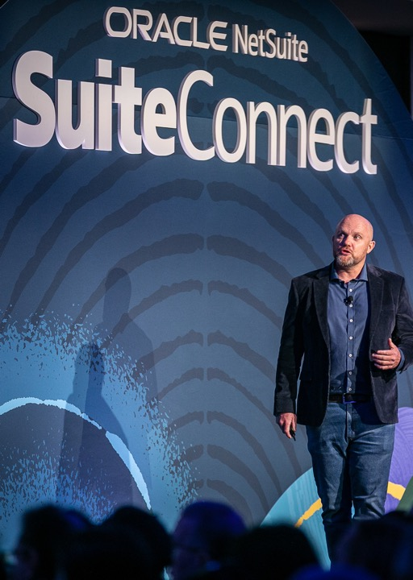
Impactful Experiences & Brand Activations
Our experiences begin with purpose and end with lasting impact.
We design environments that bring Oracle’s story to life across global events, executive briefings, virtual showcases, and brand activations.
From spatial design and screen content to signage, ambient media, and digital storytelling, we align physical and digital elements to create immersive, memorable experiences.
Every experience is designed to connect, reflect brand purpose, and make each interaction count.

Slide 40
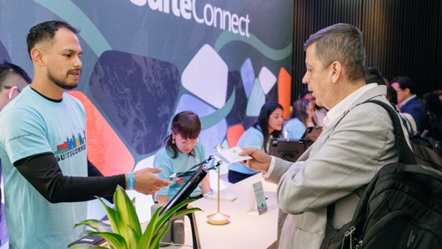
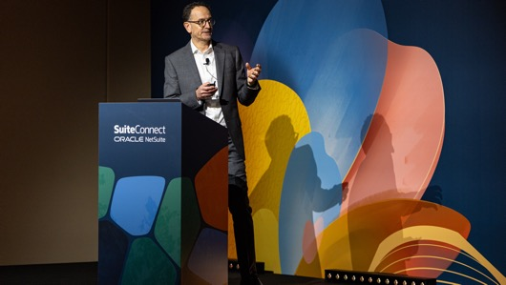
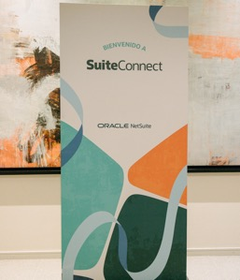
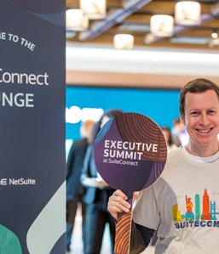
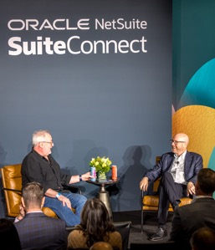

NetSuite SuiteConnect 26
Product ambition translated into real-world impact through experiences shaped around NetSuite’s strategic priorities.
12 Cities:
Dubai
NYC
Bogota
Chicago
Sydney
Melbourne
London
Toronto
San Francisco
Manila
Mexico City
Sao Paulo

Slide 41
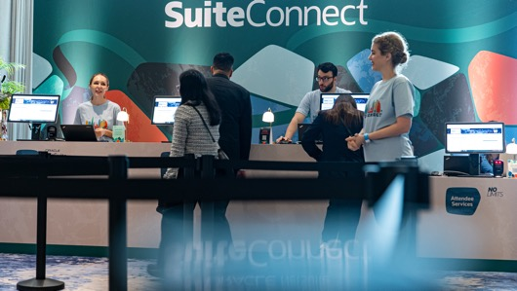
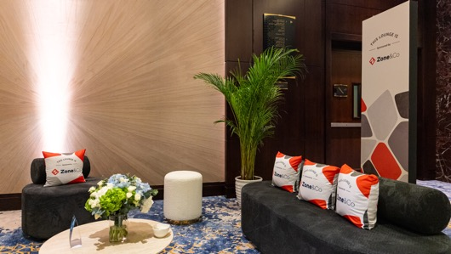

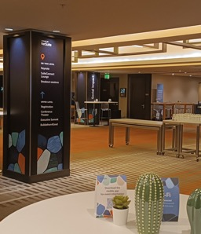
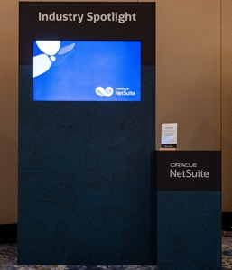
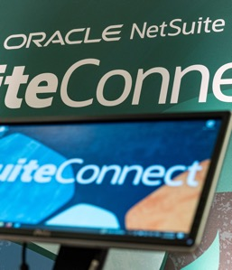
NetSuite SuiteConnect 26
A purposeful brand experience designed to align vision, message and momentum across every SuiteConnect touchpoint.
1086 Individual print artwork assets created.

Slide 42
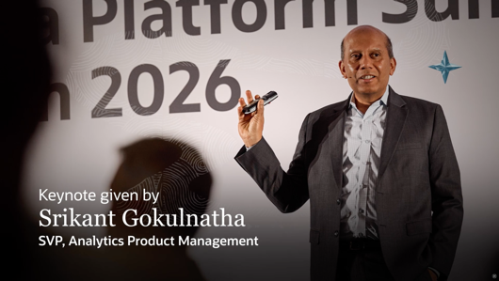
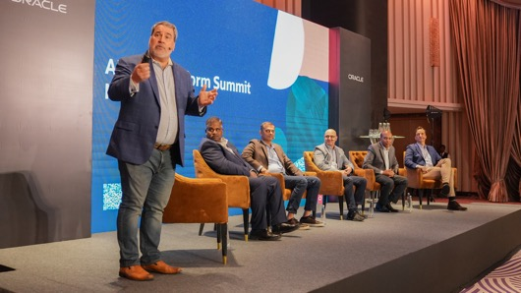
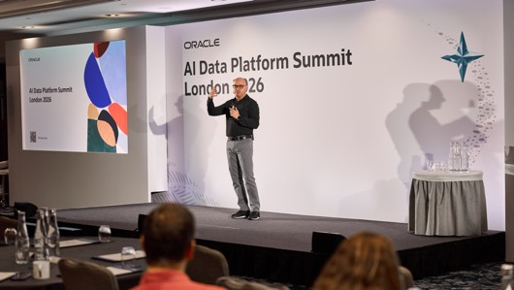
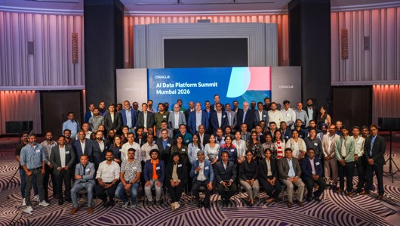
Oracle AI Summits
2026
On-site shoots, technical setup and presenter direction shaped into films that capture authentic voices and communicate with clarity.
Click to view the highlights reel

Slide 43
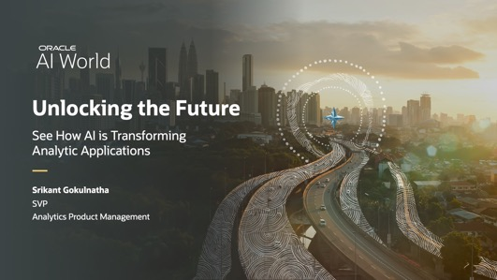
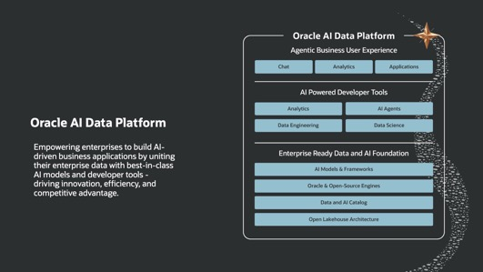


Oracle AI World Keynotes
Visual storytelling shaped to reflect intent, helping people see data in new ways, discover insights and unlock endless possibilities.

Slide 44

Employee Engagement
Our employee engagement begins with culture and ends with connection.
Working closely with Oracle teams, we shape internal stories, experiences, and communications that keep employees informed, inspired, and part of something bigger.
From employer branding and onboarding to leadership communications and employee moments, our work is rooted in strategy and crafted to resonate across teams, regions, and platforms.
Every interaction helps build belonging, strengthen advocacy, and reflect Oracle from the inside out.

Slide 45


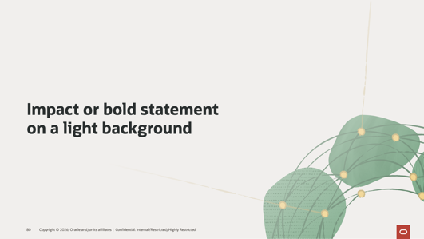
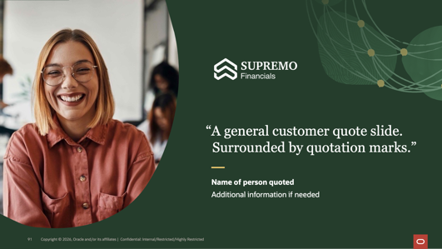

Oracle Cloud Infrastructure Data Centers
A distinct identity shaped from the ground up, designed to sit confidently within Oracle’s brand ecosystem while giving OCI Core its own presence.

Slide 46

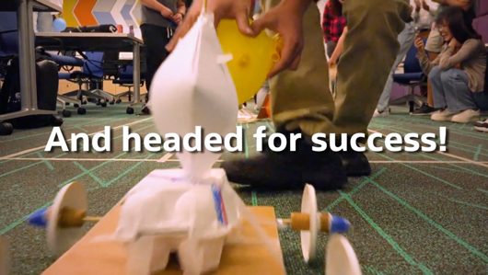

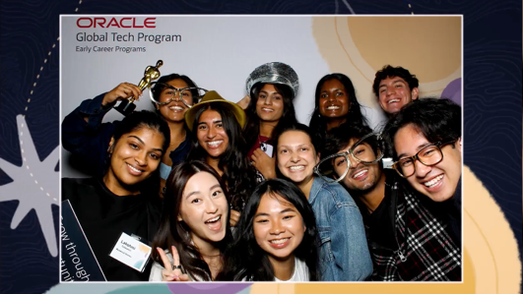
Oracle Global Tech
A distinct identity shaped from the ground up, designed to sit confidently within Oracle’s brand ecosystem while giving OCI Core its own presence.

Slide 47
Cost Savings

Slide 48
Cost Savings
Provide data on the cost savings your company has obtained or provided to Oracle in the last year
Please find data on the following slides. Over the period reported Whitewall achieved costs
savings averaging 27.7% - totaling over $2.5m in savings.
Cost Savings Opportunities
Suggest ways to drive more cost savings for Oracle and grow your volume as a supplier
        We are open to multi-year agreements and would price our services accordingly
        We would welcome opportunities to support additional GBU’s and organizations within Oracle
        We are open to providing volume-based discounts - but require commitment to enable them
Significant Cost Reductions
        Vendor Consolidation: For NetSuite, using a single vendor for multiple services led to substantial savings.
        AI Efficiencies: Automation (e.g., meta tagging, rendering) saved clients hundreds of thousands of dollars by reducing manual labor and accelerating delivery.
        Design Systems for OCI: Developed frameworks to avoid redundant design work for Oracle’s data center rollouts, enhancing efficiency.

Slide 51
Oracle cost savings summary Q4 FY25 thru Q4 FY26
REPORTING MONTH/YR | INVOICE TOTAL W/OUT ORACLE DISCOUNT | INVOICE TOTAL W/ORACLE DISCOUNT | TOTAL COST SAVING OR VARIANCE | % SAVING
Q4 FY2025 | 670,722.48 | 570,397 | 100,326 | 15%
Q1 FY2026 | 27,925.49 | 23,271 | 4,654 | 17%
Q2 FY2026 | 7,612,802.04 | 5,805,364 | 1,807,438 | 24%
Q3 FY2026 | 1,982,505.87 | 1,513,982 | 468,524 | 24%
Q4 FY2026 | 823,071.55 | 610,972 | 212,100 | 26%
Q3 FY25 thru Q4 FY26 TOTAL | 11,117,027.43 | 8,523,985.39 | 2,593,042.04 | 23%

Slide 52
Strategic Assessment
Slides to be provided by Oracle before the scheduled Supplier Business Review

Slide 53
Strategic Assessment Scoring Definitions

Slide 54

Strategic Assessment Scoring Weights
Technology 15%
Quality 20%
Responsiveness 15%
Delivery 20%
Cost 30%
Weighted Total: 100%

Slide 55
Strategic Assessment Results – Whitewall Creative

Slide 56
Strategic Supplier Assessment Results
Notes:
This is a sample Column Chart slide ideal for showcasing revenue data, product or market information.
To Customize and Edit this Chart, follow the steps below (this applies to all slides in this template that contain charts):
To Change Font Color/Size:
Select text, right-click and adjust the font setting on the Mini toolbar. Select desired attributes to change: font, size, boldness, color, etc. Note: many of the same commands can also be accessed from the Font group of the Home tab.
Edit Chart:
Click the chart to edit and select the Chart Tools Design tab (or double-click on the chart). Click the Edit Data button to access the underlying Excel 2007 spreadsheet.
Copying Data From a Separate Excel Spreadsheet:
From an existing Excel spreadsheet, select the range of cells to be copied, select copy (Ctrl C).
In PowerPoint, click the chart to edit and select the Chart Tools Design tab (or double-click on the chart). Click the Edit Data button to open the spreadsheet for editing.
Select all the data in the Chart in Microsoft Office PowerPoint spreadsheet by clicking the top left corner cell, right-click and select Delete.
Click in the first empty cell of the spreadsheet and paste (Ctrl V) to place the data copied from the other Excel file.
Changing Orientation and/or Scale of Data:
If no chart elements appear in your chart it is because either 1) the default orientation for pre-made template charts displays data series in rows, not columns, or 2) the axis scale may have to be adjusted (see below).
Change Orientation:
Click the chart to edit and select the Chart Tools Design tab (or double-click on the chart). Click the Switch Row/Column button. If the Switch Row/Column button is disabled, click the Select Data button and then click the Switch Row/Column button from within the Select Data Source dialog box, click OK.
Change Scale:
Right-click the labels next to the chart’s vertical (value) axis, select Format Axis from the pop-up menu. With Axis Options selected on the left, check all boxes under Auto to automatically provide the appropriate scale based on the data. To provide your own values, select the Fixed option, then type new values in the boxes provided to the right. Click Close when done.

Slide 57
Thank you

