Slide 1
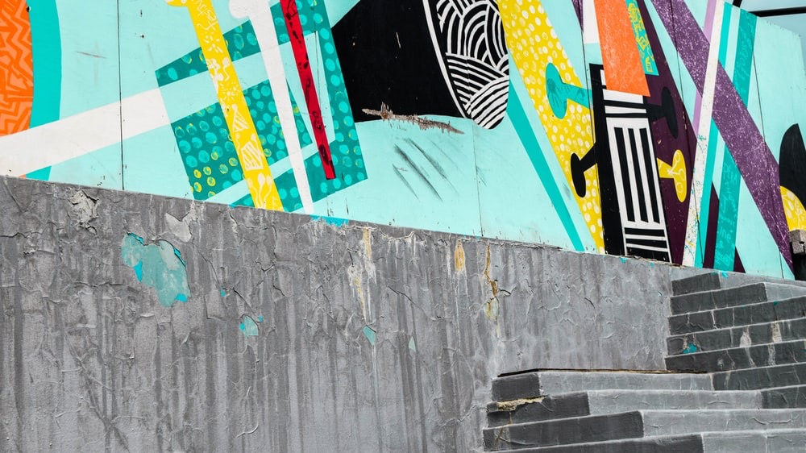

Slide 2

Oracle: FDI Tour 2026
Executive engagement through sport, data, AI and enterprise performance

Slide 3

What We Understand

Slide 4
Why “Oracle: Ahead of the Game”?
Because every customer is trying to move ahead – but not every customer defines progress in the same way. But they all share a similar challenge: how to make smart decisions in high-pressure situations.
This program starts with the customer’s view of themselves: their ambitions, pressures, transformation goals and definition of success.
Oracle’s role is not to tell customers what they should become. It’s to understand where they are going — and show how data, AI and insight can help them get there with greater confidence.
Ahead of the Game positions Oracle as the partner that listens first, understands the customer’s world and helps them turn intelligence into advantage.

Slide 5
Three Connected Workstreams
Workstream | Purpose
Experience Delivery | The stadia/venues, hospitality, F&B, fixture alignment, guest experience and live delivery
Engagement & Amplification | The narrative, branding, supporting comms, content capture, and post-event follow-through
Program Management | Ensuring workstreams operate at maximum efficiency to deliver the program

Slide 6

The Customer Journey

Slide 7

Engagement & Amplification

Slide 8

Sample Campaign Ident

Slide 9

Six Great Cities. Six Great Sporting Fixtures.

Slide 10
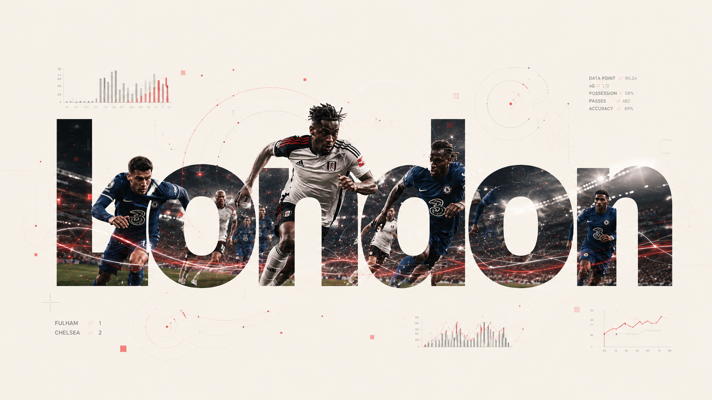
Sample Location Ident

Slide 11

Sample Campaign
Visual Language

Slide 12

Sample Experience Delivery: London

Slide 13
Sample Experience Delivery: London
COSTS | Total
Stage Management (On-site) | $2,550.00
Hospitality Package x30 | $20,300.00
Design (Step & repeat, pull-up banner, labor, transport) | $4,500.00
Photographer | $2,800.00
Logistics (Accommodation, travel & subsistence) | $2,830.00
Producer (Pre, onsite, post) | $4,926.72
Total for Experience Delivery London | $37,906.72

Slide 14
Experience Delivery (Based on 6 locations)
COSTS |  | Total
London |  | $37,906.00
New York City |  | $118,922.06
Sydney |  | $49,080.76
Rio de Janeiro |  | $89,854.56
Paris |  | $63,726.56
Dubai |  | $53,759.56
Total for Experience Delivery (6 locations) |  | $413,250.22

Slide 15
Engagement & Amplification Deliverables
Program Messaging
Visual Identity / Campaign Style
Customer Communications
Event Collateral
Event Highlights Reel - London
City Adaptation Package NY City
City Adaptation Package Sydney
City Adaptation Package Rio
City Adaptation Package Paris
City Adaptation Package Dubai

Slide 16
Engagement & Amplification
COSTS | Hours | Rate | Total
Creative Director | 33 | $267.50 | $8,835.75
Design Director | 40 | $267.50 | $10,710.00
Senior Designer | 34 | $205.28 | $6,979.52
Graphic Designer | 151 | $148.75 | $22,461.25
 |  | Sub-Total | $48,986.52
Miscellaneous Costs (Licensing, Insurances, Office infrastructure) |  |  | $2,547.00
Total for Engagement & Amplification |  |  | $51,533.52
* All hourly rates are inclusive of Oracle 15% discount

Slide 17
Project Management
COSTS | Hours | Rate | Total
Program Lead | 144 | $232.05 | $33,415.20
Program Coordinator | 96 | $116.03 | $11,138.88
 |  | Sub-Total | $44,554.08
Miscellaneous Costs (Licensing, Insurances, Office infrastructure) |  |  | $2,280.00
Total for Project Management |  |  | $46,834.08
* All hourly rates are inclusive of Oracle 15% discount

Slide 18
OVERALL COSTS SUMMARY
Workstream |  | Total
Experience Delivery |  | $413,250.22
Engagement & Amplification |  | $51,533.52
Program Management |  | $46,834.08
Total Investment |  | $511,617.82
* All hourly rates are inclusive of Oracle 15% discount

Slide 19
2026 Tour Options
Date | Location | Match / Event Option | Venue
Friday 21 August 2026, 8:00pm | London, UK | Arsenal v Coventry City | Emirates Stadium
Monday 24 August 2026, 8:00pm | London, UK | Fulham v Chelsea | Fulham FC / Craven Cottage
Thursday 27 – Monday 31 August 2026, 11:00am–6:00pm | London, UK | England v Pakistan Test Match | Lord’s
3 or 4 September 2026 | New York, USA | US Open Tennis Championship | Flushing Meadows
Thursday 3 September 2026, 7:50pm | Sydney, Australia | Bulldogs v Broncos | Accor Stadium
Sunday 27 September 2026, 5:25pm | Rio de Janeiro, Brazil | Baltimore Ravens v Dallas Cowboys | Maracanã Stadium
Saturday 7 November 2026, time TBC | Paris, France | Paris Saint-Germain v Troyes | Parc des Princes
Friday 13 November 2026, 9:10pm | Paris, France | France v South Africa | Stade de France
Saturday 21 November 2026, 9:10pm | Paris, France | France v Argentina | Stade de France
21 / 22 November 2026 | Dubai, UAE | SailGP | Mina Rashid
Saturday 28 November 2026, time TBC | Paris, France | Paris Saint-Germain v Lorient | Parc des Princes
Sunday 29 – Monday 30 November 2026 | Dubai, UAE | NGK SparkPlugs Race Weekend | Dubai Autodrome

