Slide 1


Slide 2



Zoom: Conversation to Completion.
Helping enterprise users see, trust, and embrace Zoom AI: from insight to action.

Slide 3
WHAT’S HOLDING zoom ai BACK?
High usage, low trust: Many employees use AI tools at work, but only ~46% fully trust the outputs.
Top-down resistance: Business leaders are concerned about data privacy and protection: in some cases, limiting their teams from employing AI tools.
Hidden adoption: Over half of workers report hiding their AI use from managers due to uncertainty or discomfort.
Reluctance for decisions: Only ~35% would trust AI to make important work decisions; most prefer human oversight.
Trust hinges on clarity: Users need accuracy, transparency, privacy, and control to feel confident engaging with AI.
Familiarity helps, but isn’t enough: Experience increases trust, yet poor results or privacy concerns still drive avoidance.

Slide 4
ZOOM NEEDS TO TELL A BETTER AI STORY

Slide 5
“Like this?”

Slide 6

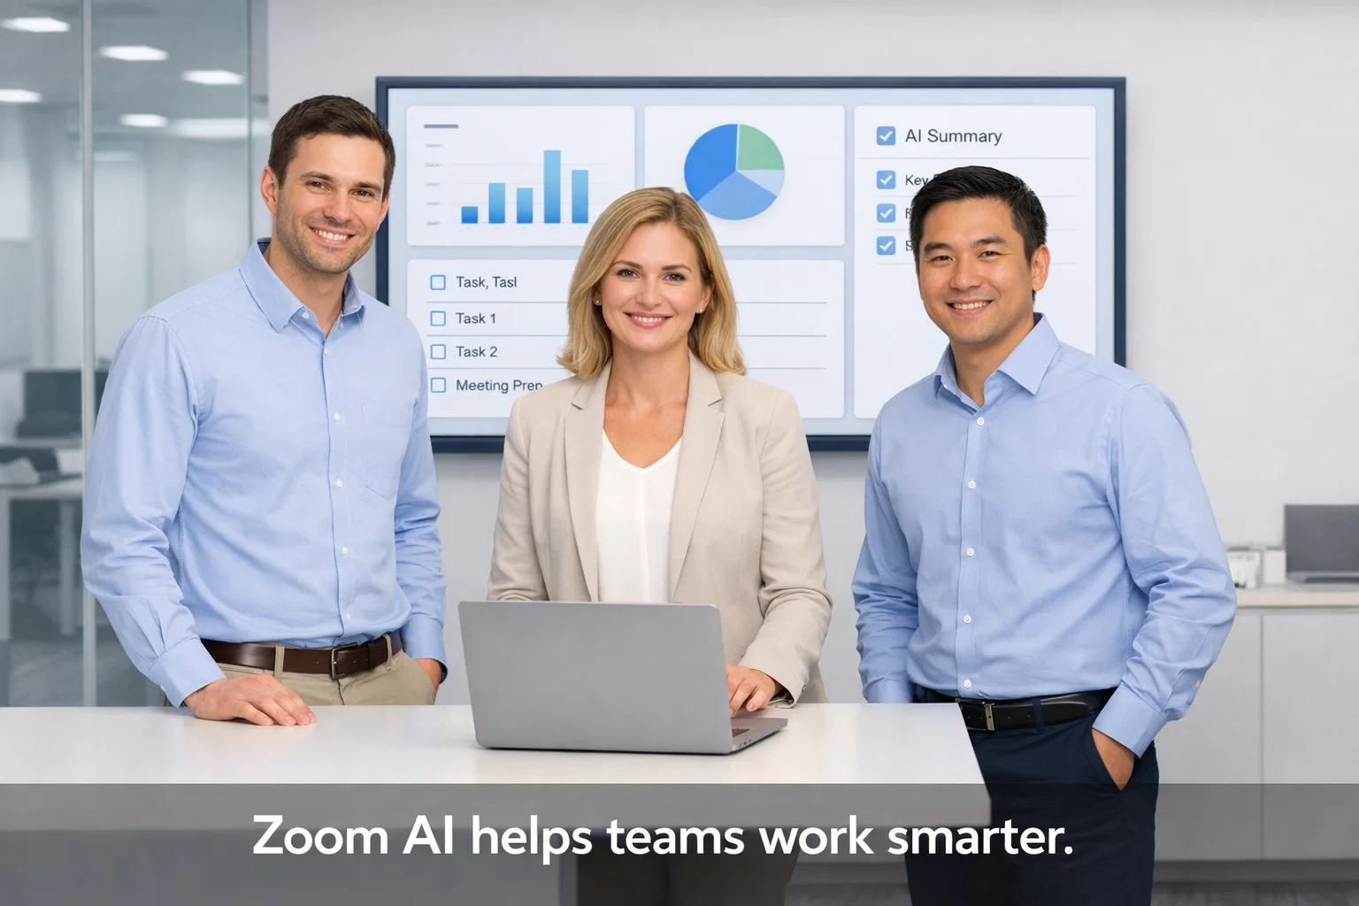

Slide 7



Slide 8
OUR BIG IDEA
Why do people keep coming back to TV shows like “The Pitt,” “CSI,” or “Succession”?
It’s because of the stories they tell and the tension they create.
Our approach: We take three of TV’s most popular genres — Medical, Police, Big Business — and bring Zoom AI to life through cinematic storytelling.
The effect: Viewers see AI in action during high-stakes, human-centered moments, making conversations feel meaningful, decisions clear, and outcomes visible.
Why it works for Zoom: The story format demonstrates value, builds trust, and is highly adaptable across industries and hero types.

Slide 9
Genre Examples
Medical Drama: Critical patient moment; AI assigns follow-ups, alerts staff, guides decisions.
Police / Crime Procedural: High-stakes investigation; AI prioritizes leads, manages tasks, tracks evidence.
Business Drama: Boardroom or executive decision-making; AI organizes tasks, highlights analytics, ensures workflow completion.

Slide 10
“in a world…”

Slide 11
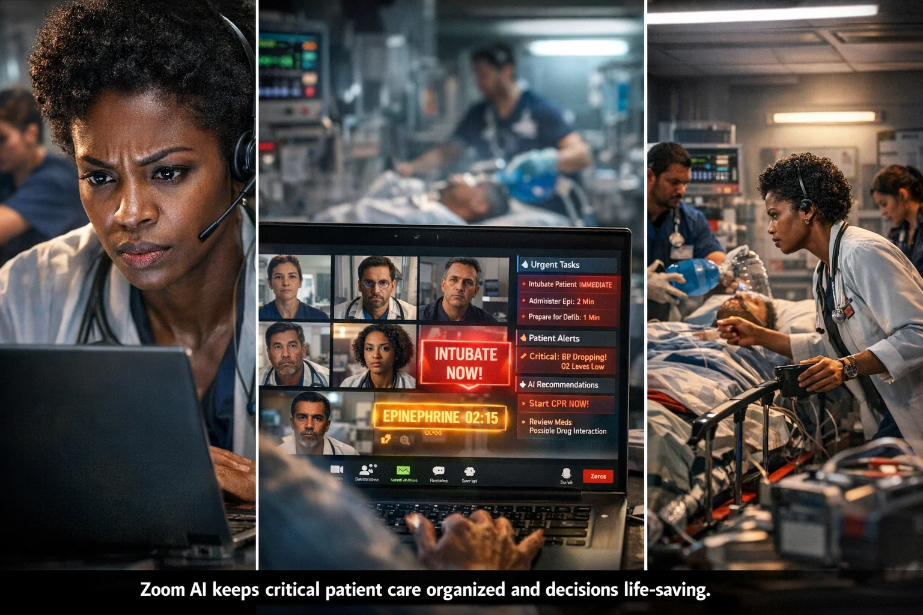
"In a world where every second counts and every decision can mean life or death… one doctor relies on Zoom AI to organize the chaos, assign critical tasks, and guide life-saving actions — instantly, confidently, and securely."

Slide 12
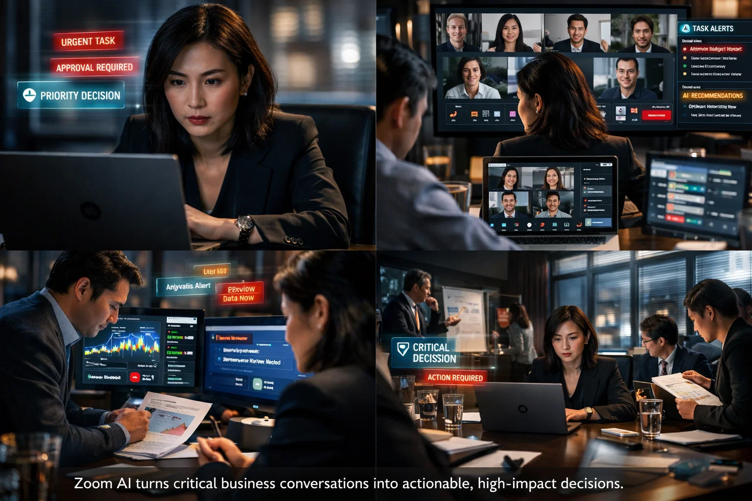
"In a world where decisions move at the speed of data, and every conversation carries weight… one executive turns to Zoom AI to turn complex meetings into actionable insights, tasks, and results — smart, fast, and reliable."

Slide 13
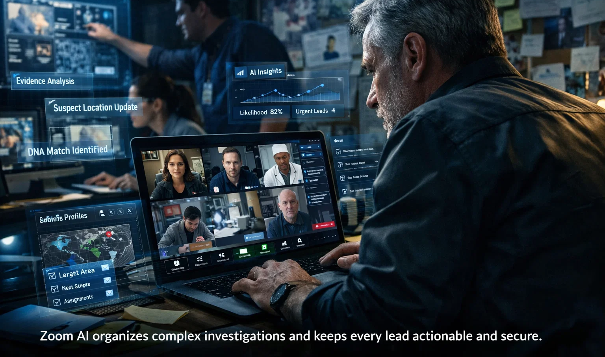
"In a world of unsolved cases and hidden clues, where every lead matters… one detective uses Zoom AI to prioritize evidence, assign tasks, and track investigations in real time — bringing clarity to the chaos and justice within reach."

Slide 14
THE STORYLINE
Talk → Action: Every conversation drives meaningful tasks automatically.
Insight → Decisions: AI highlights risks, priorities, and next steps.
Chaos → Clarity: Workflows simplified; tasks and reports completed reliably.
People first: Heroes focus on what matters most — saving lives, solving cases, or making strategic business decisions.

Slide 15
WHY IT WORKS
Heroes first: Show real people making high-stakes decisions, letting viewers see themselves in the action.
Trust in every move: Demonstrate AI’s reliability, security, and clear guidance in critical moments.
Outcomes, not features: Highlight measurable results — tasks completed, decisions executed, time saved.
Drama with clarity: Use visual storytelling to make the transformation from conversation to completion immediately obvious.

Slide 16
VISUAL & CONTENT STRATEGY
Cinematic, people-centric imagery: Live-action or photorealistic hero interactions.
Zoom UI overlays: Tasks, analytics, and AI recommendations integrated naturally.
Genre-specific tension: Medical, police, or business context shows stakes without repeating core story.
Dynamic camera angles: Reverse-angle, over-the-shoulder, close-ups, wide shots.

Slide 17
CALL TO ACTION/CLOSING
Let’s show Zoom AI in action — making every conversation matter, every decision actionable, and every workflow complete – even when the stakes couldn’t be higher.
Zoom. Conversation to Completion.

Slide 18
Further options

Slide 19
1. Live Interactive “AI Command Center” Experience
Concept: Turn a physical or virtual space into a real-time Zoom AI activation where attendees see AI in action on real workflows.
How it works:
A large-screen “control room” shows live Zoom meetings, holographic-style overlays of tasks being assigned, reports generated, and decisions tracked.
Visitors can interact with the AI, inputting decisions or initiating tasks to see completion happen in real time.
Security and trust features are visually emphasized (locked dashboards, approval workflows).
Gamified metrics show “minutes saved,” “tasks completed,” and “decisions supported.”
Impact:
Makes abstract AI capabilities tangible.
Engages enterprise users in a memorable, visceral way.
Showcases Zoom as a partner, not just a platform.

Slide 20

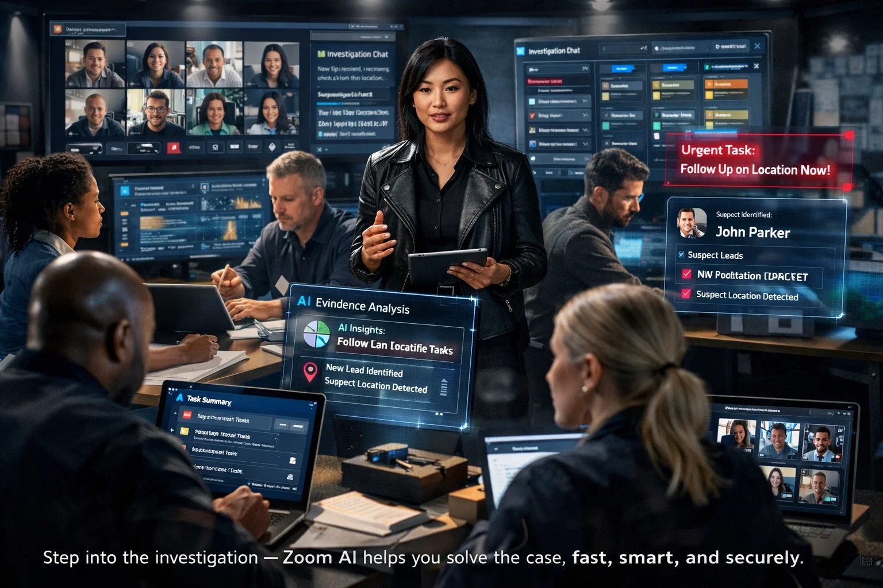
Step into a high-stakes crime investigation where participants become detectives, working together to solve a case in real time. Using Zoom AI, participants prioritize leads, assign tasks, track evidence, and make decisions — all while collaborating over live video.
The experience blends interactive screens, AI dashboards, and cinematic tension, letting participants feel the stakes, act with confidence, and see AI in action.
Click to see our live Netflix immersive experience in action.

Slide 21
2. Zoom AI “Hackathon for Action”
Concept: Invite enterprise teams to a live or virtual hackathon-style event where AI demonstrates real workflow transformations.
How it works:
Teams are given complex, simulated scenarios (HR approvals, sales follow-ups, patient care tasks).
AI is integrated live, completing tasks, guiding decisions, ensuring compliance.
Teams compete to maximize efficiency and outcomes, showing the AI’s value in real-world action.
Impact:
Highly participatory and engaging.
Positions Zoom AI as a powerful, trusted collaborator.
Creates tangible, memorable stories and user-generated content.

Slide 22
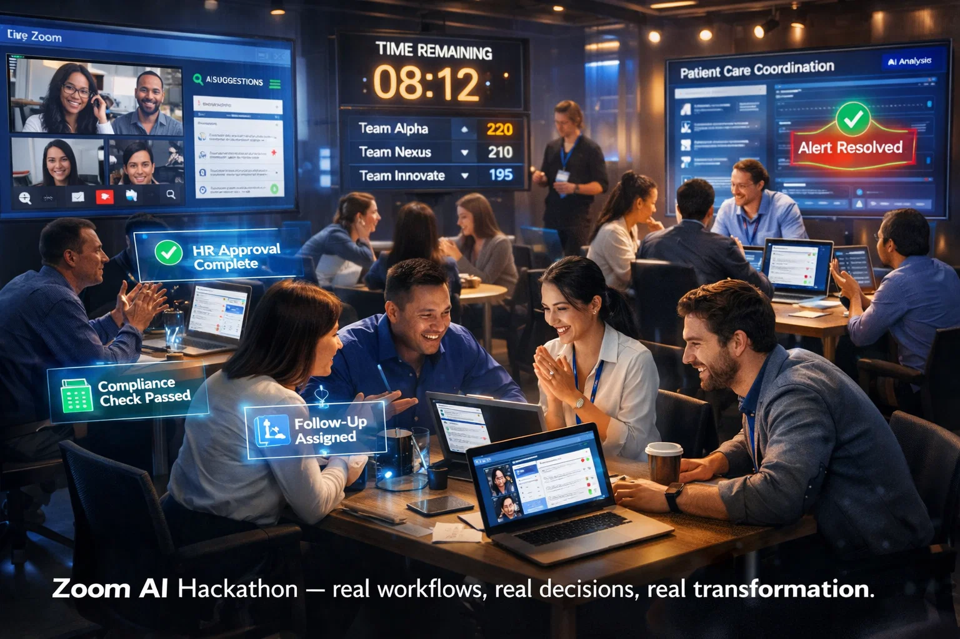
A high-energy workflow challenge where participants become problem-solvers, working together to crack complex business scenarios in real time. Using Zoom AI, teams prioritize actions, assign tasks, track progress, and make decisions — all while collaborating over live video.
The experience combines interactive screens, AI dashboards, and competitive team energy, allowing participants to feel the pressure, act with confidence, and see Zoom AI transforming real workflows in action.

Slide 23
3. “Step Into the Workflow” – Zoom AI Live Experience
Concept: Attendees become the hero, experiencing Zoom AI completing real enterprise tasks in real time.
How it works:
Room staged as a modern office or collaborative workspace.
Attendees receive role-based task scenarios (Sales, HR, IT, Operations).
Zoom AI assigns tasks, generates reports, guides decisions — shown via AR/VR overlays or interactive screens.
Optional leaderboard highlights efficiency, accuracy, and collaboration.
Impact:
Demonstrates trust, clarity, and practical AI value.
Provides an immersive, shareable experience.
Shows immediate “before vs after” workflow transformation.

Slide 24
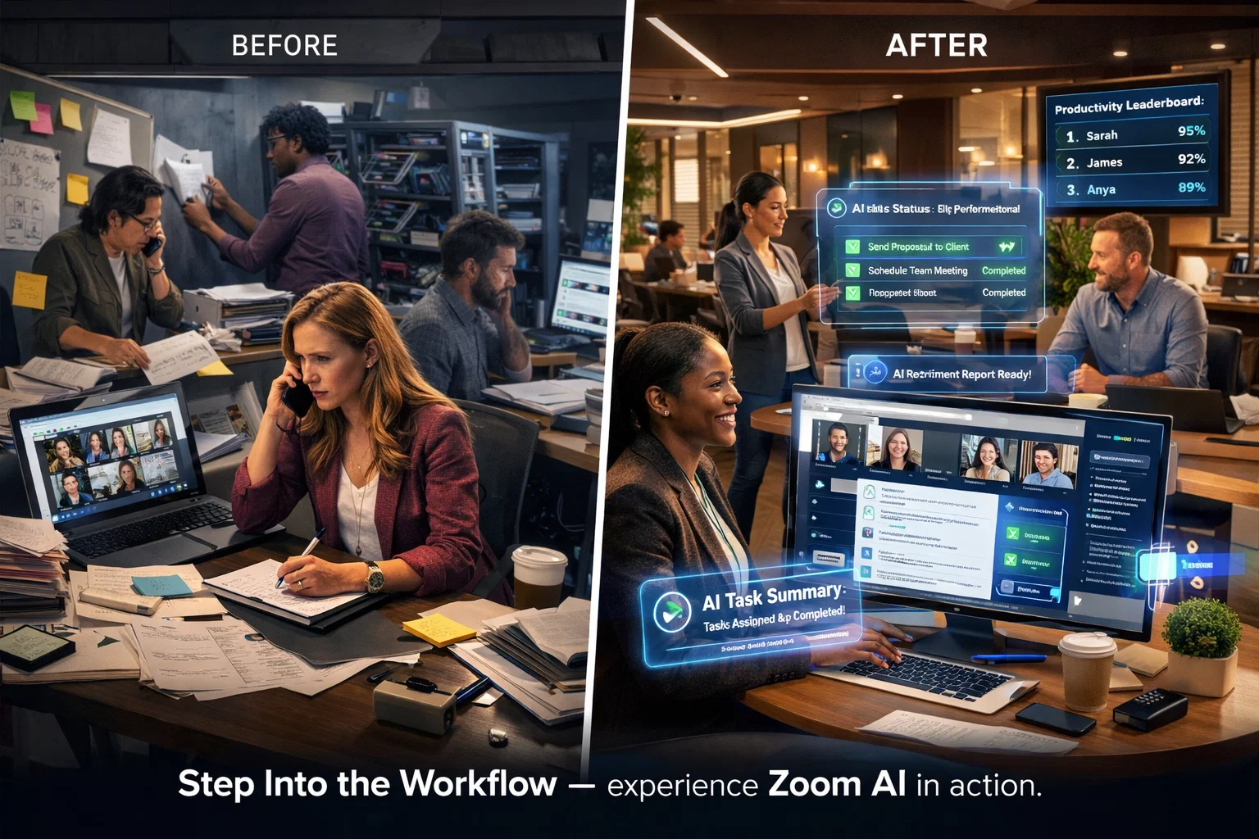
A fast-paced live challenge where participants step into real business scenarios and work together to solve them in real time. Using Zoom AI, teams organize priorities, assign next steps, track progress, and make informed decisions — all through live collaboration.
The experience blends interactive screens, AI-powered workflows, and immersive team problem-solving, giving participants a hands-on way to feel the value of Zoom AI and see how it turns complexity into action.

Slide 25
4. Campaign Concept: “AI You Can Trust”
Objective: Increase confidence and adoption of Zoom AI Companion by showing transparency, security, and real human impact.
Key Elements:
User Stories / Testimonial Videos
Short 30–60s clips of real enterprise users (Sales, HR, IT) showing AI helping complete tasks safely.
Include on-screen visual cues: AI suggestions, approvals, and automated workflows.
Highlight security overlays or compliance confirmations to reinforce trust.
Share on LinkedIn, Twitter/X, and enterprise-focused platforms.
Interactive Social Challenges
Users submit “workflow challenges” via a microsite or LinkedIn campaign.
Zoom AI demonstrates how it would complete the task in a short animation or video.
Participants can see their tasks completed safely and instantly — reinforces reliability and usefulness.

Slide 26
4. Campaign Concept: “AI You Can Trust”
Transparency / Explainer Series
Mini social videos showing how AI works, including:
“How Zoom AI decides which tasks to assign”
“How your data stays private and secure”
Use friendly, human tone with simple graphics and clear narration.
Gamified Peer Sharing
Encourage teams to share “AI wins” internally or on social with hashtags (e.g., #MyAICompanion).
Highlight “before vs after” transformations: chaotic → organized, uncertainty → confident decisions.
Impact:
Shows human outcomes first, AI transparency second.
Provides shareable content for internal advocacy and social proof.
Reduces perceived risk and builds trust by emphasizing security, reliability, and positive human impact.

