Slide 1
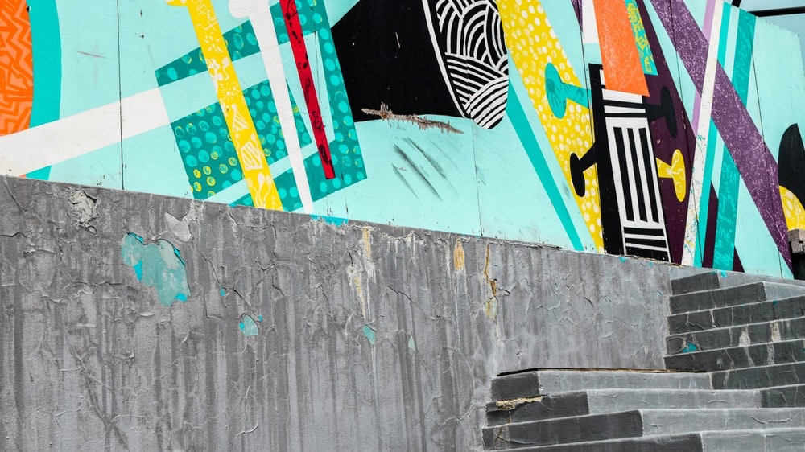

Slide 2


WHAT’S THE story?
Thryv Marketing Center.
Helping small business owners turn scattered marketing into measurable results - anywhere, anytime.

Slide 3
THE CAMPAIGN APPROACH
Showcases Thryv’s Value: Real SMB stories demonstrate tangible marketing impact—more clients, better online presence, stronger engagement.
Multi-Channel Reach: Combines hero videos, social clips, blogs, and UGC for broad awareness across YouTube, Instagram, LinkedIn, and email.
Efficient & Scalable: One cohesive campaign leverages five videos across multiple channels, maximizing ROI without fragmenting resources.
Builds Social Proof: Encourages user-generated content and testimonials, reinforcing credibility and driving organic advocacy.
Engages SMB Owners Emotionally: Relatable storytelling connects with small business owners, showing Thryv as a partner in growing their business.
Takeaway: A unified, marketing-driven campaign that drives awareness, engagement, and conversion while strengthening Thryv’s brand positioning.

Slide 4

Campaign Approach: THRYV MARKETING CENTER
Timeline & Structure
4 Weeks – Design & Development: Creative strategy, storyboard finalization, video production prep, social content planning.
8 Weeks – Campaign Execution: Launch of 5 hero videos across multiple channels, supported by a coordinated social media strategy, and retargeting.
Key Deliverables
5 Video Stories: Industry-specific narratives (SMB owner journeys, humorous and relatable)
Social Media Content & Support: Short-form video cuts, carousel graphics, UGC engagement, and retargeting campaigns
Integrated Digital Approach: Landing page design, email nurture sequences, and blog content aligned with video messaging
Outcome: Seamless campaign that builds awareness, engagement, and conversion for Thryv across small business audiences.

Slide 5
Campaign Concept & Video Overview
Relatable, people-centric SMB owner stories demonstrating the road to marketing nirvana.
Video | Focus | Key Message / Tone
Hero Video | Broad SMB overview | “Thryv in Action” – multi-tasking chaos → calm, all-in-one solution, multiple sectors
Industry Spotlight 1 | Home & Field Services | Streamlined scheduling, payments, and reviews for contractors, plumbers, electricians
Industry Spotlight 2 | Professional Services | Simplified client management for law offices, accountants, consultants
Industry Spotlight 3 | Health & Wellness | Balance appointments, marketing, payments – “marketing nirvana”
The Thryv Advantage | Social Proof & Benefits | Quick summary of features, testimonials, and conversion CTA

Slide 6

SAM’S STORY

Slide 7
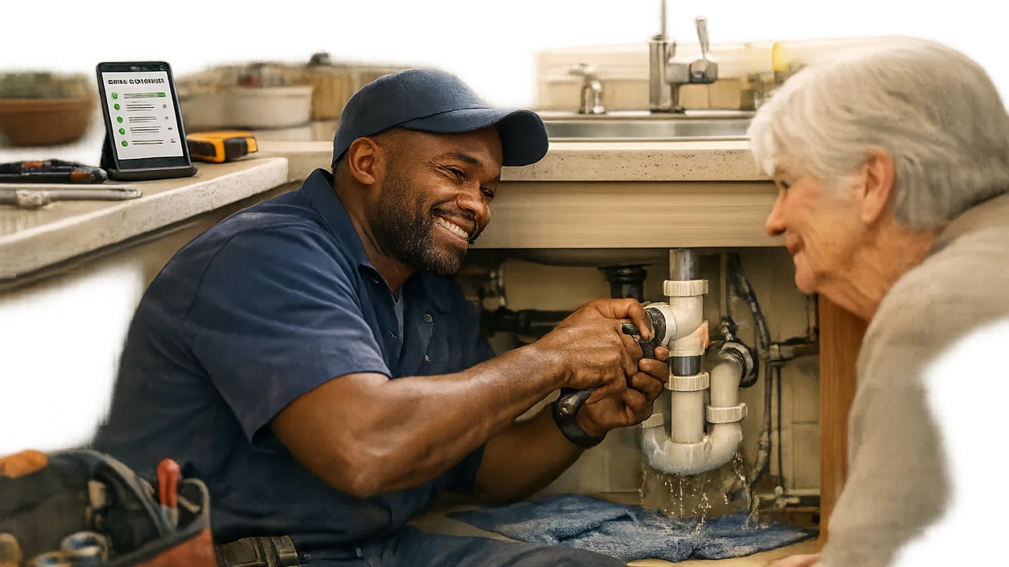
Sam loves plumbing.

Slide 8

Marketing? Not so much.

Slide 9
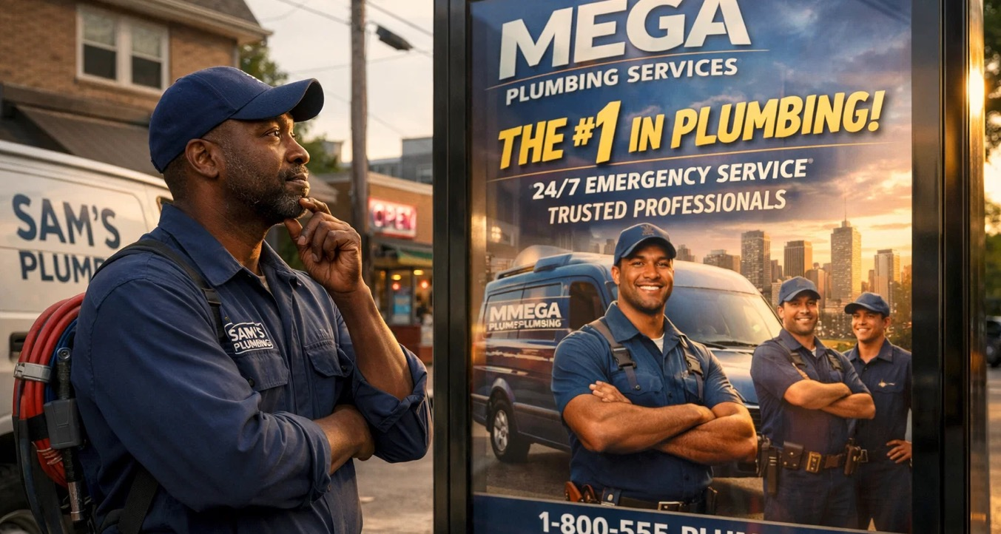
One thing’s for certain: he can’t outspend the competition.
With Thryv, he doesn’t have to…

Slide 10
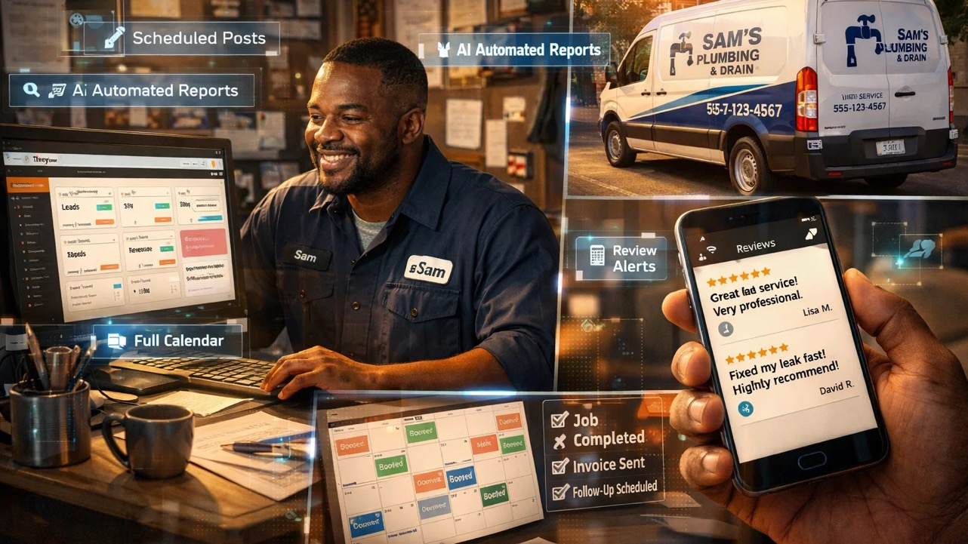
With Thryv, Sam gets consistent content, regular comms and fast review responses - without spending hours away from the job he loves.

Slide 11
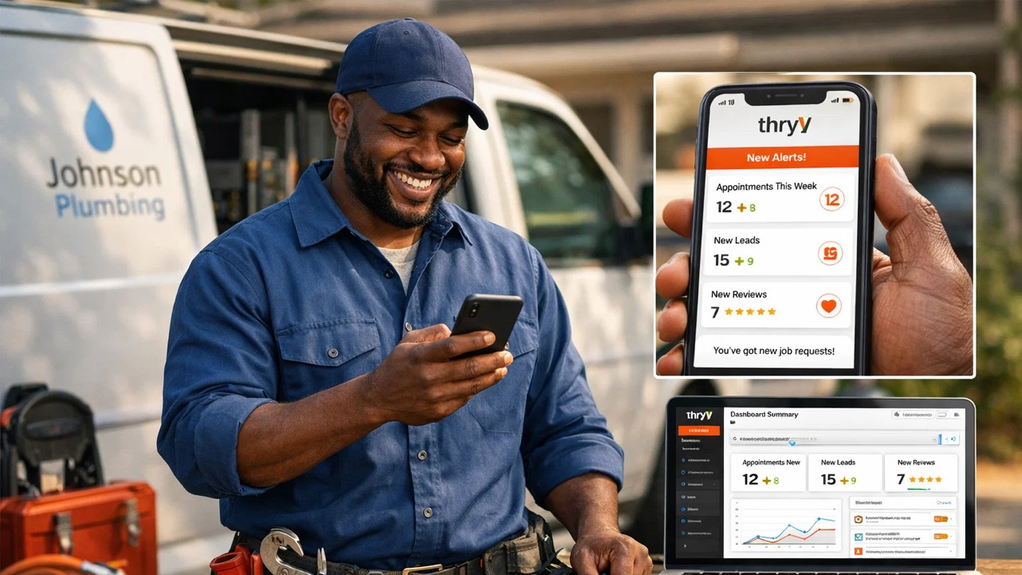
From strategy to execution, Thryv guides every decision in real time, optimizing results while keeping control in Sam’s hands.

Slide 12
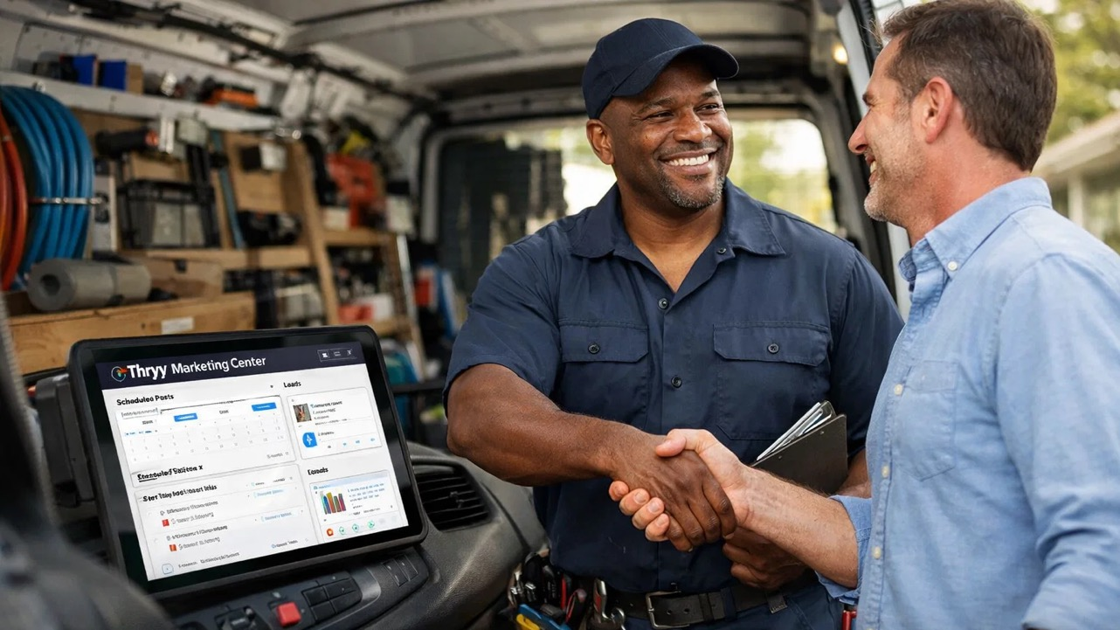
Thryv Marketing Center turns Sam’s marketing conversations
into measurable results.

Slide 13
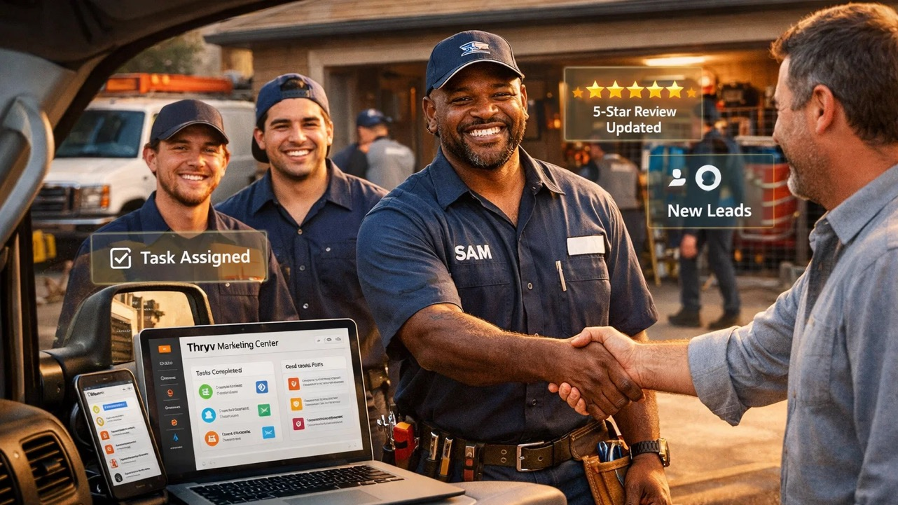

Join Sam.
Don’t just survive. Thryv.

Slide 14
MIA’S STORY

Slide 15

Mia keeps her clients in shape, but not her marketing.

Slide 16
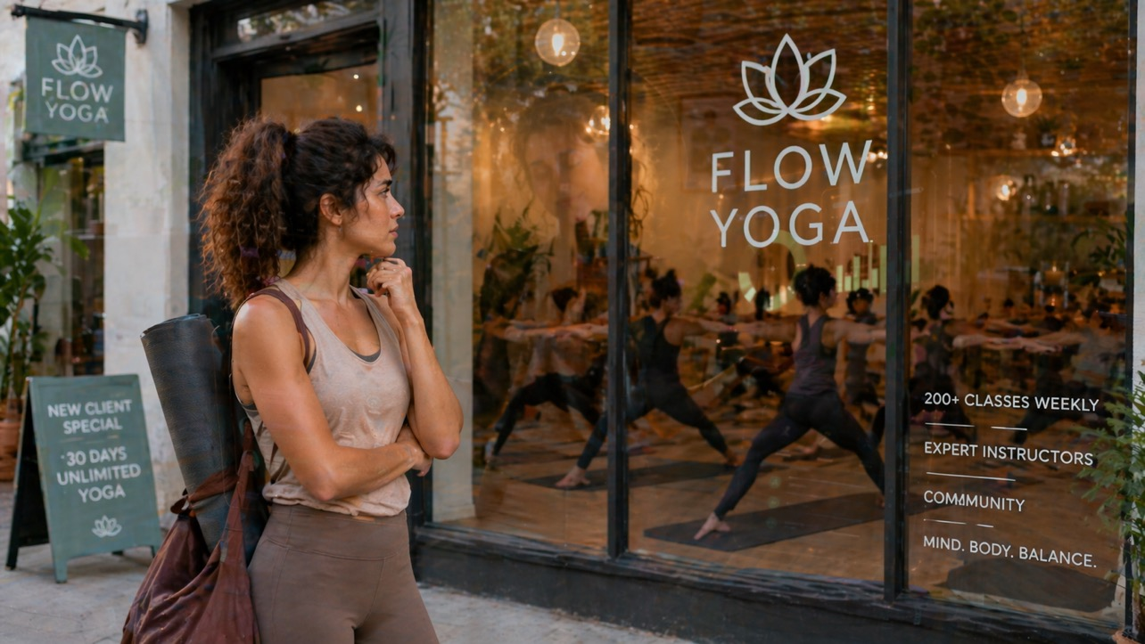
And she’s facing some pretty strong competition from the big guys.

Slide 17

With Thryv, there’s no need to worry.
Mia’s marketing chakras are fully aligned.

Slide 18

Let Thryv do the marketing lift so Mia can lift spirits.

Slide 19
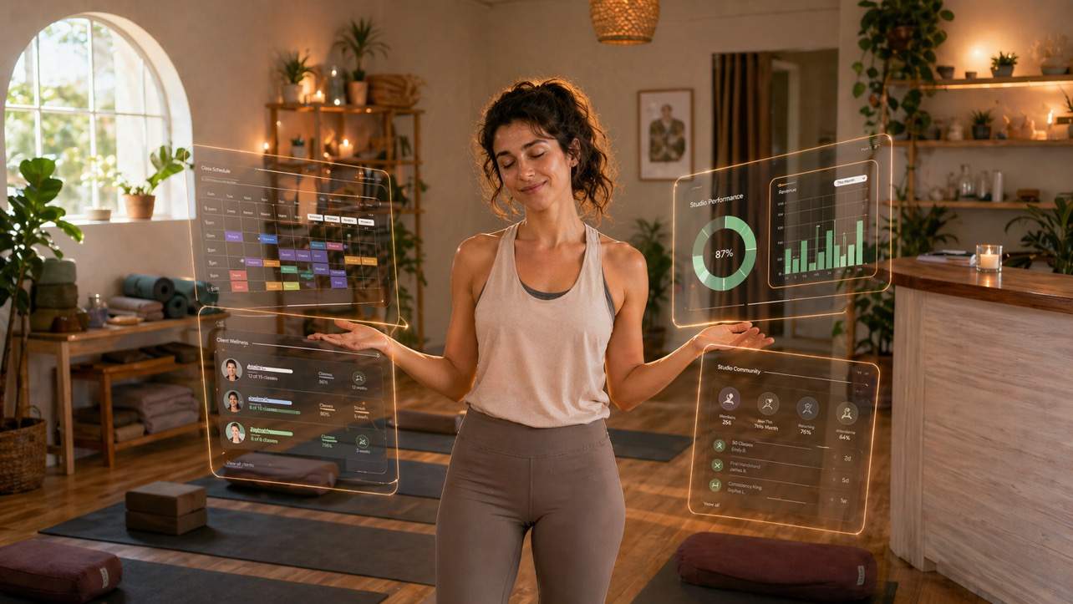
Marketing nirvana. At last.

Slide 20
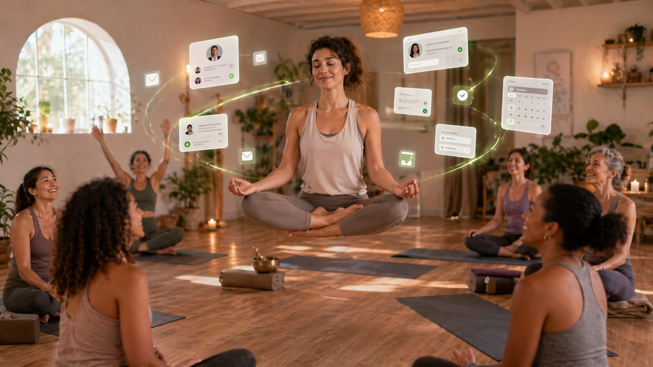
Join Mia.
Don’t just survive. Thryv.

Slide 21
LET’S GET SOCIAL

Slide 22
SOCIAL MEDIA & DIGITAL COLLATERAL
Relatable SMB owner stories demonstrating the path to marketing nirvana.
Video Support
Short-form clips from all 5 hero videos for:
  TikTok, Instagram Reels, YouTube Shorts
Visual Assets
Carousel graphics for Instagram & Facebook
UGC / testimonial templates (#ThryvLife)
Branded social overlays for videos
Digital Marketing Assets
Industry-specific landing pages with embedded videos
Email nurture sequences aligned with video content
Blog posts and case studies for campaign storytelling
Retargeting creative (static & video)
Purpose:
Maximize organic engagement, build the Thryv community, and encourage trial sign-ups through a coordinated, multi-channel digital content package.

Slide 23
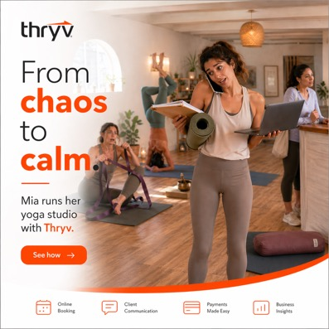
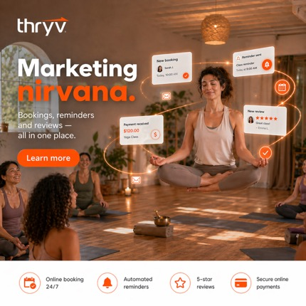
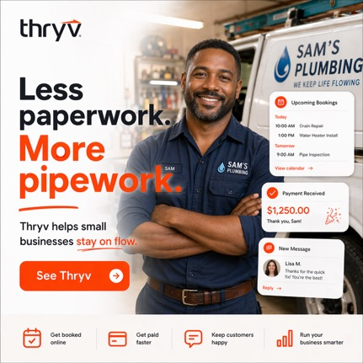

Slide 24
LET’S GET going

Slide 25
CAMPAIGN EXECUTION: WEEKS 1 – 4
Week | Asset / Video | Channels | Key Actions / Notes
1 | Hero Video – “Thryv in Action” | YouTube, LinkedIn, Instagram Reels, Homepage | Build awareness of Thryv as the ultimate marketing and engagement tool for SMBs.
2 | Social Teaser Clips (15 sec) | TikTok, Instagram Stories, LinkedIn | Showcase features that boost client engagement, online presence, and visibility.
3 | Industry Spotlight 1 – Home & Field Services | TikTok, YouTube Shorts, Facebook | Highlight marketing wins: attracting new customers, managing reviews, promoting services online.
4 | Industry Spotlight 2 – Professional Services | LinkedIn, YouTube Shorts, Email | Emphasize marketing advantages: growing client base, improving online reputation, effective follow-up campaigns.
4 | Social Carousel | Instagram, Facebook | Infographic: “Top 5 Ways SMBs Get More Clients with Thryv.”

Slide 26
CAMPAIGN EXECUTION: WEEKS 5 – 8
Week | Asset / Video | Channels | Key Actions / Notes
5 | Industry Spotlight 3 – Health & Wellness | Instagram Reels, TikTok, YouTube Shorts | Highlight successful campaigns, social media wins, and increased engagement.
6 | Blog / Case Study | Website, LinkedIn, Email | Demonstrate marketing impact: attracting and retaining clients, improving online presence.
7 | The Thryv Advantage – “Why Choose Thryv?” | YouTube, Homepage | Re-engage leads and maximize conversion from previous marketing touchpoints.
8 | Retargeting Campaigns | Facebook, Instagram, LinkedIn, Google Search | Interactive marketing-focused walkthrough: boosting visibility, customer engagement, and campaigns.
8 | Live Webinar / Demo | Zoom, YouTube Live, LinkedIn | Encourage clients to share success stories to strengthen brand presence and social proof.
Ongoing | UGC & Testimonials | Instagram, TikTok, LinkedIn | Highlight successful campaigns, social media wins, and increased engagement.

Slide 27
HOW MUCH?

Slide 28
Design costs
Deliverables | Role & Hours | Cost
Campaign Media Templates | Creative Director (6 hours @ $275.00) Senior Designer / Animator (32 hours @ $240.00) | $9,330.00
Hero Video – “Thryv in Action” | Creative Director (12 hours @ $275.00) Senior Designer / Animator (32 hours @ $240.00) | $10,9080.00
Industry Spotlight 1 – Home & Field Services | Creative Director (6 hours @ $275.00) Senior Designer / Animator (26 hours @ $240.00) | $7,890.00
Industry Spotlight 2 – Professional Services | Creative Director (6 hours @ $275.00) Senior Designer / Animator (26 hours @ $240.00) | $7,890.00
Industry Spotlight 3 – Health & Wellness | Creative Director (6 hours @ $275.00) Senior Designer / Animator (26 hours @ $240.00) | $7,890.00
The Thryv Advantage – “Why Choose Thryv?” | Creative Director (6 hours @ $275.00) Senior Designer / Animator (26 hours @ $240.00) | $7,890.00
 | Sub Total | $51,870.00

Slide 29
Project management & 3rd party costs
Role / Component | Hours | Cost
Program Lead | 24 (2 hrs per week for 12 weeks) | $6,600.00
Program Manager Social Media Comms | 40 (5 hrs per week for 12 weeks) | $6,400.00
Program Executive | 36 (3 hrs per week for 12 weeks) | $3,780.00
3rd Party Costs (Frame.io, licenses, insurance) |  | $3,065.00
15 % Discount on Project Management Fees |  | - $2,517.00
 | Sub Total | $17,328.00

Slide 30
Cost summary
Component | Cost
Design Time | $51,870.00
Project Management & 3rd Party Costs | $17,328.00
 | $69,198.00

