Slide 2

ONE NARRATIVE SPINE
TWO EXPERIENCES

Slide 3

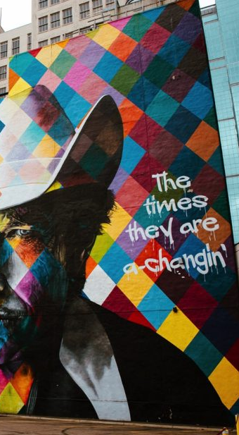

ONE NARRATIVE SPINE
TWO EXPERIENCES
Provation’s hiring velocity demands onboarding consistency where new hires need fast shared context and leadership needs a dependable operating framework that stabilizes knowledge transfer, behavioral alignment and decision confidence from day one.
We’ve got you covered
Virtual Experience (Simulive and Q&A)
Minneapolis In-Person Experience
Onboarding that’s built to scale for new hire onboarding with a sustained format, reuseable content structure and branded experiences that feel human and intentional.

Slide 4
VIRTUAL EXPERIENCE

Slide 5
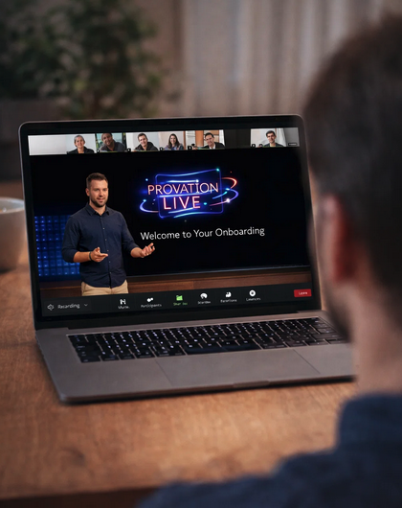


VIRTUAL EXPERIENCE
WE’VE GOT YOU COVERED
Format: Two hour engineered virtual experience with Simulive Presentations, Panels and Q&A
Audience: ~25 new hires
Virtual platform management
Presentation polishing
Simulive pre-recording of presentations
Presentation editing, lower thirds, intro/outro.
Full rehearsal of virtual experience
Speaker Support for Simulive presentations
at all stages of pre-production, rehearsal and live experience
CLICK
here
Watch our speaker support film showing you how we uplift the experience

Slide 6

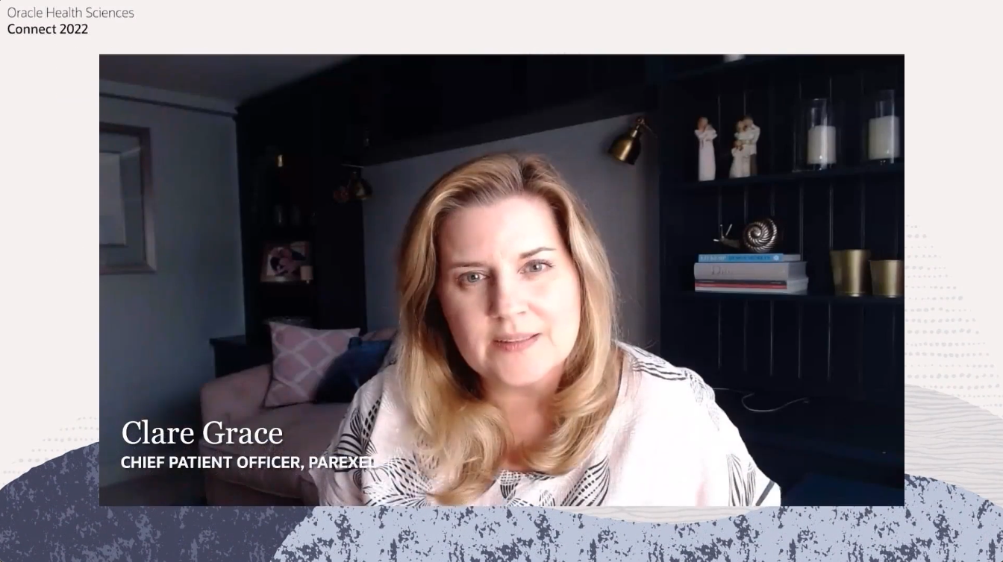
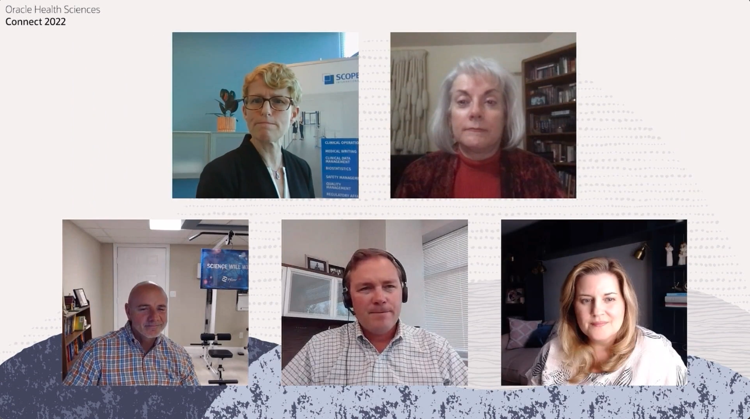
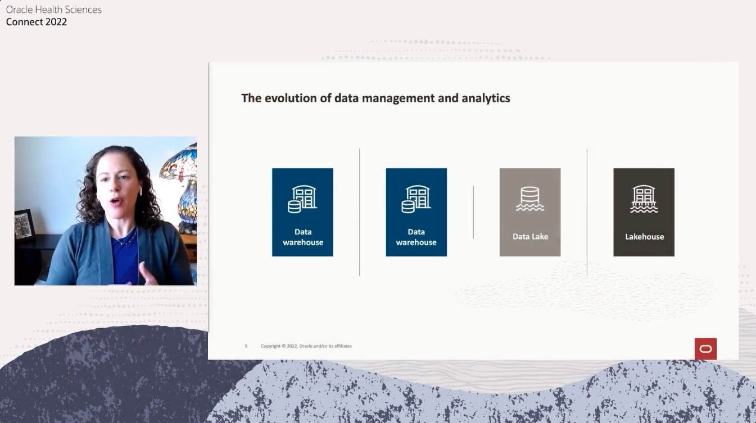
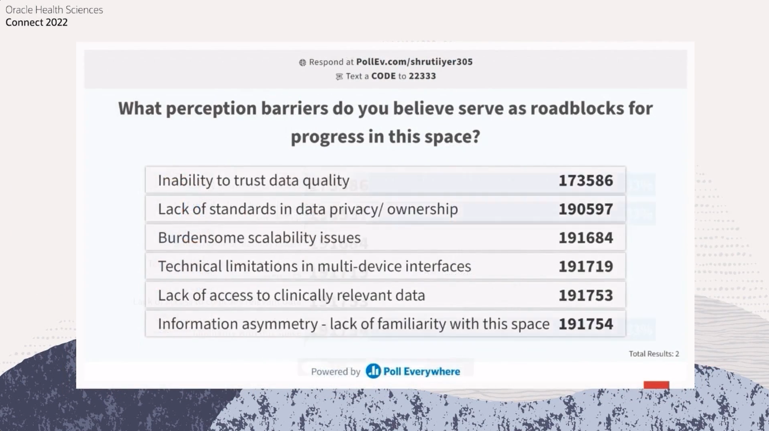

VIRTUAL EXPERIENCE – ZOOM PLATFORM
Zoom Optimizes for experience flow
Breakout room workshops
Live audience polling
Real-time reactions
Seamless video playback
Branded virtual backgrounds
Moderator control simplicity
Smooth speaker transitions
Integrated chat engagement
Effortless participant management
Broadcast-style experience flow
Integration with third party video mixing software

Slide 7
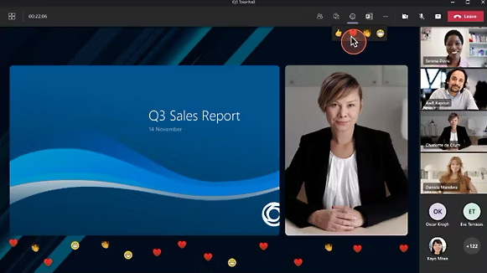
VIRTUAL EXPERIENCE - TEAMS PLATFORM
Teams Optimizes for governance,
identity and compliance
Identity-anchored access control
Enterprise security reassurance
Native organizational scheduling
Built-in document collaboration
Persistent chat continuity
Compliance-aligned governance
Less smooth video transitions
Less flexible breakout control
Heavier participant permissions friction
Awkward Simulive mechanics
Rigid presenter flow
Poor third party software integration

Slide 8
VIRTUAL EXPERIENCE
SHOW FLOW
Time | Moment | Comments
00:00 – 00:05 | Welcome
00:05 – 00:25 | Presentation 01
00:25 – 00:45 | Presentation 2
00:45 - 00:50 | Break
00:50 – 01:10 | Presentation 03
01:05 – 01:25 | Presentation 04
01:25 – 01:40 | Q&A
01:40 – 01:45 | Polling results
01:45 – 02:00 | Next Steps & Resources
Two-hour structural breakdown
Simple sequential logic
Simulive - live moments that land
Welcome and context - Live
Two presentations – pre-recorded
Reset interval for speaker coordination
Two presentations – pre-recorded
Q&A with curated intake - Live
Close with next steps and resources - Live
Polls and guided chat prompts can happen anytime during the experience

Slide 9
VIRTUAL EXPERIENCE - COST SUMMARY
ELEMENT | BUDGET
Technical Management | $ 4,440.00
Design | $ 3,840.00
Third Party | $ 390.00
Total Program Costs | $ 8,670.00
Project Management | $12,300.00
TOTAL BUDGET | $ 20,970.00

Slide 10
IN-PERSON EXPERIENCE

Slide 11
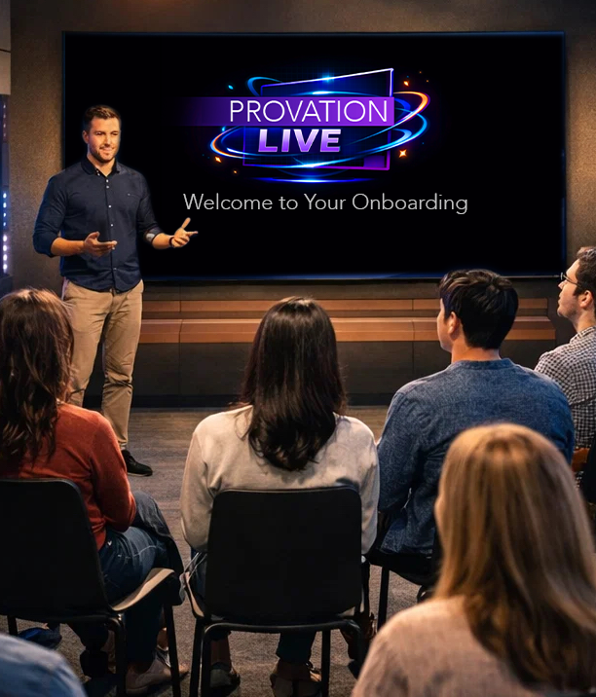

IN-PERSON EXPERIENCE
WE’VE GOT YOU COVERED
Format: 3 day in-person experience with Panels, Q&A, energizers and interactive group activity
Audience: ~25 new hires
Facilitator led engagement engineering
Support in the design of content and show flows
Energizer activities to engage audience
Single Narrative Spine over 3 days
Oversight of all Technical Production
Facilitator ensures structure not improvisation
Presentation support

Slide 12
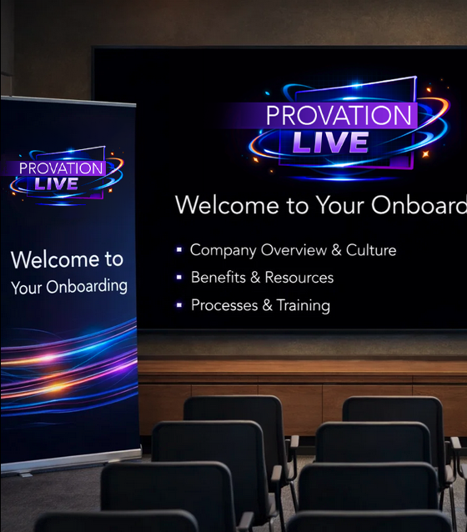
IN-PERSON EXPERIENCE
Room / technical production
Speakers become assets, interaction drives engagement and structure enables scalability
On-site branding promoting Provation Live
Speaker support throughout the technical, rehearsal and live experience
CLICK
here
Watch our speaker support film showing you how we uplift the experience

Slide 13
IN-PERSON EXPERIENCE
Show flow
DAY 1
Arrival & Registration
Delegates check in, settle, and acclimatize to the program environment.
Evening Welcome Reception
Facilitator establishes tone, intent, and cultural signal in a relaxed social setting.
Structured Icebreaker
Facilitated interaction reduces social friction and accelerates group familiarity.
DAY 2
Facilitator Opening & Reset
The Facilitator anchors the day within the program spine.
Core Content Sessions
Delegates build shared operational understanding through facilitator guided presentations and discussions.
Applied Sessions
Facilitator drives structured group engagement.
Leadership Interaction Layer
Facilitator aids alignment, clarity and executive accessibility.
Interactive Group Activity
Teams collaborate and embed
behavioral dynamics
DAY 3
Integration Session
Provation team leads delegates to consolidate insights, operational clarity and behavioral anchors.
Training Conclusion
Provation team ends by summarizing
key principles, expectations, and
success patterns
Departures
Delegates exit with aligned context, shared memory, and execution confidence.

Slide 14

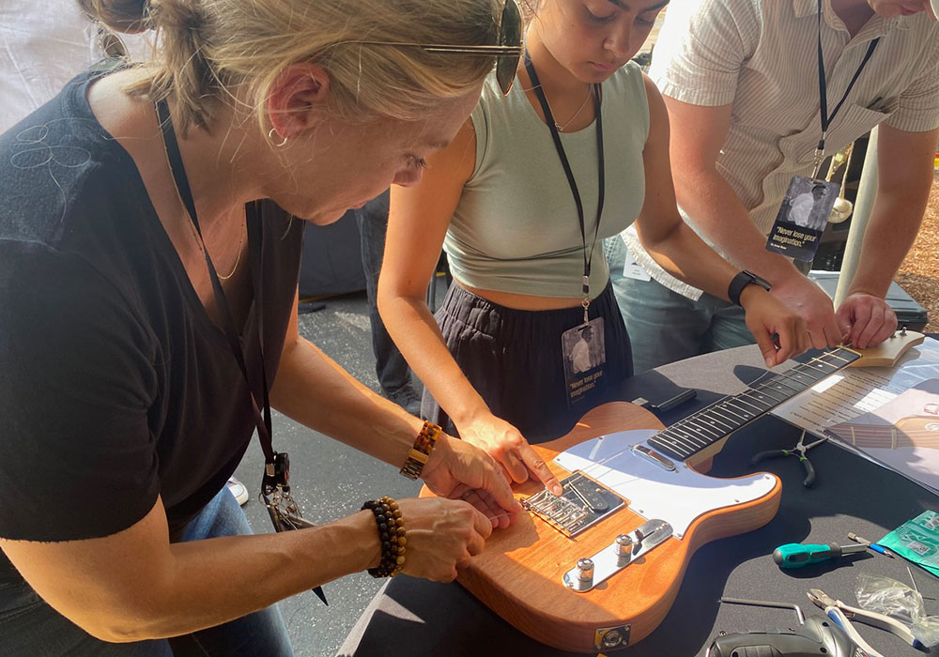
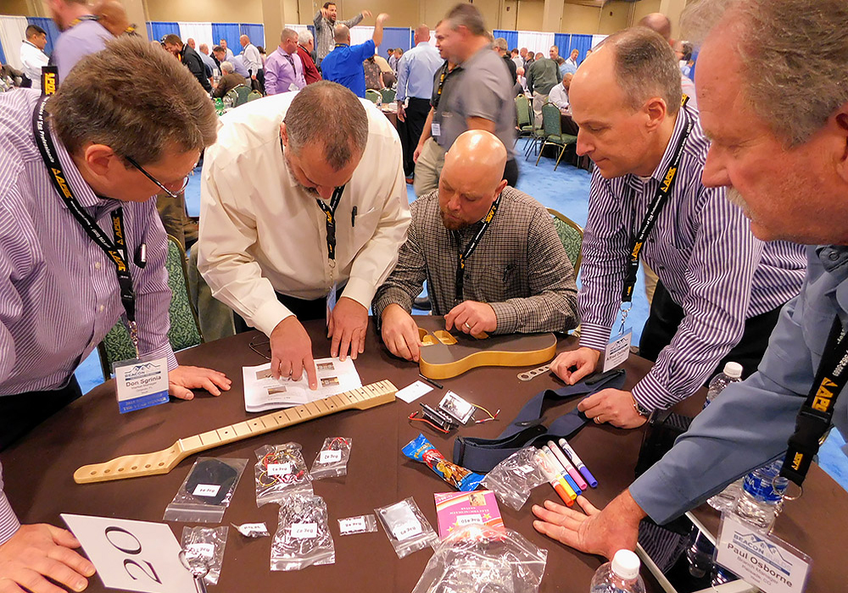
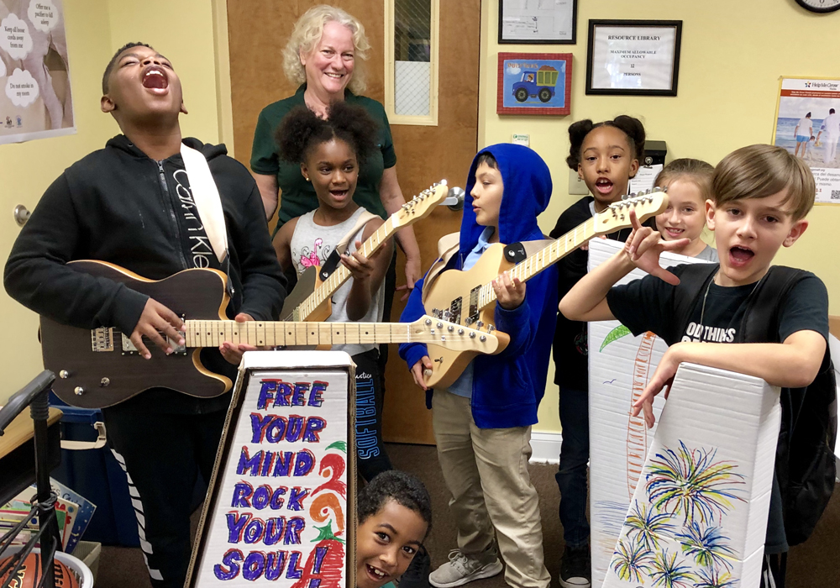
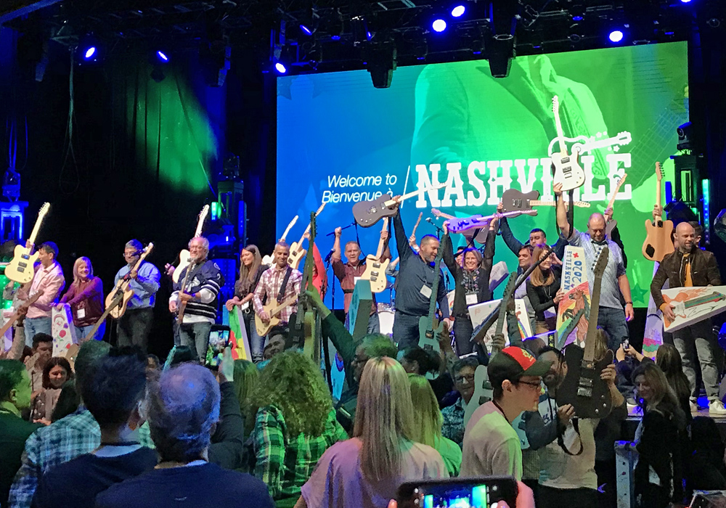
IN-PERSON EXPERIENCE
WE’VE GOT YOU COVERED
Interactive group activity suggestion
Build-a-guitar is a unique charitable team building event where your group collaborates to assemble and donate high-quality electric guitars to music programs in schools and nonprofit organizations. Combining creativity, communication, and a shared mission, this experience strikes all the right chords.

Slide 15
IN-PERSON COST SUMMARY
ELEMENT | BUDGET
Technical & Speaker Support | $ 900.00
Facilitation | $ 8,000.00
Design | $ 8,960.00
Interactive Group Activity | $ 8,500.00
Third Party | $ 4,720.00
Total Program Costs | $ 31,080.00
Project Management | $21,420.00
TOTAL BUDGET | $ 52,500.00

Slide 16




