Slide 1
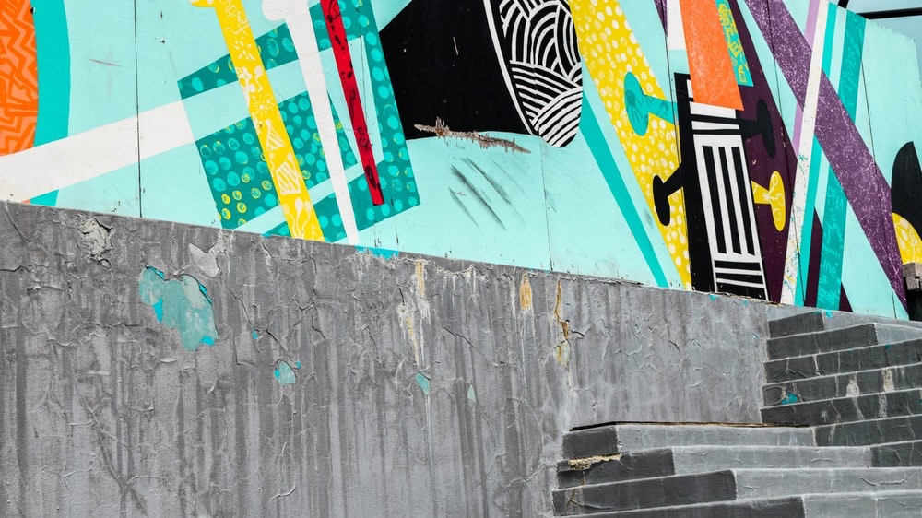


Slide 2


Slide 3
A STORYTELLING PARTNERSHIP

Slide 4


WHEN A COMPANY HAS GRAVITY IT FEELS INEVITABLE

Slide 5

STORIES ARE BUILT LAYER BY LAYER. PHASE BY PHASE
Phase 2
Value proposition
Executive narrative deck
Sales enablement toolkit
Structured demo storyline
Phase 1
Discover & Define the truth
Articulate the brand
Assert asset priorities
Website messaging
Customer Stories
Pitch Deck
Demo film
March
April
May
June
July
August
A long-term partnership will help to build your market reputation, instead of just noise

Slide 6
WHAT’S YOUR STORY?
DigitalNet AI uses the power of Agentic AI to build commercial success rapidly with human conscience in other words we believe DigitalNet.ai delivers:
Commercial success through agentic ai systems under human control.
DigitalNet.ai does this by:
Improving Governance
Enhancing Commercial Judgement
Reducing Operational Friction
Together they form a potential narrative of: Human Authentication. Agentic Orchestration. Commercial Acceleration.
This can be built layer by layer – NOT by ONE NOISY ASSET AT A TIME.

Slide 7

Human Authentication.
Agentic Orchestration.
Commercial Acceleration.

Slide 8
PHASE 1 – BRAND ARTICULATION

Slide 9
BRAND ARTICULATION – NOT A LOGO
A clear articulation of who DigitalNet.AI is, what it stands for, what it does (in plain English), and why it’s credible, so the business can speak with one voice across web, sales, product and leadership.
This includes:
A single, defensible core narrative (“what we do / for whom / why us / why now”)
Clear positioning (what category you’re in, and how you’re different)
A simple value proposition system (headline, subhead, proof points, RTBs)
Language guardrails: what to claim, what to avoid, what needs proof

Slide 10


Slide 11
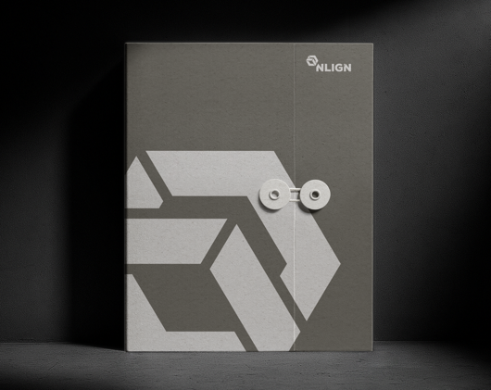


Slide 12


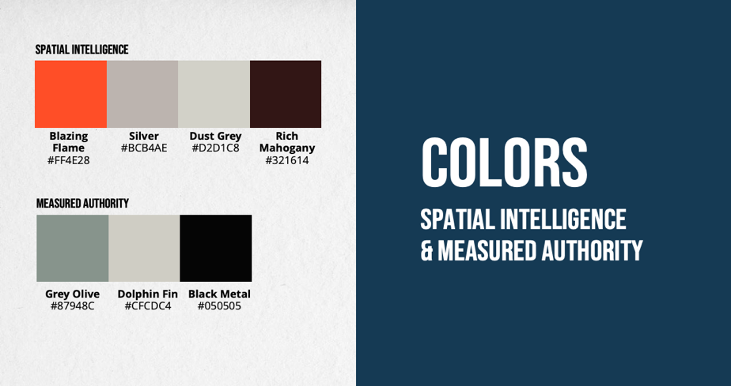
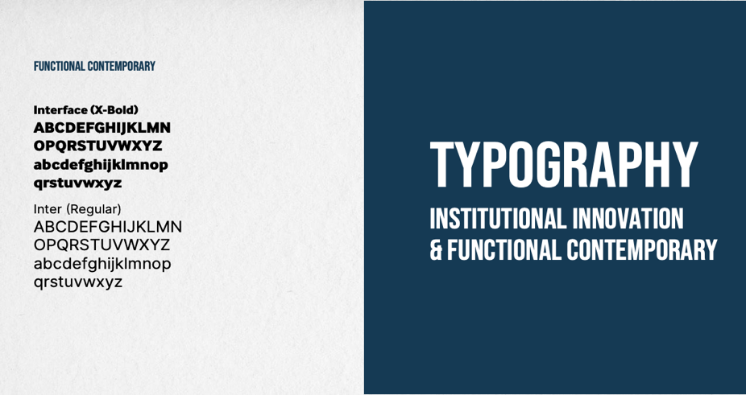

Slide 13
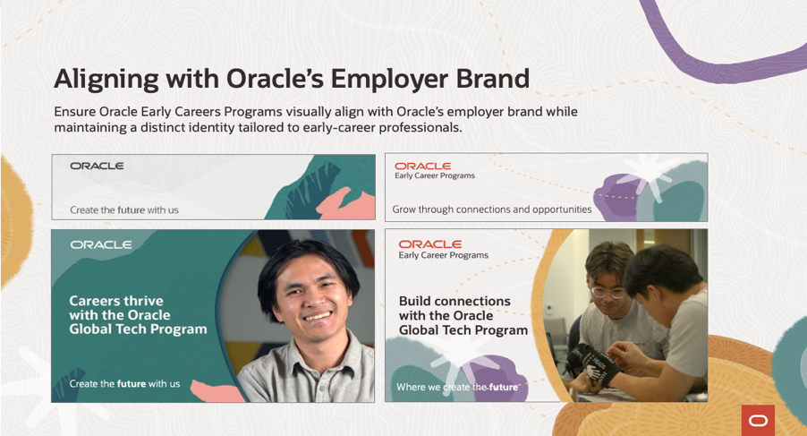
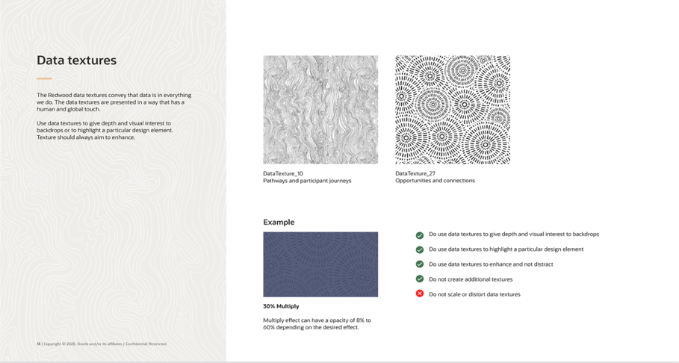
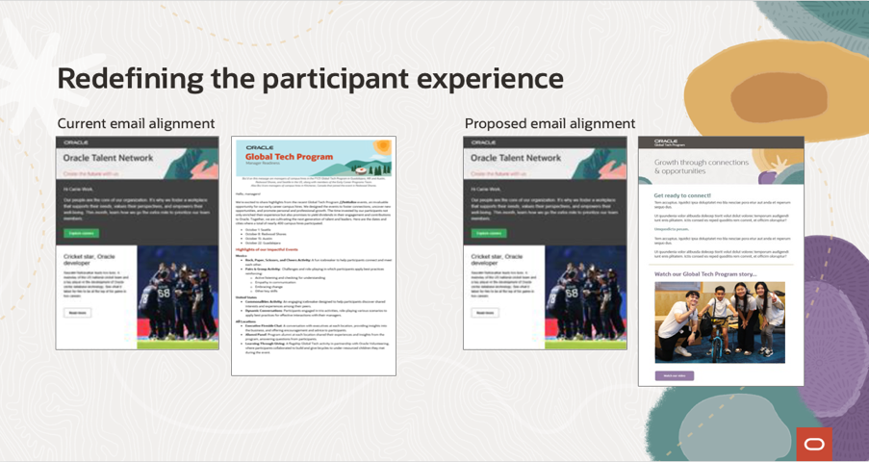
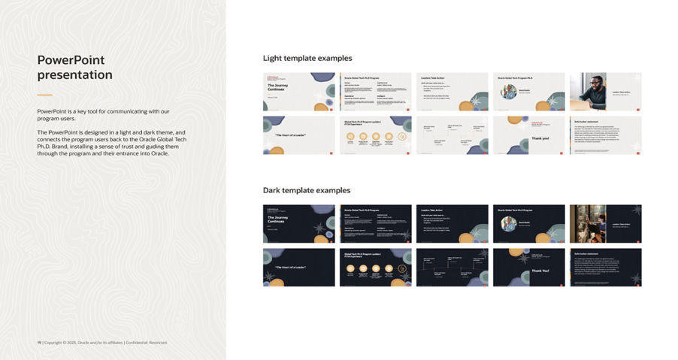

Slide 14
THE 6-week BRAND sprint
Weeks 1–2
Weeks 3–4
Weeks 5–6
Discovery + truth-finding
Brand Articulation
Preferred route + plan
Stakeholder interviews (founder, sales, product, customer success)
Review existing materials (website, deck, proposals, demos)
Competitive language scan (how others are positioning)
Proof audit (what evidence exists, what’s missing)
Deliverables
What we heard / what’s unclear / what’s working readout
Proof inventory + gaps
Initial narrative hypotheses (2–3 story options)
Working sessions to choose and refine the strongest story
Define the value prop system and message hierarchy
Establish credibility guardrails and proof requirements
Deliverables
Brand articulation doc (v1) (positioning, narrative, value prop, differentiators, why now, proof map)
10-second / 30-second / 2-minute versions of the story
Top-line homepage narrative (in words)
We outline 2–3 implementation options based on speed, budget, and business goals, then recommend the quickest results path.
Deliverables
Recommended Path Forward including:
what gets built (asset stack)
sequencing (what first, what next)
timelines (weeks)
resourcing (who needs to do what)
dependencies (proof inputs, approvals)
Phase 1 asset priorities (the first 30–60 days after the sprint)

Slide 15
PHASE 2 – PRIORITY ASSETS

Slide 16
LAYERING YOUR STORY ASSET BY ASSET
BELOW IS A LIST OF WHAT THESE ASSETS COULD BE that deliver the fastest commercial results
Value proposition – one page PDF
Product launch story – narrative
Campaign toolkit including:
email copy
landing page
social media graphics
Demo film – flagship film
Sales enablement deck – modular
Executive deck – Board level PowerPoint
Website messaging – website copy
Customer stories – Testimonial films
Sales guide –PDF handbook
Pricing guide – structured PDF
Product evolution roadmap – PowerPoint
Total cost comparison – PDF sheet
Competitive positioning – one page PDF

Slide 17
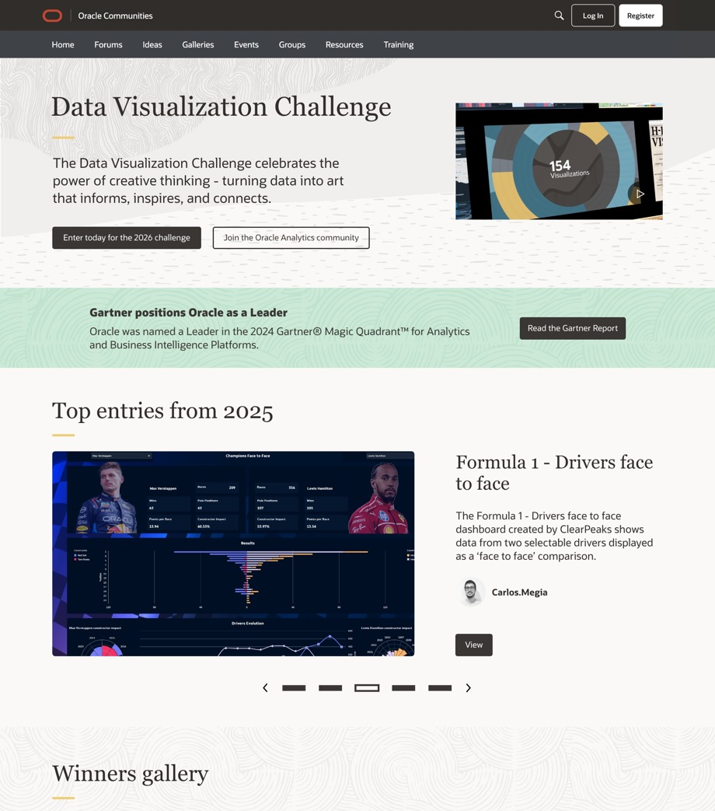
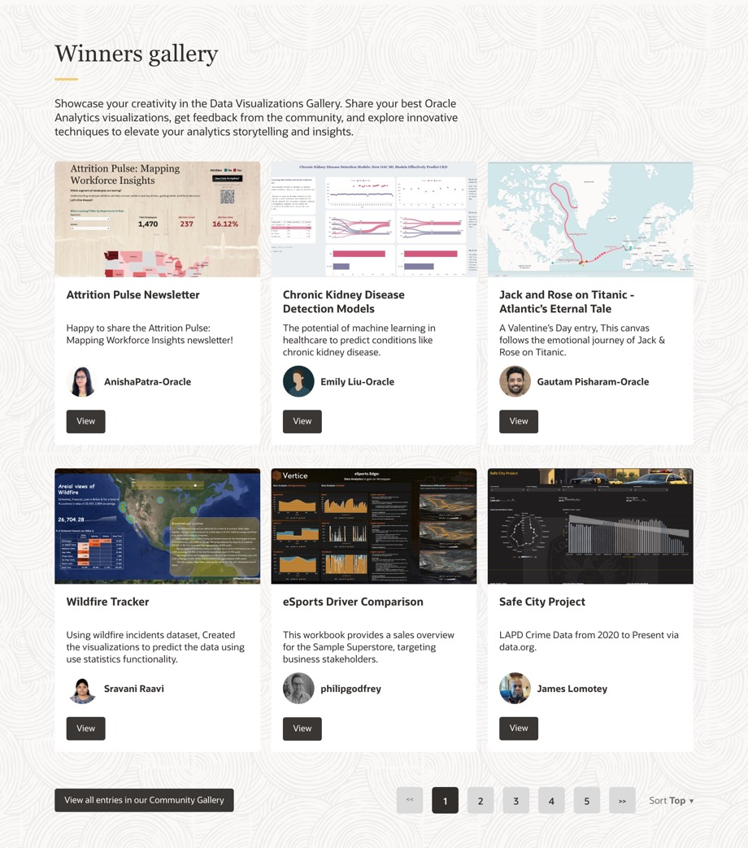

Slide 18
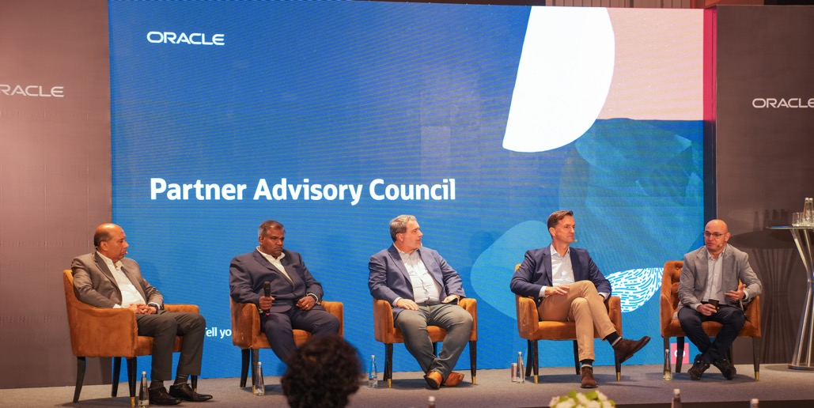
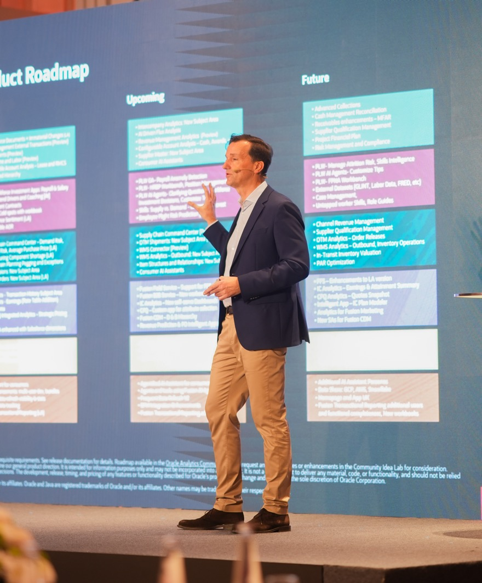
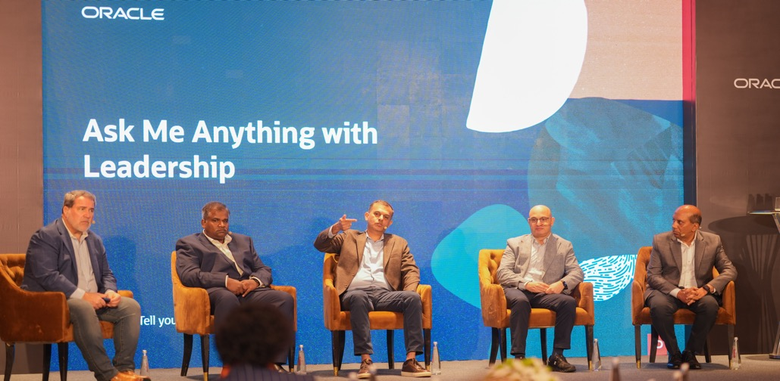

Slide 19
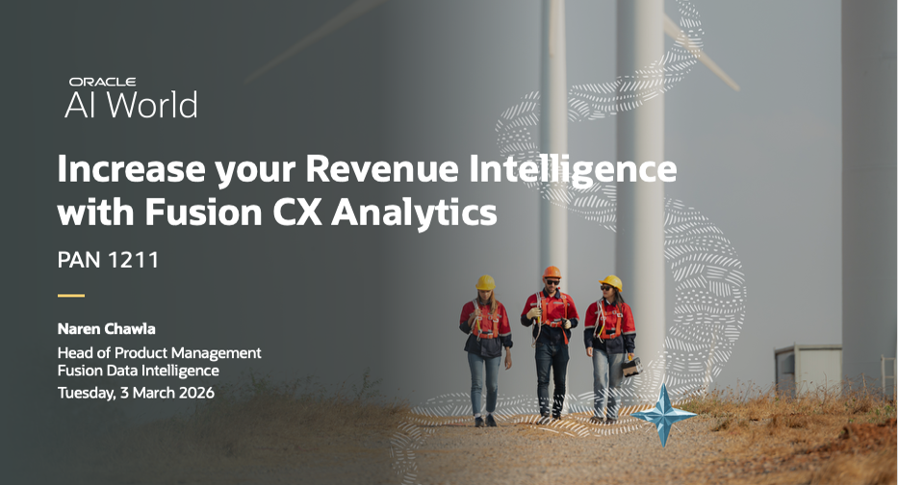
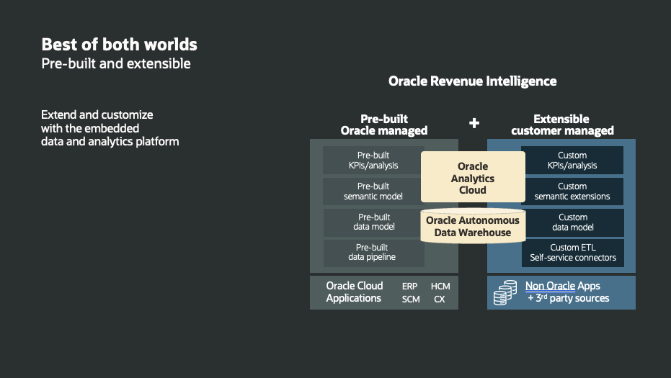
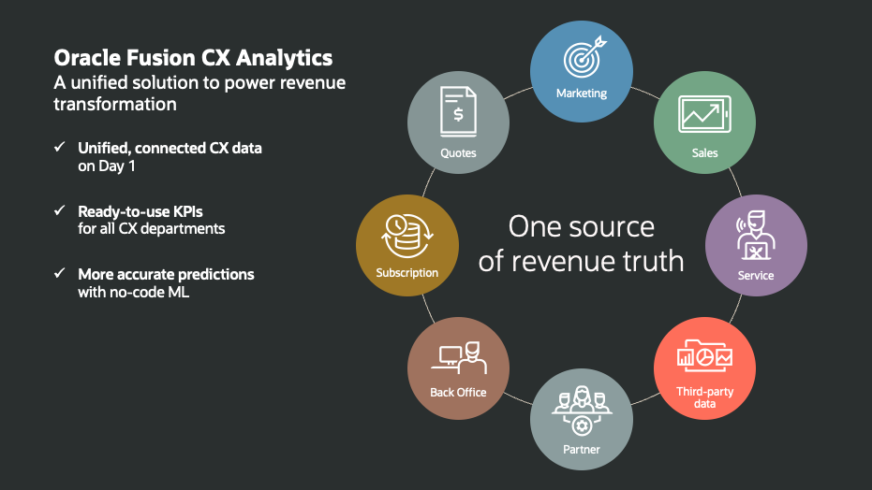
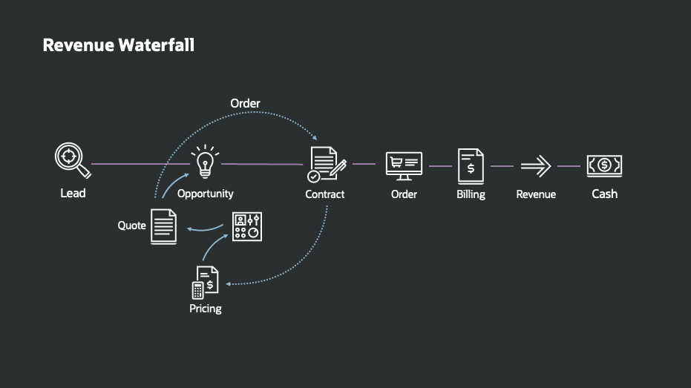

Slide 20

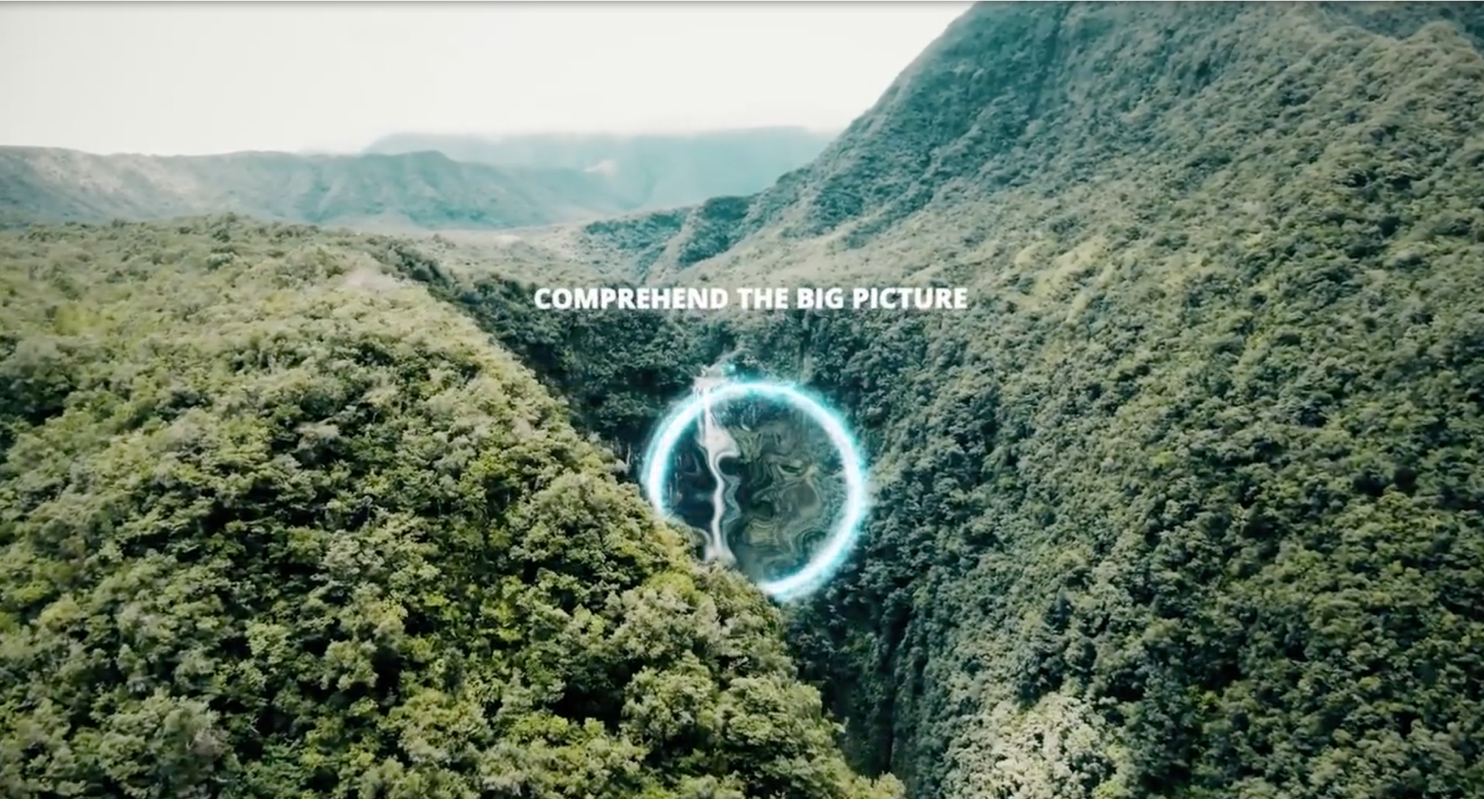

Slide 21
INVESTMENT PER MONTH
COSTS | HOURS | RATE
Creative Director | 20 | $ 275.00 | $ 5,500.00
Design Director | 32 | $ 275.00 | $ 8,800.00
Graphic Designer | 54 | $ 160.00 | $ 8,640.00
Project Co-ordinator | 16 | $ 105.00 | $ 1,680.00
DESIGN FEES |  | Sub-Total | $ 24,620.00
20% DISCRETIONARY DISCOUNT |  |  | $ (4,924.00)
 |  | Sub-Total | $ 19,696.00
3rd Party Costs |  |  | $ 1,298.00
 |  | Investment per month | $ 20,994.00

Slide 22
6 MONTH INVESTMENT SCHEDULE
SCHEDULE | AMOUNT
MARCH | $ 20,994.00
APRIL | $ 20,994.00
MAY | $ 20,994.00
JUNE | $ 20,994.00
JULY | $ 20,994.00
AUGUST | $ 20,994.00
TOTAL INVESTMENT | $125,964.00

