Slide 1


Slide 2



SPOTLIGHT ON…
ENGAGEMENT & EXPERIENCE
Maximizing client interaction through innovative, international experiences.
We design and deliver moments that engage, excite, and elevate. From high-stakes global events to intimate partner and customer engagements, we help clients strengthen relationships, build loyalty, and create lasting impressions.

Slide 3
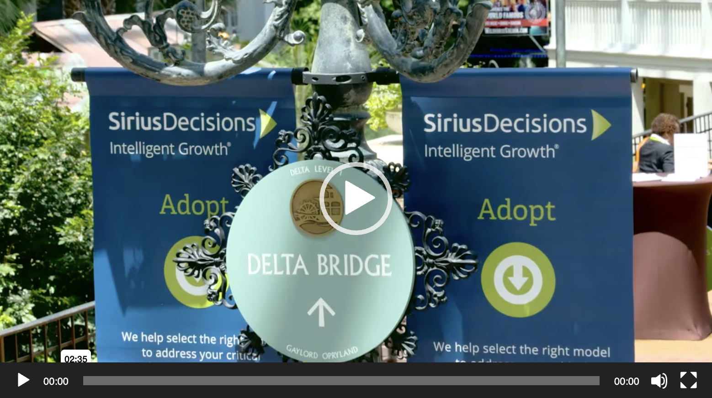
SPOTLIGHT ON…
Click image to view
Customer Engagement 1
From intimate, high-level dinners to the Vegas stage, we’ve designed and delivered dozens of customer-facing events, campaigns and activations
From world-class content to the best in production – wherever and whenever you need it

Slide 4
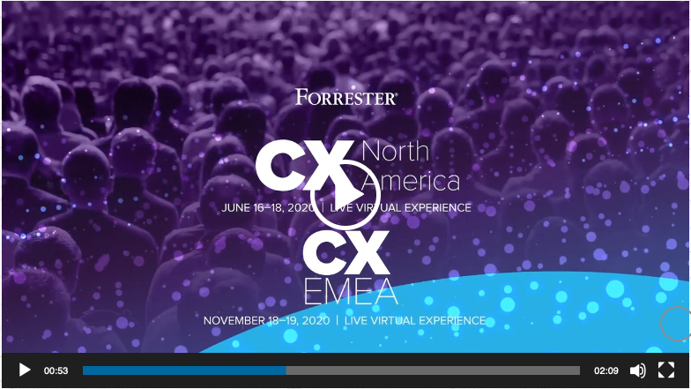
SPOTLIGHT ON…
Click image to view
CUSTOMER ENGAGEMENT 2
Global design and delivery of engaging, inspiring and informative on-line and digital that get results
Leveraging the power of curated content to deliver greater ROI on your thought-leadership

Slide 5
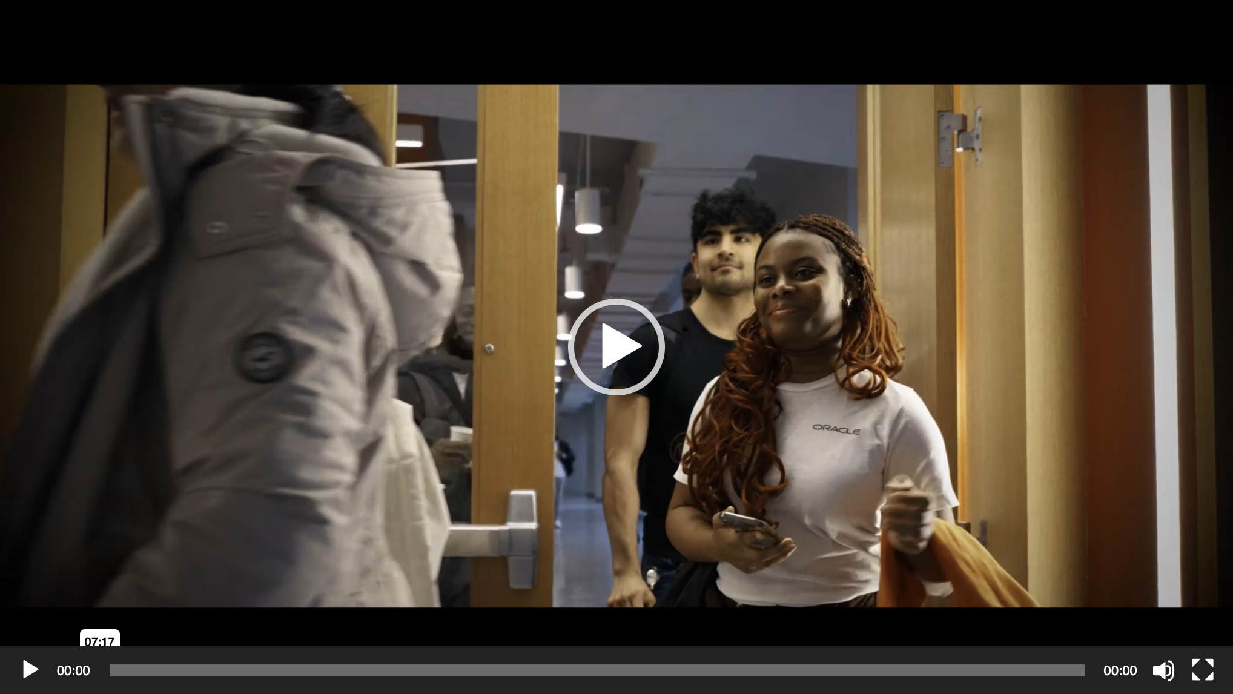
SPOTLIGHT ON…
Click image to view
Employee Engagement
Your team is your biggest asset – and we’re trusted to support them from on-boarding to reward & recognition
Global Tech, Data Centers, Early Careers and more: on- and off-line programs that build loyalty and longevity

Slide 6
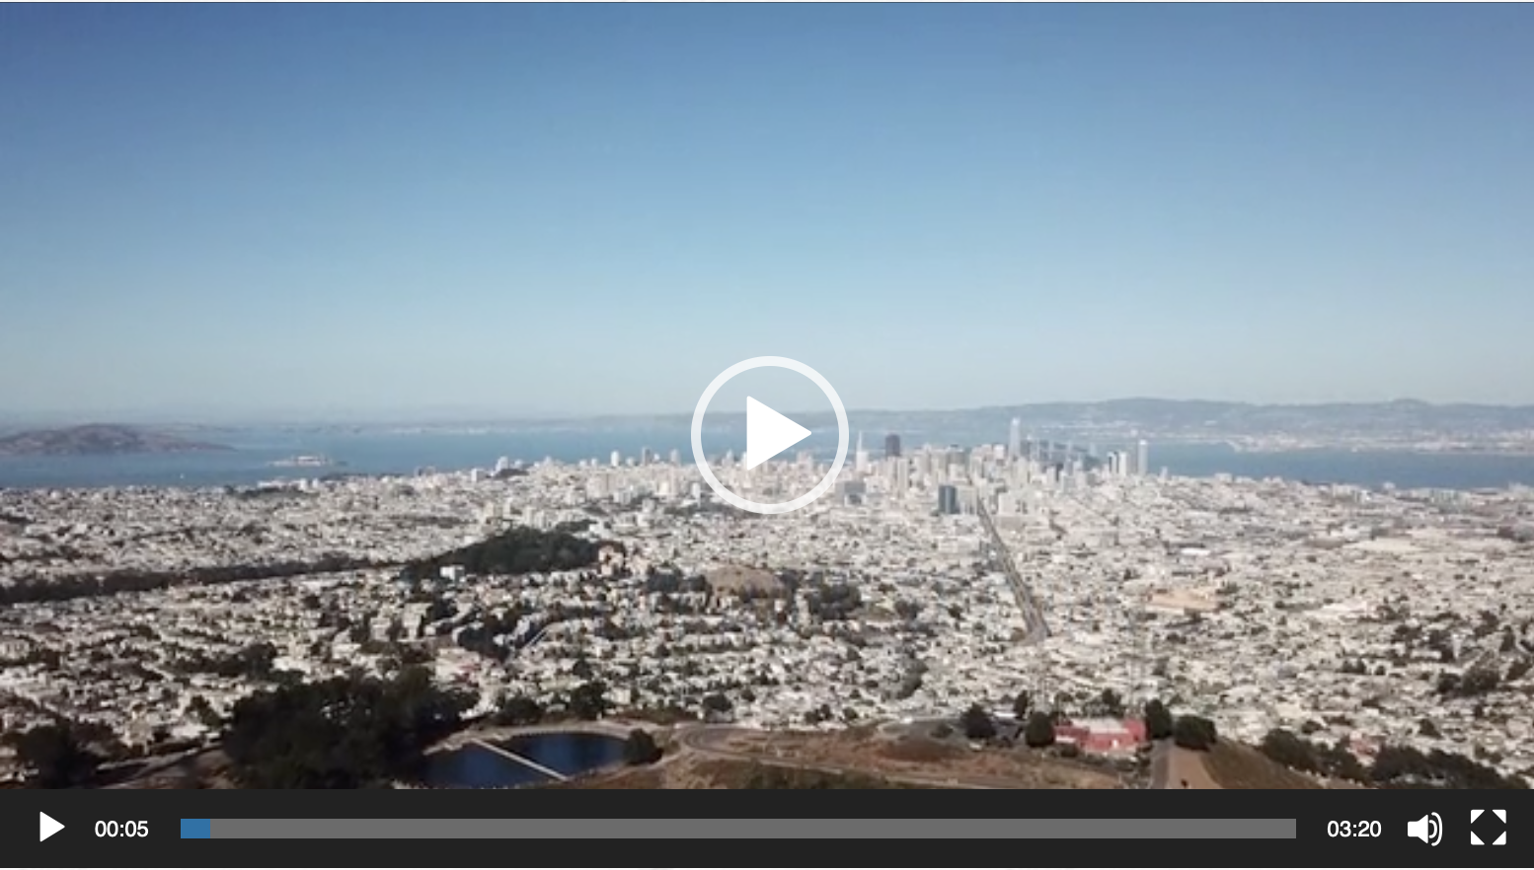
SPOTLIGHT ON…
Click image to view
Partner Engagement
Enhancing the Partner ecosystem by enablement, energy and engagement
Multi-platform on-line and live experiences to deliver better results and a more empowered Partner community

Slide 7
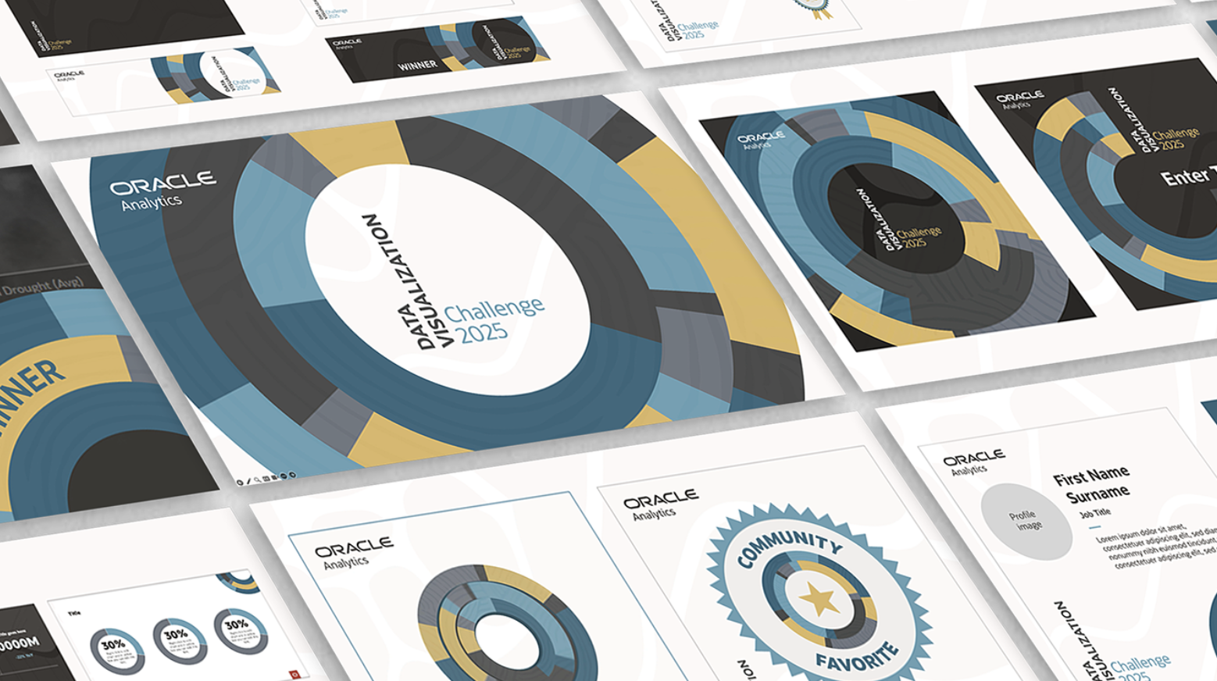
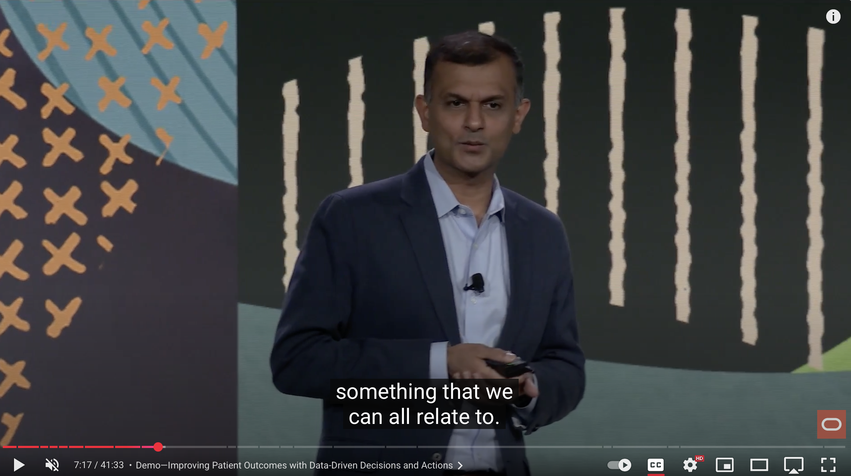
SPOTLIGHT ON…
Click image to view
Keynotes & Presentations
Decades of working with Oracle executives and teams around the world
The biggest stages, the highest stakes – we help Oracle put its best foot forward on every occasion
Trusted by your executive team on screen and on stage

Slide 8
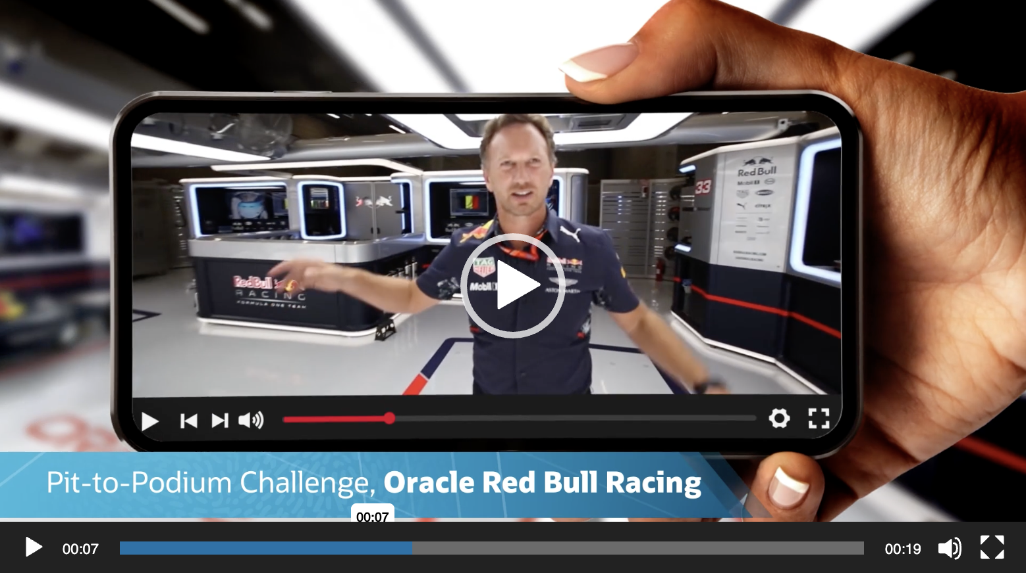
SPOTLIGHT ON…
Click image to view
Activations
Scalable, high-impact solutions that don’t just engage, they move the dial for you
World-wide capability to deliver incredible experiences and measurable ROI

Slide 9
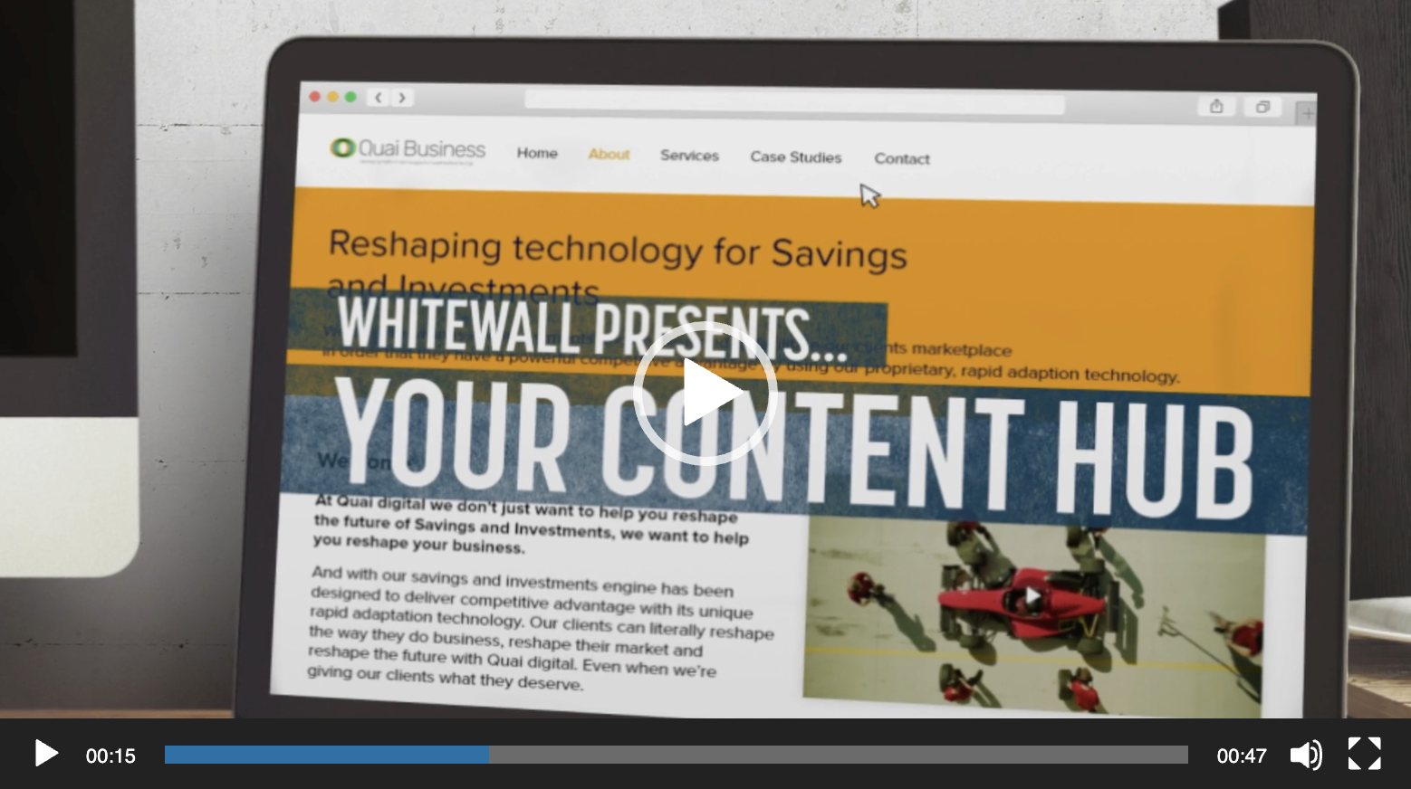
SPOTLIGHT ON…
Click image to view
DIGITAL HUBS
Maximizing ROI on content through user-friendly digital hubs
Original and repurposed content keeps the hub fresh and alive
Like having your very own streaming service

Slide 10
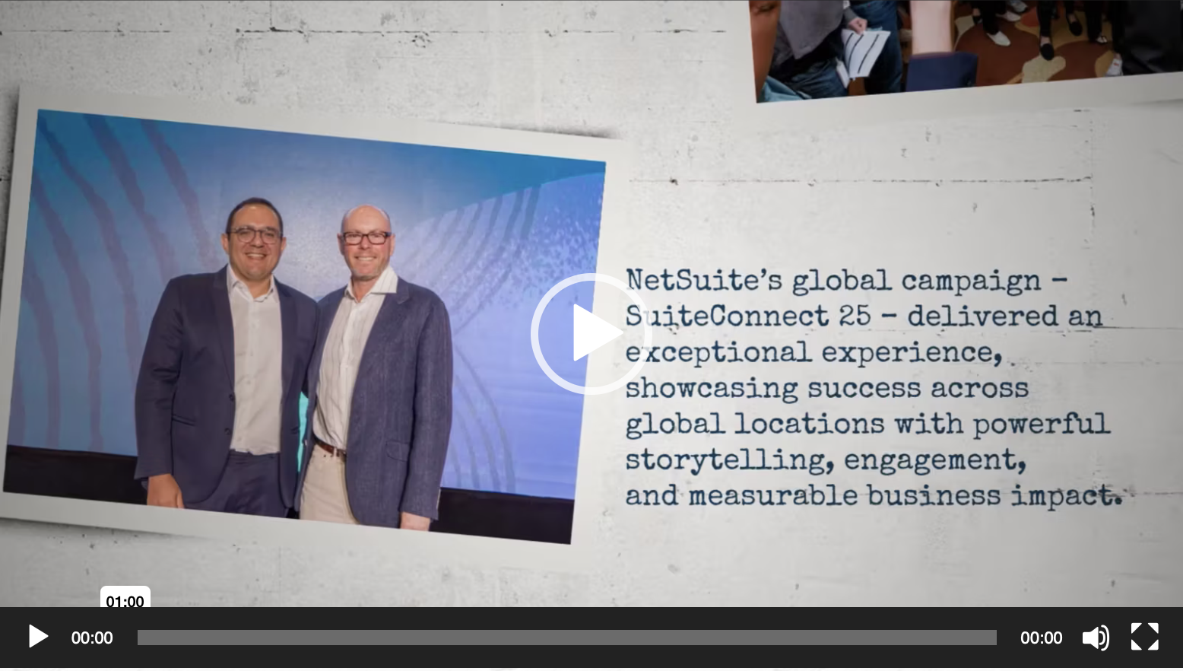
SPOTLIGHT ON…
Click image to view
Event Support
Supporting NetSuite’s global SuiteConnect program: logistics, production, expos and more
On-screen content that connects with your global audience

Slide 11
SPOTLIGHT ON…
Supporting NetSuite in:
London
New York
Sydney
Sao Paolo
Dubai
San Francisco
Singapore
Tokyo
Mexico City
Manila
Toronto
Bogota
Chicago
Melbourne

Slide 12
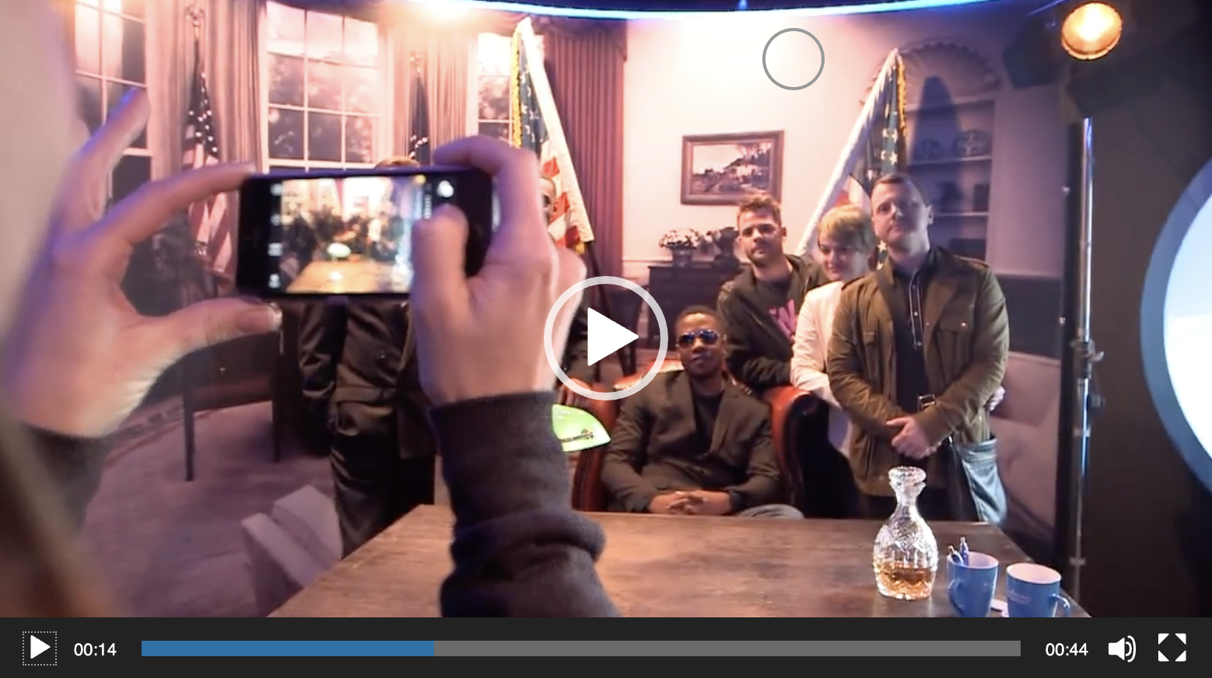
SPOTLIGHT ON…
Click image to view
BRAND ACTIVATIONS
Bringing your brand to life by bringing customers into your brand
Immersive experiences that surprise and delight as well as inform and persuade
Scalable solutions for any budget or location

Slide 13
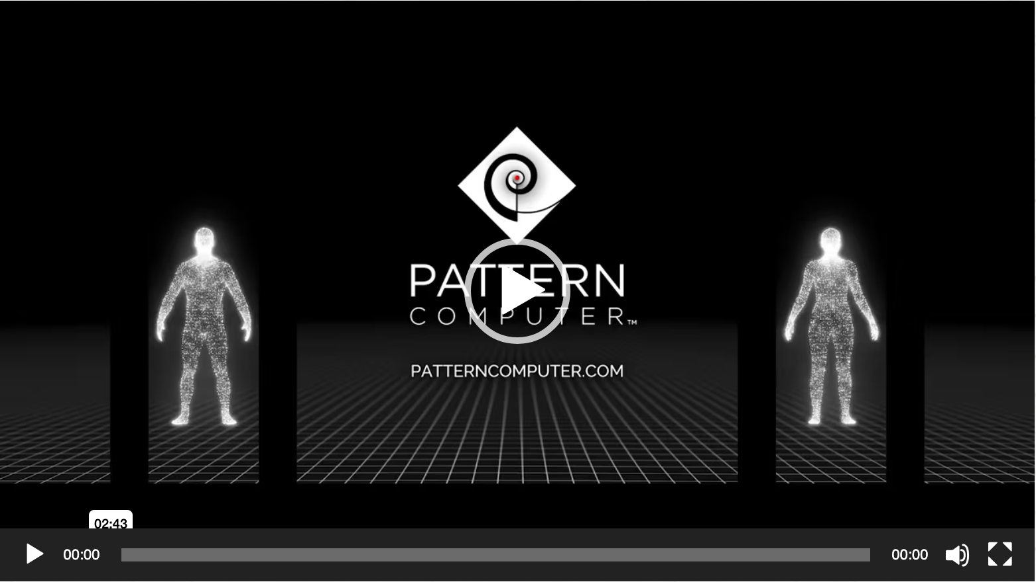
SPOTLIGHT ON…
Click image to view
PATTERN COMPUTER
Created a show-opening video with a decisive, attention-grabbing reveal
Translated brand thinking into story, motion, & sound
A launch film that builds anticipation, lands the message, and sets the tone.

Slide 14
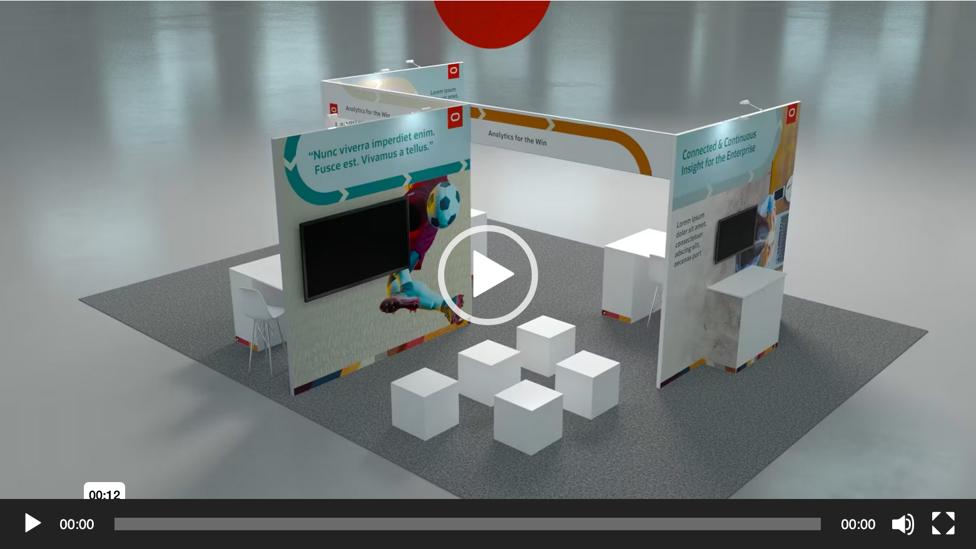
SPOTLIGHT ON…
Click image to view
EXPOS & TRADE SHOWS
Designing and building engaging spaces that captivate attendees and enhance brand presence
Developing impactful activations that turn show floors into dynamic, interactive environments, driving visitor engagement

