Slide 1
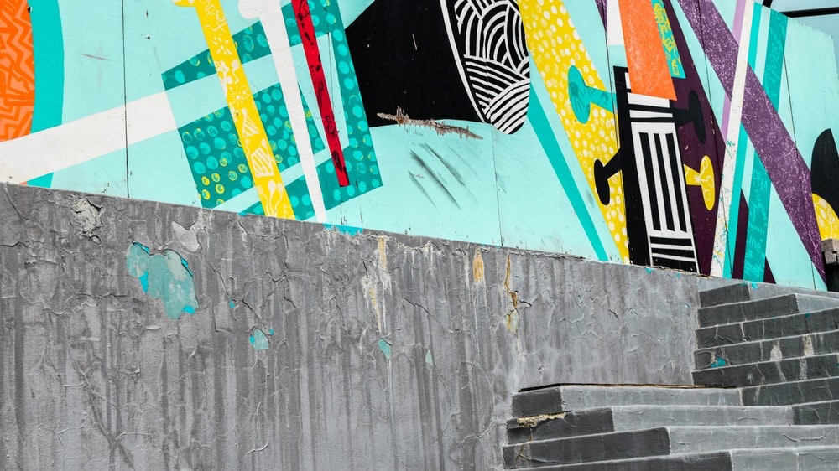


Slide 2

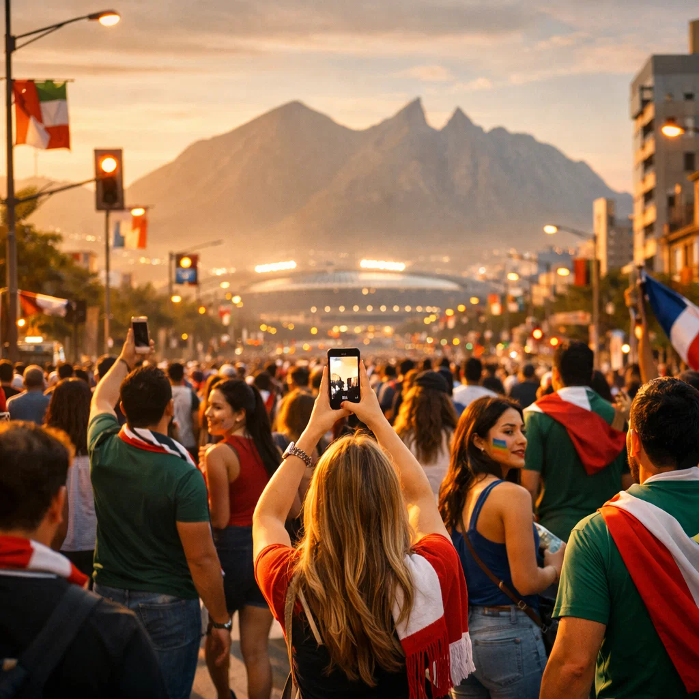
WELCOME TO THE WORLD’S BIGGEST PHOTO OP!
For one summer, Monterrey becomes the backdrop for hundreds of thousands of once-in-a-lifetime moments - and the world shares them.
Your job isn’t just to host matches. It’s to make sure every visitor leaves with a story that says: “Monterrey was the highlight.”
With Spott.Me – you turn every visitor into a billboard for Mexico City all over the world.
The prize: a citywide surge of pride, tourism, and global attention: powered by real people, not ads.
Read on to find out more…

Slide 3
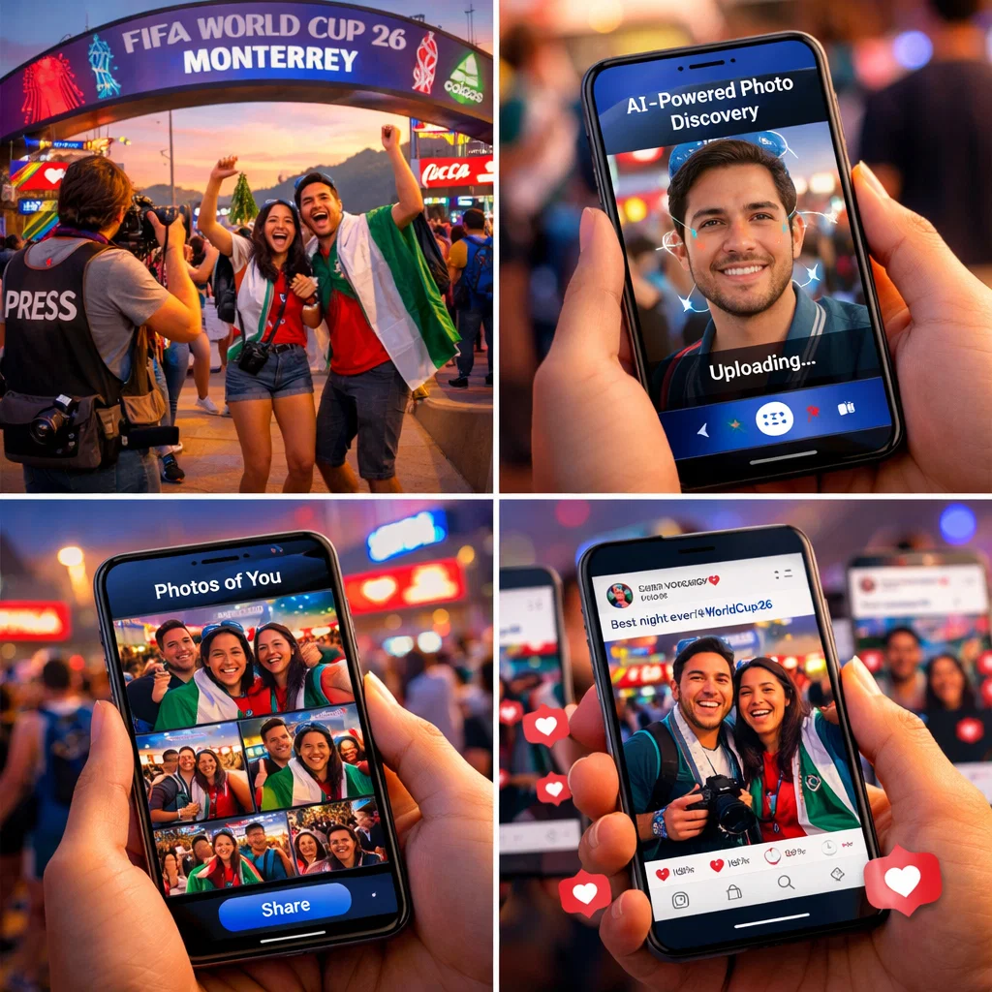
AI-Powered Photo Discovery
Spott.Me uses facial recognition AI to help event attendees instantly find professional photos of themselves.
The Result: Every attendee becomes a micro-influencer distributing professional, branded content to their networks.
How It Works:
Professional photographers capture the event
Photos uploaded to our platform
Attendees upload a selfie via their phone
AI matches their face instantly
Fans share branded content across social media

Slide 4
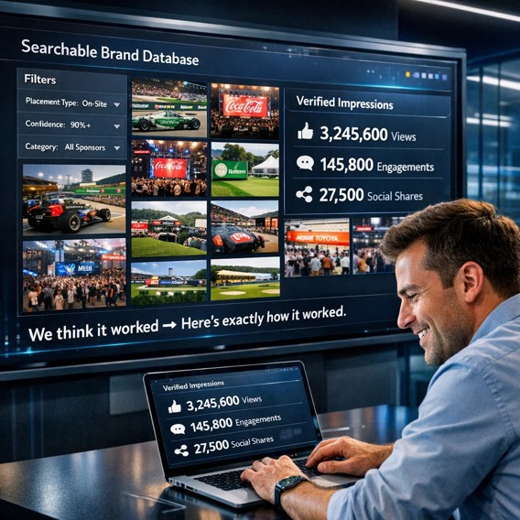
Make Sponsorship Measurable
The Problem:
Brands spend $70–$750K on activations but can’t prove ROI - reports are manual, incomplete, and estimate-based.
“For the first time, sponsors don’t have to take your word for it.”
Our Difference:
Searchable Brand Database: find every photo with logos/products/signage; filter by placement + confidence.
Verified Impressions: exact view counts, cross-platform share tracking, real-time engagement.
Automated Reporting: post-event PDF/CSV analytics, top content surfaced, exportable library.
“We think it worked” → “Here’s exactly how it worked.”

Slide 5
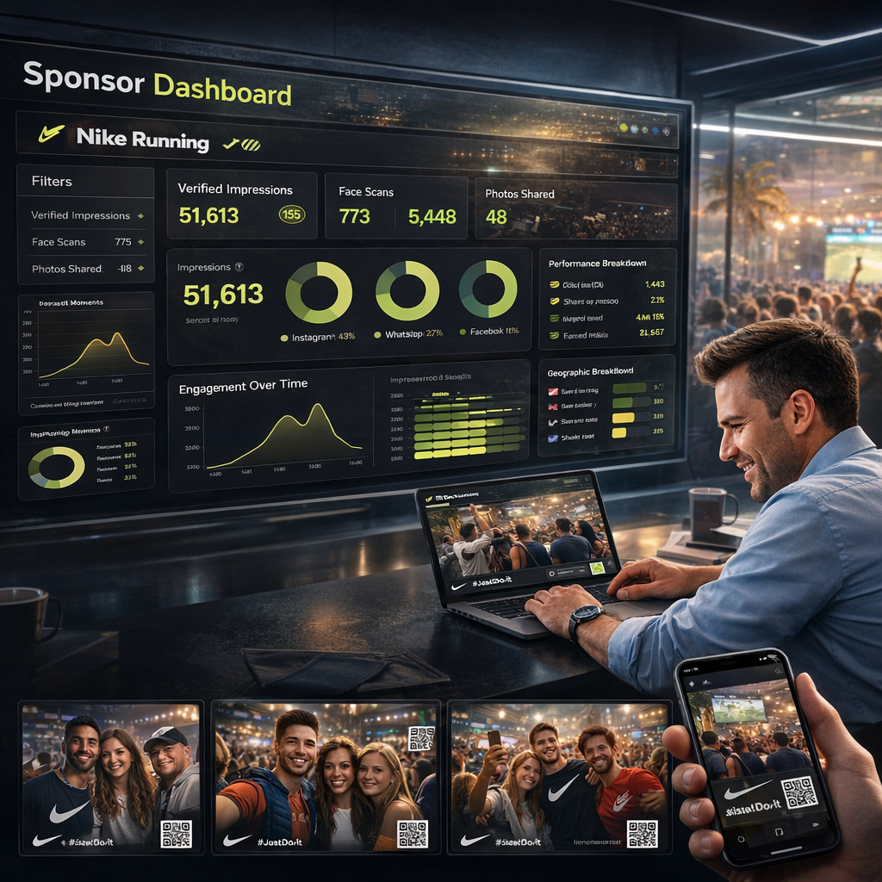
What Sponsors See
The Sponsor Dashboard:
A visual, post-event view of how branded moments performed in the real world. Dashboard view includes:
Verified impressions and views by channel
Shares, clicks, and top-performing moments
Brand appearances across photos (logo / product / signage)
Branded content, defined:
Photos delivered with a subtle frame or watermark
CTA or QR (template-controlled to meet brand guidelines)
Why it matters:
Sponsors can instantly see where their brand appeared, how it travelled, and which moments drove the most attention.

Slide 6
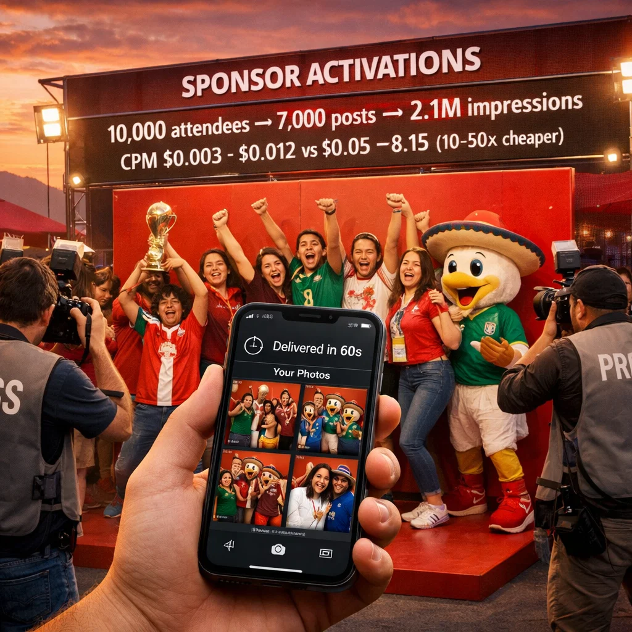
Every Fan is a Billboard!
SPONSOR ACTIVATIONS
The Math:
10,000 attendees × 70% share = 7,000 posts × 300 impressions = 2.1M impressions
Verified distribution & earned media value:
Equivalent (USD CPM): $0.004–$0.017 vs social ads $0.07–$0.21 (10–50× cheaper)
Ideal for WC26: trophy tours, mascot moments, “lift the trophy” installs, sponsor zones, challenges
Sponsors get: pro branded photos, 70–90% share rate, searchable brand appearances, automated ROI report
Example: Coca-Cola Victory Pose - photos delivered in 60s; 15,000 participants → 4.5M impressions.

Slide 7
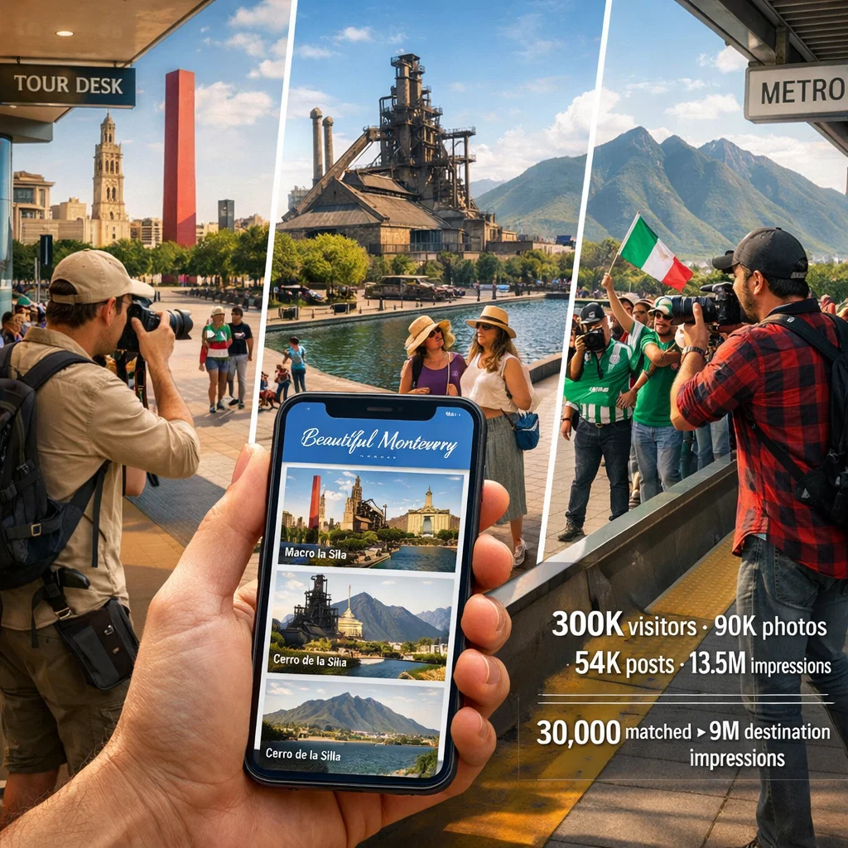
Monterrey as the Hero City
Monterrey impact: 6 matches = 300K visitors 30% hit landmarks = 90K photos 60% share = 54K posts → 13.5M impressions
Perfect for: Greater Monterrey tourism, hotels, transport partners
Tourism gets: scalable landmark photography, verified visitor metrics, proof of engagement, exportable content library for future campaigns
Legacy value: economic impact data + “We Hosted the World” assets for future bids
Example: Monterrey campaign - photographers at Fundidora Park; 30,000 visitors matched to branded photos → 9M destination impressions

Slide 8
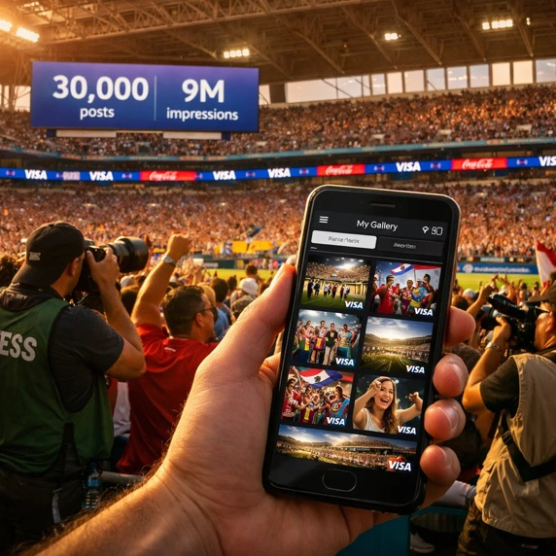
Fan Zones That Scale
Per festival: 100K attendees → 50K galleries → 32.5K posts → 9.75M impressions
Total: 50M+ Fan Festival impressions
Perfect for: FIFA® partners, host city tourism, broadcasters, entertainment sponsors
Sponsors get: multi-day repeat exposure, cross-city analytics (one dashboard), authentic moments, long-tail discovery, performance insights
Fan Festivals = a 39-day content campaign with built-in distribution.
Example: Monterrey Fan Festival - daily coverage; 50K galleries → 9.75M impressions

Slide 9
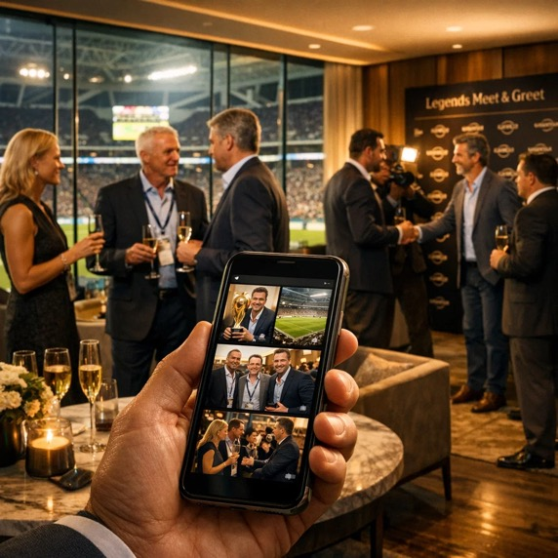
VIP Experiences Worth Sharing
VIP value: bigger followings, higher-value (B2B) networks, higher share rates; exclusivity drives posting
Business case: $10K–$100K VIP packages - pro photo delivery boosts perceived value and renewals.
Perfect for: Legends meet-and-greets, opening ceremony VIP, trophy access, sponsor lounges, behind-the-scenes
Sponsors get: premium brand association, distribution into C-suite networks, guest satisfaction metrics, testimonial-grade content
Example: Monterrey - 500 VIPs; executive networking + pitch-side + trophy moments; premium galleries shared across industries.

Slide 10
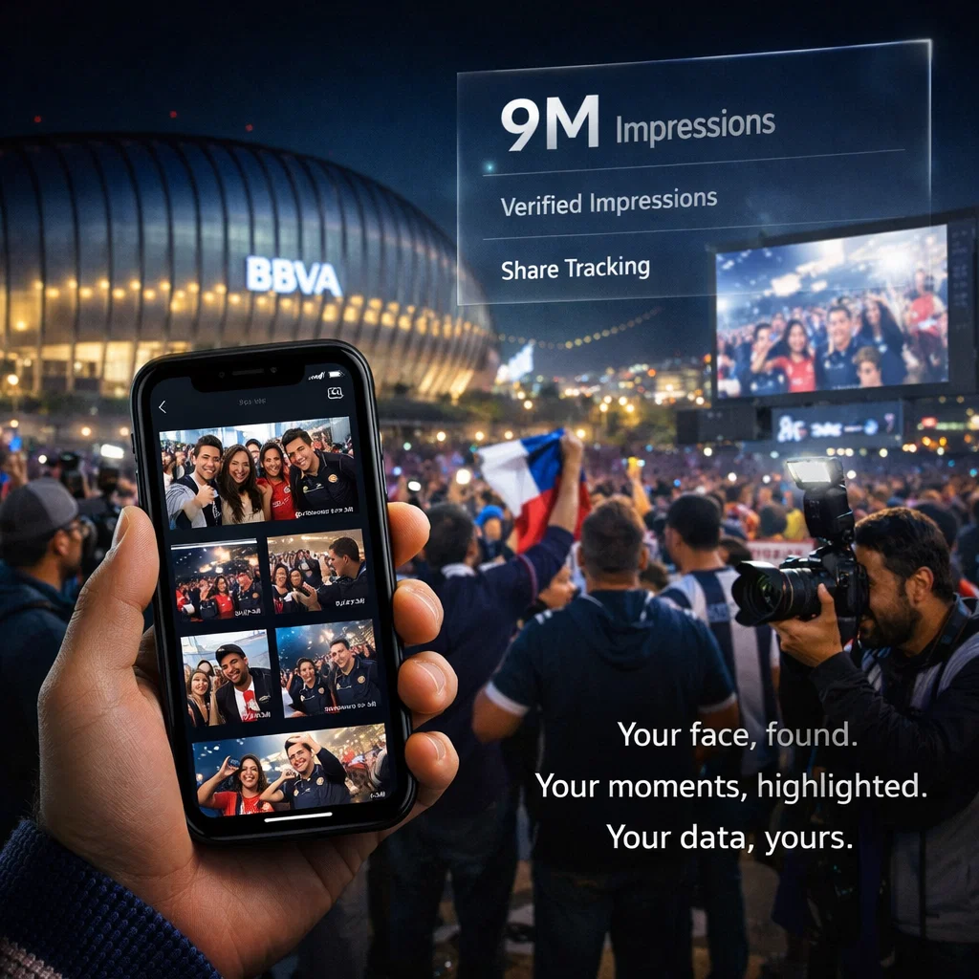
NEXT STEPS
Demo (30 mins): guest upload + organizer dashboard
Proposal: model attendees, pricing, projected ROI
Go live: faces found, moments delivered, data owned

Slide 11
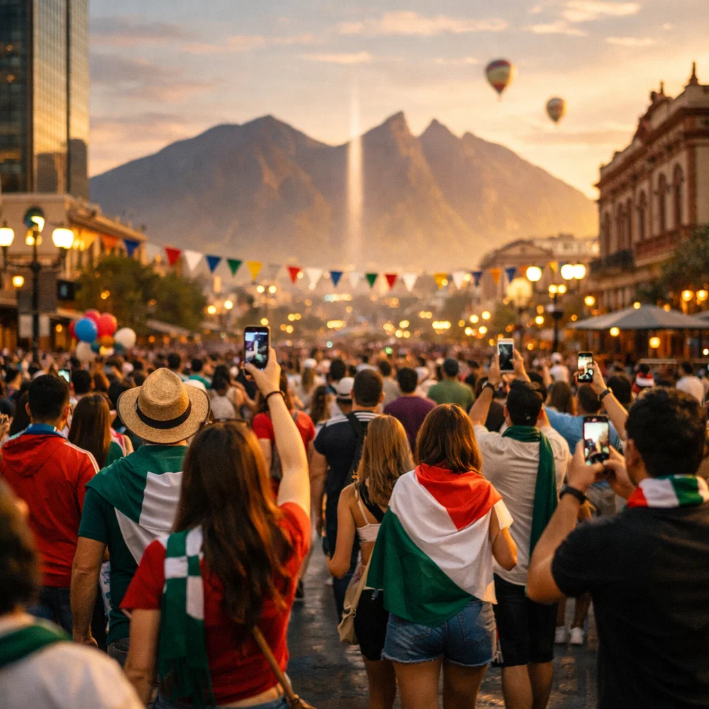
CONTACT US
Rod Lee
SVP Customer Success
Whitewall
E: rod@whitewallcreative.com
C: 1 814 692 7945

