Slide 2


WHITEWALL PRESENTS…
This deck is a creative overview of our approach to delivering the Oracle Global Tech program.
We look forward to going into greater detail with you on our upcoming call but wanted to share some of our ideas of how best to connect the new cohort with Oracle content, with its ethos of volunteering, and with each other – plus have fun too!

Slide 3
ORACLE GLOBAL TECH

Slide 4
“OGTV” Overview
At Whitewall, we’re all about the “red thread”: the connective tissue that turns an event into an experience and delivers immersive learning that makes every moment count. And so we present: OGTV.
Leaning into TV makes for a fun and relatable concept, but OGTV is more than just a snappy title. In our minds, it also stands for “Oracle Global Tech: Vision” – a testament to the importance of this program to its participants, who will shape Oracle’s future.

Slide 5


Slide 6
Event Website - Your OGTV Hub
A sleek, user-friendly hub that keeps participants connected. From session schedules to updates, the OGTV website is the central point of engagement before, during, and after the event.

Slide 7
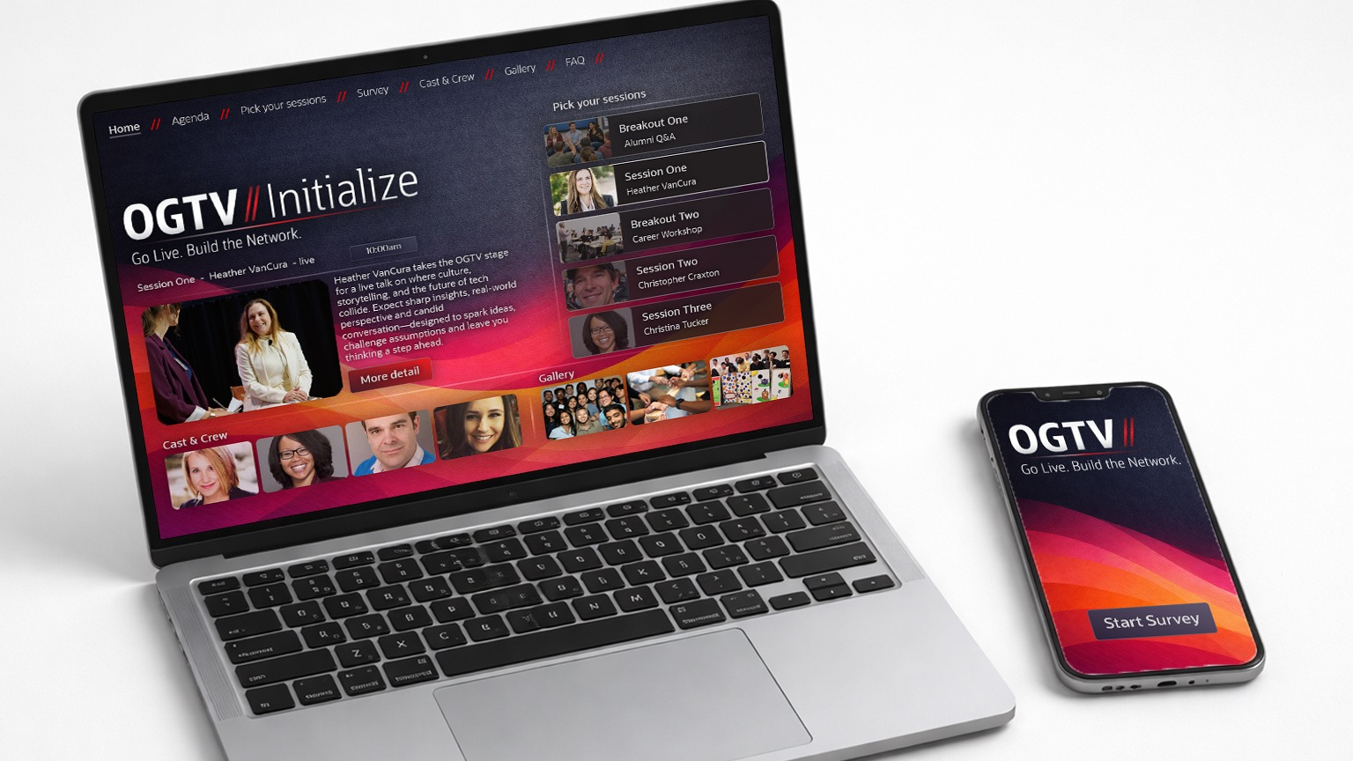

Slide 8
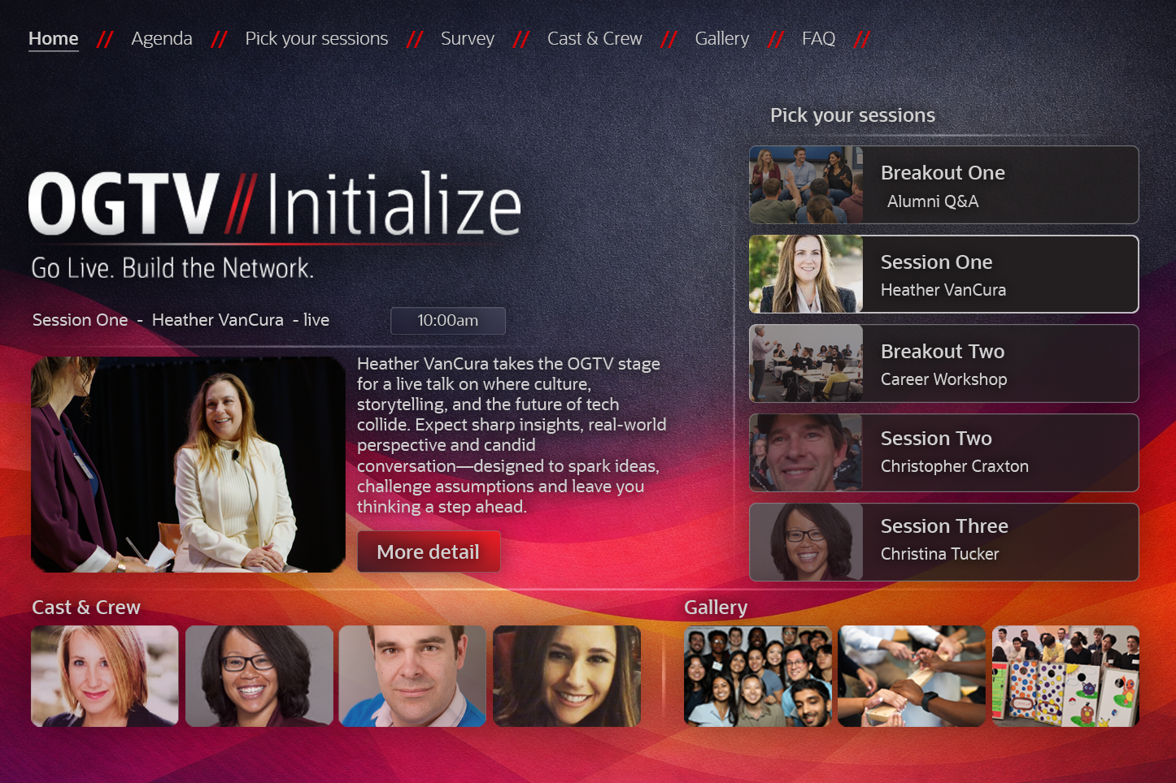

Slide 9
Front of House Branding - First Impressions Matter
A few clever props and dynamic signage transform the registration space into a bold, engaging OGTV set. It’s the first visual cue that this is no ordinary event - it’s an immersive network(ing) experience.

Slide 10
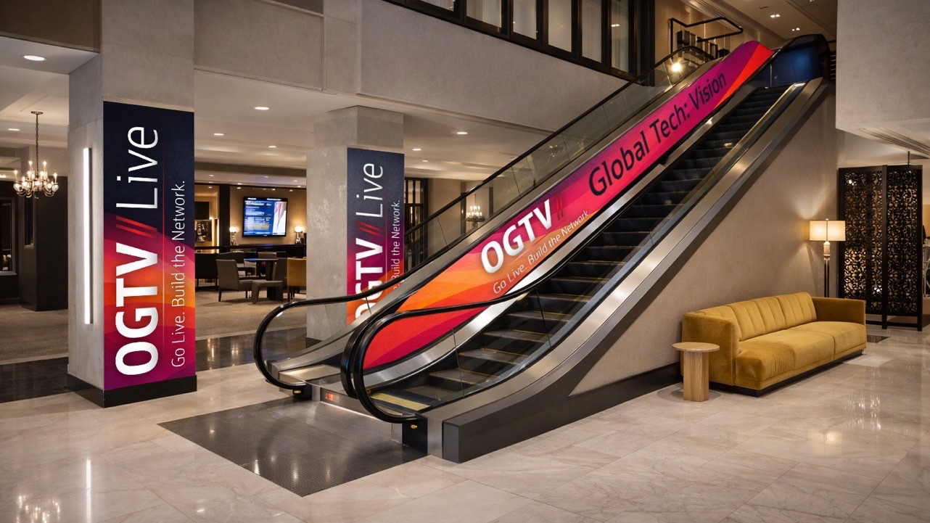

Slide 11
On-Site Registration -
Easy and Streamlined
A seamless registration process where participants quickly receive personalized badges and gear.
The check-in system ensures they’re integrated into the OGTV experience from the moment they arrive.

Slide 12


Slide 13
Swag - Get the OGTV Gear
Custom OGTV-branded merchandise that reinforces the event’s identity and gives participants memorable takeaways. From branded jackets to pins, these pieces amplify the OGTV experience, lasting long after the event.

Slide 14


Slide 15
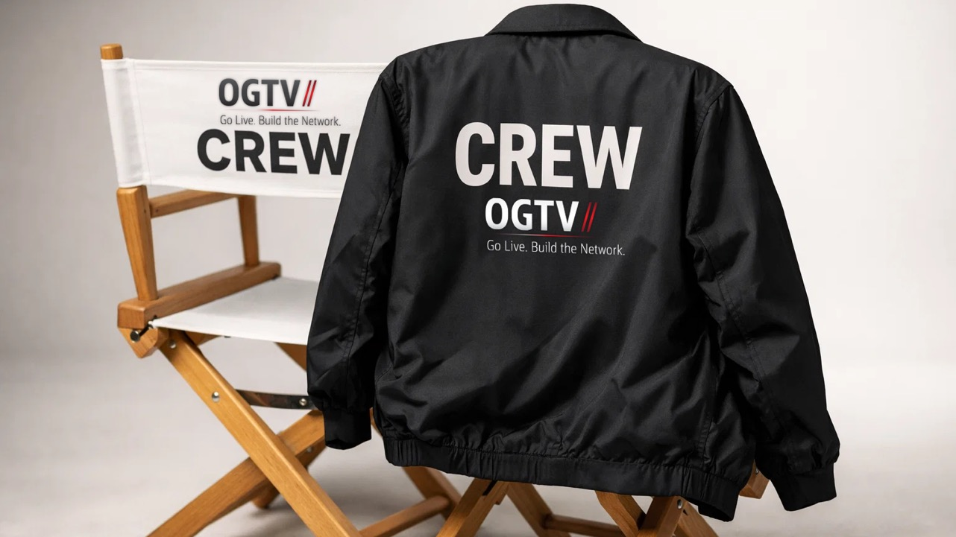

Slide 16
The team you know and trust
Our facilitators are dynamic hosts with TV-level charisma, guiding participants through each activity, ensuring smooth transitions, and maintaining high energy throughout.
Our project management team ensures seamless event execution, handling logistics, timelines, and communication, so the facilitators can focus on delivering an engaging experience.
We have some familiar and new faces on your team!

Slide 17
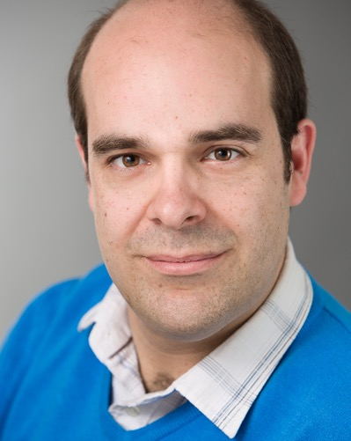

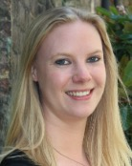

Giles Stoakley
Michelle White
Grace Newman
Lili White

Slide 18
Main Room Scenic Design -
The Studio Set
The main event space feels like a studio, with screens, dynamic visuals, and interactive elements. The scene is designed to immerse participants, making them feel like they’re on a live TV show.
The use of some simple props: a boom mic, free-standing TV lights transform the environment quickly and easily.

Slide 19
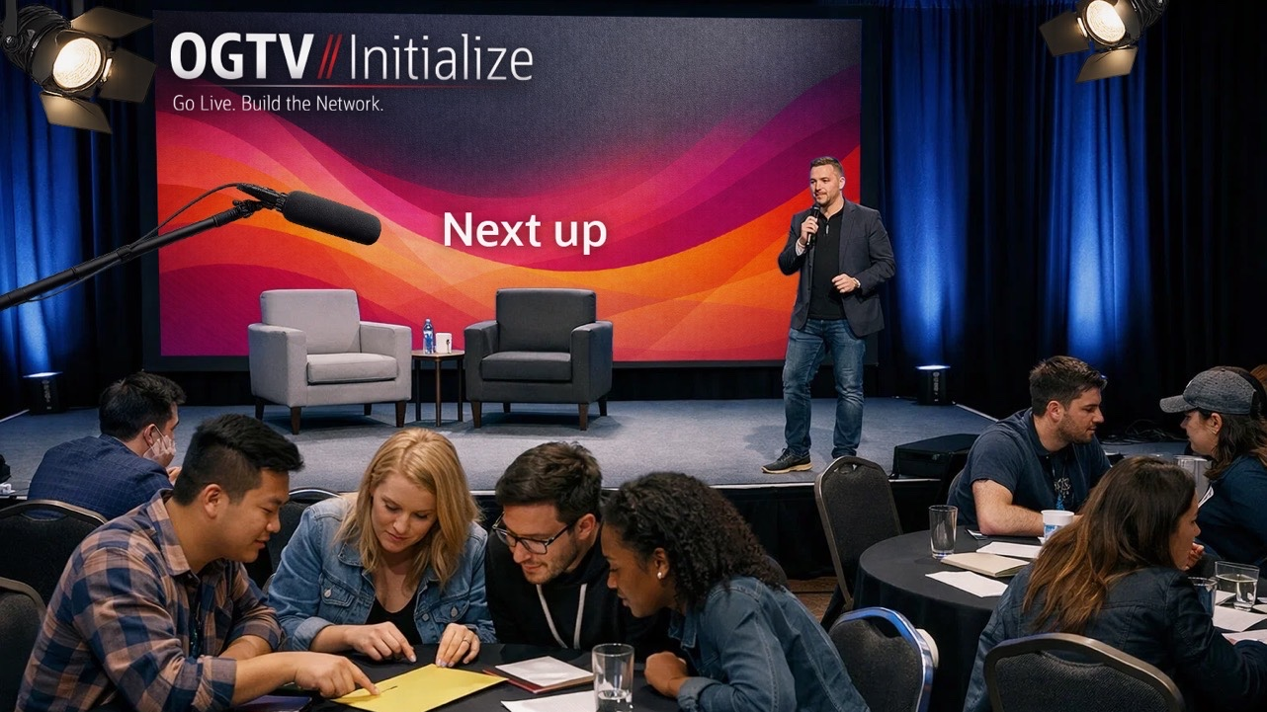

Slide 20
Travelers’ Reception -
OGTV Green Room
A laid-back space with comfortable seating and interactive stations, perfect for networking, breaking the ice and welcoming travelers.
The OGTV Green Room sets the tone for the experience, welcoming this group of participants before they “go live”.

Slide 21
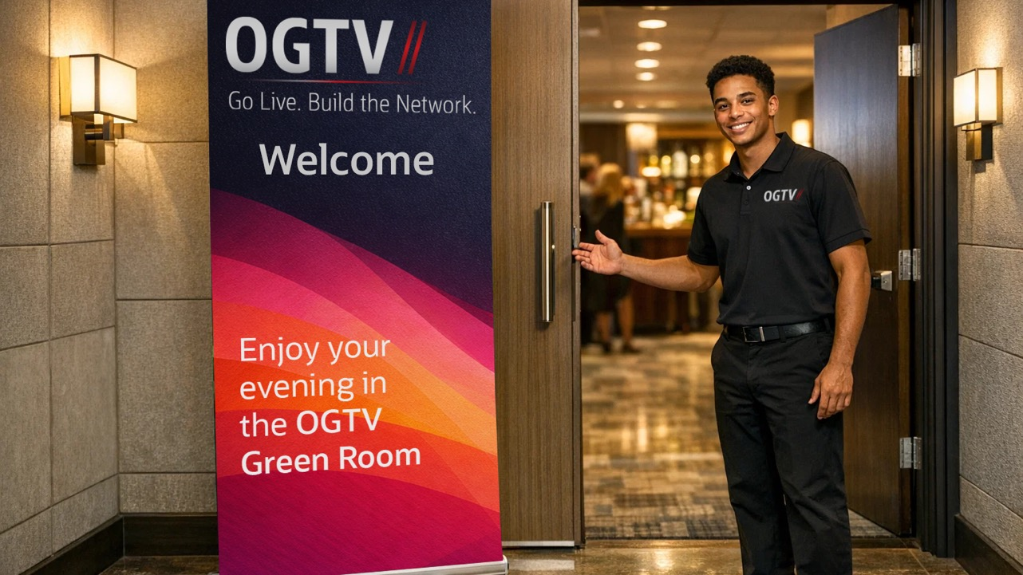

Slide 22
Learning through Giving Activities - Canstruction & Beyond
Hands-on, creative activities like Canstruction allow participants to work together while contributing to charity. These activities promote collaboration, problem-solving, and a sense of social responsibility
Click to view Learning Through Giving activations

Slide 23
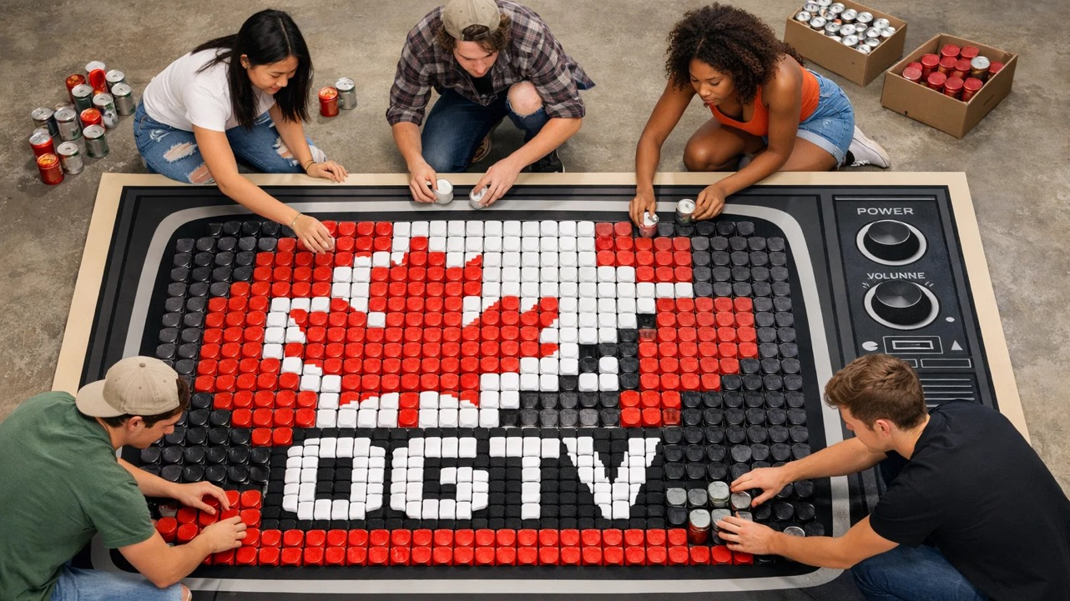

Slide 24
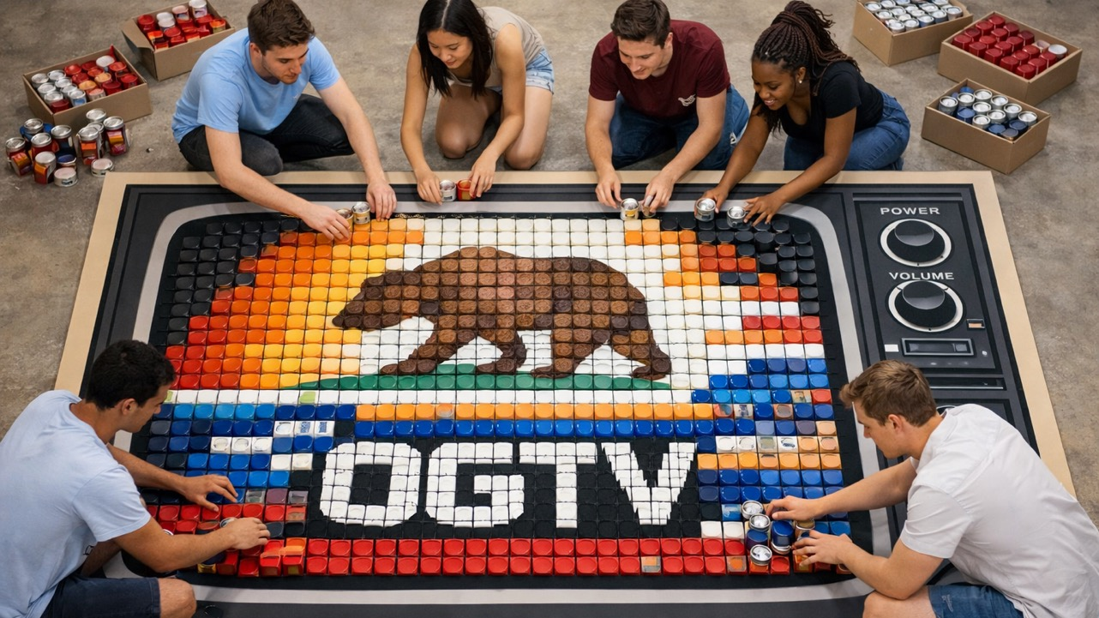

Slide 25
GLobal Tech Quest -
A Network-Expanding Adventure
Participants will complete challenges and puzzles that expand their networks and help them gain valuable insights. Think of it as a fun, interactive quest that encourages learning and collaboration in real-time
Click to view Global Tech Quest activations

Slide 26
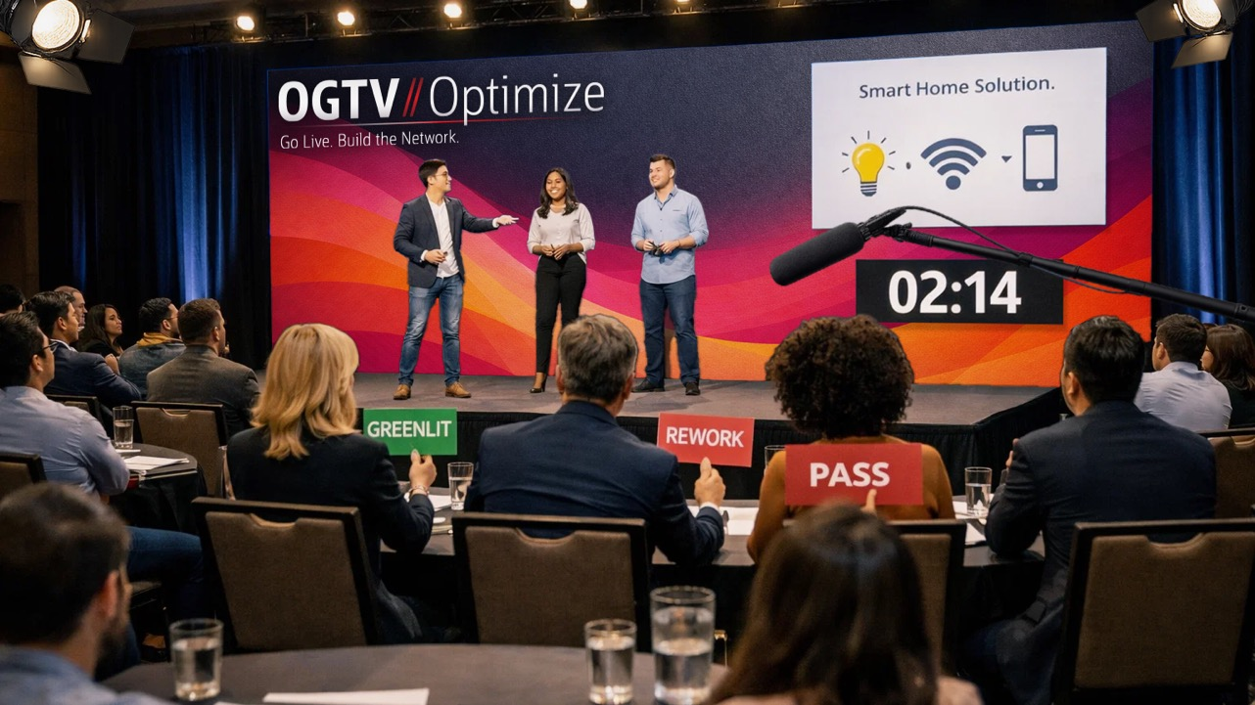

Slide 27
Evening Reception (//Initialize) - The Lounge Vibe
A shift from the day’s intensity into a relaxed, lounge-inspired space. The soft music, comfortable seating, and casual atmosphere create the perfect setting for evening networking and deepening connections.
Click to view Evening Event activations

Slide 28
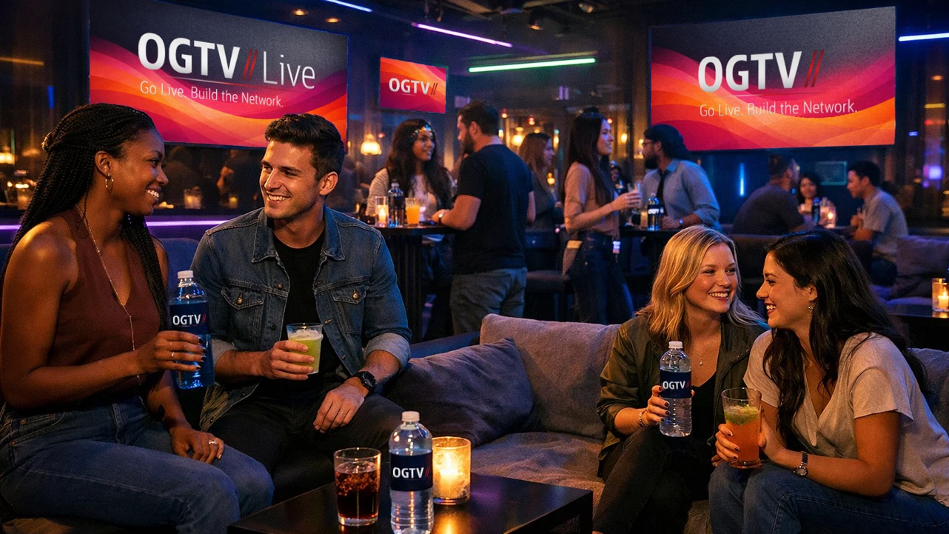
MCW TO DO

Slide 29
Evening Reception (//Optimize) - The Celebration Finale
A high-energy wrap party to celebrate the growth and achievements of the cohort. With upbeat music, vibrant vibes, and interactive moments, this is the ultimate celebration to cap off the OGTV experience and send everyone off on a high note!
It's all about fun, connection, and the excitement of what's next.

Slide 30
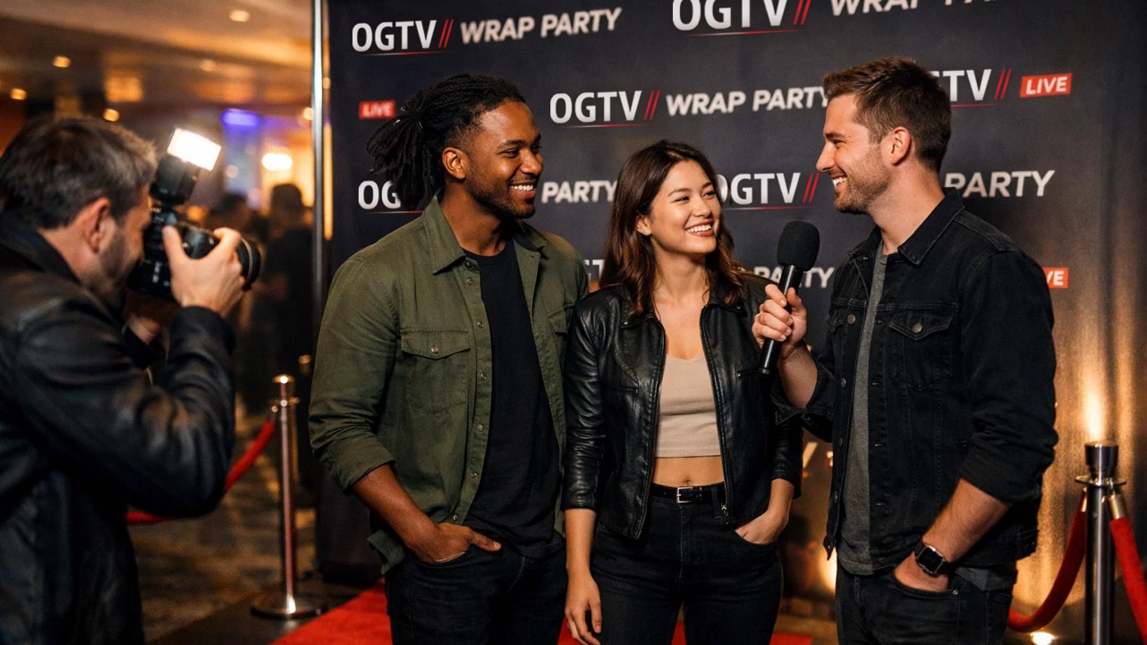

Slide 31
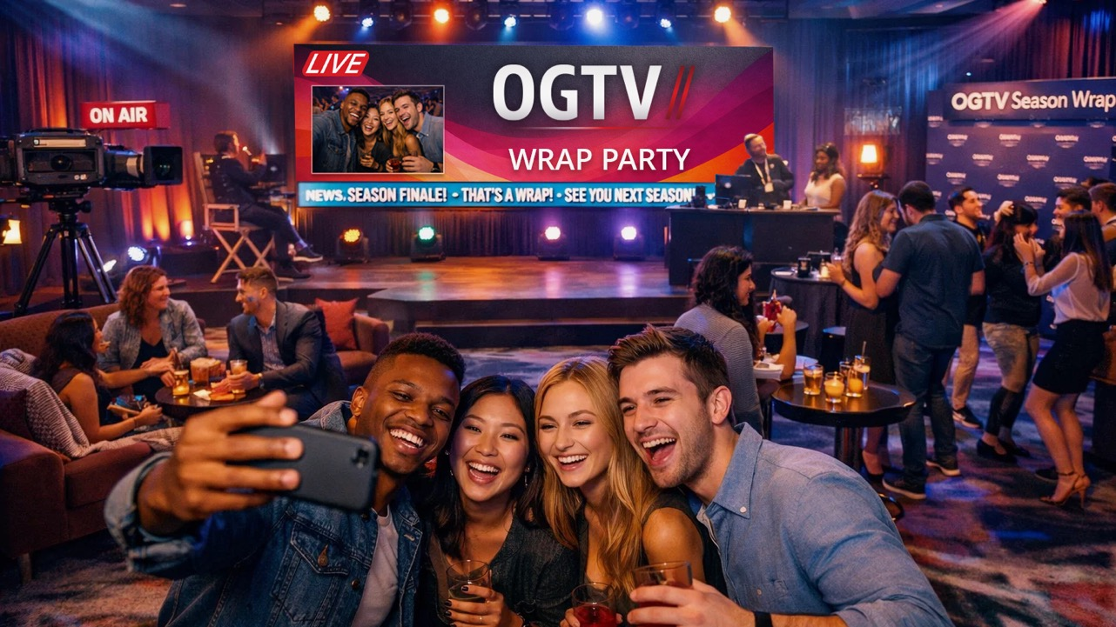

Slide 32
Guest Speaker -
Insight & Inspiration
Industry leaders and inspiring guest speakers share insights that challenge and motivate the cohort.
These talks are aligned with the themes of career growth and networking, providing valuable takeaways for participants.

Slide 33

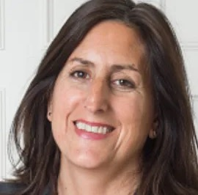
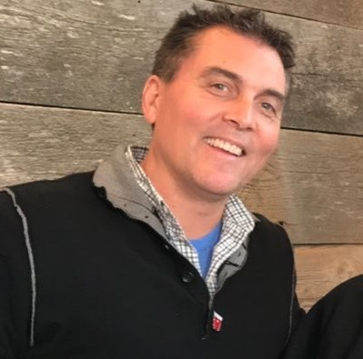
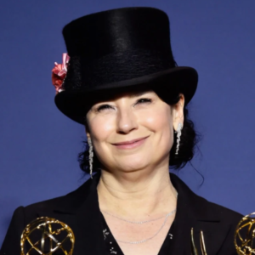
Kate Rhodes James
Casting Director
“Alien: Earth”, “Gladiator II”, “Sherlock” , ”House of the Dragon”
Nonny de la Peña
Tech Journalist/Entrepreneur
“The Godmother of Virtual Reality”. Pioneer in AI, virtual and augmented reality, immersive technologies, and journalism.
Paul Scanlan
Entrepreneur
Co-Founder of MobiTV, CEO of Legion M (the first fan-owned entertainment company).
Amy Sherman-Palladino
Showrunner
Creator of “Gilmore Girls”, “The Marvelous Mrs. Maisel”

Slide 34


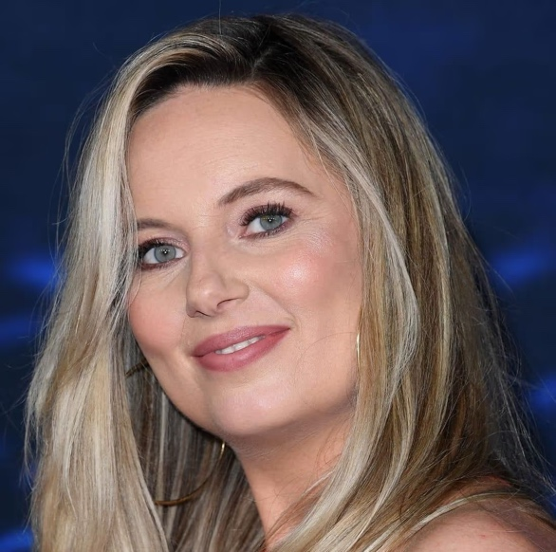
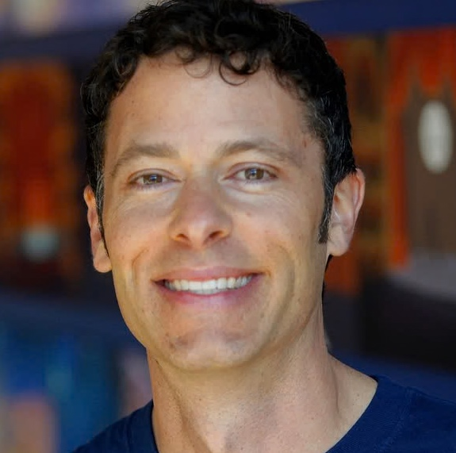
Reed Morano
Director/Cinematographer
Emmy Award winner for “The Handmaid’s Tale”
Platon
Photographer
Leading photographer: Rolling Stone, Esquire, Vogue, TIME
MJ Delaney
Director
Emmy Award nominee for “Ted Lasso”
Matthew Luhn
Animator/Story Artist
“Toy Story”, “Monsters, Inc.”, “Finding Nemo”

Slide 35
On-Site Vlogger - Capturing the Magic
An on-site vlogger will capture live feedback in real time on each day: behind-the-scenes moments, and real-time reactions throughout the event.
These snippets will showcase the energy and engagement of OGTV, giving participants the chance to be featured in the highlight reel and share, repost and tag their unique experiences.
Click to watch the OGTV Vlog

Slide 36

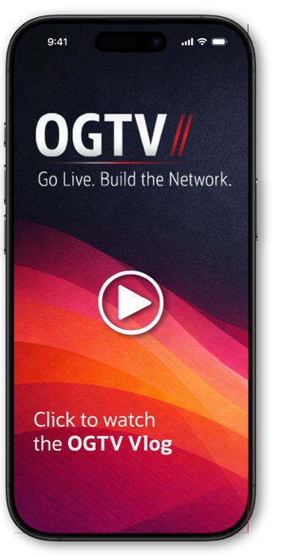


Slide 37
The OGTV Network Experience
OGTV is more than just an event - it’s a transformative experience that blends career growth, networking, and community engagement, leaving participants with unforgettable memories and lasting connections.

Slide 39

But wait. . . There’s more!
Much like a trailer, we hope this look at OGTV’s Creative Highlights, and we’ve whet your appetites to find out more.
Being a creative agency means we have no shortage of ideas, so we wanted to outline one for you: themed around music. (The “Build a Guitar” activation would work great here!)
Read on for more about our alternative creative concept…

Slide 40


Slide 41
ALTERNATIVE PROGRAM CONCEPT –
“SOUND & VISION”
Sound & Vision is an immersive, creative activation designed to enhance Oracle’s existing curriculum by blending music and visual arts. Participants engage in interactive activities that use music and visual expression as tools to deepen understanding of key concepts. By merging collaboration and creativity, the concept encourages participants to engage with content in new ways, reinforcing learning outcomes through hands-on experiences.
The environment recreates a live music studio to encourage imagination and discovery. These activities are designed to complement Oracle's curriculum, providing a fresh way to engage with content while fostering teamwork and creative thinking.
Sound & Vision promotes active learning and teamwork in an environment that is interactive but grounded in the program’s core objectives. This concept provides an opportunity to enrich Oracle’s educational experience by using creativity as a means of connecting participants to the material, making learning more engaging and memorable.

Slide 42
