Slide 1


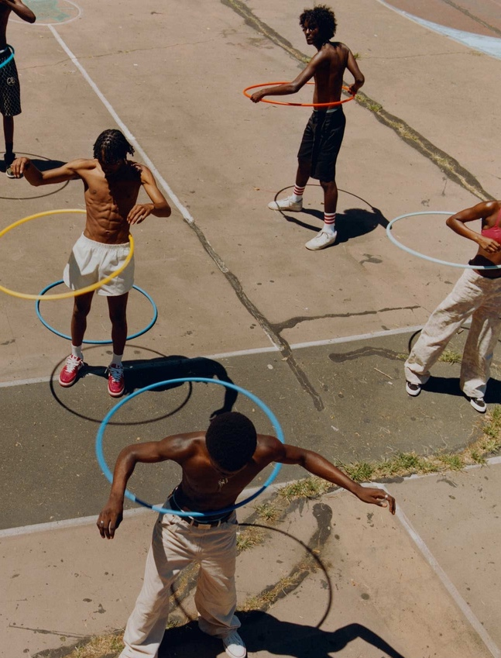
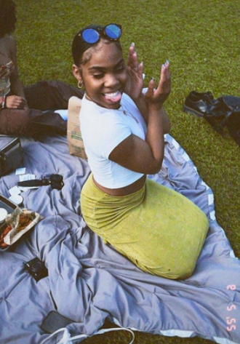
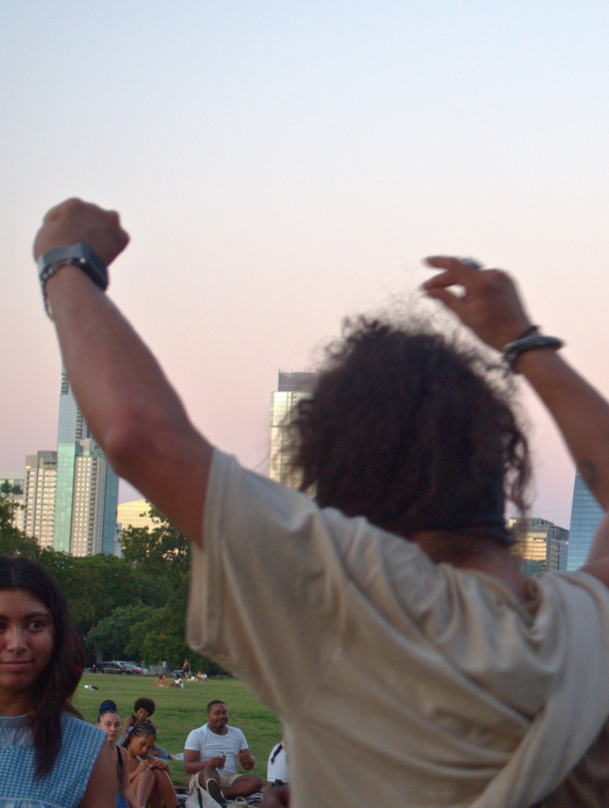
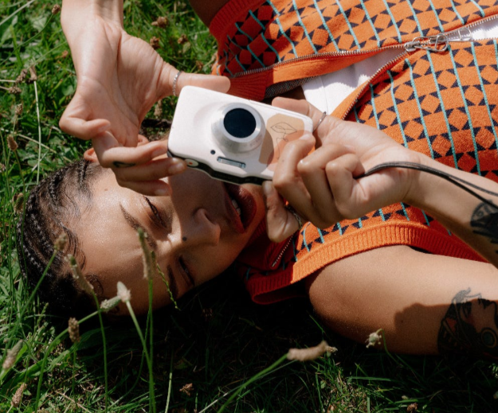
Connect with your target market in a way that speaks directly to them.

Slide 2

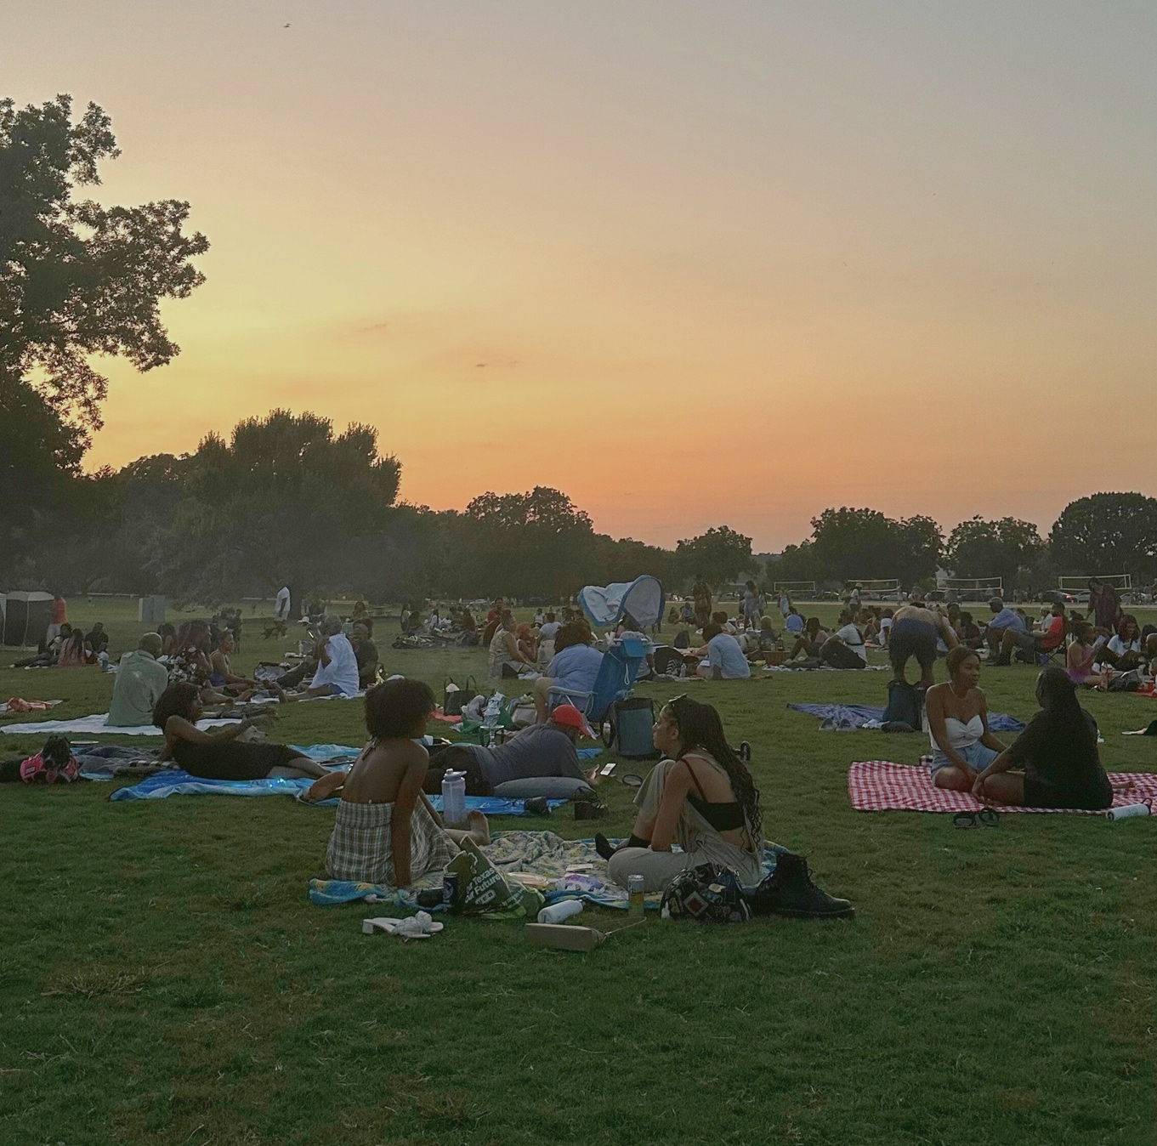
What is Sunday
Sessions?
A community-centered event creating space for music, relaxation, play, and cultural expression.
Mission & Values
A grassroots hub that centers Black & Brown people, prioritizing wellness, nature, mobilization & local creativity
Highlights
We’ve partnered with countless local entrepreneurs, practitioners, and DJs & have been featured with Austin City Limits Music Fest & Black House Radio. We’ve created a uniquely organic vibe right in the heart of Austin, TX

Slide 3

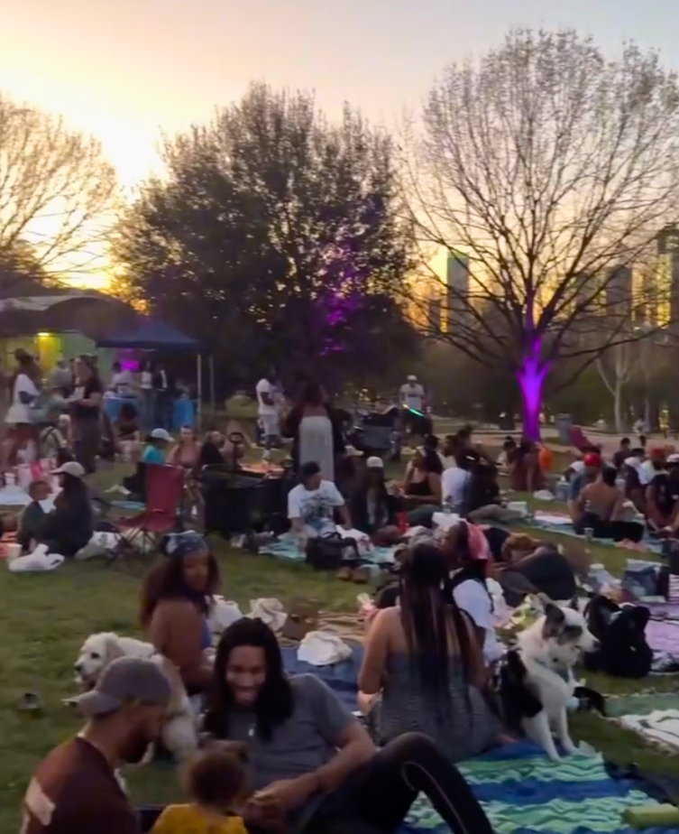
Audience
Age
Gender
Geographic Distributions
Female: 68%
Black & brown Millennial, Gen X, and Gen Z young adults who value quality time outside with friends & family.
Male: 31%
Austin
Houston
Mexico
67%
8%
2%
Lifestyle
Industries & Jobs
Key Metrics
foodies
wine
travel
dance & music
fitness/sports
wellness/self care
art/culture
LGBTQ+
hiking/watersports
plants/gardening
holistic health
tarot/astrology
hair care
skin/beauty
social justice
local culture
festival-goers
HR
Tech
Educators
Entrepreneurs
Lawyers
Consultants
College graduates
Service industry
Families
Single mothers
Wellness practitioners
Local community members
Cultural influencers
Attendance
1200
Direct to consumer
1100+ text/email blast attendees
64% click-through rate
Social Media Metrics
7200+ Followers (10/25)
Reach & Engagement (30 days)
Accts reached: 26k+
Profile Visits: 5300 Views: 47k+
03

Slide 4

Let me introduce you to. . .
Javon
Sofia
Adam
Erin
Proud husband and
father of two. At 43, he owns a plumbing business and is working to buy a new home.
Loves to spend time watching sports, reading, and learning. His biggest priority is building a foundation for his family and securing their future while enjoying the present with them.
Latina single mother, 35, working in healthcare. Loves yoga, sound healing and painting.
Enjoys going out with her girlfriends on the weekends for wine, good food, and dancing, or taking her dogs to the park.
Really wants to transition out of her current job and be a creative entrepreneur.
33-year-old Black man who works in Tech.
Engaged to a woman who has a passion for skin/hair care, beauty, and content creation. They both love to travel and work out together.
His focus is upward mobility in his field and social justice on a local & national level.
Queer college grad, 29, seeking job opportunities.
Moving into first apartment. Excited to start gardening & learning about herbalism.
Loves nature: hiking, biking, paddle boarding and all things astrology.
Climate change and environmental decay keeps them up at night.
They all love Sunday Sessions!
04

Slide 5
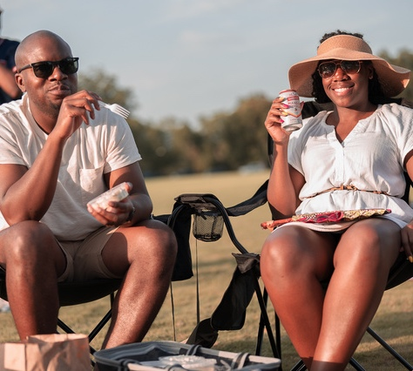
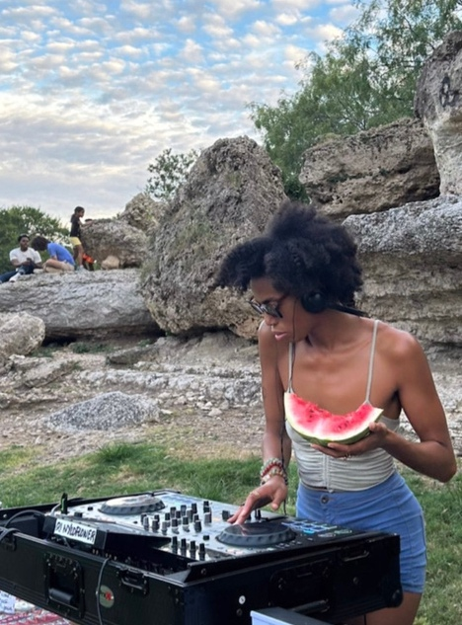
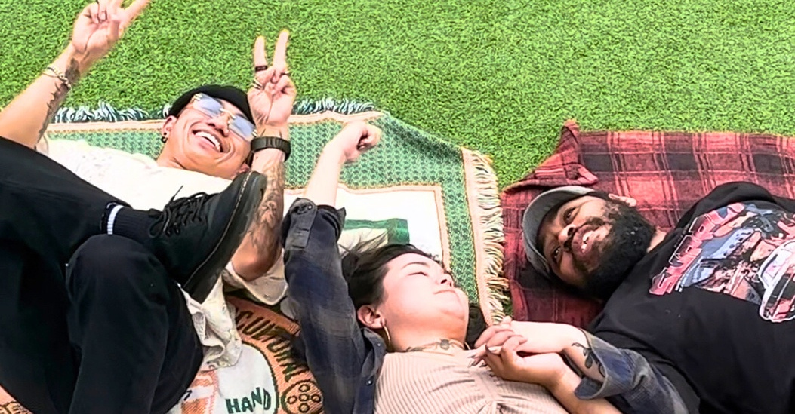
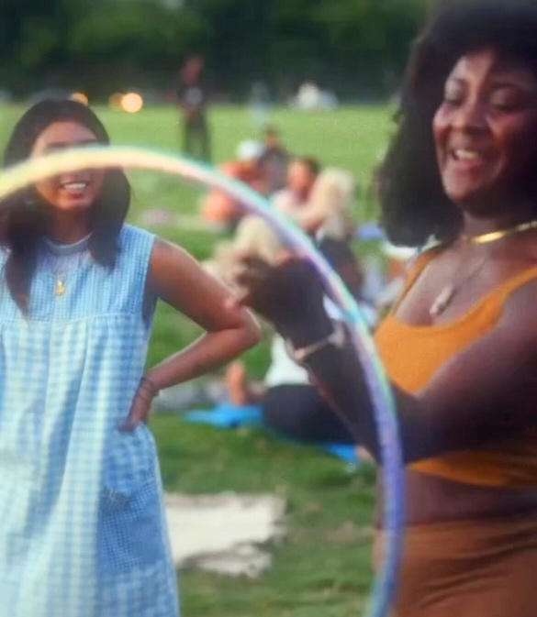
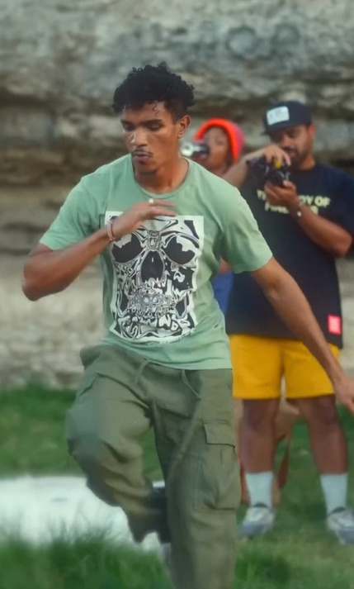
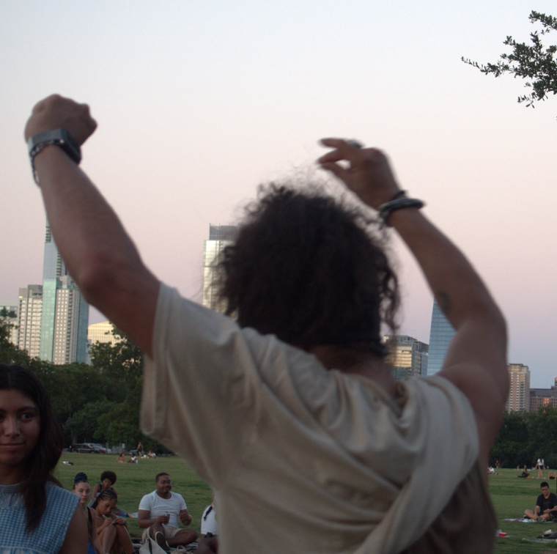
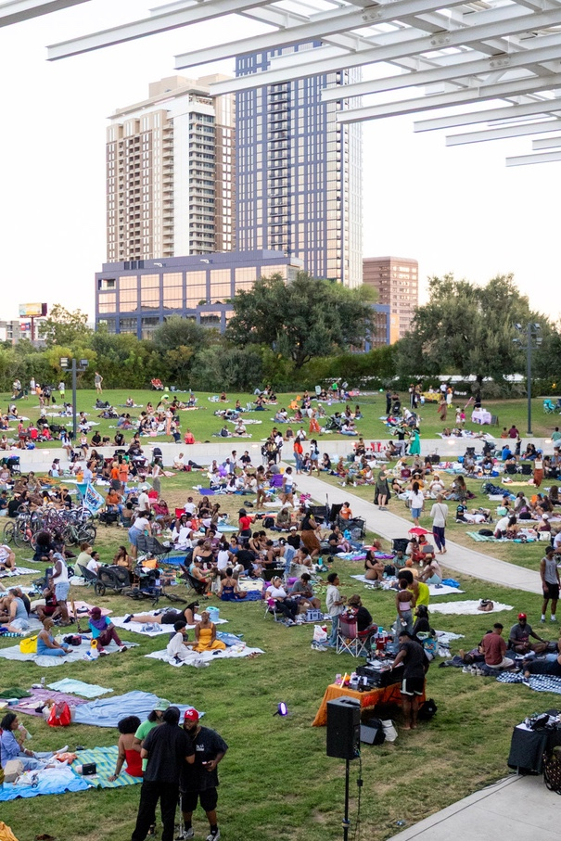
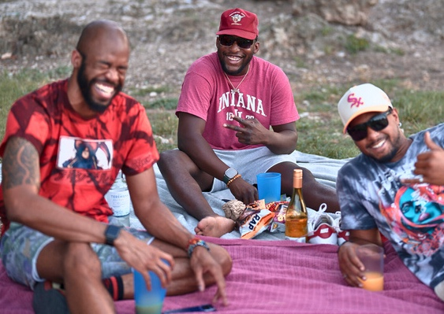
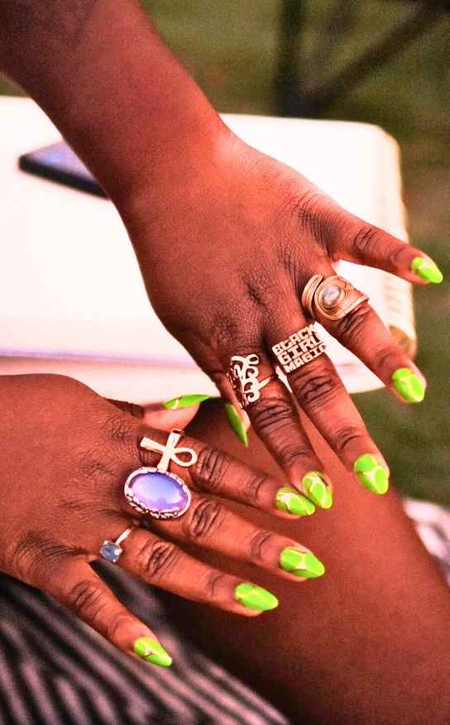
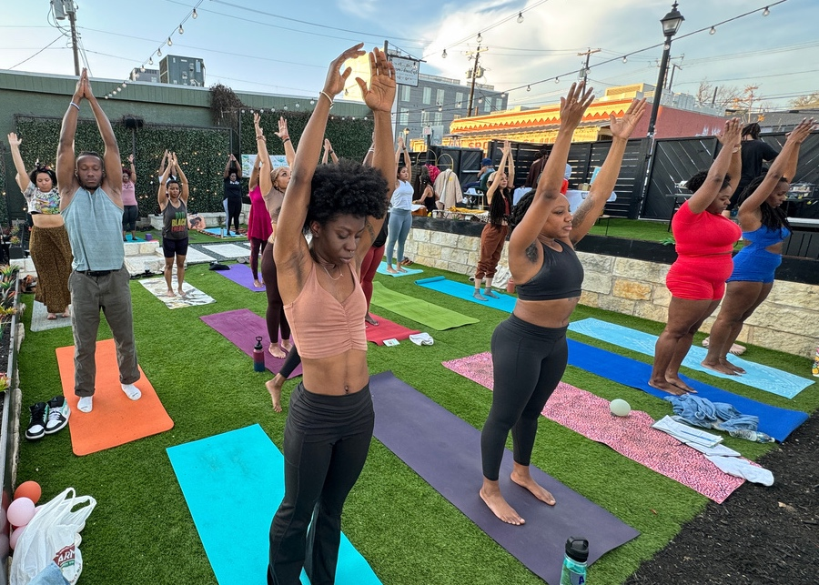
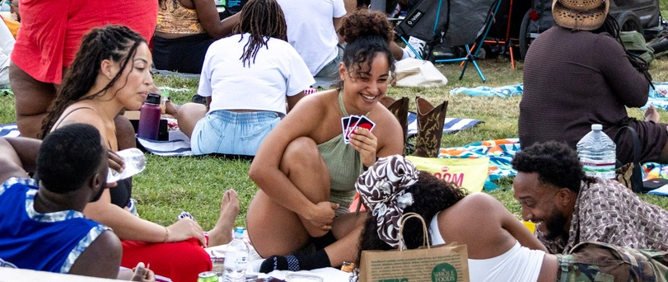
OPPORTUNITY

Slide 6
Partnership Opportunities
Choose what works for your business - based on your goals, we can customize!
Types of Sponsorships
Title Sponsor:
Gold Sponsor:
Silver Sponsor:
Community Partner:
In-kind Sponsorship:
Exclusive rights, highest visibility, and featured presence across all event materials.
Prominent branding opportunities, including event signage, digital content, and community engagement.
Visibility on event website, social media shoutouts, and limited brand placement.
Support for local businesses and non-profits, with branding opportunities during the event and digital shout-outs.
Donations of products or services in exchange for promotional benefits.
06
Notes:
Activations that serve the audience
Case studies (how we’ve delivered before)

Slide 7






Contests
Contests
GOAL: lead generation
Sampling
Brand Activations
Looking to grow your social media presence or collect leads?
Run a contest for a chance to win a prize in exchange for our audience’s connection
Great way to collect emails, newsletter signups, get people into your store, offer free trials, get more followers, fill out quotes, etc.
Giveaway can happen in person or online
07
Notes:
Activations that serve the audience
Case studies (how we’ve delivered before)

Slide 8
Product Sampling
GOAL: try your product
Setup an on-site booth or offer goodie bags to giveaway product
Our sampling rights are a great way to get your product directly in your target market’s hands
Email or mail coupons/free products to our audience
Giveaway can happen in person or online
08
Notes:
Activations that serve the audience
Case studies (how we’ve delivered before)

Slide 9

Brand Activations
GOAL: experience your product/service
Want to send a message to your audience about who you are/what you do?
Have a new product/offer the market hasn’t heard of?
Offering guests an enhanced experience through storytelling/experiential marketing is a great way to speak to the audience in a way that will resonate
Want to show our audience that you believe what they believe?
09
Notes:
Activations that serve the audience
Case studies (how we’ve delivered before)

Slide 10






We cover all the bases:
We offer all our sponsors these main assets and benefits, but we don’t stop there. Our goal is to develop an opportunity that will engage your target audience in meaningful ways.
Event signage
(on site)
Promotional photos
NAME
Social media promotion
Verbal mentions
on mic
Company
reviews
Company mention in e-blast
10
Whether you’re looking for product promotion, brand awareness, reaching a specific market or a different goal, we can find a sponsorship plan that works for everyone
Notes:
Activations that serve the audience
Case studies (how we’ve delivered before)

Slide 11
Pricing
We can tailor a sponsorship package to suit your needs, and with packages starting at only $3,500, there’s something to offer everyone.
Not including additional costs related to your activation (product, coupons, printed material etc.)
Upcoming Dates
Costs per Event
*subject to change
current event expenses:
Oct 5, 2025
Nov 9, 2025
Dec 7, 2025
Mar 15, 2026
Apr 19, 2026
Permit/insurance
Talent
Practitioners
Equipment Rental
Support Team
Ask about opportunities
for ongoing partnership!
We are a fiscally sponsored organization and able to accept tax-deductible donations
11
Notes:
Activations that serve the audience
Case studies (how we’ve delivered before)

Slide 12



Next Steps:
Reach out to our sponsorship team to discuss opportunities & secure your spot.
Available options to discuss custom or tailored sponsorship packages based on specific goals and needs.
Contact us! Let’s work together
Sponsorship Manager:
Email:
Phone:
Website:
Dom Okus
dom@sundaysessionsatx.com
512.939.4954
sundaysessionsatx.com
Instagram: @sundaysessionsatx
Sunday Sessions ATX
Pitch Deck

