Slide 1
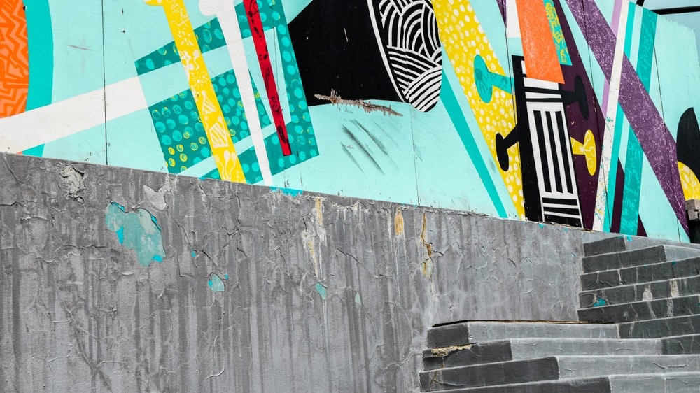


Slide 2



SPOTLIGHT ON…
SPECIAL PROJECTS
Tailored solutions for unique challenges and opportunities.
From major global sports events like the World Cup to specialized campaigns, we take on complex projects that require precision and impact. We support clients in seizing unique opportunities with creative, on-brand solutions that resonate worldwide.

Slide 3

SPOTLIGHT ON…
Click image to view
CULTURE & INCLUSION
Engaging in live and on-line engagement with Oracle Women’s Leadership
Supporting diversity, equity, and belonging through Oracle Culture & Inclusion

Slide 4
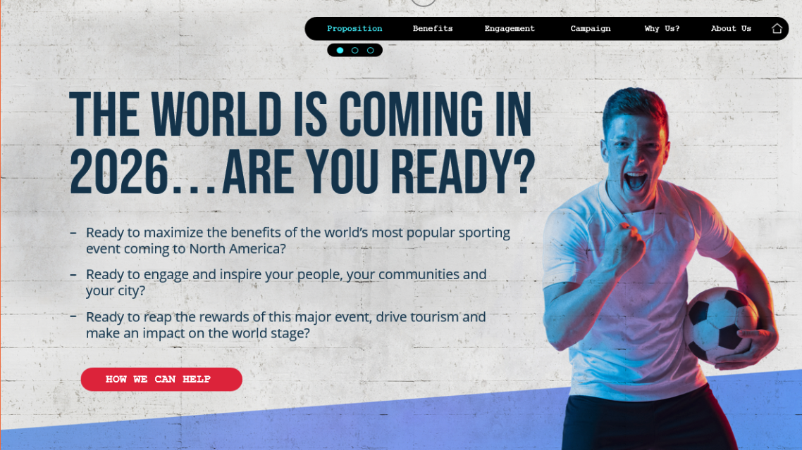
SPOTLIGHT ON…
Click image to view
WORLD CUP 26
Maximizing business opportunities around the 2026 FIFA World Cup ©
From activations to events, campaigns to fan zones, we’re setting clients up for success for the world’s most popular sporting event

Slide 5
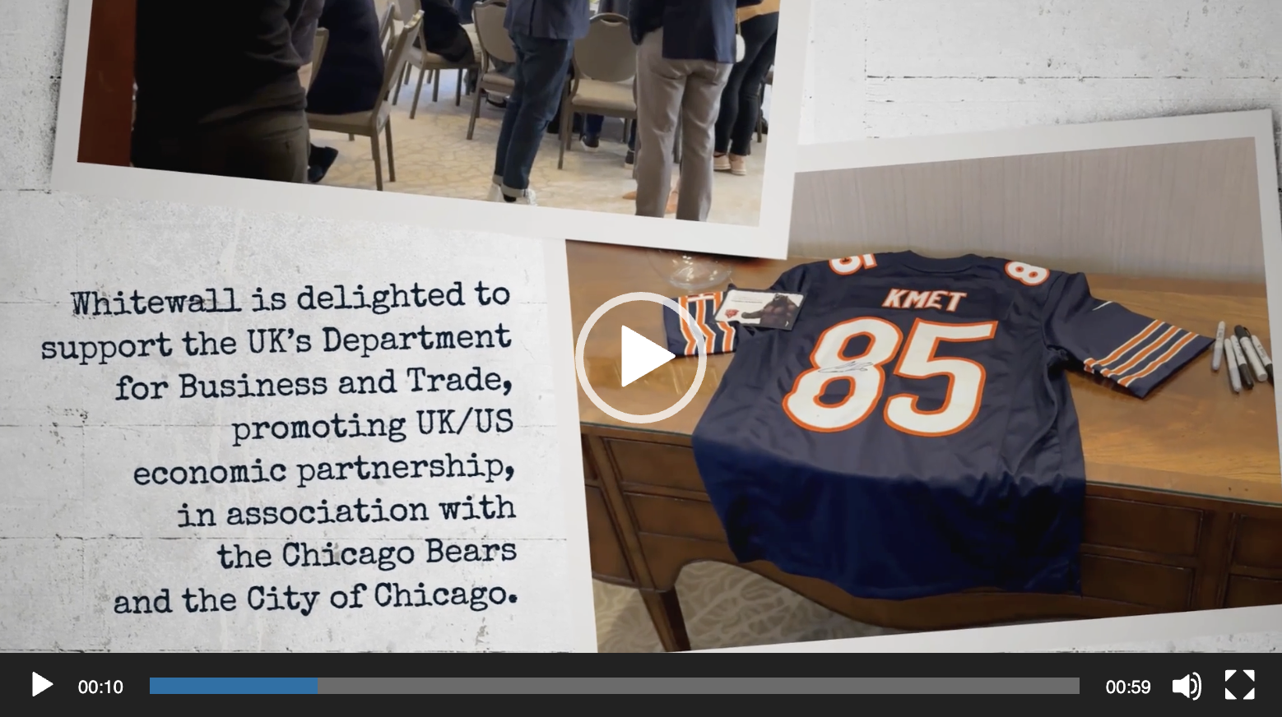
SPOTLIGHT ON…
Click image to view
INTERNATIONAL TRADE
Bringing together business and government to drive mutual investment and generate growth
Experts in helping brands tell their stories in overseas markets – with special emphasis on US/UK

