Slide 1
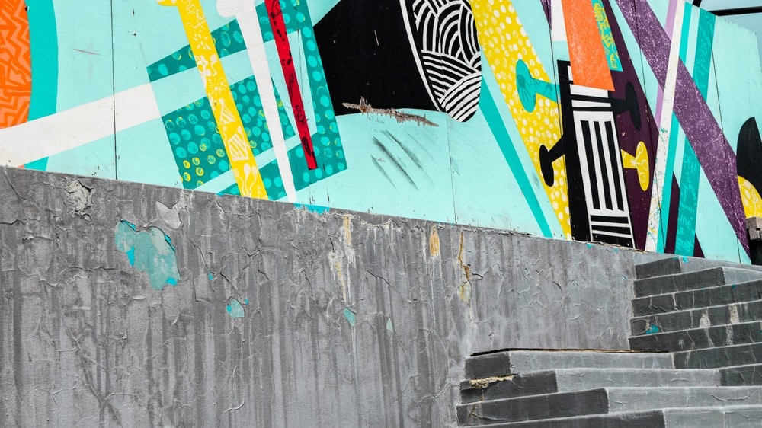


Slide 2



SPOTLIGHT ON…
RECOGNITION & MOTIVATION
Inspiring teams and clients with unforgettable recognition programs.
We drive success through powerful reward and recognition programs that motivate. From global award shows to incentive campaigns, we create experiences that celebrate achievements, foster loyalty, and elevate performance at all levels.

Slide 3
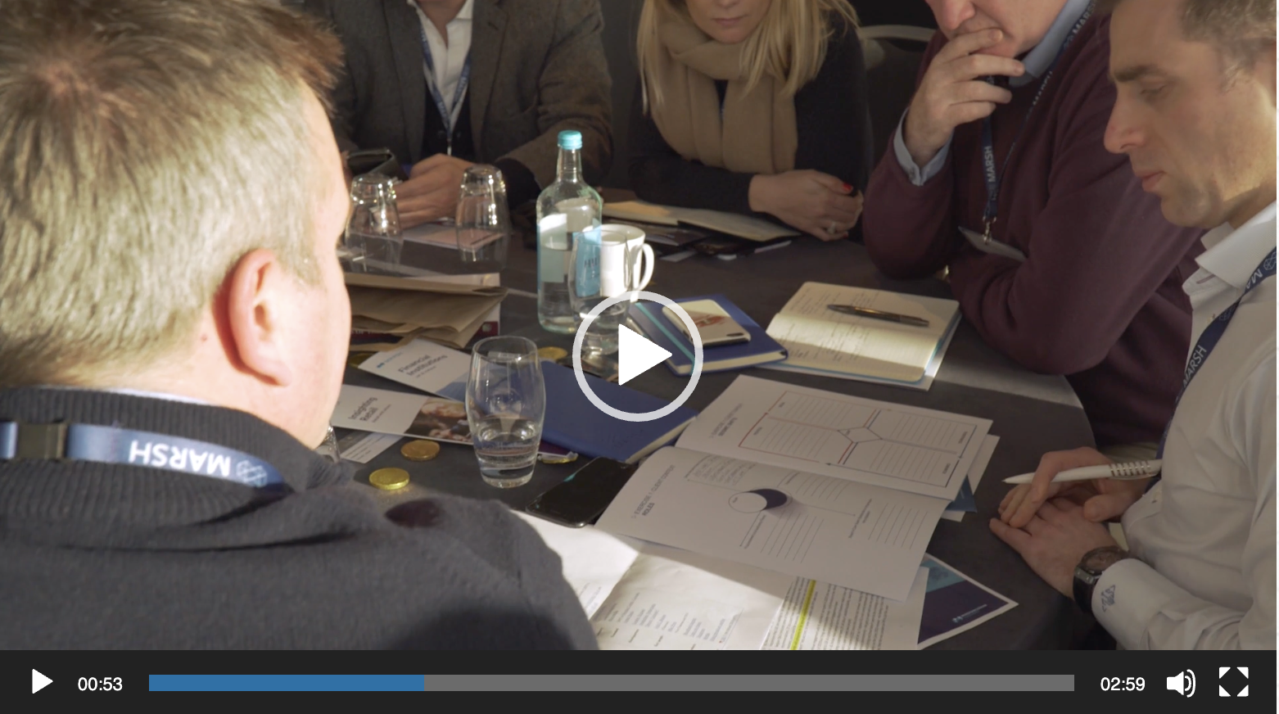
SPOTLIGHT ON…
Click image to view
SALES KICK-OFFS
Start your fiscal year as you mean to go on – with a clear vision and an engaged sales force
Content and delivery that embodies your key messages and drive revenue growth

Slide 4
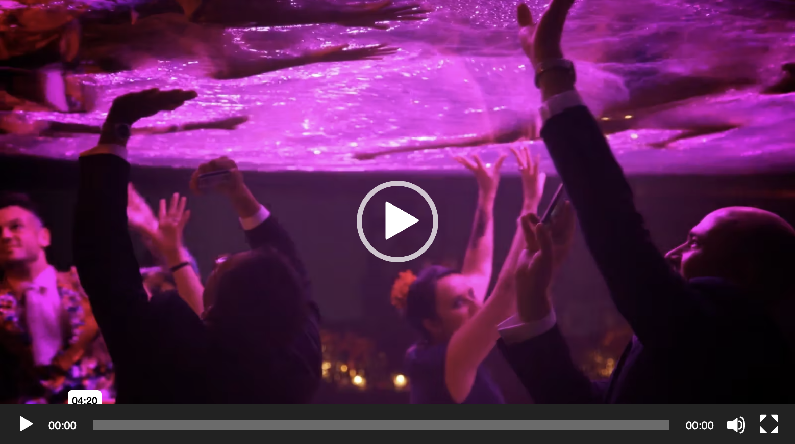
SPOTLIGHT ON…
Click image to view
INCENTIVE PROGRAMS
Reward and recognize your top performers with money-can’t-buy creativity
Programs that deliver long-term benefits in retention and employee loyalty
Access to creative talent like Tony and Olivier Award winners

Slide 5
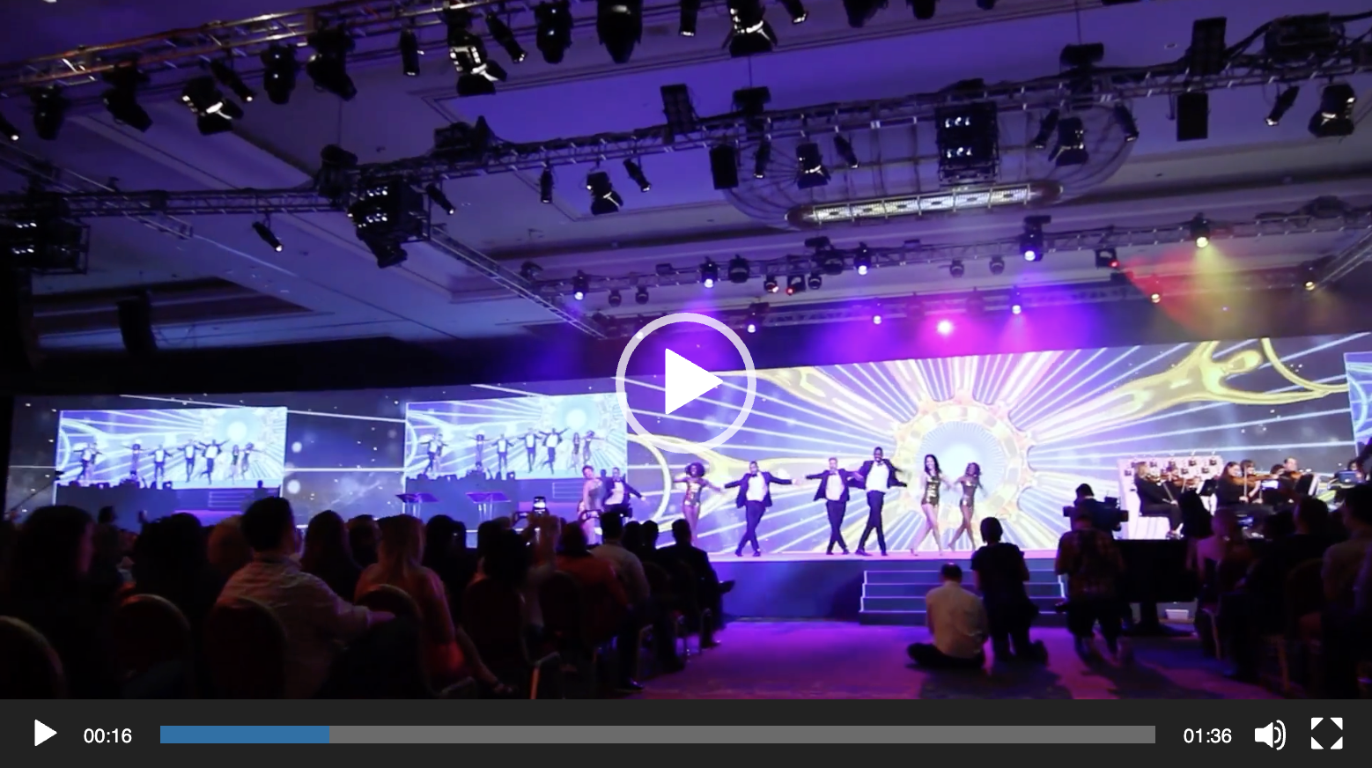
SPOTLIGHT ON…
Click image to view
AWARDS PROGRAMS
We know how to put on a show
Broadway-level talent both on- and backstage
On- and off-line programs that drive revenue growth and brand equity

Slide 6
SPOTLIGHT ON…
Click image to view
Reward & Recognition
Awards programs, campaigns and events to celebrate and inspire
Customers, partners and employees – we find the right way to drive continued success
On- and off-line solutions at a global scale

Slide 7
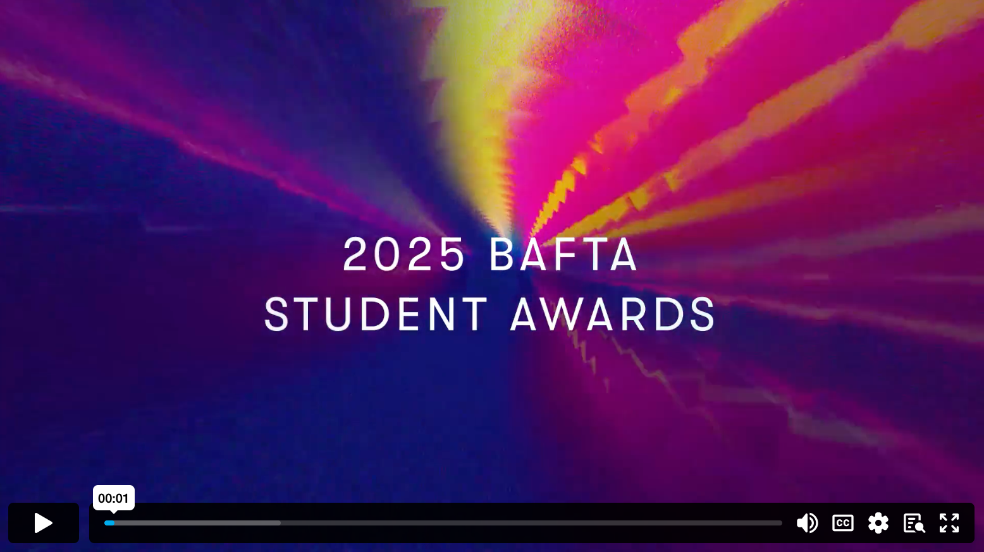
SPOTLIGHT ON…
Click image to view
REWARD & RECOGNITION
Creating show content and creative for the BAFTA Student Film Awards in LA
Delivering compelling narratives and innovative design to showcase emerging talent and celebrate excellence in film
Needs Weblink – BAFTA Highlights VT

