Slide 1



Slide 2


GIVING you CREATIVE AGENCY TO . . .
  MAKE EVERY MOMENT COUNT
Empowering design, digital, and experience solutions

Slide 3



CREATIVE AGENCY
At Whitewall, we believe that every moment holds the potential to create impact. We empower our clients with creative agency—offering the tools, talent, and vision to turn ideas into results that matter.
Design
Digital
Experience
Transforming visuals into captivating stories.
Crafting seamless, effective digital solutions.
Creating memorable moments that resonate and engage.

Slide 4















WHO WE WORK WITH

Slide 5





OUR GLOBAL REACH

Slide 6
Our team Is your team
Full spectrum of creative, design & production experts:
Creative directors
Designers & animators
Video creators & editors
Copywriters
Social media specialists
Event producers & technical directors

Slide 7

SPOTLIGHT ON…
ENGAGEMENT & EXPERIENCE
Maximizing client interaction through innovative, international experiences.
We design and deliver moments that engage, excite, and elevate. From high-stakes global events to intimate partner and customer engagements, we help clients strengthen relationships, build loyalty, and create lasting impressions.

Slide 8
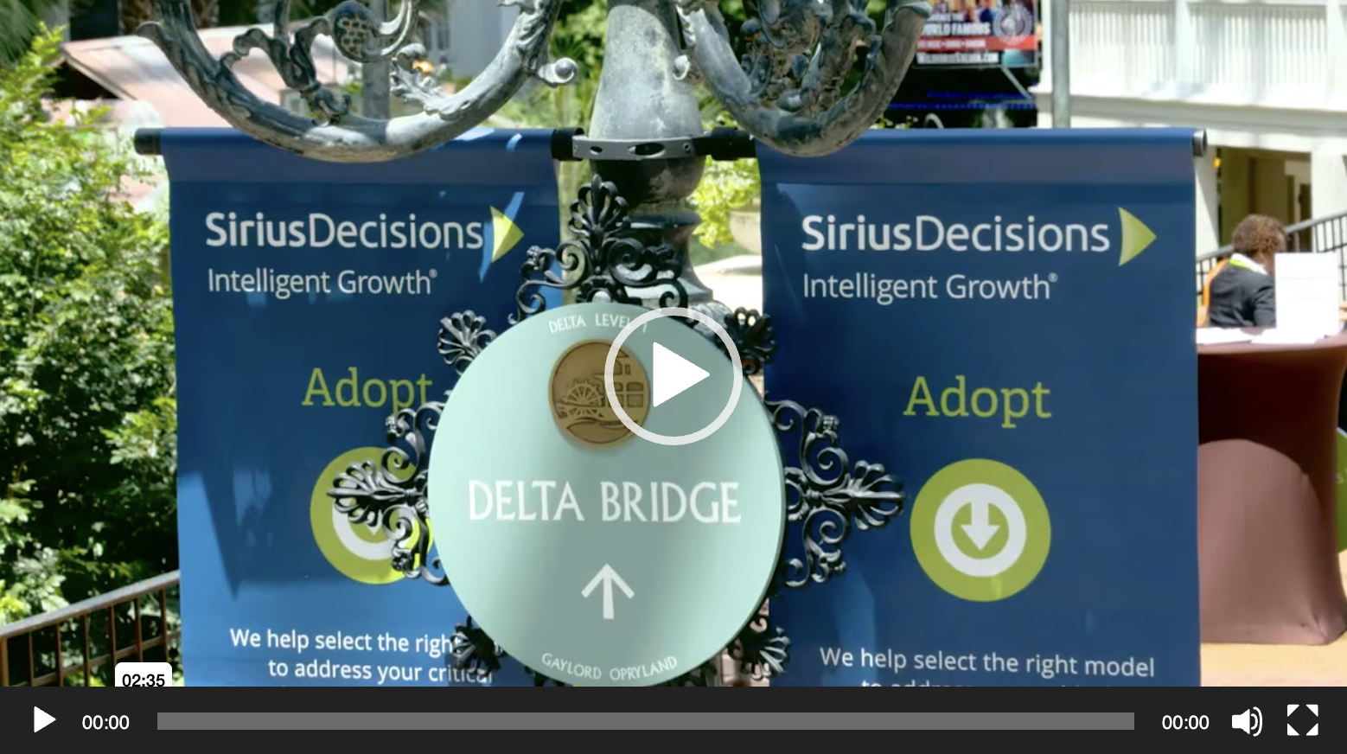
SPOTLIGHT ON…
Click image to view
Customer Engagement 1
From intimate, high-level dinners to the Vegas stage, we’ve designed and delivered dozens of customer-facing events, campaigns and activations
From world-class content to the best in production – wherever and whenever you need it

Slide 9
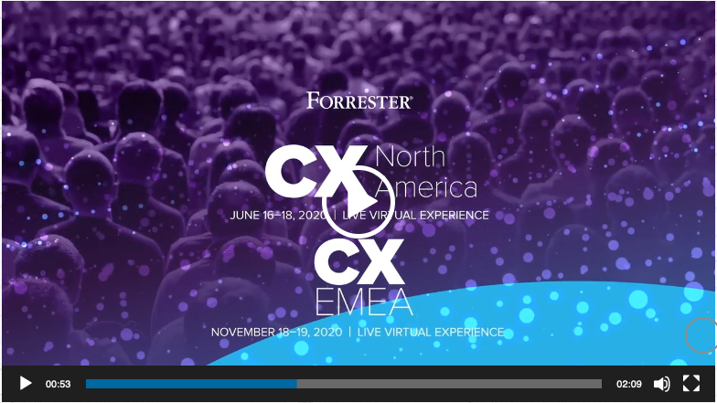
SPOTLIGHT ON…
Click image to view
CUSTOMER ENGAGEMENT 2
Global design and delivery of engaging, inspiring and informative on-line and digital that get results
Leveraging the power of curated content to deliver greater ROI on your thought-leadership

Slide 10
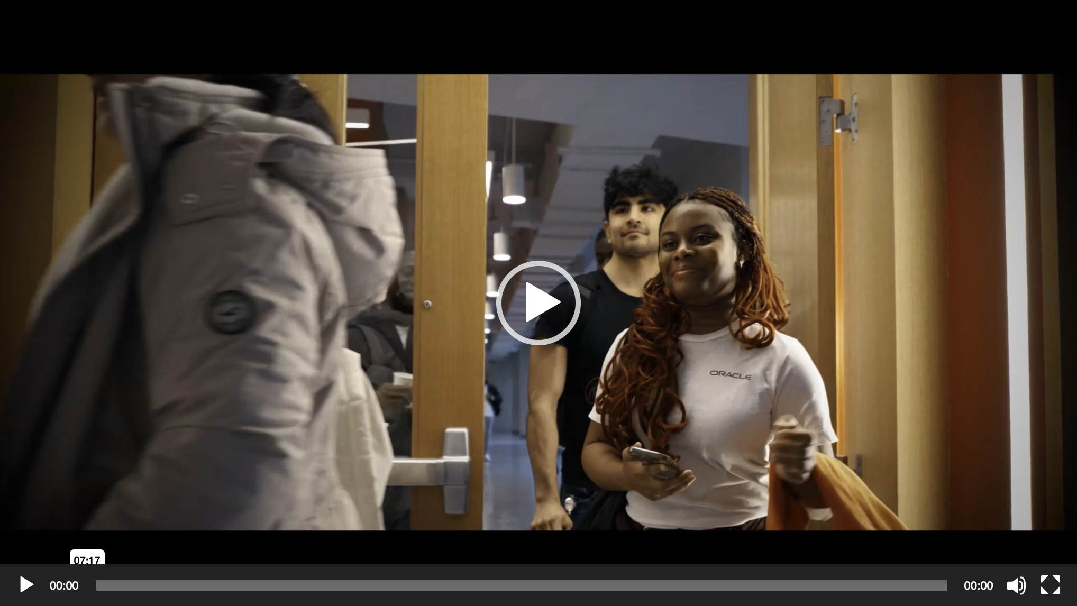
SPOTLIGHT ON…
Click image to view
Employee Engagement
Your team is your biggest asset – and we’re trusted to support them from on-boarding to reward & recognition
Global Tech, Data Centers, Early Careers and more: on- and off-line programs that build loyalty and longevity

Slide 11
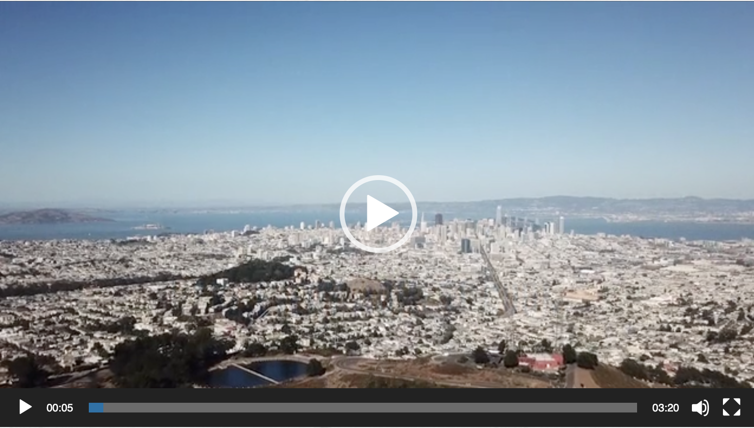
SPOTLIGHT ON…
Click image to view
Partner Engagement
Enhancing the Partner ecosystem by enablement, energy and engagement
Multi-platform on-line and live experiences to deliver better results and a more empowered Partner community

Slide 12
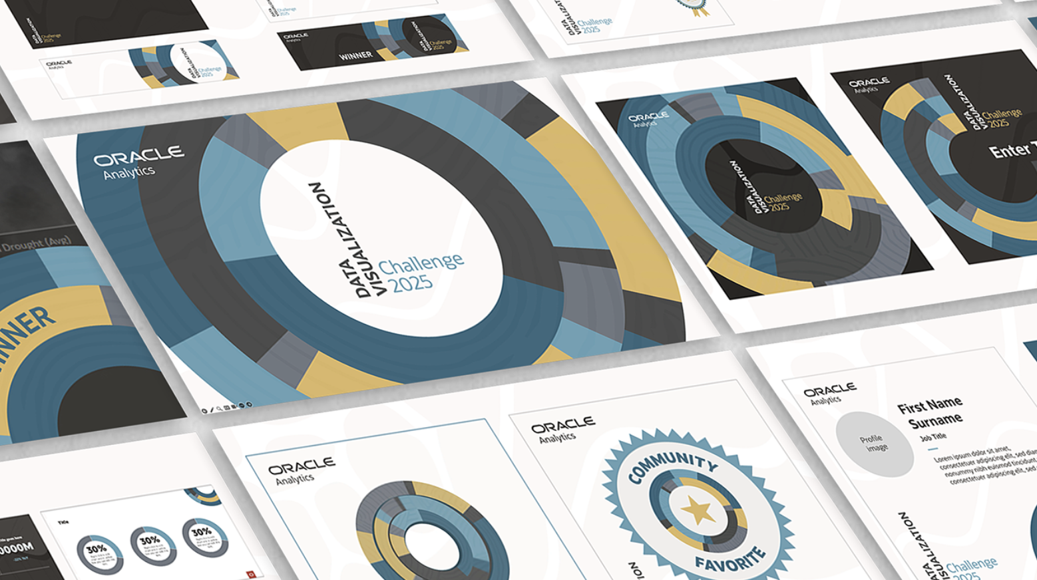
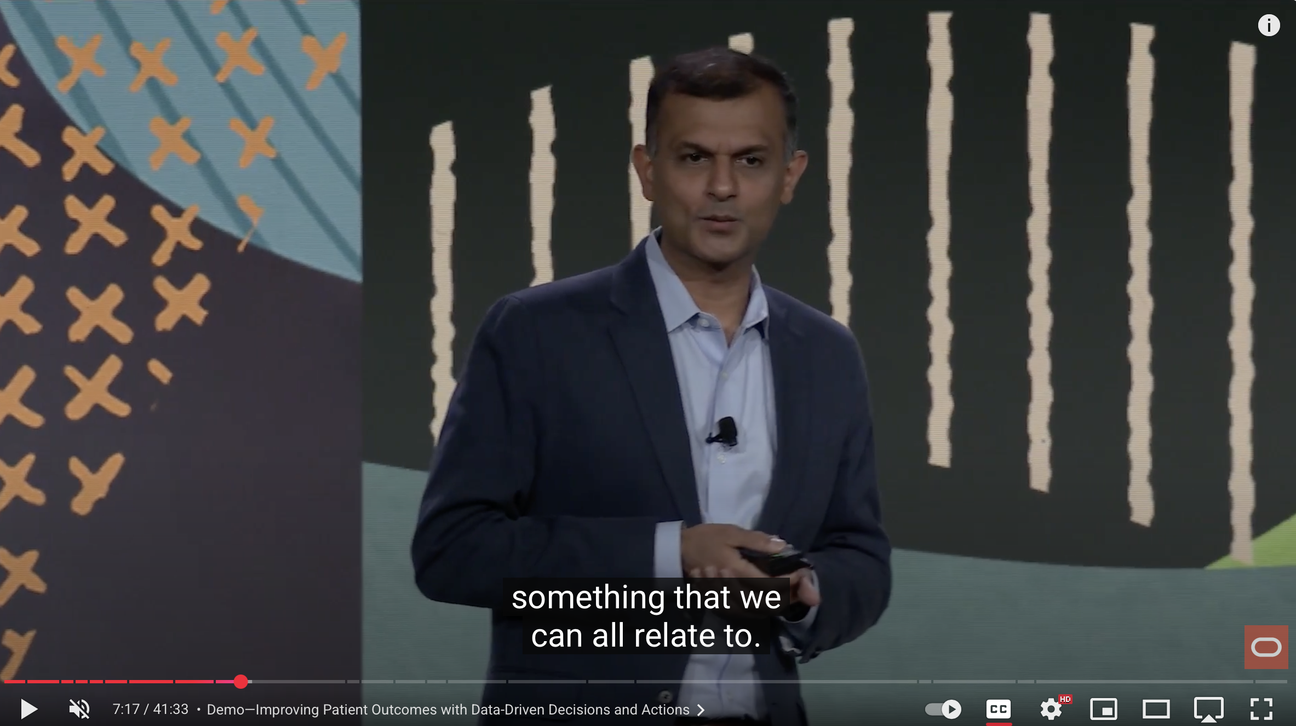
SPOTLIGHT ON…
Click image to view
Keynotes & Presentations
Decades of working with Oracle executives and teams around the world
The biggest stages, the highest stakes – we help Oracle put its best foot forward on every occasion
Trusted by your executive team on screen and on stage

Slide 13
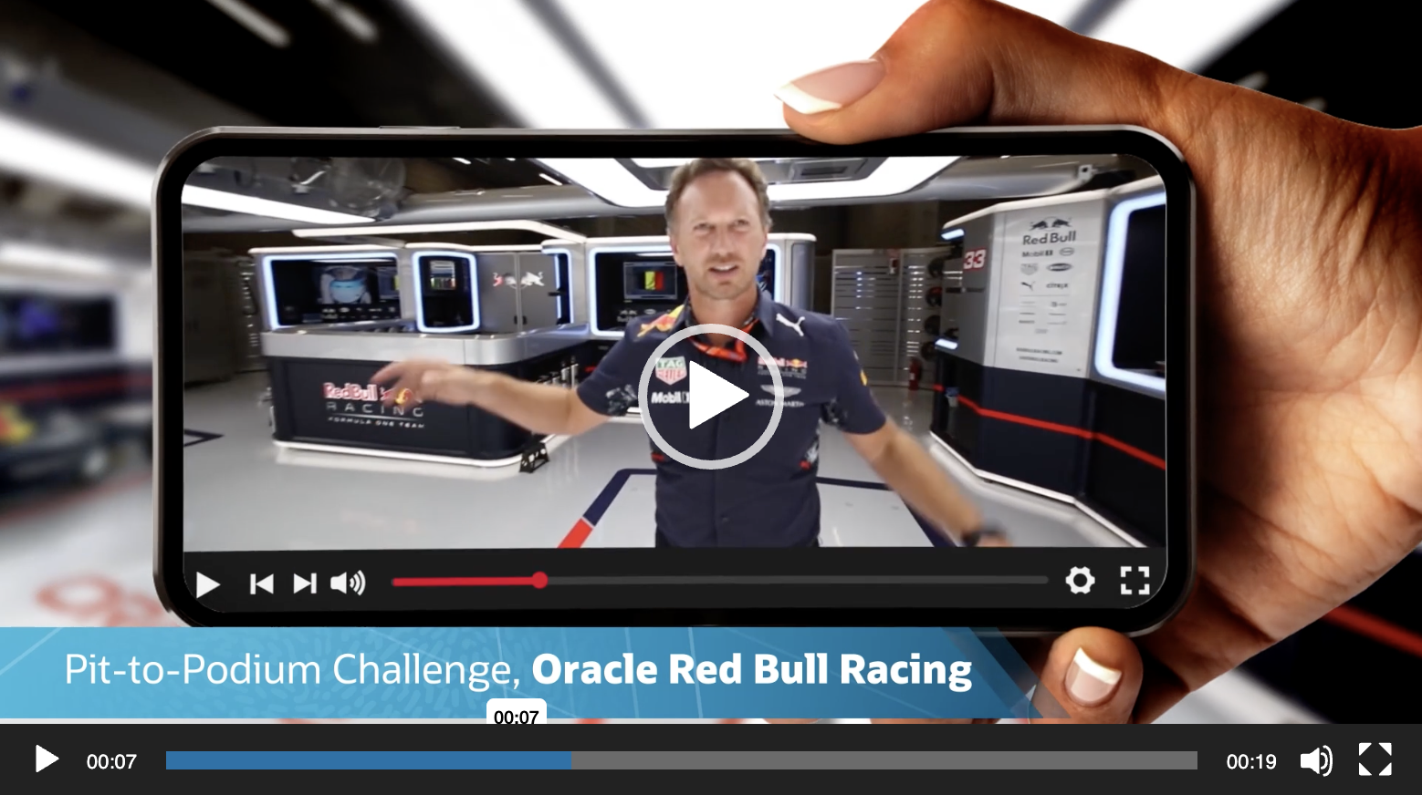
SPOTLIGHT ON…
Click image to view
Activations
Scalable, high-impact solutions that don’t just engage, they move the dial for you
World-wide capability to deliver incredible experiences and measurable ROI

Slide 14
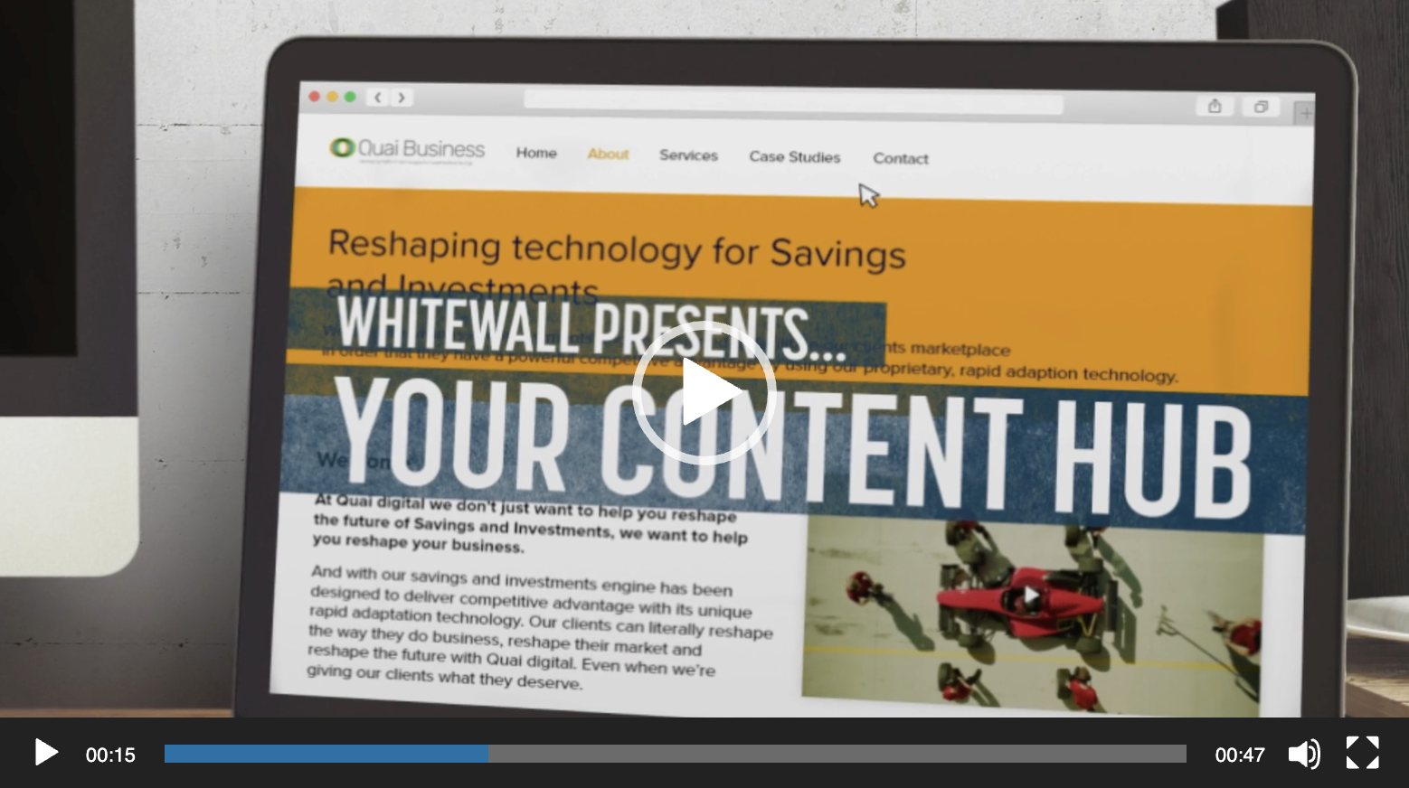
SPOTLIGHT ON…
Click image to view
DIGITAL HUBS
Maximizing ROI on content through user-friendly digital hubs
Original and repurposed content keeps the hub fresh and alive
Like having your very own streaming service

Slide 15
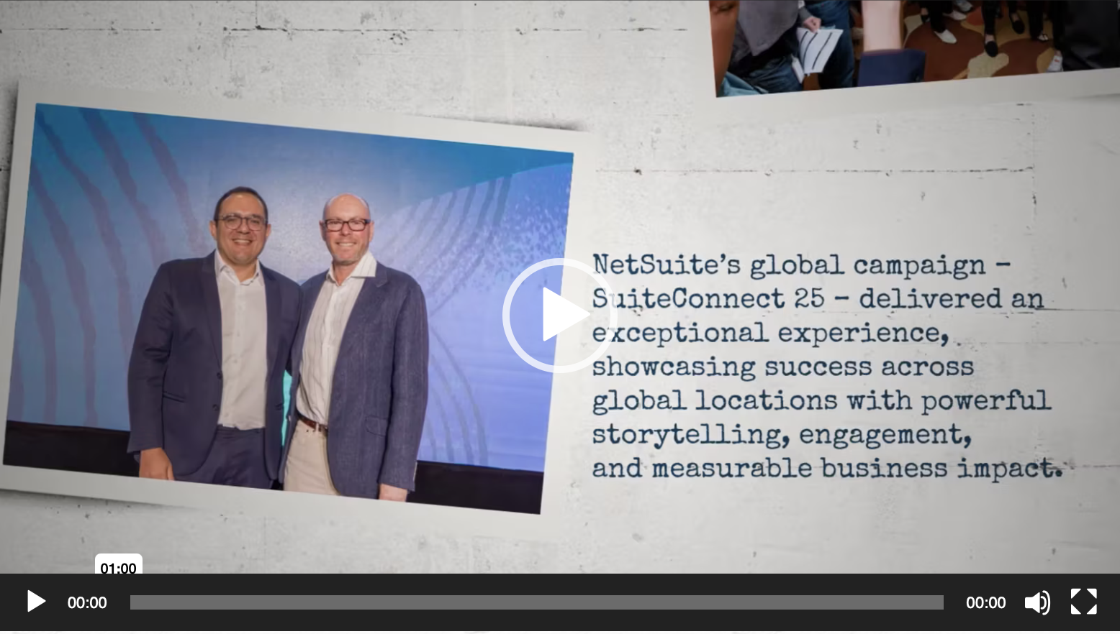
SPOTLIGHT ON…
Click image to view
Event Support
Supporting NetSuite’s global SuiteConnect program: logistics, production, expos and more
On-screen content that connects with your global audience

Slide 16
SPOTLIGHT ON…
Supporting NetSuite in:
London
New York
Sydney
Sao Paolo
Dubai
San Francisco
Singapore
Tokyo
Mexico City
Manila
Toronto
Bogota
Chicago
Melbourne

Slide 17
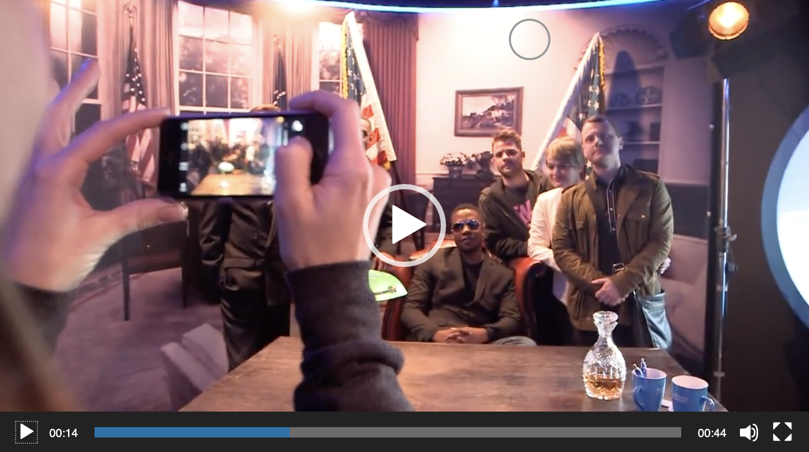
SPOTLIGHT ON…
Click image to view
BRAND ACTIVATIONS
Bringing your brand to life by bringing customers into your brand
Immersive experiences that surprise and delight as well as inform and persuade
Scalable solutions for any budget or location

Slide 18
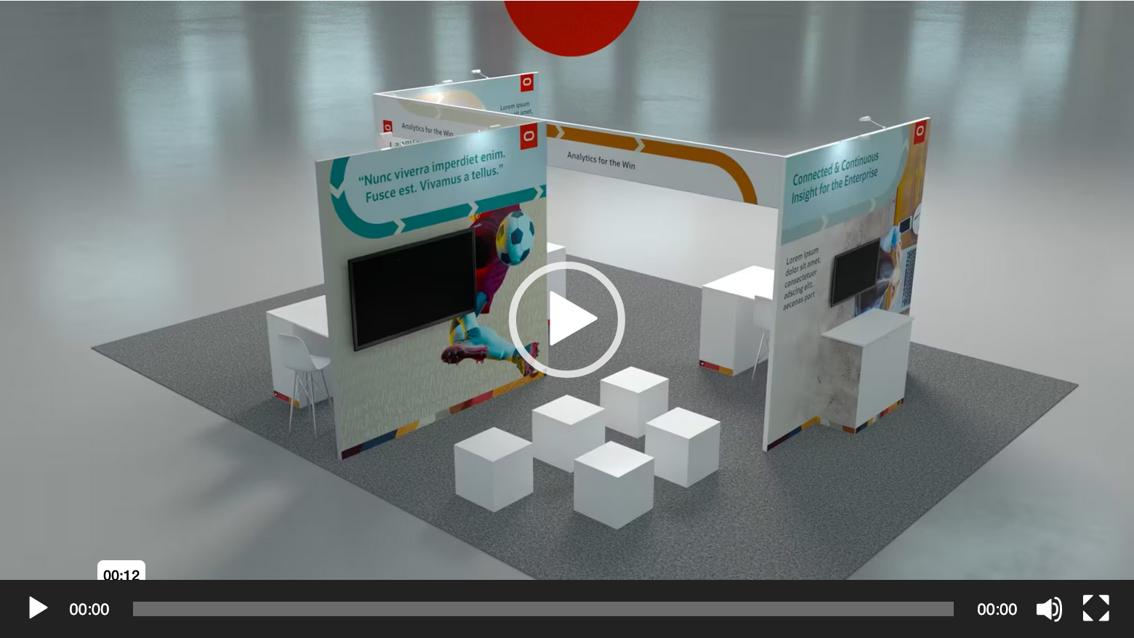
SPOTLIGHT ON…
Click image to view
EXPOS & TRADE SHOWS
Designing and building engaging spaces that captivate attendees and enhance brand presence
Developing impactful activations that turn show floors into dynamic, interactive environments, driving visitor engagement

Slide 19

SPOTLIGHT ON…
INNOVATION & CREATIVITY
Transforming ideas into impactful, creative solutions.
By combining cutting-edge technology and bold creativity, we deliver high-impact visual, digital, and experiential content. We help clients innovate through stunning design, immersive video, and engaging online experiences that stand out and drive measurable results.

Slide 20
SPOTLIGHT ON…
Click image to view
Video Production
Compelling, high-impact video that engages, informs and inspires
Live footage, graphics and animation blended seamlessly to tell your stories
Elevated content that showcases the best of Oracle and the Oracle brand

Slide 21
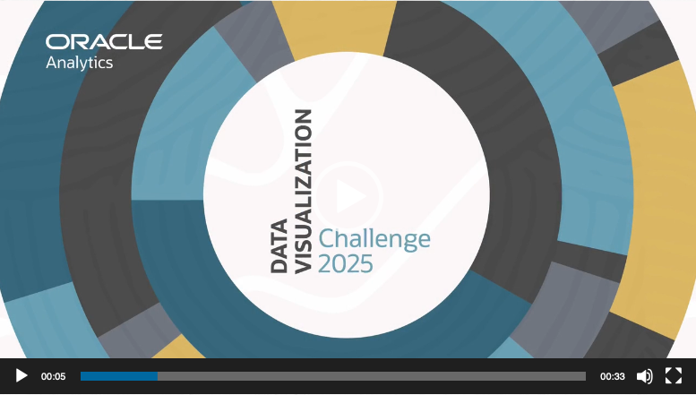
SPOTLIGHT ON…
Click image to view
innovation
Supporting the Oracle Analytics Data Visualization Awards through strategic content and creative direction
Highlighting excellence in data visualization with engaging narratives and impactful presentations that celebrate innovation

Slide 22
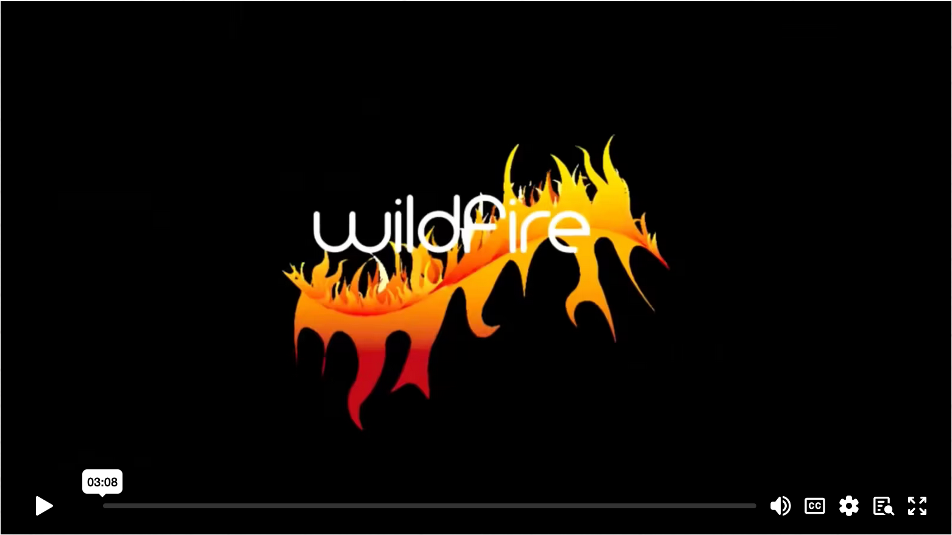
SPOTLIGHT ON…
Click image to view
INNOVATION
Designed and delivered the RBS Wildfire program: a ground-breaking enablement and employee engagement initiative
Driving transformative solutions and fostering a culture of innovation across the organization

Slide 23
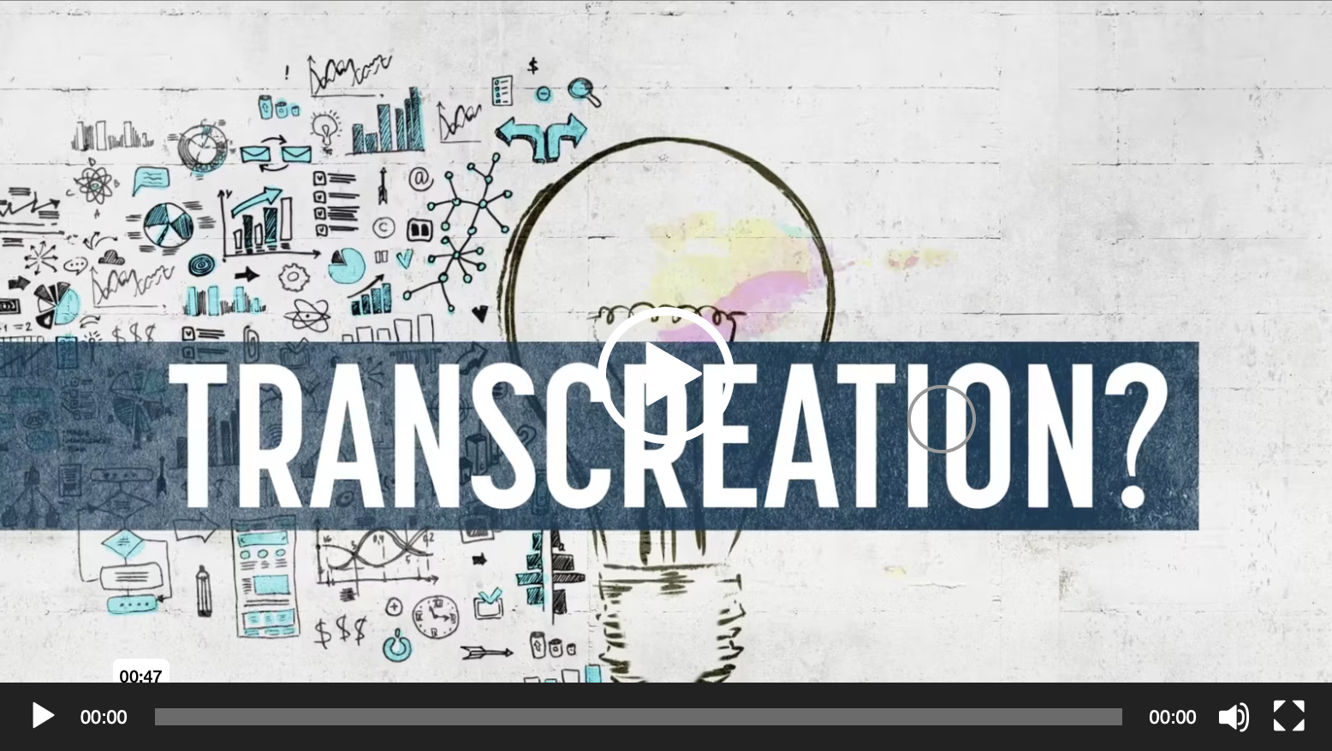
SPOTLIGHT ON…
Click image to view
Transcreation
Making complexity simple
From Analytics to Health Sciences, Data Centers to AI World, we’re bringing your ideas to life in ways that are clear, clean and comprehensible

Slide 24
SPOTLIGHT ON…
Click image to view
Design & Animation
Highly engaging visuals and animations that delight the mind and the eye - static, animated or interactive
Storytelling with a visual flair
Content that is flexible and multi-purpose – suitable for all media and platforms

Slide 25

SPOTLIGHT ON…
RECOGNITION & MOTIVATION
Inspiring teams and clients with unforgettable recognition programs.
We drive success through powerful reward and recognition programs that motivate. From global award shows to incentive campaigns, we create experiences that celebrate achievements, foster loyalty, and elevate performance at all levels.

Slide 26
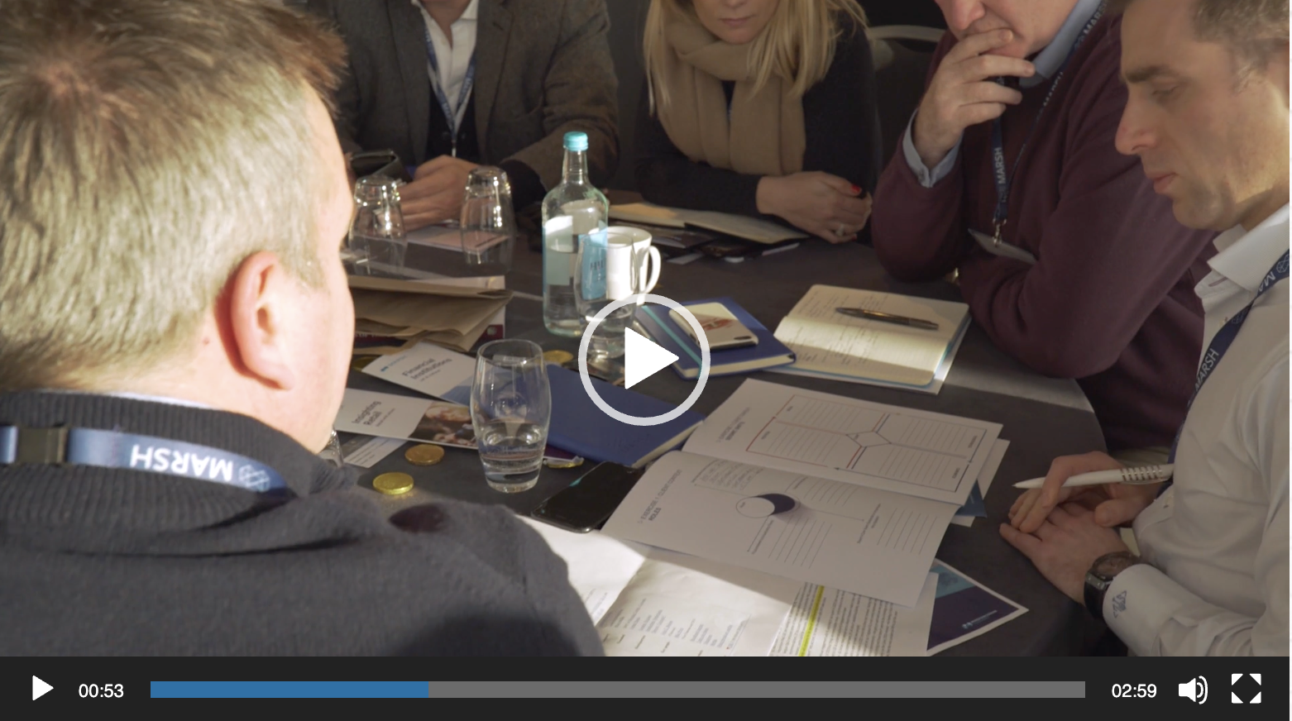
SPOTLIGHT ON…
Click image to view
SALES KICK-OFFS
Start your fiscal year as you mean to go on – with a clear vision and an engaged sales force
Content and delivery that embodies your key messages and drive revenue growth

Slide 27
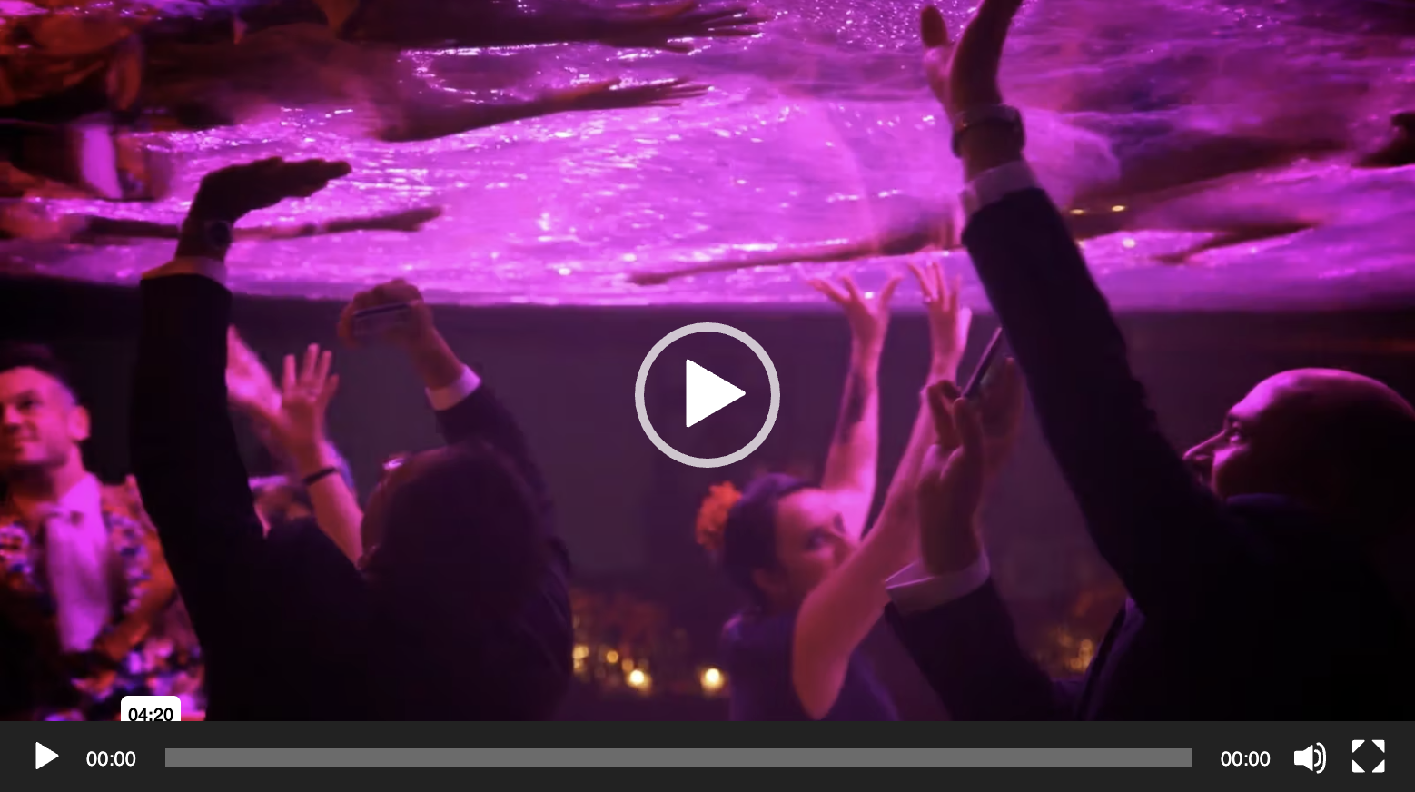
SPOTLIGHT ON…
Click image to view
INCENTIVE PROGRAMS
Reward and recognize your top performers with money-can’t-buy creativity
Programs that deliver long-term benefits in retention and employee loyalty
Access to creative talent like Tony and Olivier Award winners

Slide 28
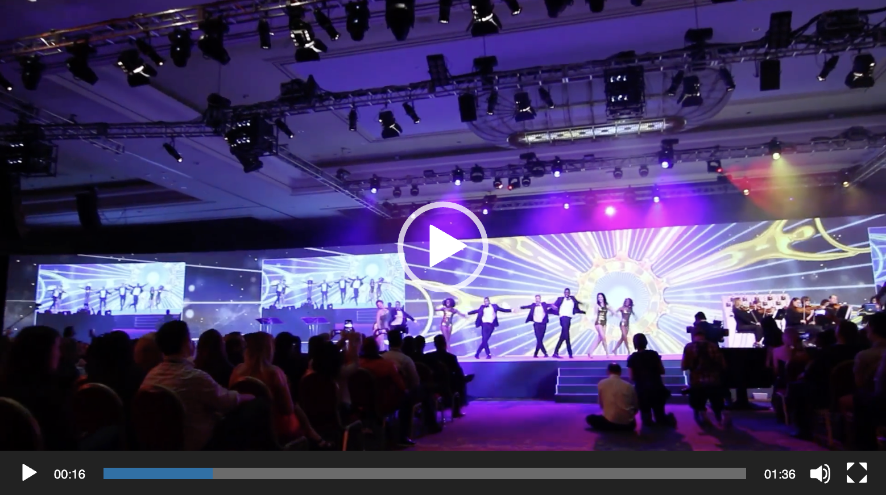
SPOTLIGHT ON…
Click image to view
AWARDS PROGRAMS
We know how to put on a show
Broadway-level talent both on- and backstage
On- and off-line programs that drive revenue growth and brand equity

Slide 29
SPOTLIGHT ON…
Click image to view
Reward & Recognition
Awards programs, campaigns and events to celebrate and inspire
Customers, partners and employees – we find the right way to drive continued success
On- and off-line solutions at a global scale

Slide 30

SPOTLIGHT ON…
Click image to view
REWARD & RECOGNITION
Creating show content and creative for the BAFTA Student Film Awards in LA
Delivering compelling narratives and innovative design to showcase emerging talent and celebrate excellence in film
Needs Weblink – BAFTA Highlights VT

Slide 31

SPOTLIGHT ON…
SPECIAL PROJECTS
Tailored solutions for unique challenges and opportunities.
From major global sports events like the World Cup to specialized campaigns, we take on complex projects that require precision and impact. We support clients in seizing unique opportunities with creative, on-brand solutions that resonate worldwide.

Slide 32

SPOTLIGHT ON…
Click image to view
CULTURE & INCLUSION
Engaging in live and on-line engagement with Oracle Women’s Leadership
Supporting diversity, equity, and belonging through Oracle Culture & Inclusion

Slide 33
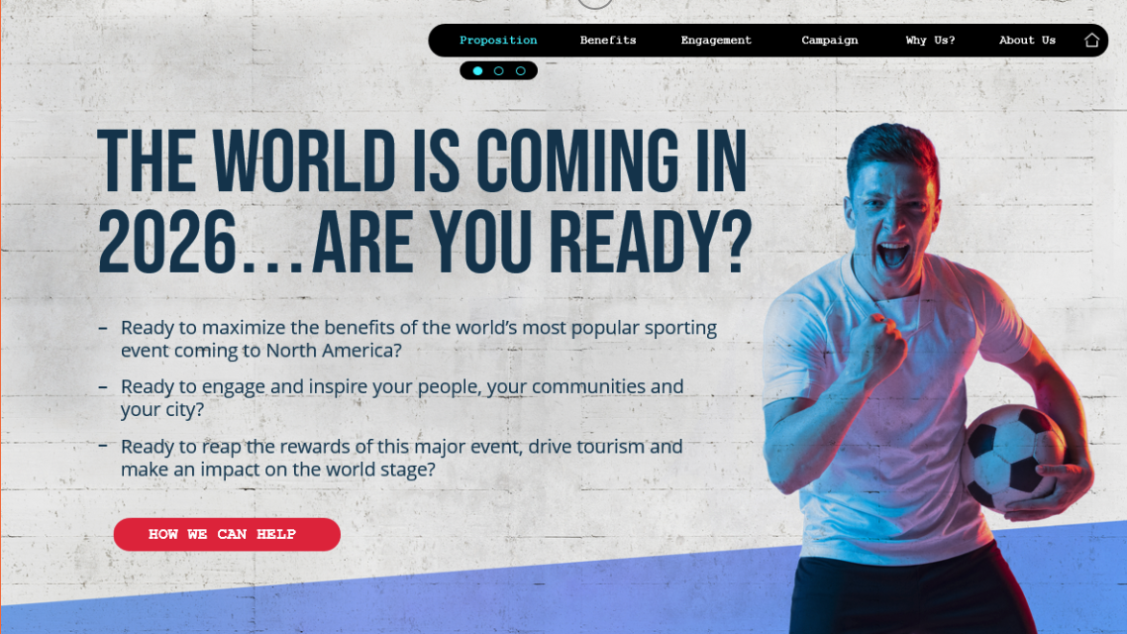
SPOTLIGHT ON…
Click image to view
WORLD CUP 26
Maximizing business opportunities around the 2026 FIFA World Cup ©
From activations to events, campaigns to fan zones, we’re setting clients up for success for the world’s most popular sporting event

Slide 34
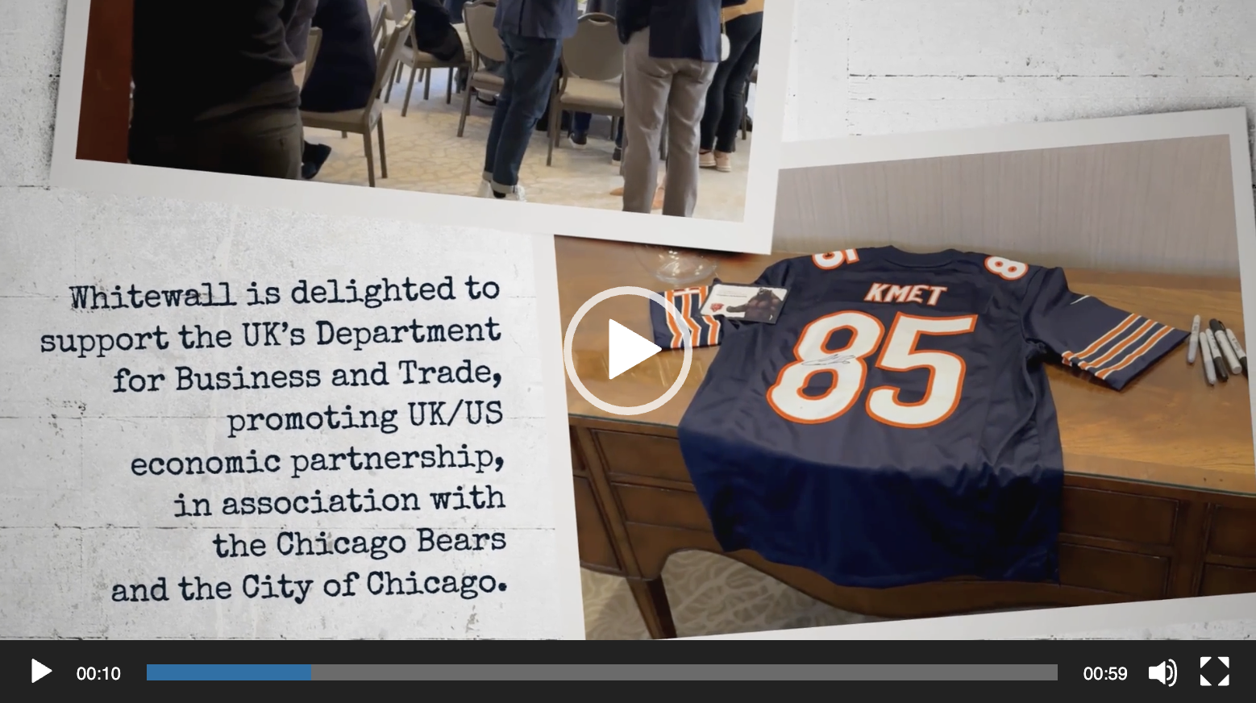
SPOTLIGHT ON…
Click image to view
INTERNATIONAL TRADE
Bringing together business and government to drive mutual investment and generate growth
Experts in helping brands tell their stories in overseas markets – with special emphasis on US/UK

