Slide 1
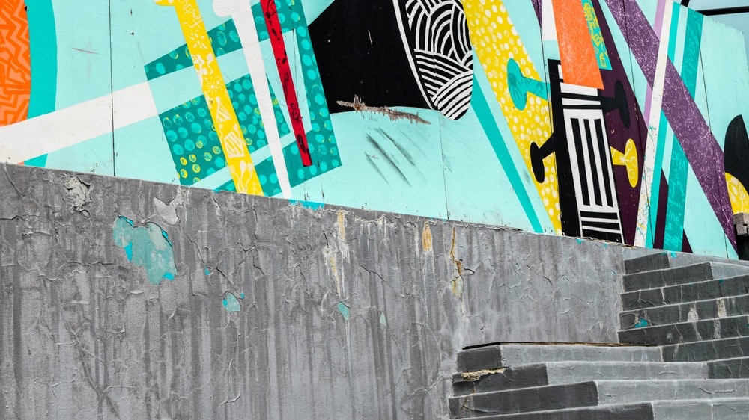


Slide 2

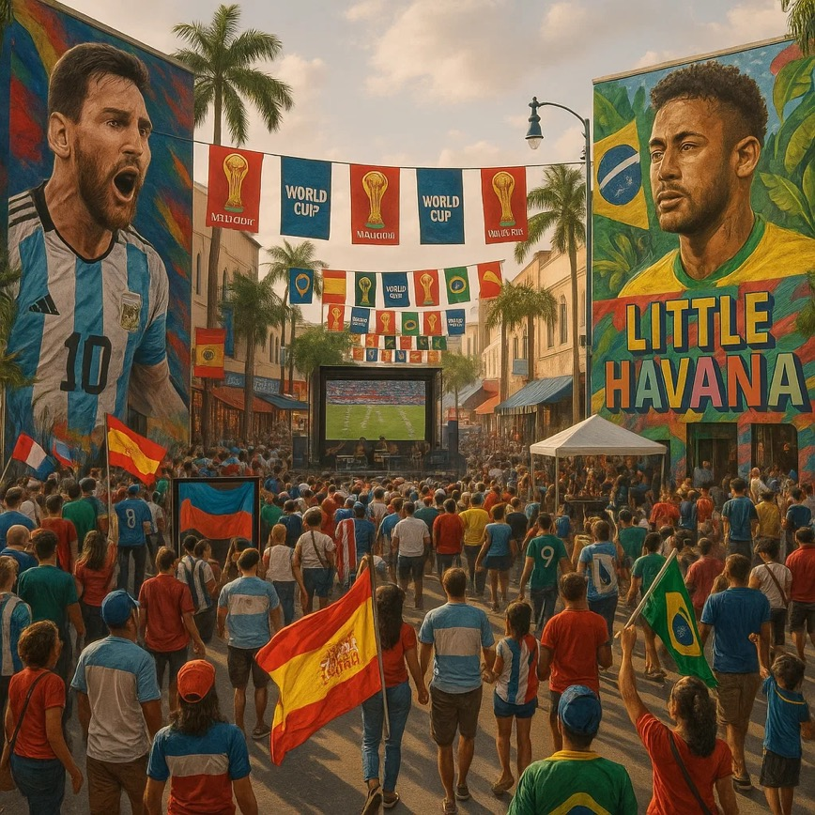

Why Whitewall Creative?
We are Whitewall — an independent creative and experience agency that turns audiences into fans through storytelling, design, and spectacle.
Global mindset, boutique agility
Deep roots in cultural storytelling and sport
Studios in London, East and West Coast US, and worldwide partner talent
Visit our website here:
www.whitewallcreative.com

Slide 3
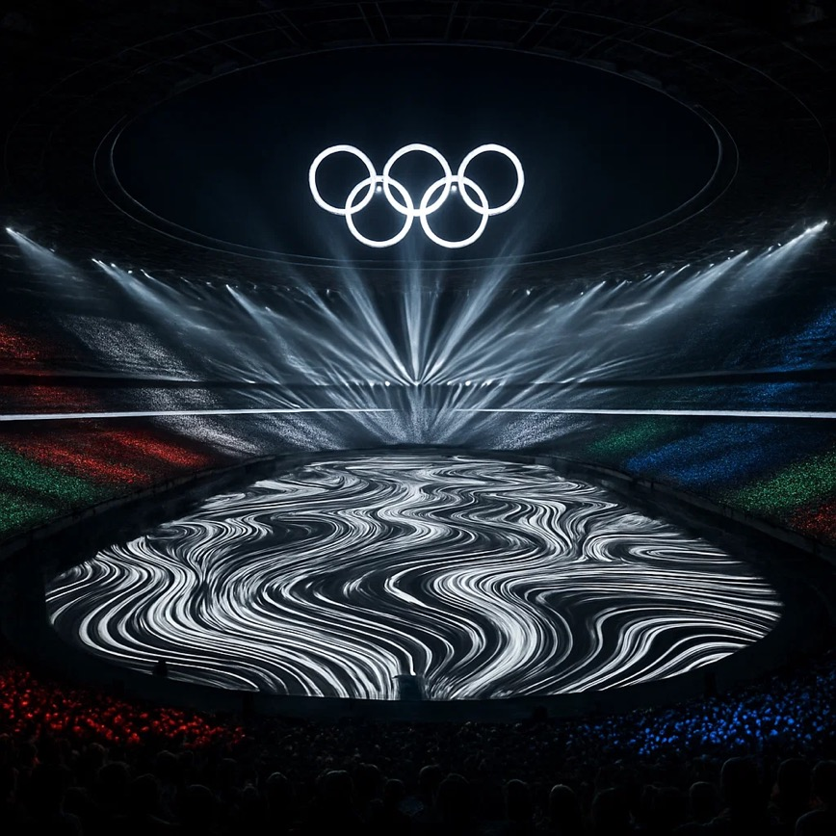
GLOBAL CREDENTIALS
We design global moments.
Our team has delivered creative and experience programs for:
Olympic Games (London 2012)
Iconic moments like Royal Weddings, Glastonbury Festival and the Coronation
Live engagement activations for Netflix
See our Netflix activation here:
FanBox

Slide 4
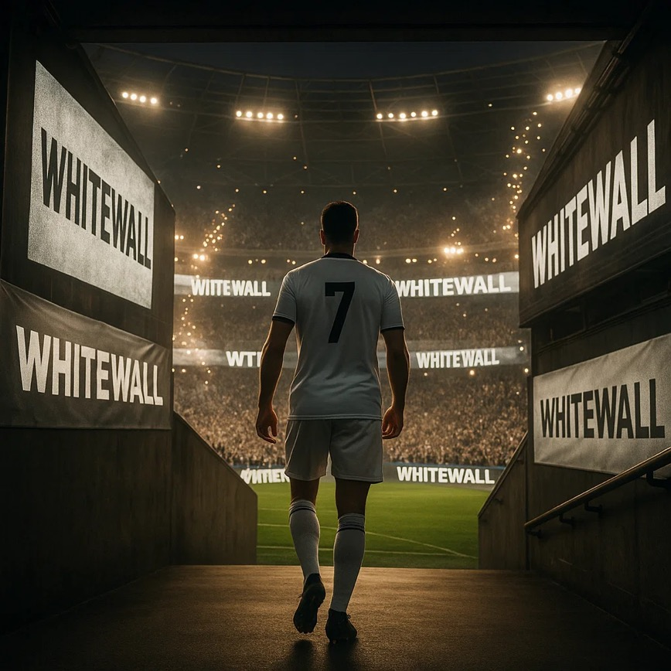
WE KNOW SOCCER
Football isn’t just a sport. It’s culture, identity, connection.
We live it — as players, fans, and storytellers.
We know the energy of a locker room and the silence before a penalty.
We know which kits matter, which chants stick, and where the stories are.
We speak fluent fan, from terrace to TikTok.
Visit our LinkedIn football community page here:
Whitewall Winning Together

Slide 5
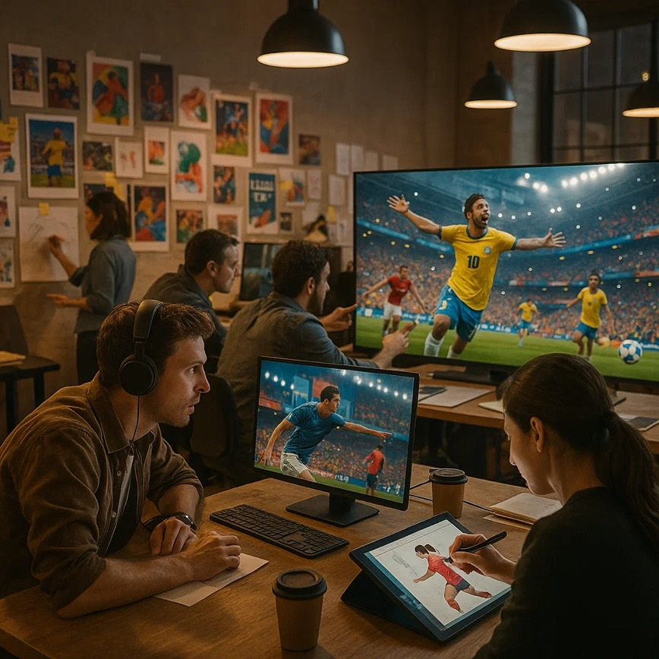
WHY WHITEWALL
We bring:
Elite Creative Talent: World-class directors, designers, writers, and editors.
Embedded Partnership: We work as an extension of your team, not just a vendor.
Football-First Culture: We live the game — in our team, our campaigns, our weekends.
Check out our Creative reel here:
Whitewall Creative

Slide 6
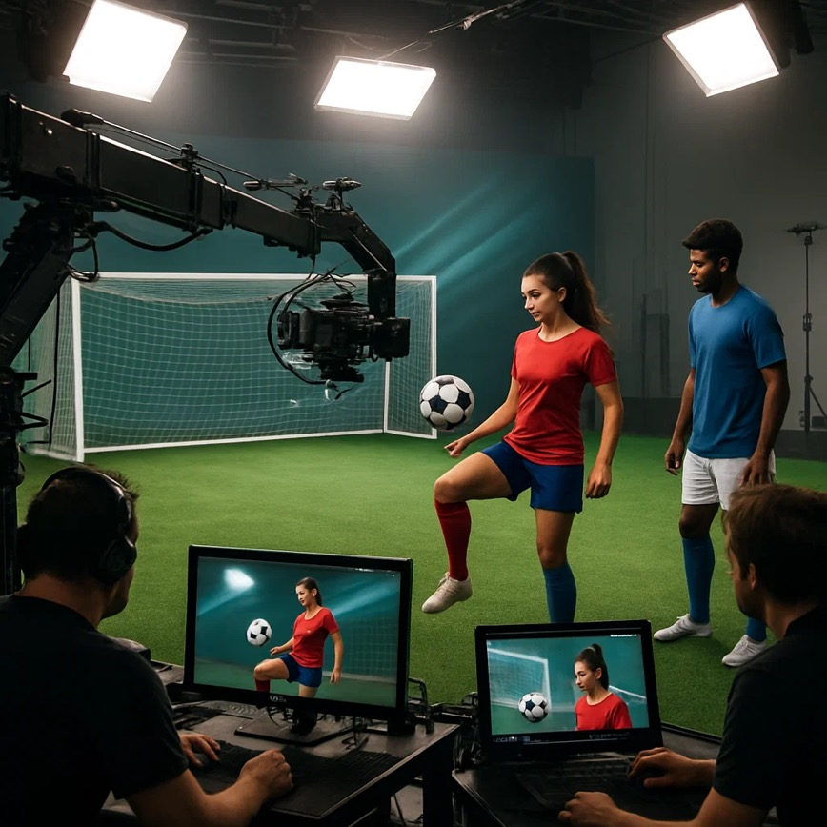
Content & Craft
Branded content and campaign creative
Digital and social-first storytelling
Live event creative & staging
Toolkits for partners, ambassadors and cities
All world-class. All FIFA-ready.
See how we’re helping FWC26 host cities here:
Are You Ready?

Slide 7
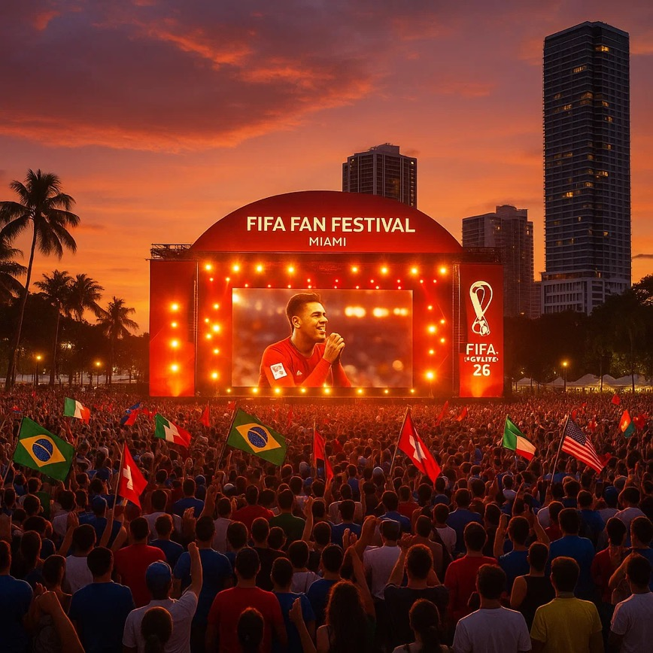
Next play
We’re ready to step onto the pitch.
Let’s make Miami’s World Cup unforgettable.
whitewallcreative.com | @whitewallcreative

