Slide 1



Slide 2

Enhancing Reach & Impact
From Whitewall, Oracle’s creative thought partner.
This document presents a set of ideas to enrich and extend the Oracle Global Tech program, ensuring it delivers lasting impact beyond milestone events.
It explores ways to deepen engagement through new formats and activations, establish a central knowledge hub for alumni and leaders, build meaningful peer-to-peer connections, and sustain momentum with always-on content delivered through Slack.
The intention is simple: to give Oracle Global Tech greater reach, stronger visibility, and enhanced impact — positioning it as a flagship development experience that empowers participants, celebrates alumni, and inspires the community now and well into the future.

Slide 3
Enhancing Reach & Impact
1. Greater Reach
Multiple touchpoints (events, hub, Slack, buddies) keep participants and alumni engaged wherever they are.
Consistent visibility across platforms (oracle.com + Slack) broadens program awareness.
Alumni voices amplified through stories, spotlights, and peer challenges.
2. Enhanced Impact
Richer content mix: live conversations, on-demand resources, FAQs, and exec insights.
Deeper connections through buddy matching and community discussions.
Continuous learning with micro-drops and expert Q&A in between milestones.
Stronger sense of belonging to a global Oracle community.
The Result:
An always-on ecosystem that delivers not just information, but insight and connection — sustaining engagement long after milestone events and positioning Oracle Global Tech as a flagship development program.

Slide 4
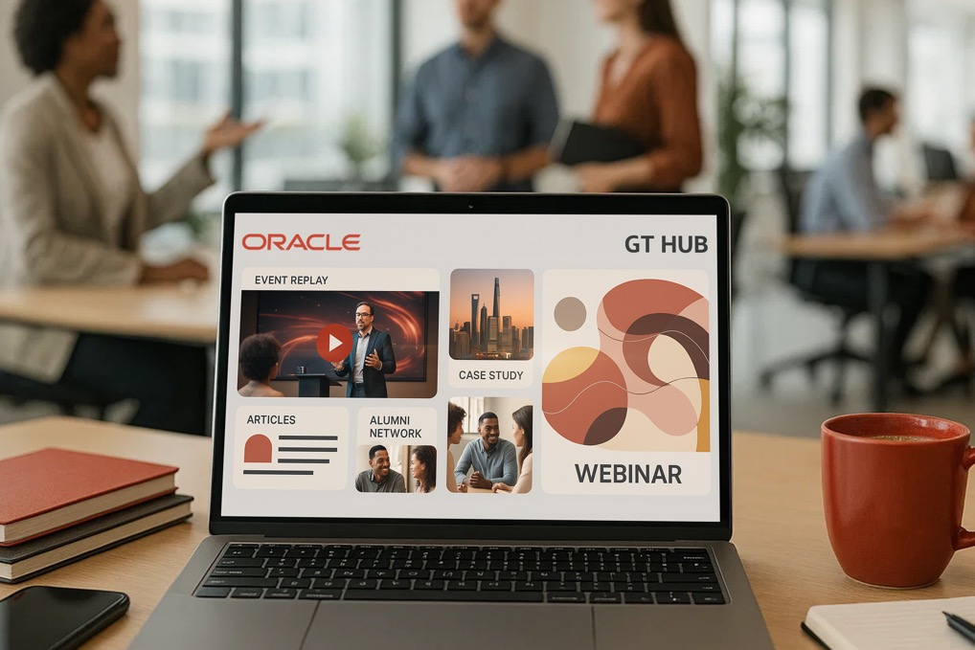
The Oracle Global Tech Community Hub
What it is:
A dedicated space on oracle.com where current participants and alumni can connect, learn,
and access program content.
Features:
Highlights from Energize sessions
Interviews with Oracle execs
FAQs and alumni insights
“Ask Me Anything” responses from leaders
Resource library of articles and toolkits
Why it matters:
Extends the value of live events
Fosters collaboration and shared growth
Keeps the Oracle Global Tech community active and connected

Slide 5
Energize!

Slide 6
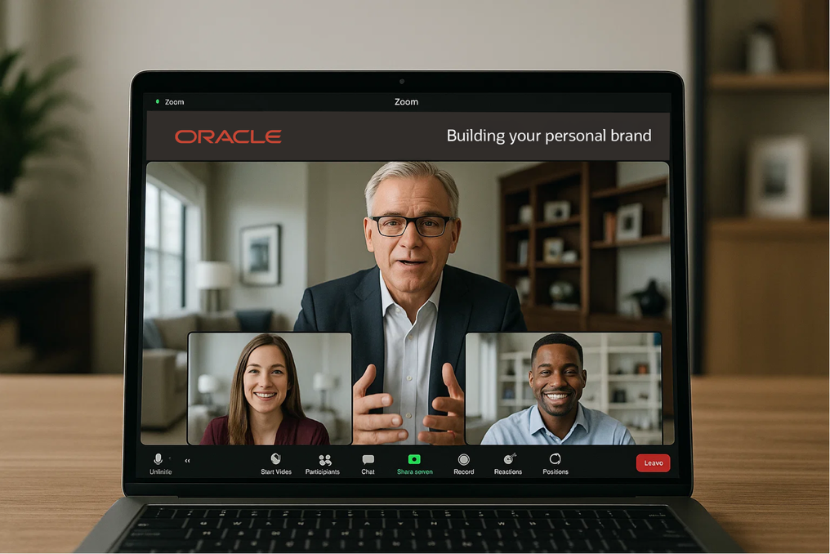
Energize: Oracle Global Tech Alumni & Exec Conversations
What it is:
A 30-minute, interactive Zoom series connecting participants with Oracle leaders and program alumni.
Format:
1 Executive + 2 Alumni panel
Topic-driven (e.g. Getting Ahead at Oracle, Your First Appraisal, Building Your Personal Brand)
Pre-submitted audience Q&A
Why it matters:
Insider perspectives on career growth
Practical, actionable strategies
Builds connection and confidence

Slide 7
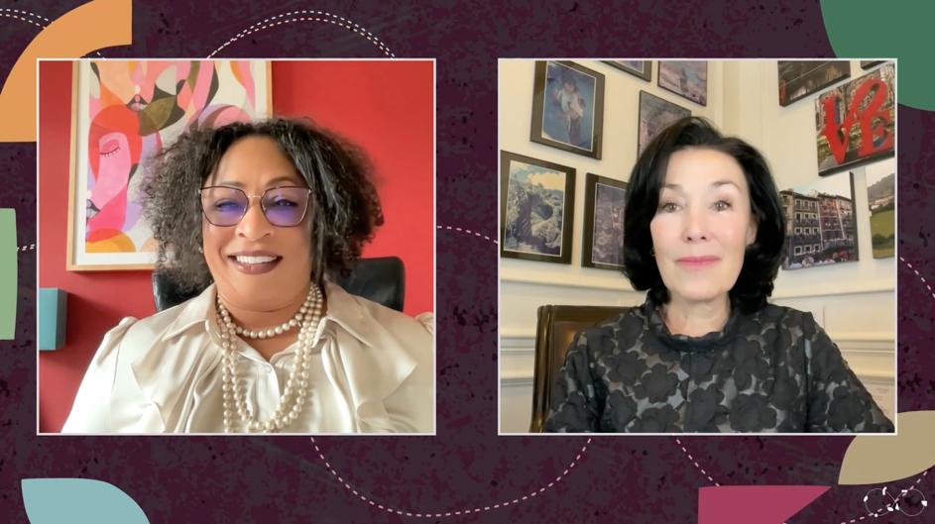
Media Options Explained
Pre-Recorded Video – Longform
Scripted/ prepared video content recorded remotely by a Whitewall Producer.
This would be edited into a broadcast media asset that could be streamed simulive
or placed on a content hub for download/access.
Live Video Content
Live video content recorded remotely or onsite.
The content is mixed live and streamed out to a media site. This can also be recorded for later or simulive use.
It is possible to create Live Video Content through zoom or other video conference software, however branding options and technical quality are reduced.
Oracle D&I
Click here to view the video

Slide 8

Leadership Shadow & Coffee Chats
What it is:
Direct interactions with Oracle leaders via virtual coffee chats and shadow sessions
Why it matters:
Builds inspiration, visibility, and trust in leadership
Helps new hires see real decision-making and culture in action
Encourages early mentorship relationships
How it works:
Quarterly schedule pairing OGT cohorts with execs
30-min group coffee chats (global) and half-day shadows (local)
Debrief sessions to share key takeaways

Slide 9
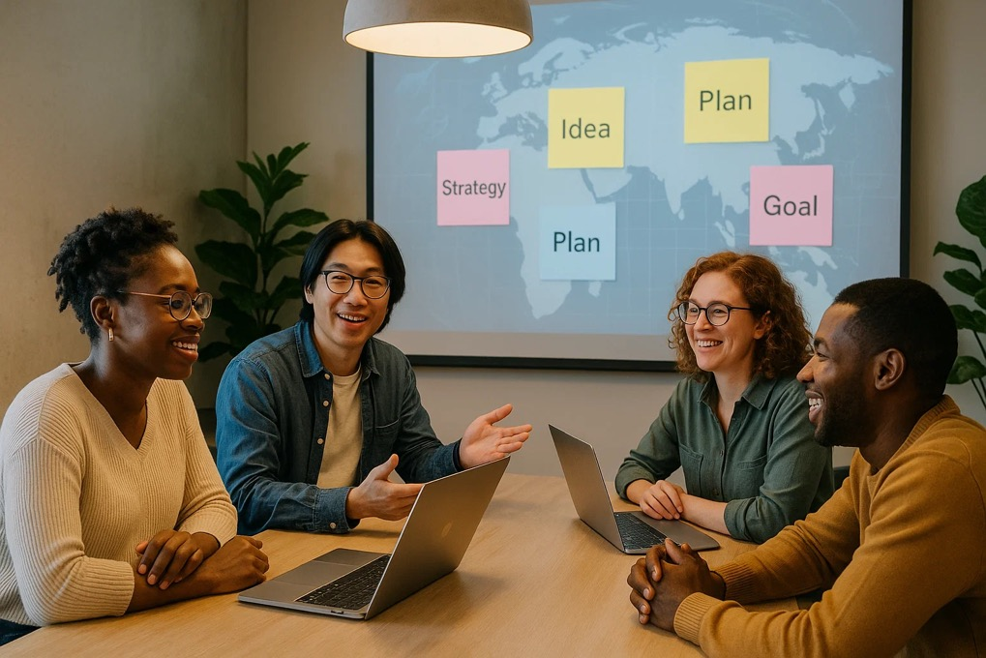
Peer Learning Circles (Mastermind Pods)
What it is:
Small, recurring peer groups that meet to share learning and challenges
Guided by alumni or local mentors
Why it matters:
Builds supportive networks across functions and geographies
Reinforces program learnings through discussion and practice
Creates lifelong peer connections
How it works:
Pods of 4–6 new hires meet biweekly
Discussion prompts from the OGT team (skills, values, goals)
Shared Slack threads for continuity and collaboration

Slide 10

Technical & Soft Skills Bootcamps
What it is:
Intensive workshops focused on Oracle-relevant tech and career skills
Combines certification prep and applied team projects
Why it matters:
Builds confidence and job readiness
Reinforces learning through real-world application
Signals Oracle’s commitment to early career development
How it works:
Monthly get-togethers
Tracks include Cloud, AI, Project Management, Communication
Certification and recognition badges awarded on completion

Slide 11
SYNCHRONIZE!

Slide 12
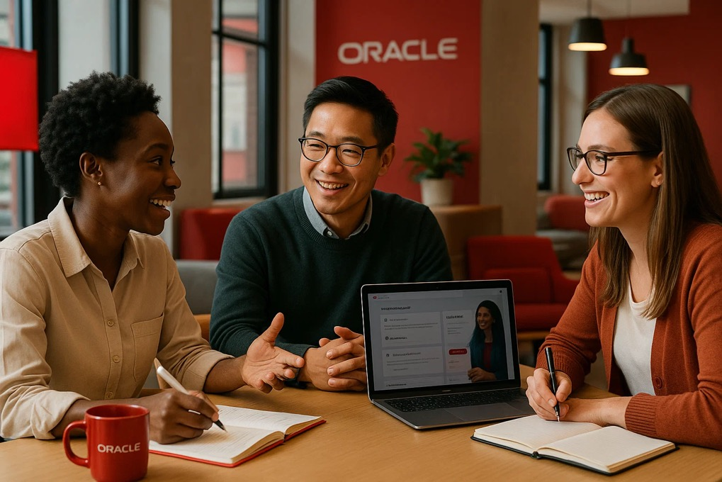
Synchronize: The Oracle Global Tech Buddy Program
What it is:
A peer-to-peer support network that connects program participants and alumni for mentorship and camaraderie.
How it works:
Smart matchmaking by goals, interests, or career stage
Informal mentorship and knowledge-sharing
Flexible structure (coffee chats, check-ins, project tips)
Why it matters:
Strengthens alumni bonds
Provides informal coaching and encouragement
Builds lasting networks of support

Slide 13

Gamified On-boarding Journey & Badges
What it is:
A game-like onboarding experience with quests, challenges, and badges
Tracks key milestones across the first 90 days
Why it matters:
Makes learning and orientation engaging
Encourages participation and progress tracking
Creates a sense of friendly competition and shared momentum
How it works:
Integrated via Slack bot or web dashboard
Badges for completing trainings, meeting mentors, joining events
Leaderboards and local “Badge Champion” celebrations

Slide 14

Innovation Hackathon Challenge
What it is:
Global and regional hackathons for OGT participants and alumni
Cross-functional teams solve real Oracle challenges in short sprints
Why it matters:
Harnesses fresh perspectives and creativity
Builds collaboration and technical problem-solving
Creates visibility and early wins for new hires
How it works:
Quarterly events (virtual + local) themed around Oracle tech or culture
Teams present prototypes to exec judges
Winning ideas showcased internally and implemented

Slide 15
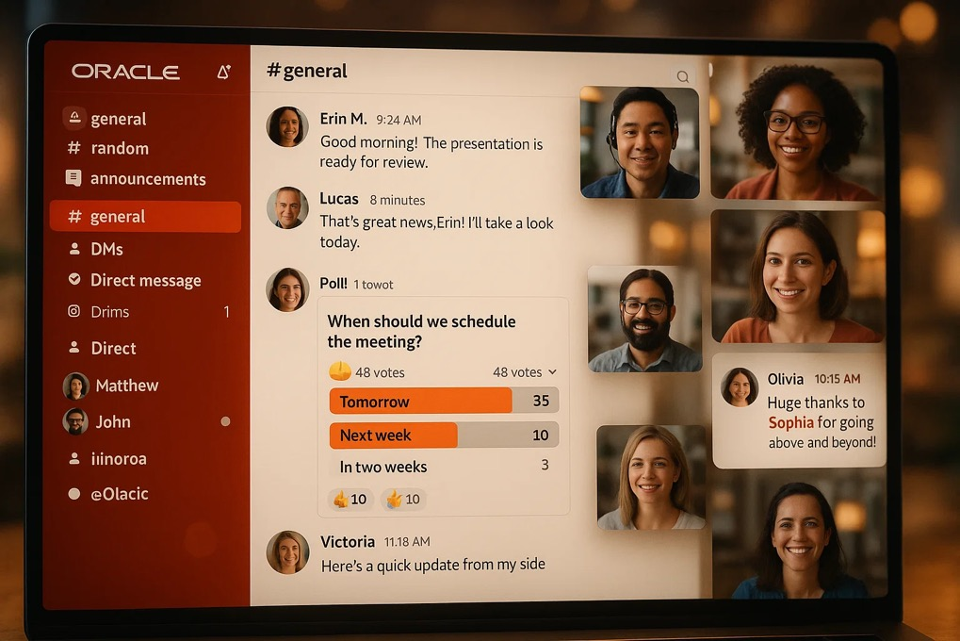
Engagement through slack
Dedicated Channel – central hub for updates, content, and reminders
Event Hype & Recaps – teasers before, highlights after
Snackable Content – quick tips, exec quotes, alumni spotlights
Interactive Prompts – polls, Q&As, discussion threads
Buddy Program Integration – easy check-ins for pairs/groups
Recognition & Shoutouts – celebrate active contributors
Why it matters:
Keeps communication light, regular, and engaging
Bridges live events with ongoing touchpoints
Makes Oracle Global Tech feel dynamic and connected every week

Slide 16
SYNTHESIZE!

Slide 17
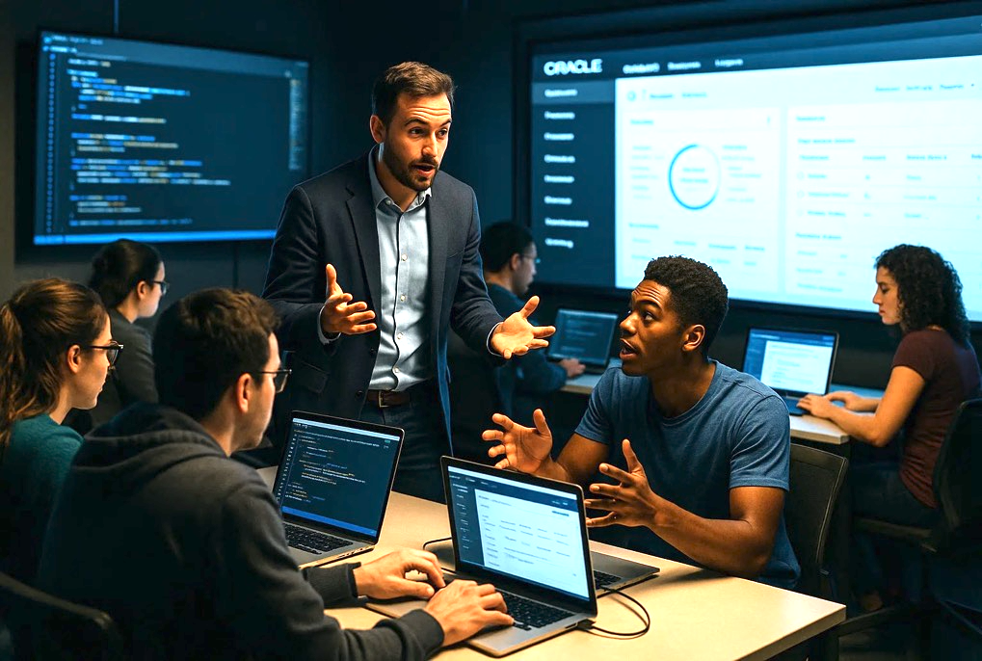
New Hire Showcases & Demo Days
What it is:
Regular forums for new hires to present learnings or projects
Opportunity to share work and ideas with peers and leaders
Why it matters:
Builds confidence, visibility, and communication skills
Encourages peer learning and recognition
Helps leaders identify emerging talent early
How it works:
End-of-cohort or quarterly events (virtual + in-person)
5-minute lightning talks or demos
Audience voting for “Innovation” and “Collaboration” awards

Slide 18
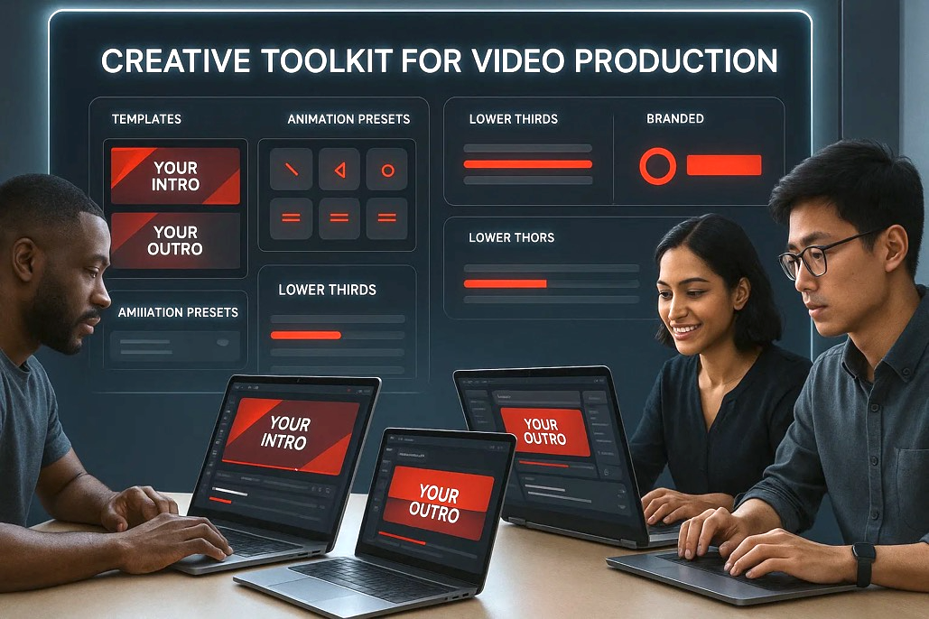
OGT Video Branding
Video Idents & Brand Pack
Creation of short branded video idents (intros and outros) for use across all video content. These ensure consistency of look and feel while remaining specific to video use.
Alongside this, a video brand pack would be developed. This would include lower thirds, audio and music recommendations, and a set of master animation asset style guides.
These elements provide a toolkit for editors and producers to keep all video content aligned with the brand identity, while also making it easier to scale content production quickly and consistently.

Slide 19
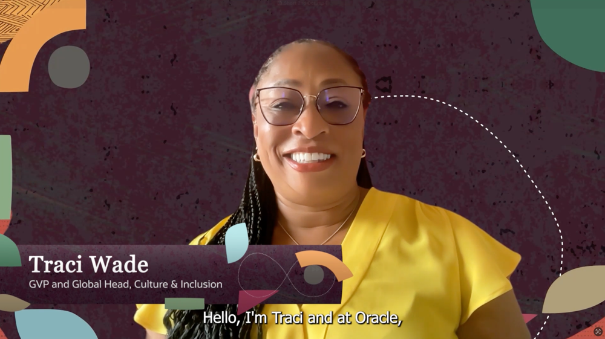
Media Options Explained
Pre-Recorded Video – Shortform
More informal video content recorded remotely by a Whitewall Producer.
This would be edited into a broadcast media asset that could be streamed simulive.
or placed on a content hub for download/access.
Live Video Content
Live video content recorded remotely or onsite.
The content is mixed live and streamed out to a media site. This can also be recorded for later or simulive use.
It is possible to create Live Video Content through zoom or other video conference software, however branding options and technical quality are reduced.
Oracle C&I
Click here to view the video

Slide 20
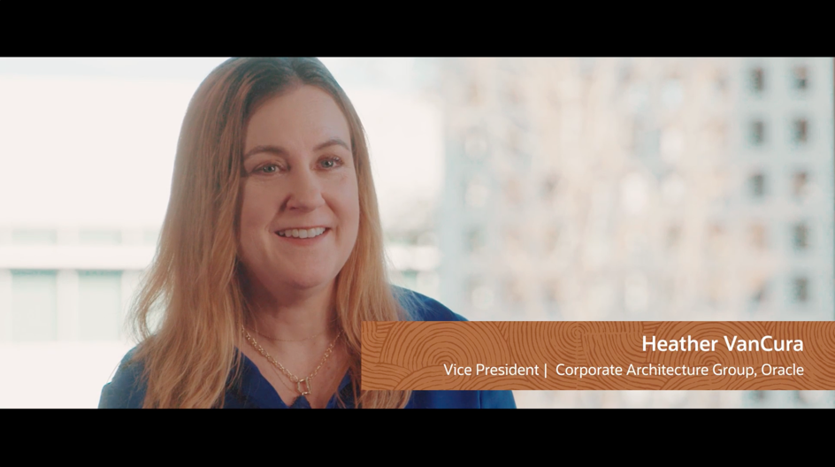
Media Options Explained
Podcast
Scripted/ prepared audio content recorded remotely by a Whitewall Producer.
This would be mixed down to provide a broadcast quality audio asset for use on a content hub.
Podcasts could be hosted by one of the OGT team or by an external host.
Ask Me Anything
This can be very accessible content, often hosted on Instagram, TikTok or Reddit. It allows much greater engagement in a slightly less formal environment.
Self Recorded Content
Participant of the program could self record and submit content. This is filmed on their cell phone and submitted. It would then be edited into a broadcast asset for use on a content hub.
Oracle Executive Film
Click here to view the video

Slide 21

Engagement Activations
High-Impact, Low-Effort Touchpoints:
Micro-Learning Drops – 2–5 min tips from alumni and execs
Spotlight Stories – monthly alumni profiles and journeys
Virtual Coffee Roulette – opt-in 1:1 networking matches
Ask the Expert – quickfire answers from Oracle leaders
Why it matters:
Sustains momentum between milestone events
Builds community connection and peer-to-peer learning
Keeps Oracle Global Tech “always on” in participants’ careers
International Women's Day
Click here to view the video

