Slide 1
OCI DATA CENTER
Phase 1 – Visual Language v1.0

Slide 2
Visual language
OBJECTIVE
To develop a unified visual language integrating identity and tone of voice that defines how Oracle Cloud Infrastructure (OCI) CORE will onboard and develop technical talent - visually aligned with Redwood, operationally aligned with reliability and experientially aligned with trust.

Slide 3



CORE: VISUAL LANGUAGE – naming hierarchy
Established Oracle Cloud Infrastructure brand architecture
Oracle framework to create sub-identity: Oracle Sans Semi Bold
Oracle Sans Light

Slide 4
CORE: VISUAL LANGUAGE – color theory
Tech & loyalty - Preferred option Blue anchors the palette in clarity, stability and trust. Grey adds neutrality and precision, grounding the composition. Yellow introduces energy and optimism, the spark of insight within the steady flow of data and information.
Grounded progress - Alternate option Rooted in the familiar OCI palette evoking a sense of grounded progress. Green symbolizes growth and continuity, grey steadies the tone and yellow offers a touch of energy, a nod to optimism within an established framework.
Ocean
Pebble
Sienna
Pine
Slate
Sienna

Slide 5
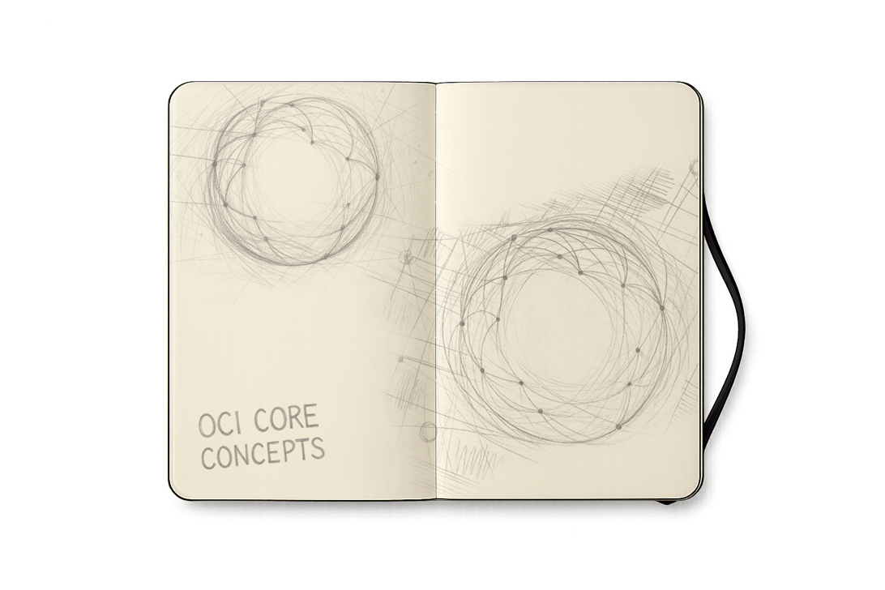
VISUAL LANGUAGE
Early exploration

Slide 6

CORE: VISUAL LANGUAGE – structure & framework
Building upon layers & organic structure

Slide 7
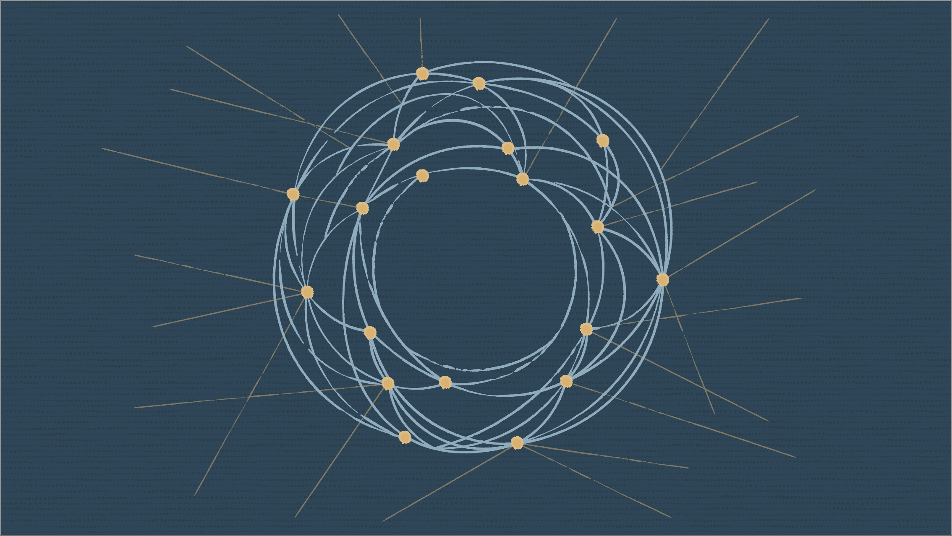
CORE: VISUAL LANGUAGE – structure & framework
Combined with a dynamic ‘Core’, reliability through connections

Slide 8

CORE: VISUAL LANGUAGE – structure & framework
Integrated into a layered, center-outward architecture, surrounded by connections of opportunity and growth

Slide 9
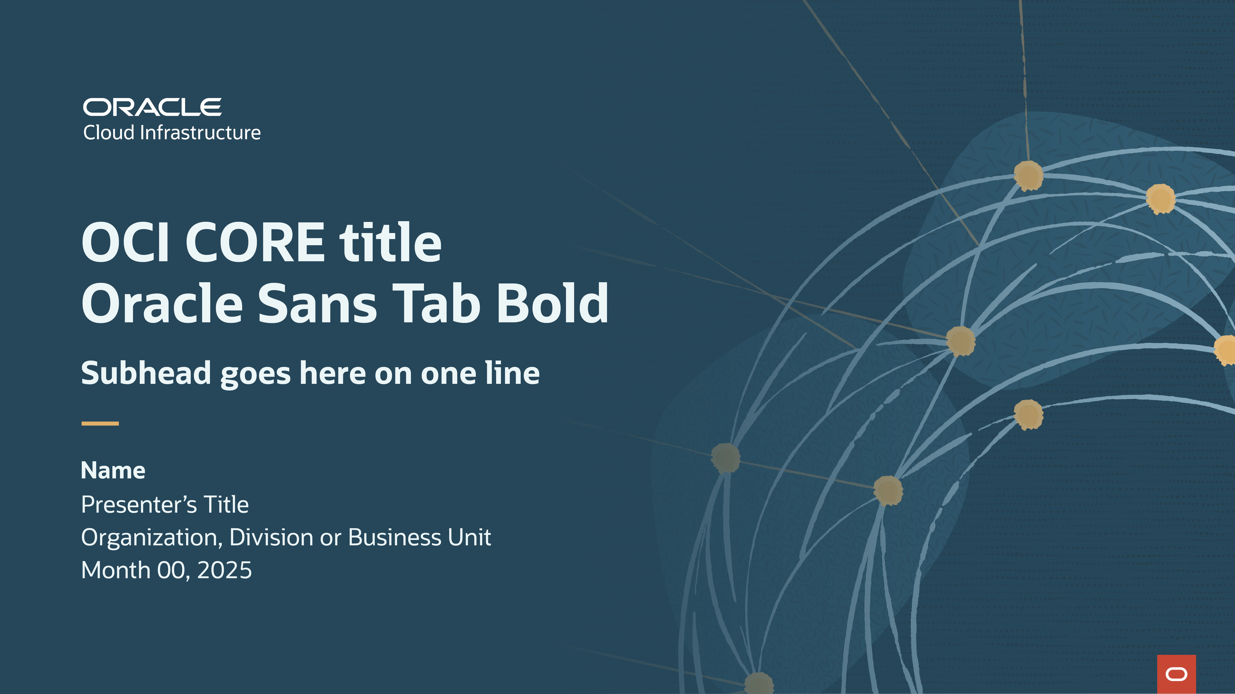
VISUAL LANGUAGE – HOW IT COMES TOGETHER
Rooted in Redwood’s established shapes and textures whilst drawing from the environment and energy of data centers

Slide 10
MAKE EVERY MOMENT COUNT

