Slide 1
PS2026 CREATIVE RFI RESPONSE
5 September 2025

Slide 2

WHY WHITEWALL?
Whitewall Creative is a full-service creative agency delivering integrated design, digital content, and event experience solutions. We can support you across all RFI categories: Event Photographers, Videographers, Apparel Designers, and Graphic Designers.
As a true one-stop-shop, we eliminate the risks of managing disparate vendors — inconsistent quality, fluctuating availability, and disjointed execution. Instead, our dedicated in-house team provides end-to-end creative services under one roof, ensuring consistency, speed, and accountability at every stage.
And the best thing about us? We are the perfect combination of Local and Global. With a base in State College, PA, we know your market and your people, but with our foundation in the soccer mad United Kingdom, we are uniquely placed to understand the amazing impact of this great sporting tournament.
Our people have worked on programs and events for, among others: Olympic Games, major FIFA tournaments, including previous World Cups, NCAA, NFL, Premier League (UK), the US Open Tennis and the MLS.
Whitewall has a proven track record of delivering creative campaigns and event production at scale. We bring the agility of a boutique agency together with the reliability of an established firm — this makes us the ideal partner for PS2026’s creative delivery.

Slide 3
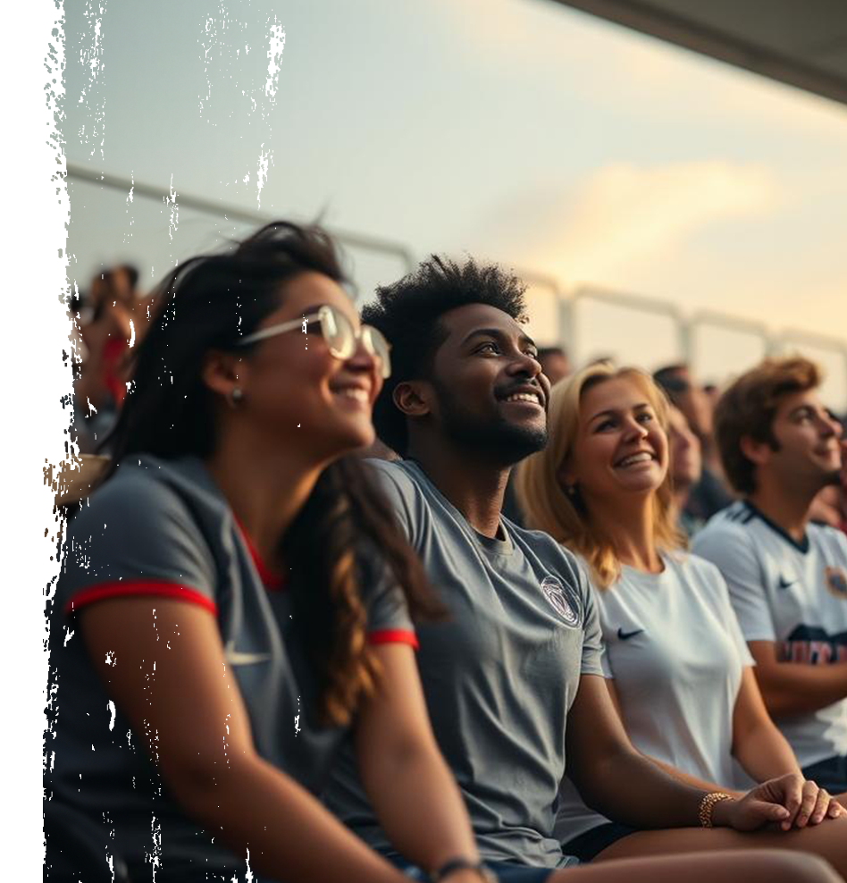
OUR APPROACH
Our approach is grounded, delivery-focused, and collaborative. We excel at delivering high-quality outputs at speed, under pressure, and at scale.
Integrated Team Leadership: Unified project teams led by experienced producers ensure all creative disciplines – design, film, branding, merchandise – align seamlessly.
Efficiency & Agility: Proven project management and multi-time-zone presence enable rapid turnaround without sacrificing quality.
Client-Centric: We act as an extension of your team – responsive, flexible, and solutions-oriented.
Quality & Compliance: Familiar with FIFA requirements; rigorous internal reviews ensure everything meets PS2026 standards.
Sustainability & DEI: Sustainable design practices and inclusive representation are embedded in our work, aligning with PS2026’s goals.

Slide 4
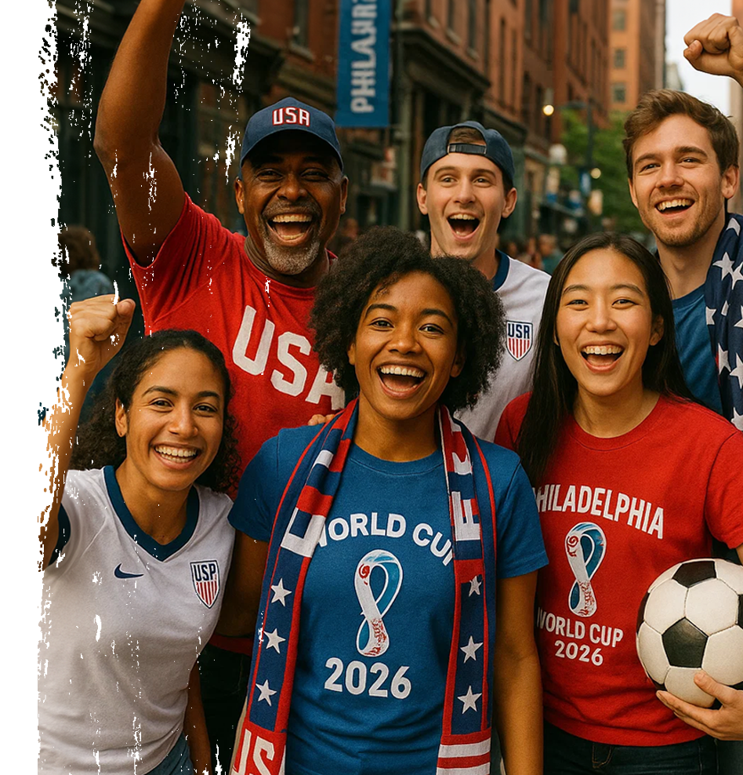
SERVICES & CAPABILITIES
Whitewall leverages professional-grade design, video, and collaboration tools to deliver efficiently.
Our structure allows us to scale quickly for projects ranging from small activations to festivals with 25,000+ attendees.
Graphic Design & Event Branding: Logos, identities, signage, and cohesive visual systems for events of all sizes.
Video Production & Motion Graphics: Event coverage, promos, social content, and animated graphics delivered at speed and in broadcast quality.
Apparel & Merchandise Design: Uniforms, fan apparel, and branded products – balancing creativity with production realities and sustainability.
Additional Capabilities: Copywriting, digital assets, and experiential design. We integrate multidisciplinary services under one roof for consistency and impact.

Slide 5

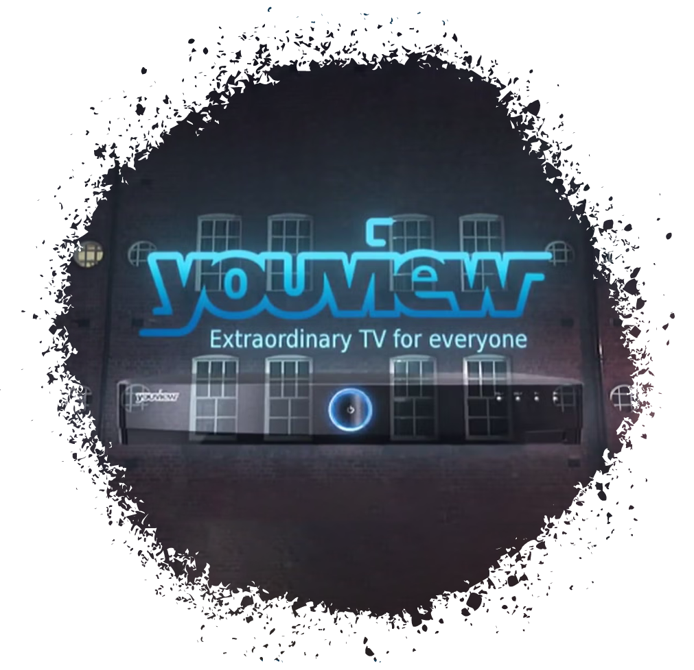


Relevant Experience
Click on
image
for link
Click on
image
for link
Click on
image
for link
Oracle SUITECONNECT 2025
YouView/ Netflix Activation
49ers Season Hype video
The global series of SuiteConnect events for Oracle involved thousands of built, printed, digital and photographic assets - Delivered on time across 7 cities in 13 weeks
Whitewall’s creative producers designed the perfect activation to engage the public in the youview/ Netflix partnership right in the heart of central London
Whitewall’s videographers
perfectly capture the excitement
that surrounds the opening of
another NFL season. Fan engagement
is a crucial part of this video

Slide 6

CONCLUSION
Whitewall Creative is eager to support Philadelphia Soccer 2026 with world-class creative services.
We offer the unique advantage of a single, trusted partner delivering graphic design, event branding, video production, and merchandise design under one coordinated team. Based in the US but with UK Soccer DNA we have the passion, skills and dedication to deliver a flawless service.
We thrive in the exciting, fast-paced environment of the lead-up to 2026 and look forward to contributing to Philadelphia’s success as a FIFA World Cup Host City!

Slide 7
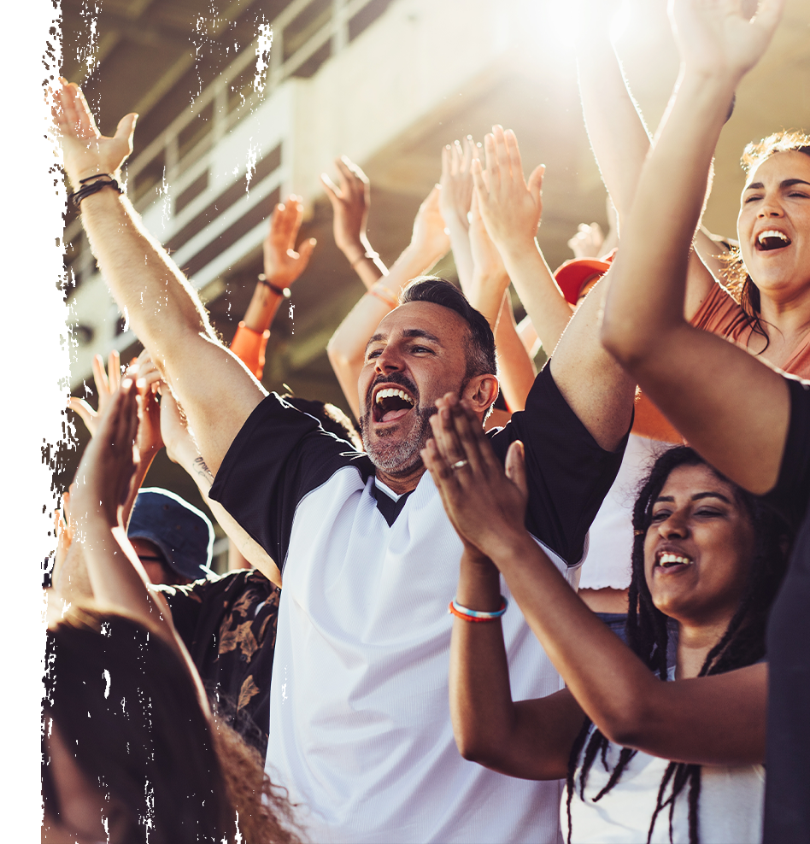
We’d love to hear from you
Let’s face it, great sporting moments aren’t created in isolation. They are created by shared experiences and those precious moments when we all come together.
So, let’s make a connection.
Rod, our SVP of Customer Success, based in State College, PA is waiting to talk to you about this incredible opportunity.
If you’d like to understand more about what we offer he would love to speak with you.
cell: 814 692-7945
email: rod@whitewallcreative.com
We can’t wait to get connected.

Slide 8




