Slide 2
CREATIVE AGENCY
At Whitewall, we believe that every moment holds the potential to create impact. We empower our clients with creative agency — offering the tools, talent, and vision to turn ideas into results that matter.
Design
Digital
Experience
Transforming visuals into captivating stories.
Crafting seamless, effective digital solutions.
Creating memorable moments that resonate and engage.
Click on the star to check out who we are and what we do!

Slide 3
OUR GLOBAL REACH

Slide 4
WHO WE WORK WITH . . .

Slide 5
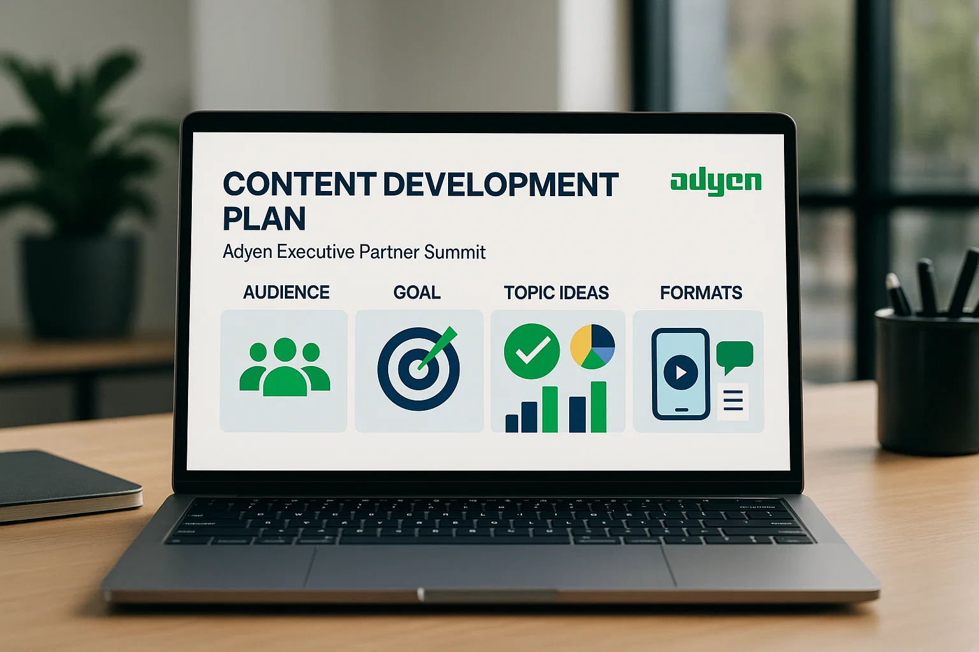
PARTNERSHIP IS IN OUR DNA
At Whitewall, Partner Engagement isn’t just part of what we do — it’s a discipline we’ve refined across formats, industries, and continents.
We specialize in crafting experiences that:
Prioritize Partner voices
Deliver frank, facilitated dialogue
Drive tangible, co-created outcomes
Scale across regions and platforms
Partner Advisory Boards (PABs) We’ve designed and facilitated numerous PABs that unlock strategic, honest feedback and create actionable next steps — jointly owned by client and partner.
Rolling Campaigns & Multi-Platform Programs From digital engagement to executive roundtables and flagship summits, we build sustained, thematic journeys that connect Partner ecosystems across markets.
Content Development We shape the narrative: from theme development and storytelling frameworks to supporting comms, visuals, and agenda design.

Slide 6
ADYEN PARTNER ENGAGEMENT
THE BRIEF
Audience: 30–50 attendees (50% Adyen executives, 50% high-value partners)
Location: U.S.-based (suggested locations include NYC, San Francisco or Chicago)
Timing: Fall 2025
Objective: Facilitate an exclusive, 5-star experience emphasizing partner insights and fostering mutual growth.

Slide 7
SAMPLE AGENDA
Day 0: Setting the Stage
Partner and executive arrivals
Elegant welcome reception to build early rapport
Day 1: Dialogue + Discovery
Opening remarks + keynote context
Facilitated sessions focused on listening to and learning from Partners
Breakout sessions to draw out meaningful, actionable insight
Real-time synthesis to share and shape themes
Evening: Off-site experience
Memorable and immersive, designed to deepen relationships and spark continued dialogue
Day 2: Synthesis + Momentum
Breakfast with roundtable discussions
Reflection session to distill insights and define next steps

Slide 8
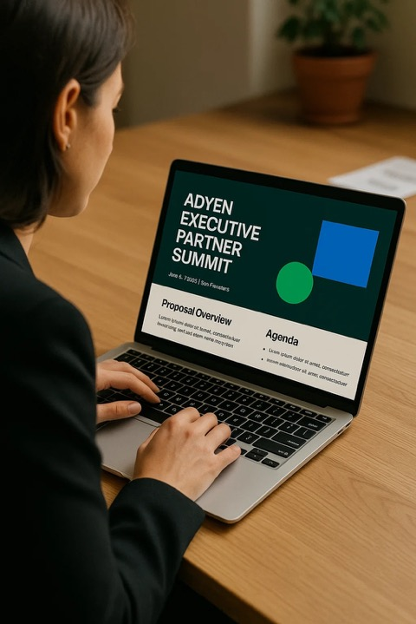
PARTNERSHIP IS IN OUR DNA
Partner engagement isn’t just a service line for Whitewall — it’s an area in which we are world-class.
We excel across formats:
High-touch, one-off executive events
Digital engagement experiences
Multi-platform, region-wide programs that scale
Trusted by:
Oracle – Delivering global partner forums and immersive experiences
Marsh – Designing events for growth-stage Partners that deliver tangible results
Dell Boomi – Curating an immersive experience to reward and recognize exceptional achievement
We shape how Partners experience your brand — digitally, in-person, and at scale.

Slide 9
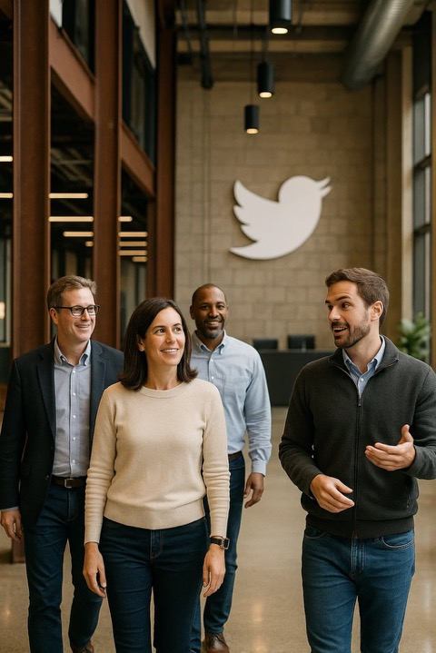
Oracle partner cloud tour
Client: Oracle
Challenge: Bringing together Cloud partners to experience Oracle Cloud World plus a bespoke Partner program.
Solution:
Multi-day San Francisco event featuring visits to Bay Area tech companies, tailored sessions, and high-end engagement.
Whitewall managed the experience end-to-end, from venue sourcing through creative and all the way to production.
Impact:
Strengthened Oracle’s perception as an innovative partner.
Facilitated direct Partner-to-Executive feedback.
A repeatable global format.
View the video here: View Tour VT

Slide 10
MARSH GROWTH SUMMIT
Client: Marsh
Challenge: Create a premium forum to connect growth-stage partners with Marsh executives.
Solution:
Curated summit with facilitated workshops, strategic networking, and focused business matchups.
Designed specifically to capture and act on partner feedback
Impact:
Clear, actionable partner insights
Strengthened strategic alliances
Framework adopted across other regions
View the video here: View Summit VT

Slide 11
Dell boomi Argentina experience
Client: Dell Boomi
Challenge: Reward and bond with high-value executives through a culturally immersive experience.
Solution:
Executive retreat in Argentina blending business reflection with cultural depth.
Included tailored excursions, fireside chats, and high-end hospitality.
Impact:
Strengthened partner loyalty through emotional connection
Elevated perception of Dell Boomi brand among global partners
View the video here: View Argentina VT

