Slide 1
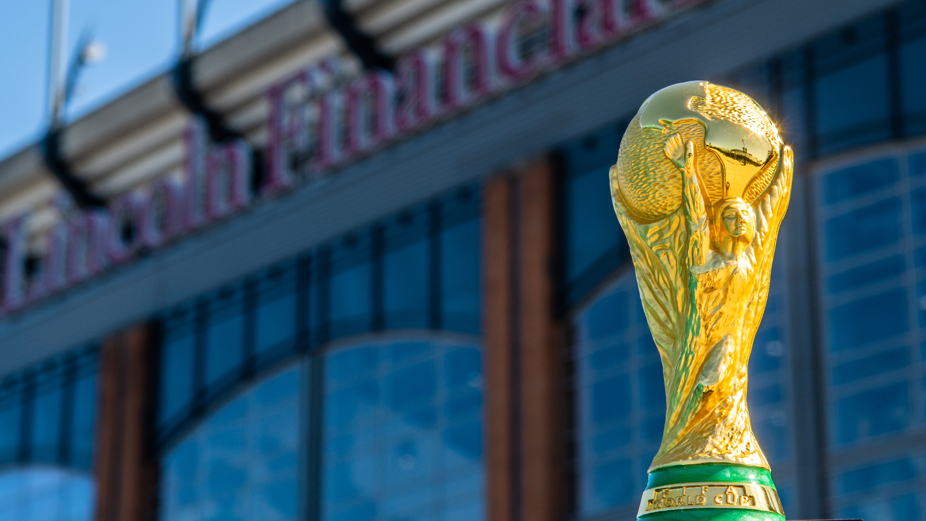

PS2026
creative thought partners

Slide 2

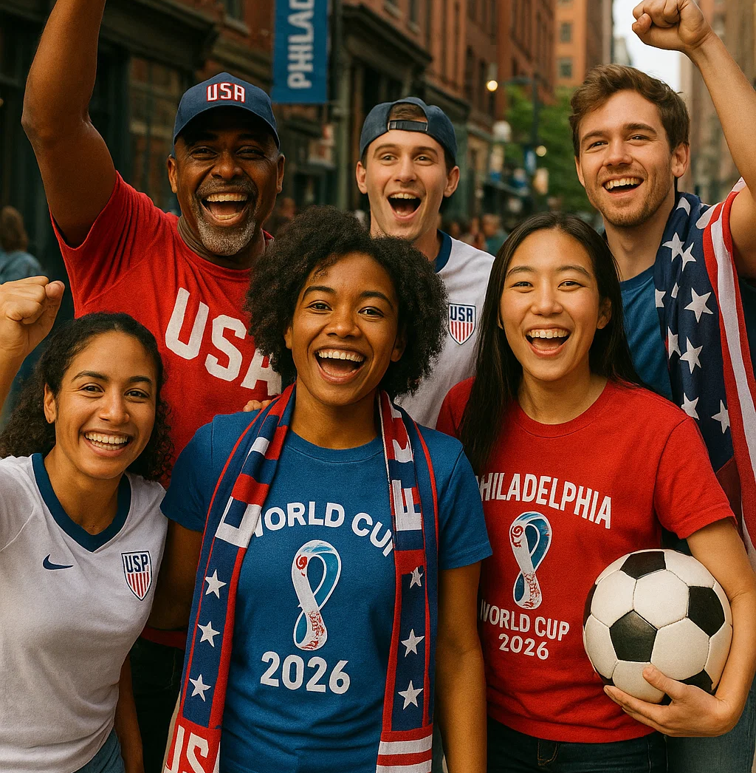
WHY WHITEWALL?
We understand we may not be the right agency to deliver the Fan Zone.
But we believe we can bring value as “Creative Thought Partners”.
We're excited to collaborate with the Organizing Committee, Executive Producer and key stakeholders to:
  Contribute original, strategic ideas
  Amplify the creative potential of the Fan Zone and broader PS2026 events

Slide 3
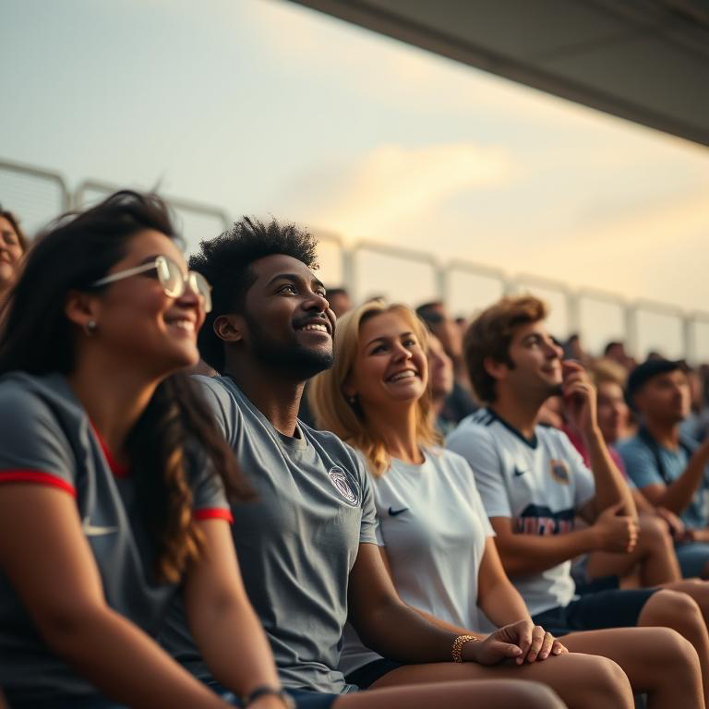
A PASSION FOR PHILLY
Rooted in Pennsylvania, driven by purpose.
We bring bold ideas, cultural fluency, and creative firepower to put Philadelphia’s voice — not just its skyline — on the world stage.
With deep local insight and a proven record of turning moments into movements, we craft unforgettable fan experiences that pulse with grit, pride, and heart.
Imagine what we could do if we were working together. On the next few slides are just a few examples of the thoughts we have had to make every moment count for PS2026.

Slide 4
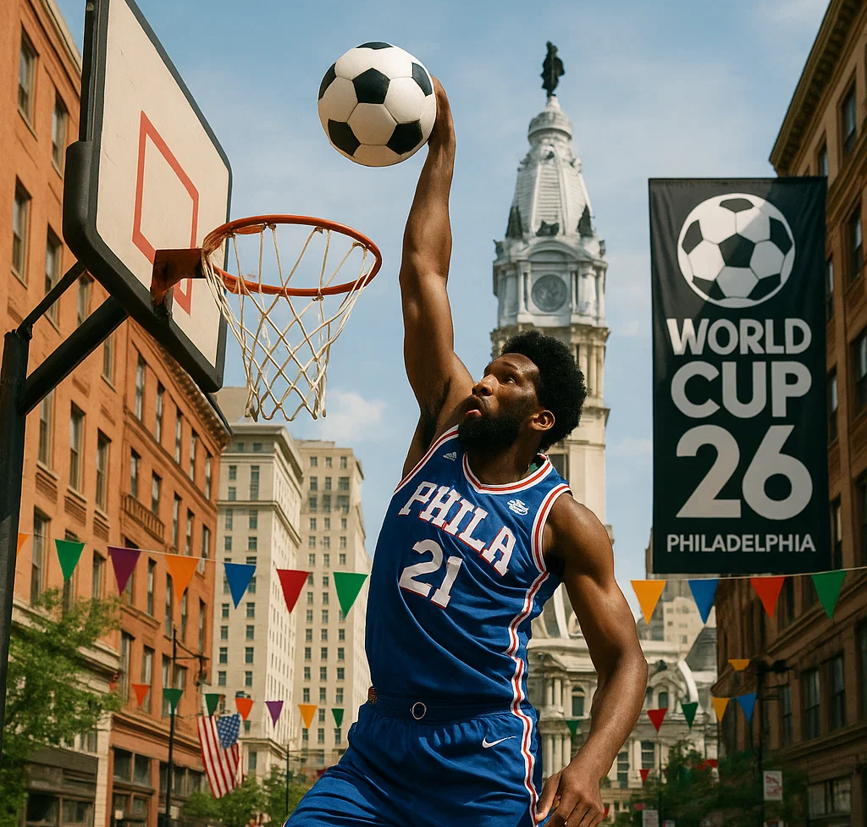
THE REAL PHILADELPHIA
A high-energy, cross-sport mash-up street party celebrating Philly’s culture merging basketball, soccer, and local identity into one unforgettable experience.
Street Basketball Tournaments:
3-point and dunk contests with pro or college hoopers and soccer players from Drexel, Temple, Villanova, etc.
Soccer x Hoops Challenges:
Fun hybrid games — soccer players shoot into hoops, hoopers dunk soccer balls — anything goes: dunk a cheesesteak! ☺
Philly Culture:
Music, food, art, and streetwear reflecting the city’s urban, authentic vibe.

Slide 5
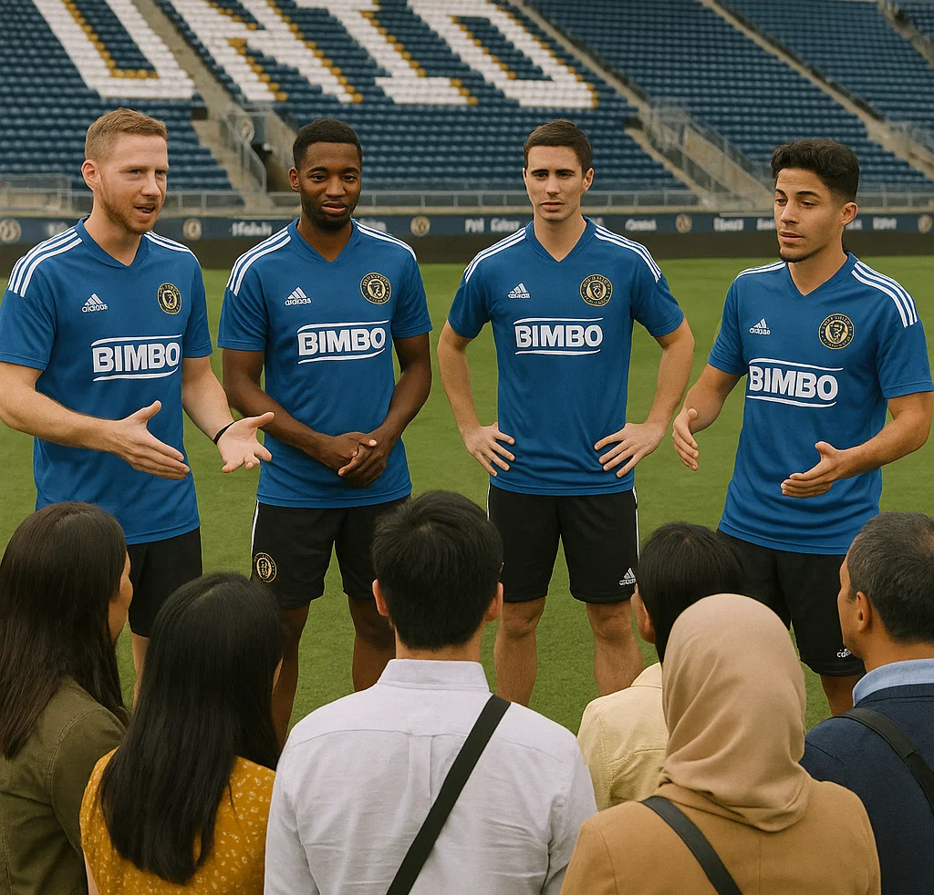
GET SOCCER-SMART!
Philadelphia Union should not go dark during the World Cup.
Host open training sessions, legends’ matches, meet-the-players sessions, and gamified events like penalty shootouts for fans.
Teach new fans about MLS through fun activations, possibly offering “Intro to MLS” info booths at fan fests.

Slide 6
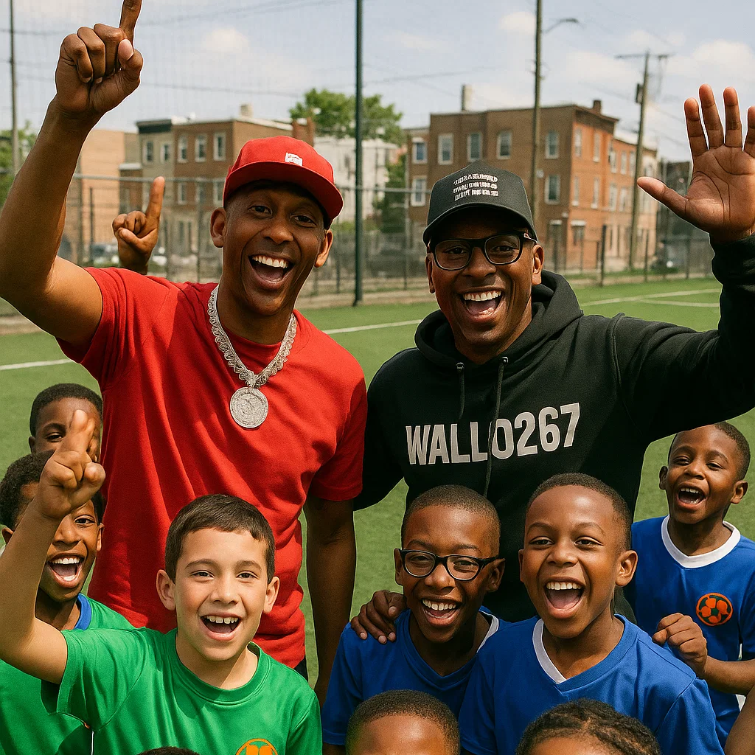
A ‘MILLION DOLLAR’ IDEA
Leverage the cultural power of Philly's own hit podcast: Million Dollars Worth of Game.
Bring in hosts Gillie Da Kid and Wallo267 for live podcast segments or stage appearances.
Use their massive social following and streetwise energy to engage younger, local audiences.
Tie their participation into Philly-centric programming, athlete spotlights, or live fan commentary.
This collaboration turns cultural authenticity into a viral moment — rooted in Philly, built for the world.

Slide 7
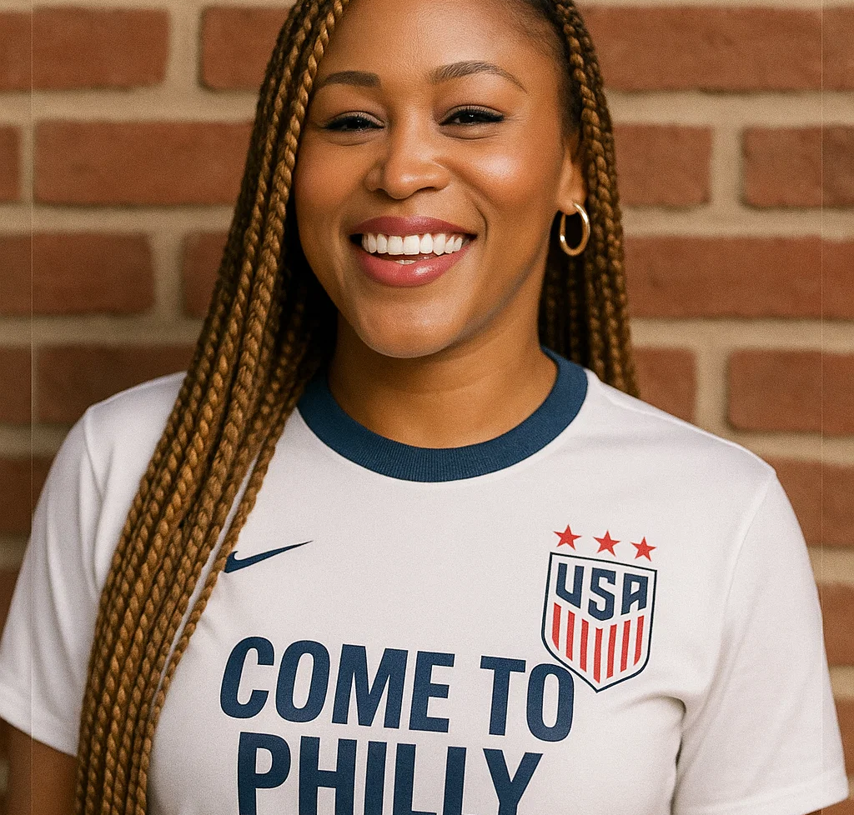
Wield your influence(rs)!
Invite Philly-born celebrities (Eve, Rob McIlhenny, Questlove, etc.) and top social media influencers (TikTokers, Twitch streamers) to be visible at games and fan events.
Encourage live streaming, vlogging, and posting behind-the-scenes at games and pop-up events.
Give them customized Philly Union or World Cup swag to promote.

Slide 8
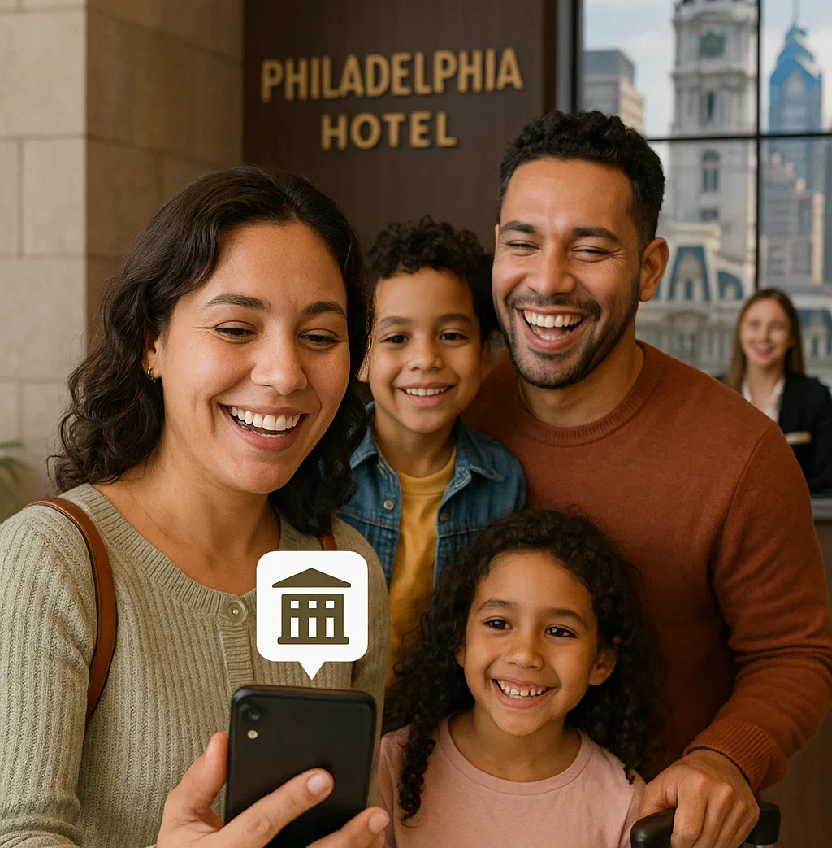
MAXIMIZING REVENUE & ANALYTICS
Click here to See it in action!
When the world is watching, content must perform. Whitewall brings bold creative ideas powered by visionary tech that transforms content into cash and connections.
Seamless Shopability: Every video becomes a point of sale.
Layered Interactivity: Rich content that deepens fan engagement.
Real-Time Intelligence: Data-driven decisions, match by match.
Together, we make content that’s seen, felt, shared — and measured. This is the future of fan engagement: powered by vision and precision.

Slide 9
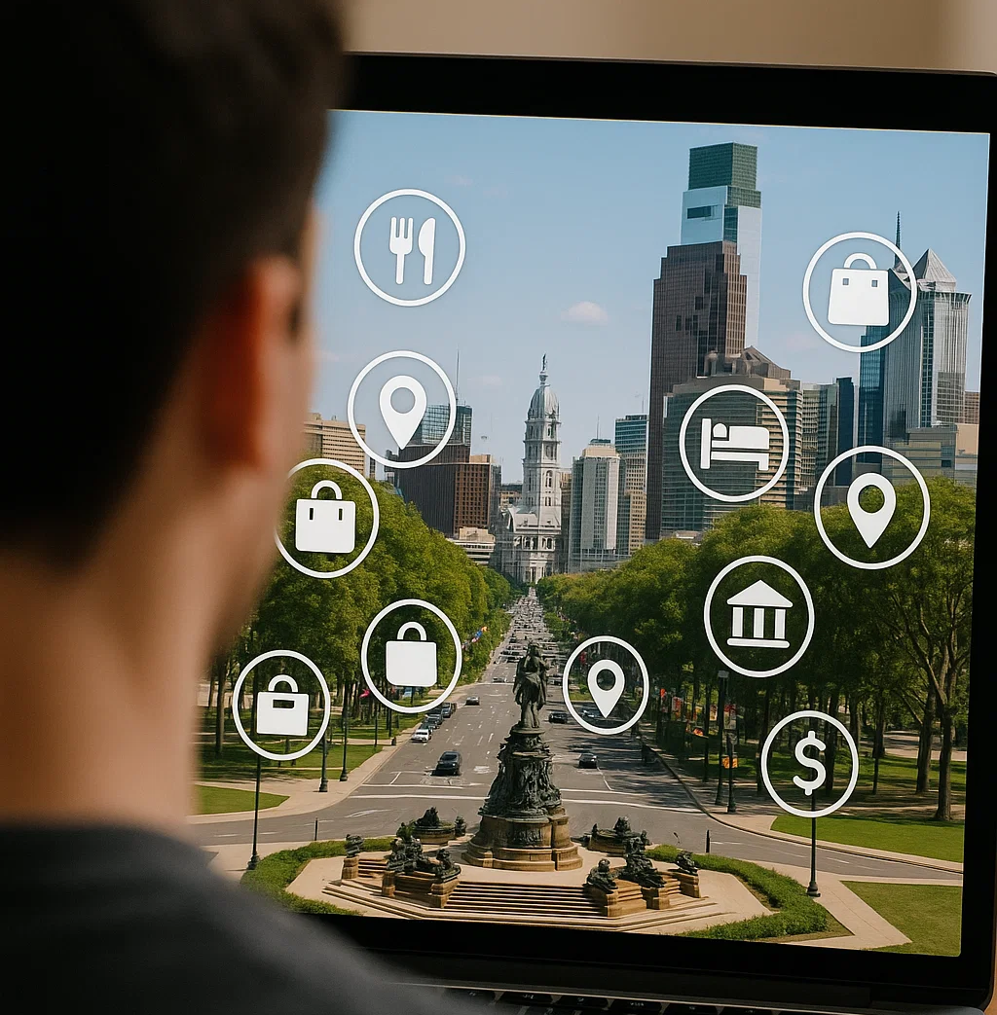
VIDEO THAT REALLY DELIVERS
Click here to See it in action!
Turn digital content into happy visitors and an economic boost for Philly businesses!
Imagine being able to drive visitors (and locals) to Philly businesses while they enjoy the World Cup. With our tech partners, Viktrs, we can make that happen for you!
Our technology, we can create video that is accompanied by clickable links, allowing viewers to see hotels, restaurants, attractions – in fact, anything that makes Philly so special!
Not only does this deliver a great UX, it allows us to track spend, popularity and any number of other valuable and informative metrics.

Slide 10
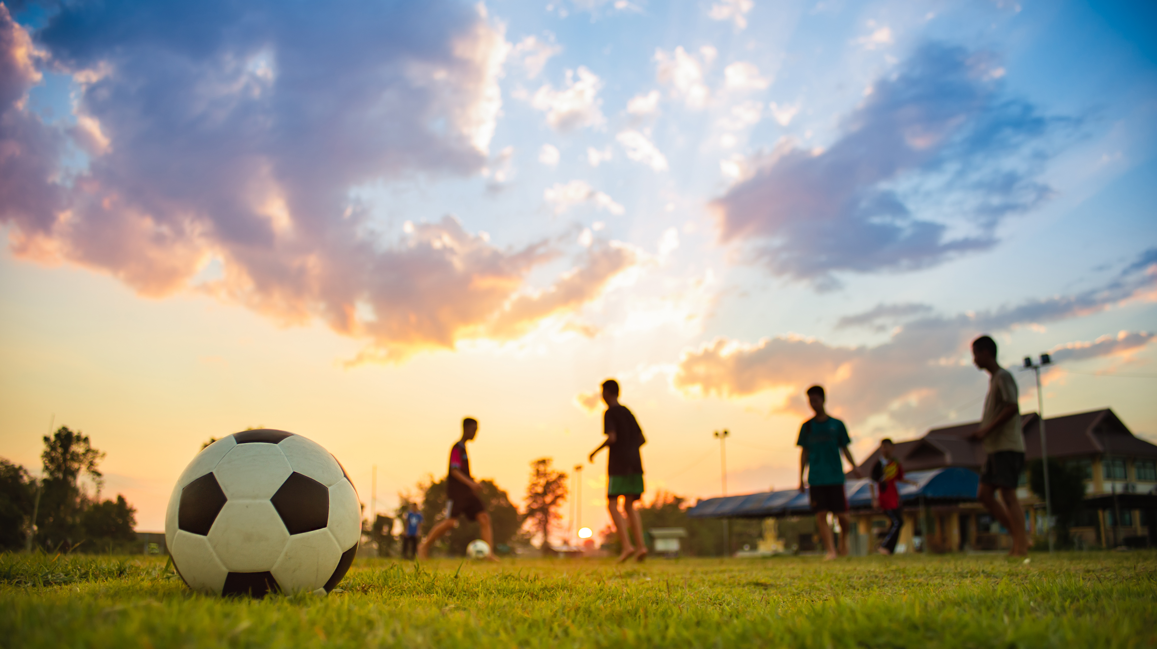
Rod Lee, SVP Client Success
Cell: 814-692-7945
Email: rod@whitewallcreative.com
Website: https://www.whitewallcreative.com

