Slide 1


Slide 2
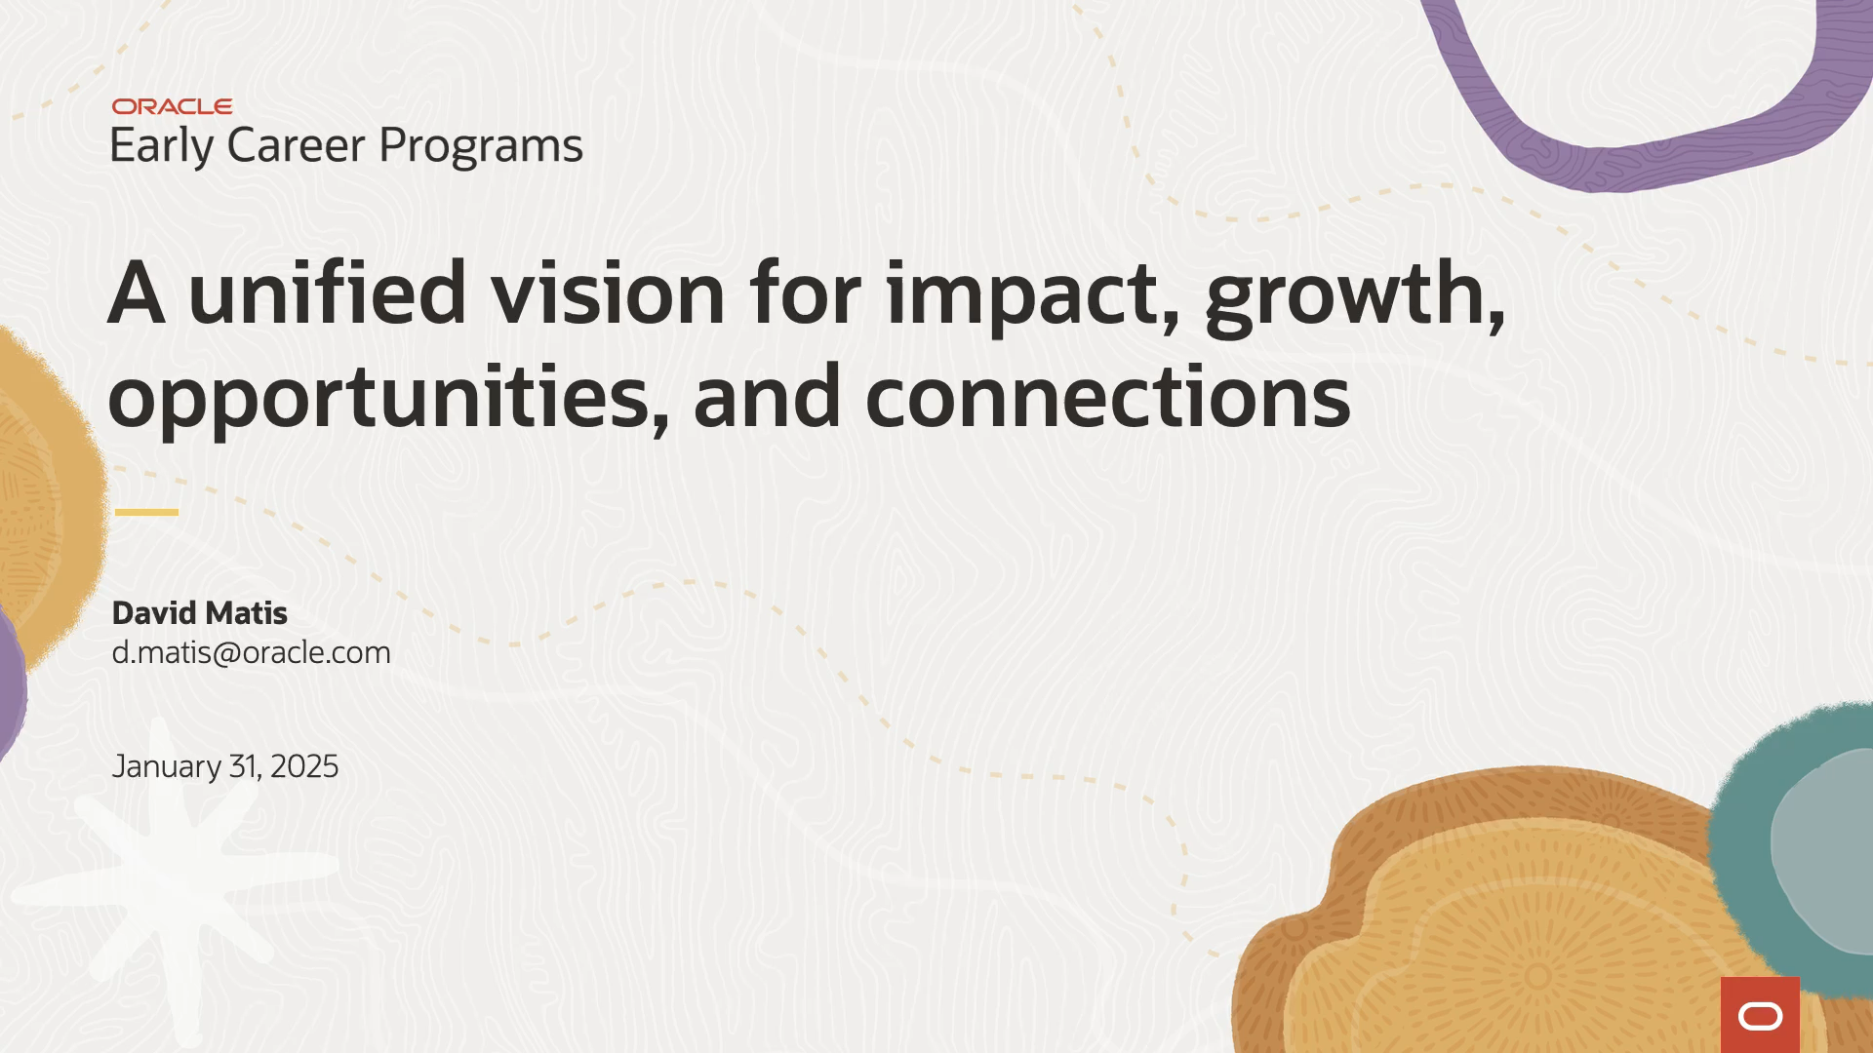

Slide 3

Aligning for global impact
The Opportunity
Oracle Early Careers Programs are growing significantly, reaching new regions and impacting hundreds of early-career professionals.
This expansion presents a unique opportunity to create a unified, global participant experience.
The Challenge
Currently, participant touchpoints (emails, events, documents, and Slack communications) lack consistency.
Fragmented visuals and messaging dilute impact and fail to fully align with Oracle Employer Brand or Redwood.
The Objective
To amplify the impact of Oracle Early Careers Programs by aligning visuals
and storytelling with Oracle Employer Brand while tailoring these to resonate with
early-career talent.

Slide 4

Creating a unified look and feel
for Oracle Early Careers Programs
Why now?
We’re at a pivotal moment of global expansion (e.g., adding Morocco in FY26).
Aligning now ensures scalability, consistency, and stronger brand recognition as the programs continue to grow.
The Value of Alignment
Enhance participant engagement and retention.
Strengthen Oracle’s reputation as an employer of choice.
Deliver a seamless, cohesive experience that reinforces Oracle’s commitment to growth, opportunity, and connection.

Slide 5

Agenda
Strategy rooted in growth, visual alignment, and an ever-expanding journey.
Strategic Evolution
Manifesto for Growth
Creative Strategy: An Ever-Expanding Journey
Visual Alignment with Oracle’s Employer Brand
Participant Experience Change
Business Case for a Unified Approach
Next Steps & Recommendations

Slide 6

Strategic evolution: The Foundation for the Future
Unifying design, storytelling, and participant touchpoints.
Our moment
For more than three years, the Oracle Early Career Programs team has been at the forefront of delivering innovative in-person and virtual development programs that ease the transition from campus to Oracle. It’s no exaggeration to say we’ve impacted the lives of thousands of new campus hires, their managers, and partners across the globe. What began in the United States and Mexico in the Fiscal Year 2023 has expanded year by year. First to India, then Canada, and in FY26, Morocco.
With each milestone, we've built momentum and achieved remarkable growth. Now, as we reflect on our accomplishments, the Early Career Programs team stands at a pivotal moment—one that calls for reimagining how we can continue to amplify the impact of our program participants. This is the inflection point where we find ourselves today.
Amplifying impact and aligning with Oracle’s employer brand.

Slide 7

Manifesto for Growth through
connections and opportunities
Every connection, opportunity, and experience contributes to an ever-expanding journey of discovery, diversity, collaboration, discovery and growth.
We believe in growth through connections and opportunities.
Oracle Early Career Programs celebrates diversity, collaboration, and discovery.
By fostering connections and creating meaningful opportunities, we build lasting bonds that foster growth and realize potential.
We design every development experience to align people with purpose, amplify impact, and unlock endless possibilities.
This is Oracle Early Career Programs — Where we create the future.

Slide 8

Creative Strategy: An ever-expanding journey
Oracle Early Careers Programs has a continuous journey where participants grow through meaningful connections and future opportunities.
This strategy offers an abstract landscape, showcasing Oracle as the invisible guiding force that helps cohorts pursue growth through connections and opportunity.
The landscape is amorphous, an abstract world as different as each participant’s path. This landscape has pathways that help provide clarity and brings shape to their future growth.
A guiding light (Oracle Early Career Programs) lead the way through these paths and connections, referencing the direction the participants should seek out for their own career growth at Oracle.

Slide 9
Creative Strategy: An ever-expanding journey
Design Concept - The journey as a metaphor
A visual identity inspired by growth, movement, connection, opportunity and expansion.
Visual language
Flowing lines, expanding circles, and gradients to symbolize progress and connecting lines, expanding circles, and gradients to symbolize progress and connectivity.
Color palette
Oracle’s core brand colors (red, white, and black) with vibrant secondary hues to appeal to early-career professionals and align with the employer brand.
Typography
Maintaining Oracle’s corporate typography, adapted with dynamic layouts for younger audiences.

Slide 10


Storytelling Framework: Connecting the programs
Oracle Early Careers Programs are a continuous journey where participants grow through meaningful connections that create opportunities.
From Campus to Career
The initial steps of professional growth
Learning Together
Building skills and bonds
Amplifying Impact
Evolving within Oracle and contributing globally

Slide 11

Aligning with Oracle Employer Brand
Ensure Oracle Early Careers Programs visually align with Oracle Employer Brand while maintaining a distinct identity tailored to early-career professionals.
Key Alignment Elements
Typography: Maintain Oracle’s corporate typography, adapted with dynamic layouts for younger audiences.
Color Palette: Use Oracle’s foundational colors utilizing Redwood’s most vibrant tones for energy and growth.
Imagery Style: Blend professional visuals with authentic, people-centric images that showcase collaboration and diversity.
Graphics and Illustrations: Incorporate bold, modern visuals (patterns, and illustrations) to engage early-career audiences while aligning with Oracle’s
design ethos

Slide 12








Aligning with Oracle’s Employer Brand
Ensure Oracle Early Careers Programs visually align with Oracle’s employer brand while maintaining a distinct identity tailored to early-career professionals.
Grow through connections and opportunities
Build connections
with the Oracle
Global Tech Program
Create the future with us
Where we create the future

Slide 13
Redefining the participant experience
Our Participant Experience
A redefined experience calls for an expansive, three core-principles approach.
We look at every participant experience—whether through in-person virtual event design, email, Slack, PowerPoint, documents, and—as part of a unified participant journey.
Our programs extend and reinforce the Oracle employee brand.
We are redesigning our experience to consistently communicate our employee brand story in every participant-facing touchpoint, deepening engagement, amplifying impact, and enhancing retention.

Slide 14

Redefining the participant experience
Current state
There is a fragmented experience across emails, events, and communication channels.
Lack of consistency dilutes the impact and participant engagement.
Unified Participant Journey
Consistent Branding: Cohesive design across all touchpoints for a unified experience.
Alignment with Employer Brand: Strengthens familiarity, trust, and connection to Oracle.
Enhanced Storytelling: Deepens engagement and amplifies the impact of every interaction.

Slide 15
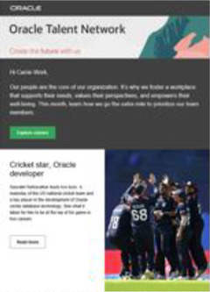
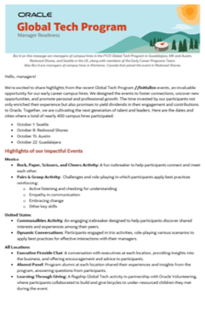
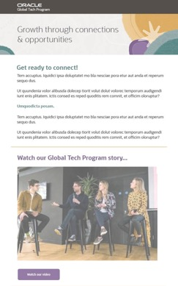

Redefining the participant experience
Current email alignment
Proposed email alignment

Slide 16
Redefining the participant experience
Delivering Impact Through a Unified Experience - Participant Impact
Stronger connections:
A unified journey fosters meaningful connections, strengthening participants’ sense of community and alignment with Oracle’s mission and values.
Enhanced Retention:
Consistent and engaging touchpoints build trust and loyalty, enhancing retention and maximizing the return on talent development investments.
Enhanced Retention:
Cohesive branding and storytelling that amplifies engagement, driving measurable outcomes such as career growth, satisfaction, and Oracle’s reputation as an employer of choice.

Slide 17
Business case for a unified approach
Why it matters
Tie the creative strategy and visual alignment to Oracle’s broader goals:
  Improved talent retention and satisfaction.
  Enhanced global brand consistency.
  Long-term ROI by investing in scalable design solutions.
Benefits of Visual Alignment:
Strengthen Oracle Early Career Programs brand recognition and trust.
Create a competitive edge in attracting early-career talent.
Metrics for Success:
Demonstrate impact through:
  Higher engagement rates with program materials.
  Increased retention of early-career participants.

Slide 18
Next Steps & Recommendations
Phased Implementation Plan
Phase 1: Stakeholder alignment workshops to finalize the visual direction.
Phase 2: Pilot in Morocco and existing regions to gather feedback.
Phase 3: Full global rollout with iterative improvements.
Key Actions for Approval
Secure leadership buy-in for unified branding and creative execution.
Allocate resources for design, training, and implementation.
Call to Action
Position the decision as critical to amplifying Oracle Early Careers Programs and aligning with Oracle’s global mission.

Slide 19

Conclusion
Reinforce the Vision
Emphasize the unified look and feel as a foundation for amplifying Oracle’s
early-career impact and aligning with its employer brand.
Closing Statement
Inspire action: Together, we can create a consistent, engaging participant experience that reflects Oracle’s commitment to growth, connection, and opportunity.

Slide 20
Vision statement
Our vision is to create an environment where participant potential is realized, connections inspire innovation, and opportunities define the future—shaping experiences that drive growth and transformation.

Slide 21

Implementation roadmap
Stakeholder Alignment
Agree unified vision and messaging framework.
Design Development
Create visual identity aligned with Oracle’s employer brand.
Pilot Program Launch
Test the unified look and feel in a selected region – Morocco & gather
feedback from participants, managers, and stakeholders for refinement.
Global Rollout
Scale the program globally, ensuring consistency across all regions, and train managers and teams on the new branding and participant experience guidelines.
Measurement and Optimization
Track engagement, retention, and satisfaction metrics to assess impact & use insights to refine and evolve the participant experience over time.

Slide 27
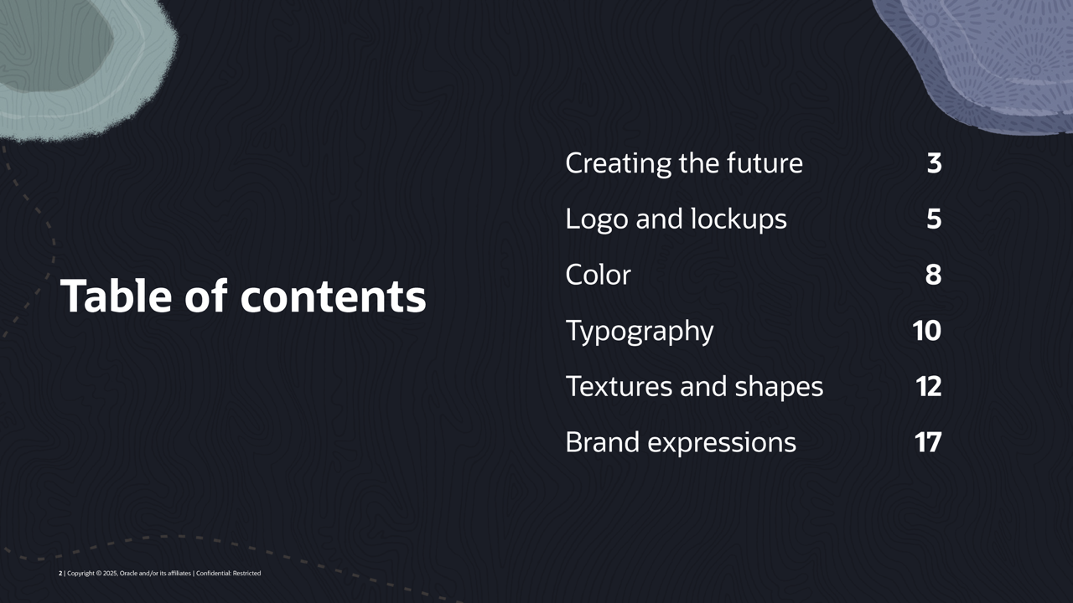

Slide 28


Slide 29
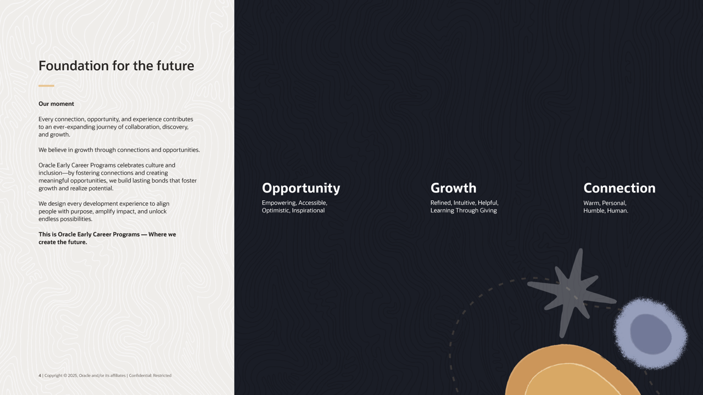

Slide 30
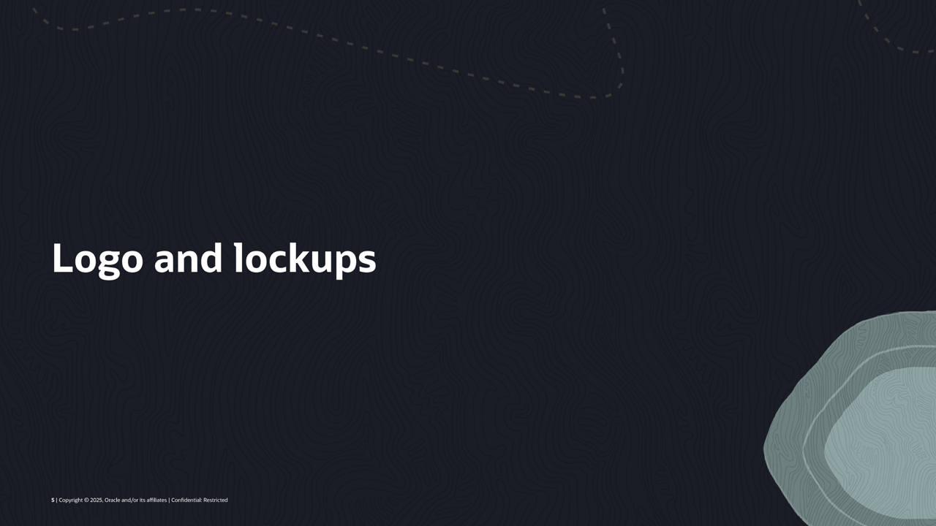

Slide 31
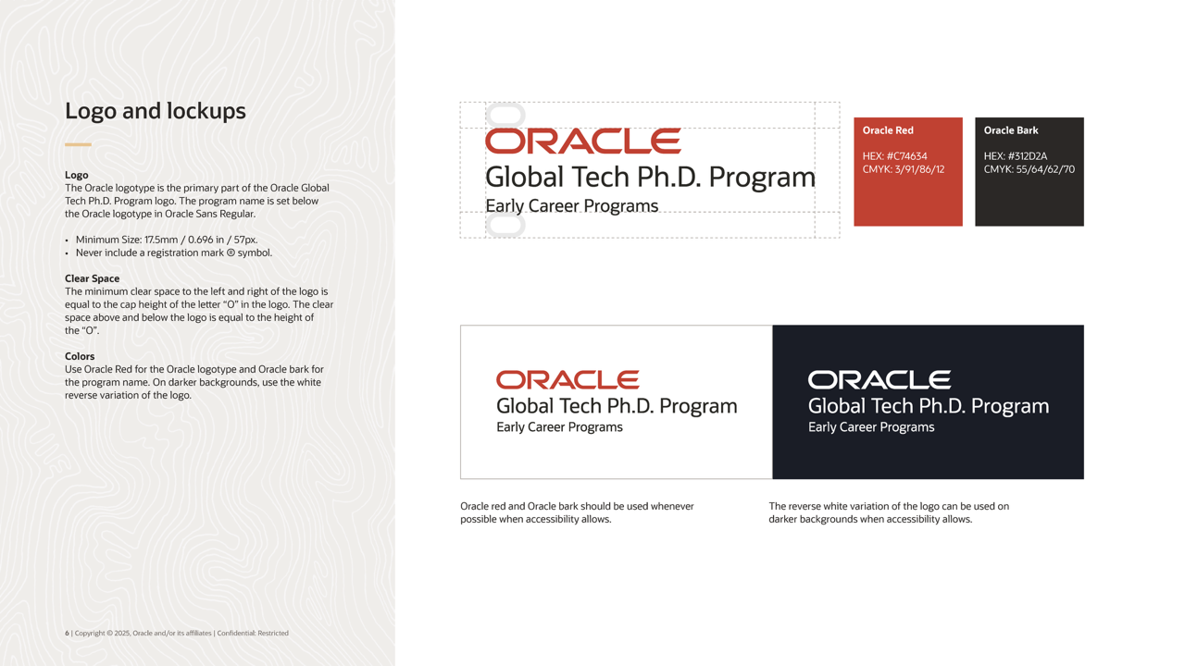

Slide 32
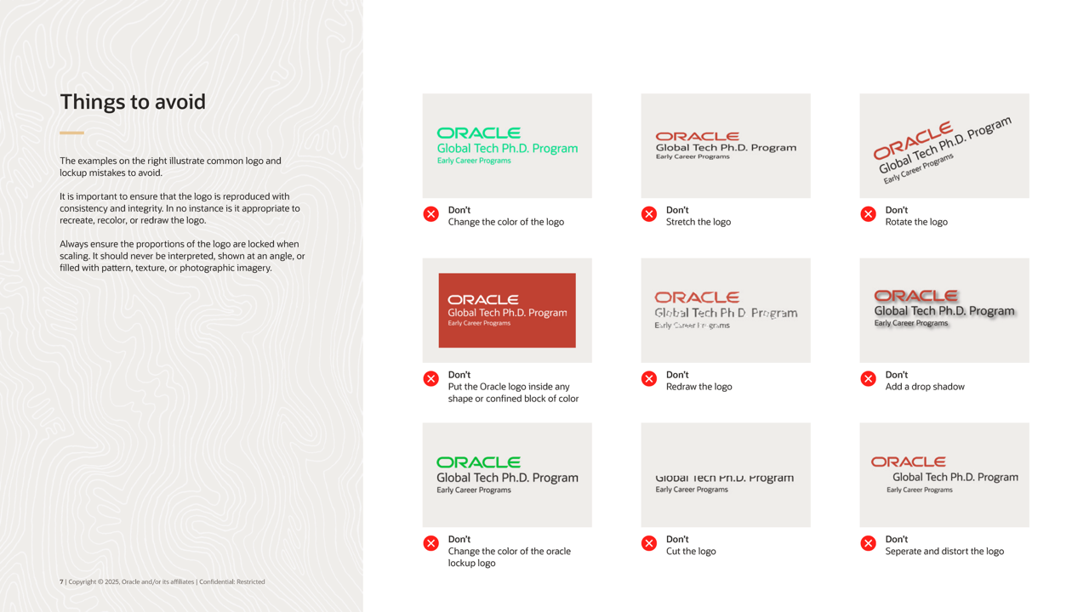

Slide 33


Slide 34
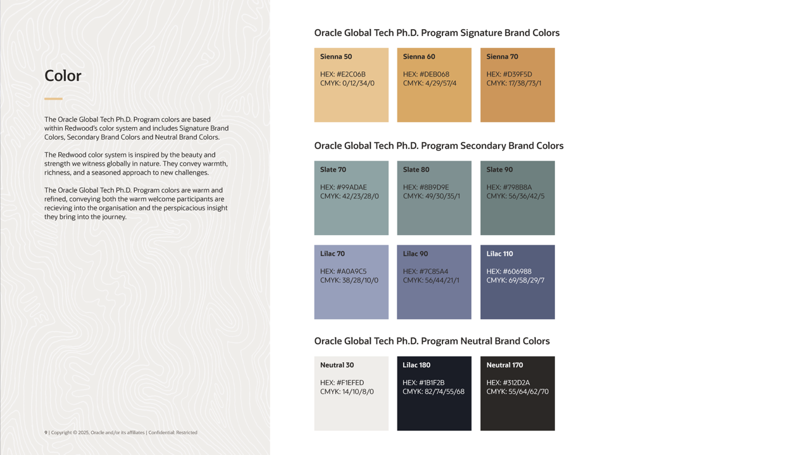

Slide 35


Slide 36
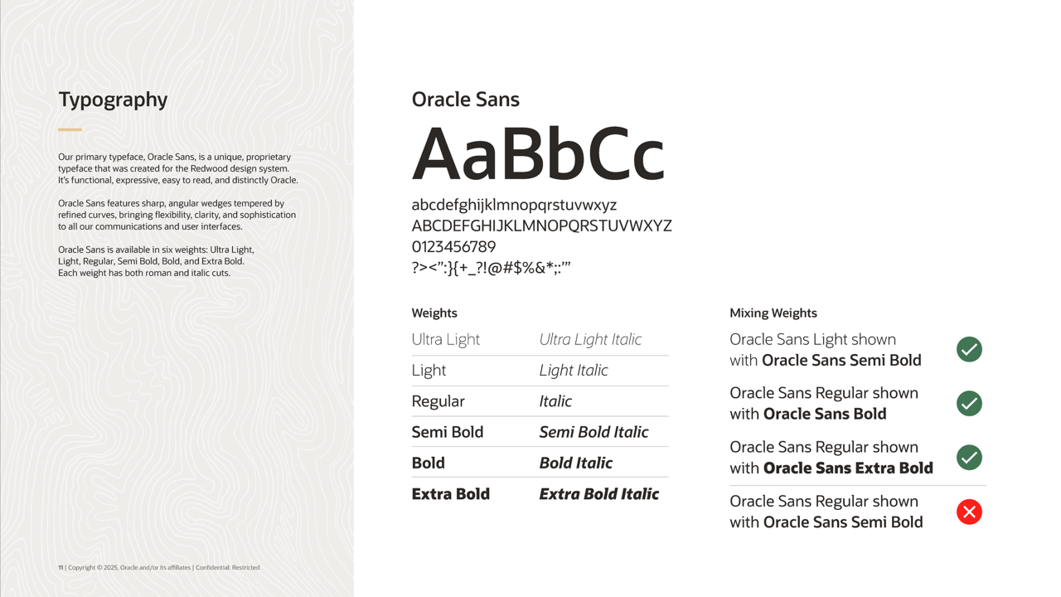

Slide 37


Slide 38
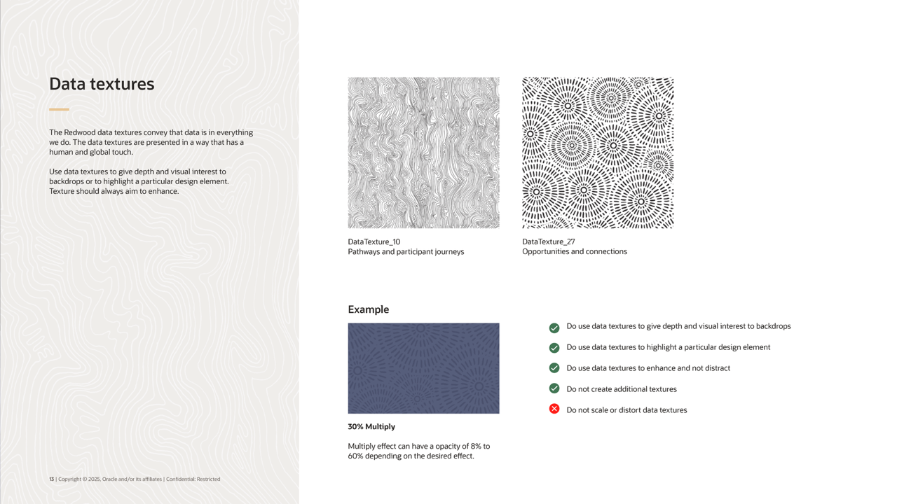

Slide 39
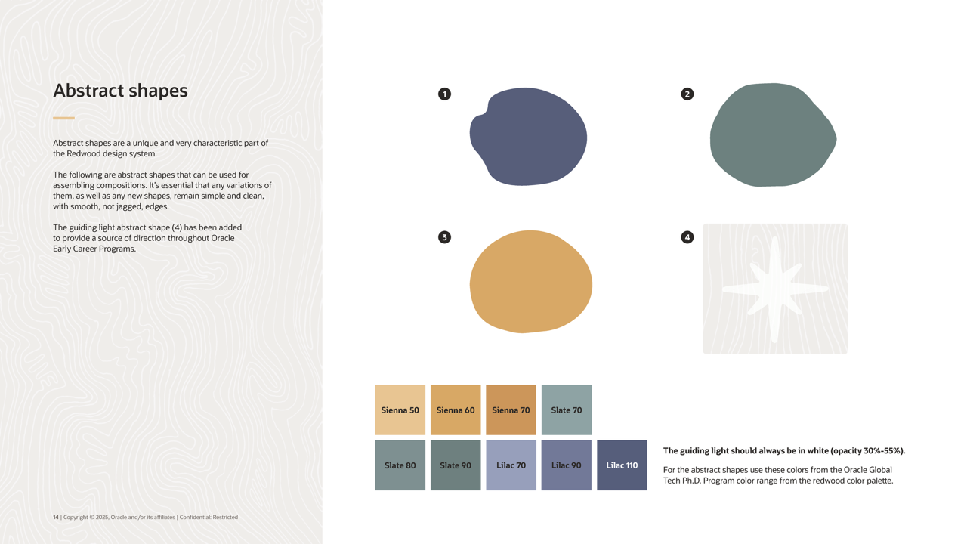

Slide 40
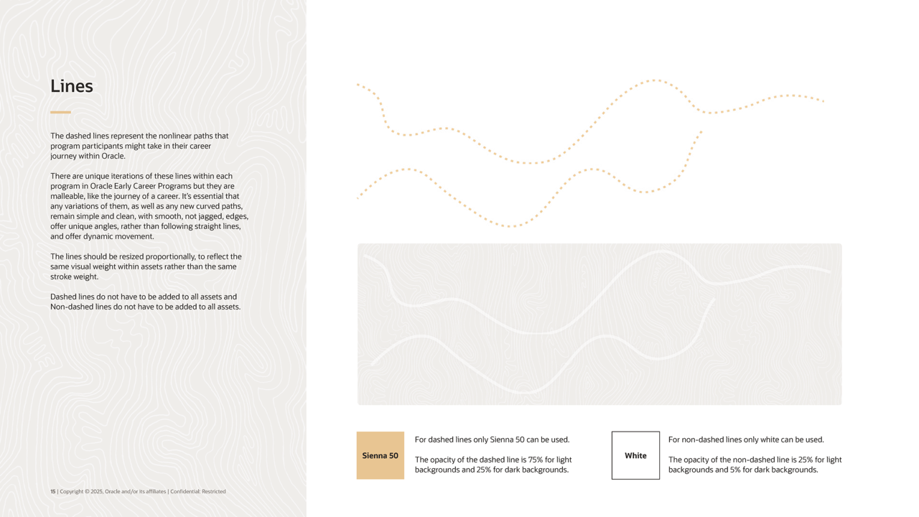

Slide 41


Slide 42


Slide 43
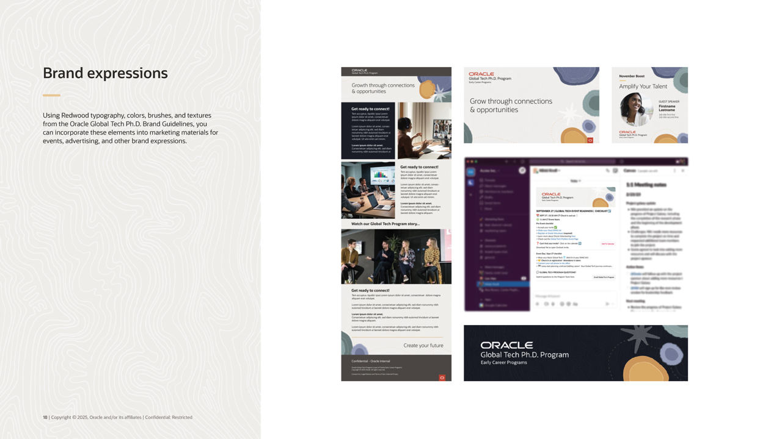

Slide 44
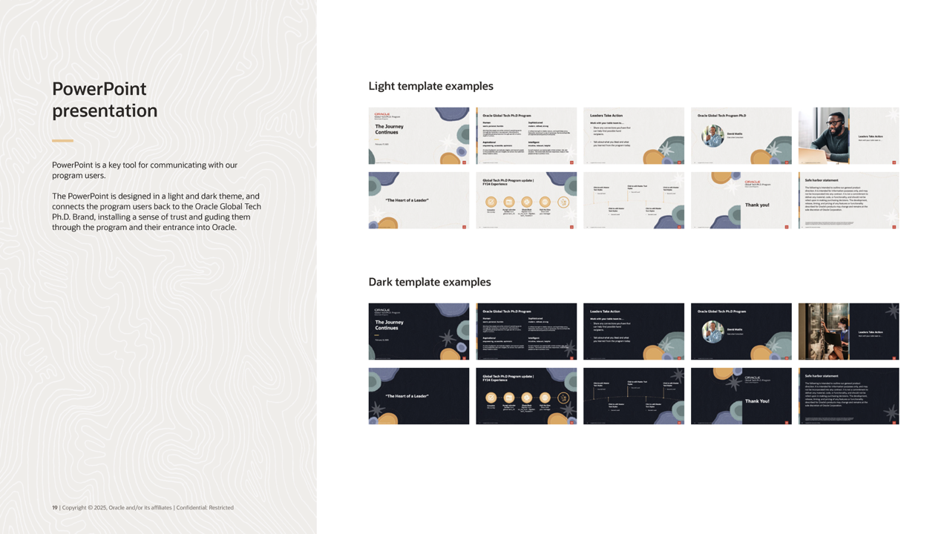

Slide 45
