Slide 1
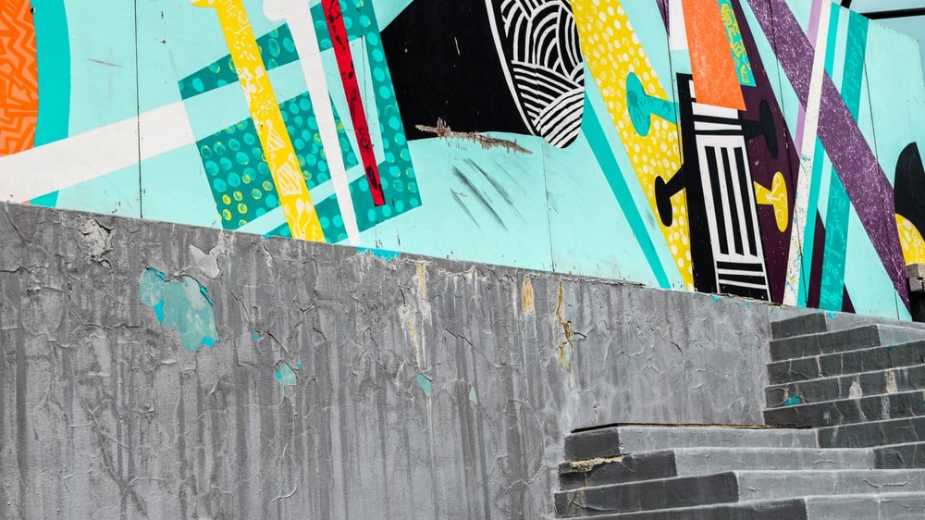

Slide 2
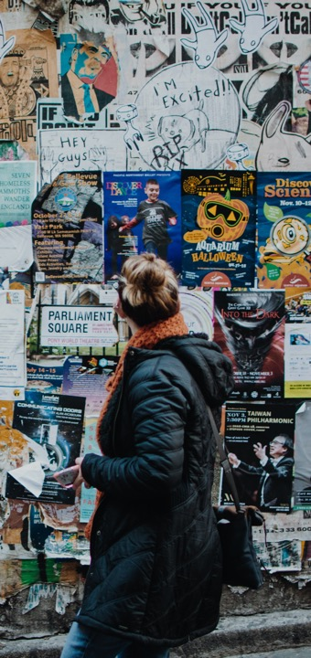
At Whitewall, we
make every moment count
At Whitewall, we don’t just tell stories — we bring them vividly to life, backed by over a decade of proven experience designing and delivering standout events in every major U.S. city over the last 10+ years.
Our deep network of trusted partners and vendors means we’re equipped to handle every detail, no matter the scale or location.
GREAT Futures is about more than just inspiration — it’s about precision, innovation, and seamless execution. That’s where we come in. From pre-event registration and venue sourcing to guest flow management, AV, creative, and on-site logistics, we deliver true turnkey solutions across the full spectrum of creative and event services.
What follows is a taste of just a few of the shows we have delivered that reflect the creative and operational excellence we bring to all the work we do.

Slide 3
ORACLE PARTNER connect PROGRAM San Francisco, CA
GREAT Futures
Partner Engagement by the Bay
Comprehensive experience management covering everything from guest logistics and delivery to immersive brand storytelling and engagement strategy.
VIDEO
Creative Concept and Strategy
Develop program theme, look, and feel aligned with the brand.
Venue Logistics
Sourcing, contracting, Room grid planning.
Handle permits, insurance, and compliance.
Catering Management
All F&B co-ordination and onsite delivery.
Production Management
Design event environments and activations.
Source and manage all lighting, sound, and A/V production.
Live Facilitation Coordination
Source and contract speakers, performers, and special guests.
Guest Experience and Registration
Curate VIP experiences.
Manage invitations, RSVPs, check-ins, and security.
On-Site Operations
Staff the event (event management team, tech crews, guest services).
Ensure smooth execution and troubleshoot live.

Slide 4
SIRIUS DECISIONS B2B SUMMIT NASHVILLE, TN
GREAT Futures
Conference & Expo
Full-service delivery for their flagship annual event, hosting 3,000+ delegates over three days in Nashville.
From theme development to logistics, technical production, and messaging, we handled every detail — powered by our trusted U.S. partner network.
VIDEO
Creative Concept and Strategy
Develop event theme, look, and feel aligned with the brand.
Production Management
Design and build event environments (stages, sets, expo, activations).
Source and manage all lighting, sound, and A/V production.
Live Facilitation Coordination
Source and contract speakers, performers, and special guests.
Event Signage, Content Design & Branding
Ensure entire venue is fully branded for both client identity and event theme.
Design and delivery of screen content.
On-Site Operations
Staff the event (tech crew, event management team, etc.).
Ensure smooth execution and troubleshoot live.

Slide 5
Netsuite suiteconnect NEW YORK CITY, NY
GREAT Futures
Conference & Networking Lounges
Full-service delivery including content development, creative production, stage design, event branding, guest communications, registration, on-site execution, and post-event reporting.
Creative Concept and Strategy
Develop event theme, look, and feel aligned with the brand.
Design and delivery of screen content.
Venue Logistics
Sourcing, contracting, Room grid planning.
Handle permits, insurance, and compliance.
Catering Management
All F&B co-ordination and onsite delivery
Event Signage, Content Design & Branding
Ensure entire venue is fully branded for both client identity and event theme.
Design and delivery of screen content.
Production Management
Design and build event environments (stages, sets, expo, activations).
Source and manage all lighting, sound, and A/V production.
Guest Experience and Registration
Curate VIP experiences.
Manage invitations, RSVPs, check-ins, and security.
On-Site Operations
Staff the event (event management team, tech crews, guest services).
Ensure smooth execution and troubleshoot live.

Slide 6
PATTERN COMPUTER LAUNCH SAN FRANCISCO, CA
GREAT Futures
AI Product Launch
A 360° solution from venue selection and agenda curation to live show direction and digital asset creation.
High profile audience of tech investors and Press
Complimented a multi-channel PR & Advertising Campaign
VIDEO
Creative Concept and Strategy
Develop event theme, look and feel aligned with the brand.
Venue Logistics
Sourcing, Contracting Room grid planning.
Handle permits, insurance, and compliance.
Catering Management
All F&B co-ordination and onsite delivery
Production Management
Design and build event environments (stages, sets, activations).
Sourced and managed all lighting, sound, and A/V production.
Video Creation
Design and deliver multi-screen opening VT.
Guest Experience and Registration
Manage check-in, and security.
On-Site Operations
Staff the event (event management team, tech crews, guest services).
Ensure smooth execution and troubleshoot live.

Slide 7
YOUVIEW FANBOX London (UK!)
GREAT Futures
Immersive Experience
A bold public activation featuring a life-sized set-top box where fans acted out scenes with real sets, costumes, and actors.
Whitewall delivered end-to-end creative, technical production, and on-site management — drawing hundreds and generating major PR buzz.
VIDEO
Creative Concepting
Developed event theme and guest journey aligned with Netflix and YouView branding.
Created three “sound stages” to mimic Netflix’s biggest shows.
Venue Design & Construction
Designed and constructed purpose-built venue.
Production & Build
Source and manage all lighting, sound, and A/V production.
Talent Acquisition & Co-ordination
Managed actors, stage management, host and brand ambassadors.
Guest Management
Handled attendee experience, including helping costume participants who wanted to join the fun.
On-Site Execution
Staffed and co-ordinated all event operations.

