Slide 1
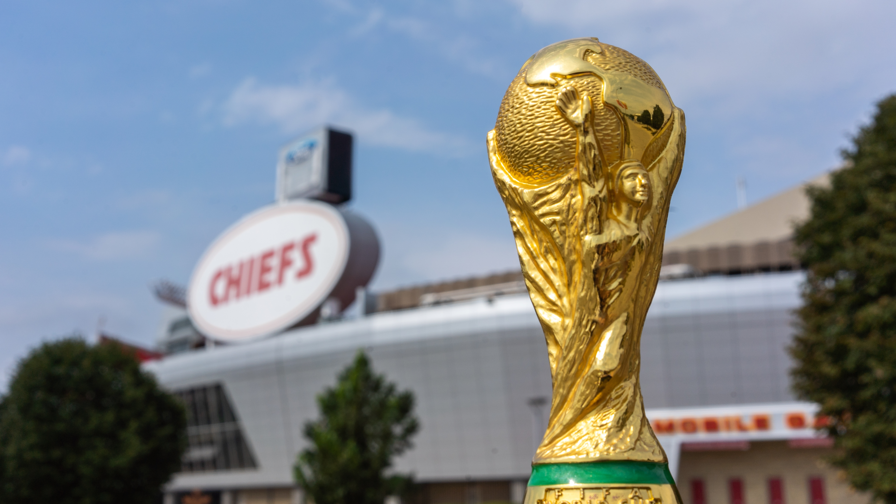

KC2026 RFI
WHITEWALL RESPONSE
4 MARCH 2025

Slide 2


Thank you, KANSAS CITY!
We are honored for the opportunity to collaborate with KC2026 in shaping an unforgettable FIFA World Cup 2026™ experience.
At Whitewall Creative, we share Kansas City’s passion for the game and its community, and we’re excited to bring our global expertise, creative vision, and event production excellence to this historic moment.
We look forward to the possibility of working together to make Kansas City a world-class host city.
Thank you for your time and consideration!

Slide 3
WHATS is the wow document?
The Sizzle, The Strategy and a #CITYUNITED
Our Response to Your One Year to Go Event: The excitement, the spectacle, the unforgettable moments that make Kansas City’s FIFA World Cup 2026™ journey come alive. But that’s not all…
Our Extra Treat – #CITYUNITED: More than an event—it’s a movement. A bold, citywide activation that ensures everyone in Kansas City, feels part of the World Cup, creating a lasting impact long after the final whistle.
From Vision to Reality: This is where Kansas City’s global moment takes shape—uniting
sport, culture, and community into an experience the world will never forget.

Slide 4
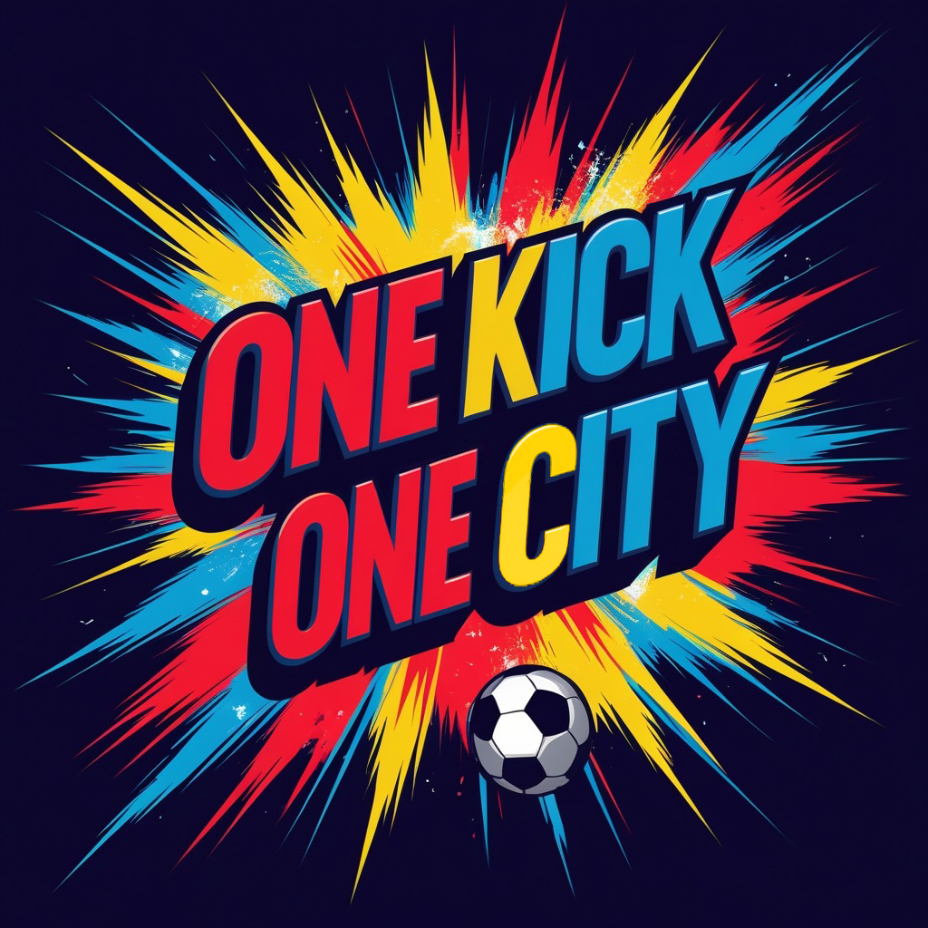

Slide 5
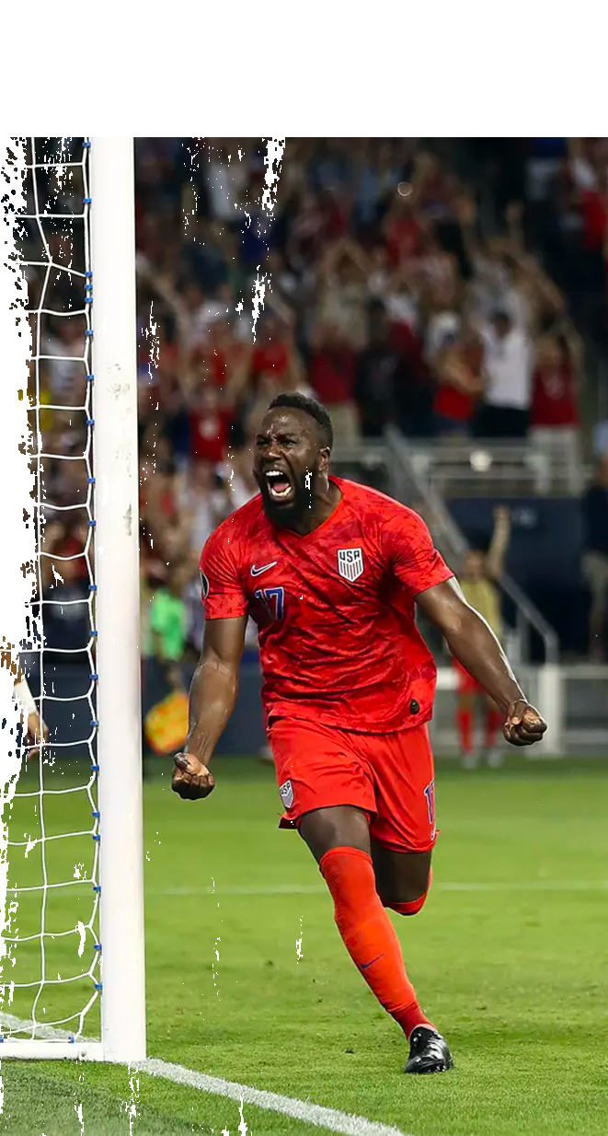
One year to go event: the perfect kick-off
A Celebration That Unites Kansas City
Kansas City has a deep love for soccer, and "One Kick, One City" is the ultimate way to channel that passion into a citywide celebration.
This unique activation will:
Build Excitement – Engages the entire community in the countdown to FIFA World Cup 2026™
Showcase KC’s Soccer Legacy – Highlights your role as the Soccer Capital of America
Connect Fans & Icons – Brings together celebrities, athletes, youth players, and everyday fans
Honor Iconic Landmarks – Celebrates the places and people that
make KC great

Slide 6

One year to go event: “ONE KICK, ONE CITY”
To celebrate the countdown to FIFA World Cup 2026™, Kansas City will come together for an epic soccer relay, symbolizing the city’s passion for the game.
A soccer ball travels across Kansas City in a pre-recorded video, passed from one person to the next.
Participants include:
Celebrities, athletes, and community leaders
Youth players and local fans
Filmed at Kansas City’s most iconic landmarks:
Union Station, Arrowhead Stadium, Power & Light, Nelson-Atkins, KC Current Stadium
The final pass happens live on stage at Compass Minerals National Performance Center, officially launching the one-year countdown to FIFA World Cup 2026™!

Slide 7
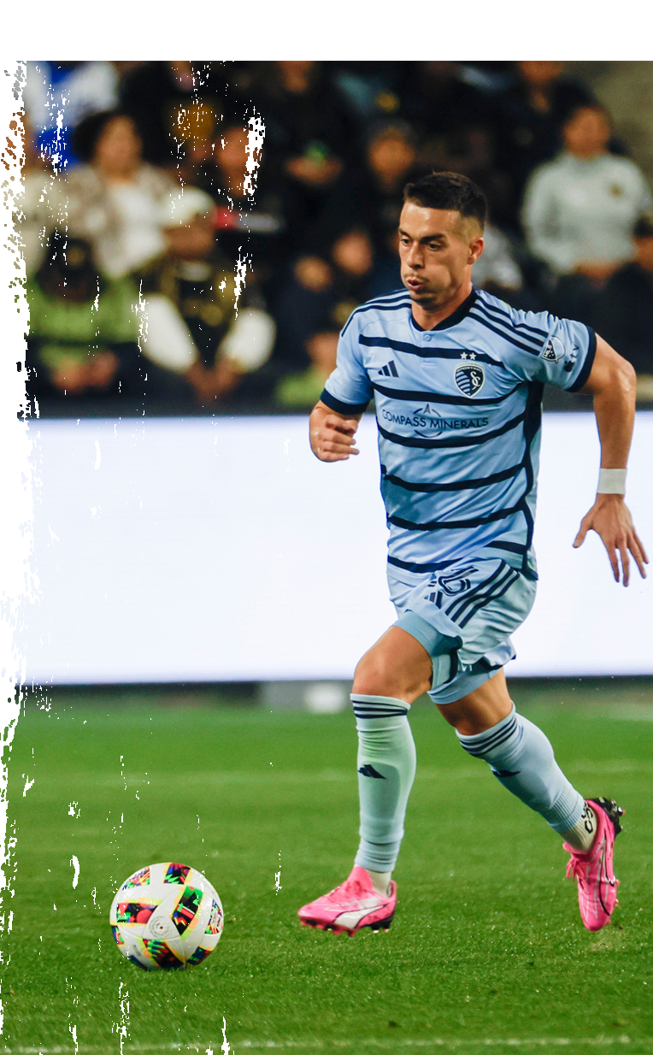
One year to go event: “ONE KICK, ONE CITY”
The Grand Finale: Compass Minerals National Performance Center
The final pass culminates live on stage at the Compass Minerals National Performance Center, Kansas City’s premier soccer training facility and home to Sporting Kansas City.
Here, we will launch the official one-year countdown to FIFA World Cup 2026™ with an unforgettable moment!
The pre-recorded montage plays on giant screens, showing the ball traveling through KC’s iconic locations.
The last recorded participant (e.g., a soccer legend, a community leader, or a young fan) makes a pass toward the camera.
The video fades seamlessly to live footage, revealing the final participant standing on stage, receiving the actual ball!
Notes:
across

Slide 8
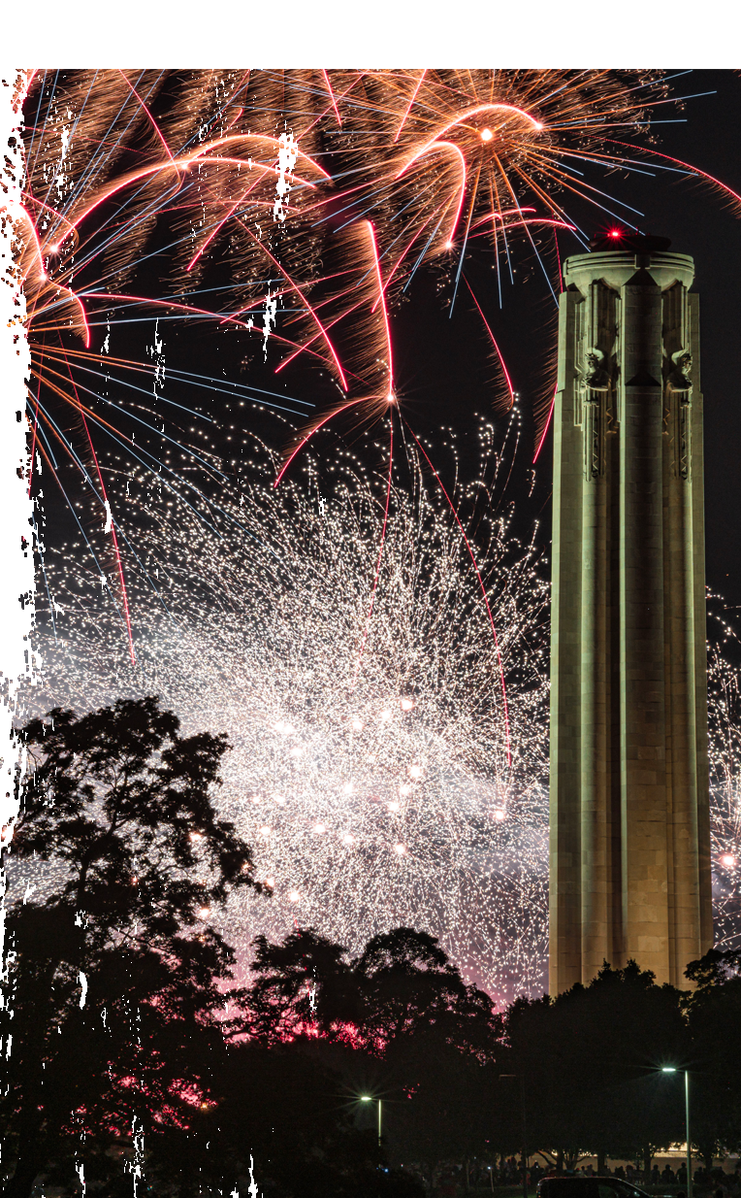
One year to go event: “ONE KICK, ONE CITY”
The final participant kicks the ball into a special illuminated goal, triggering:
A dramatic stadium-wide countdown (10…9…8…)
Fireworks and confetti cannons bursting in KC’s colors
The official FIFA World Cup 2026 countdown clock lighting up
LED screens displaying "Kansas City is Ready!” and the hashtag #1Kick1City26.
Tech N9ne to perform his Kansas City FIFA World Cup 26™ Sonic ID.

Slide 9
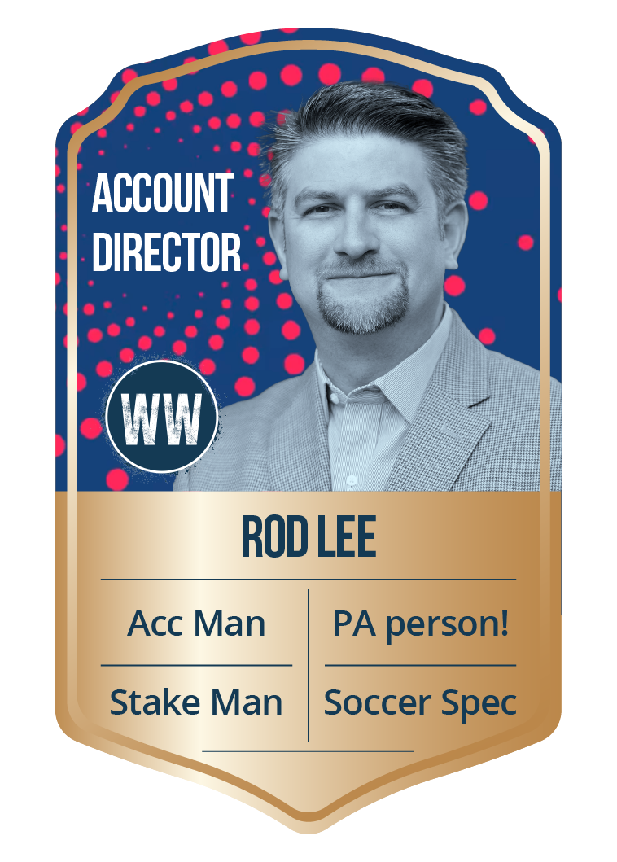
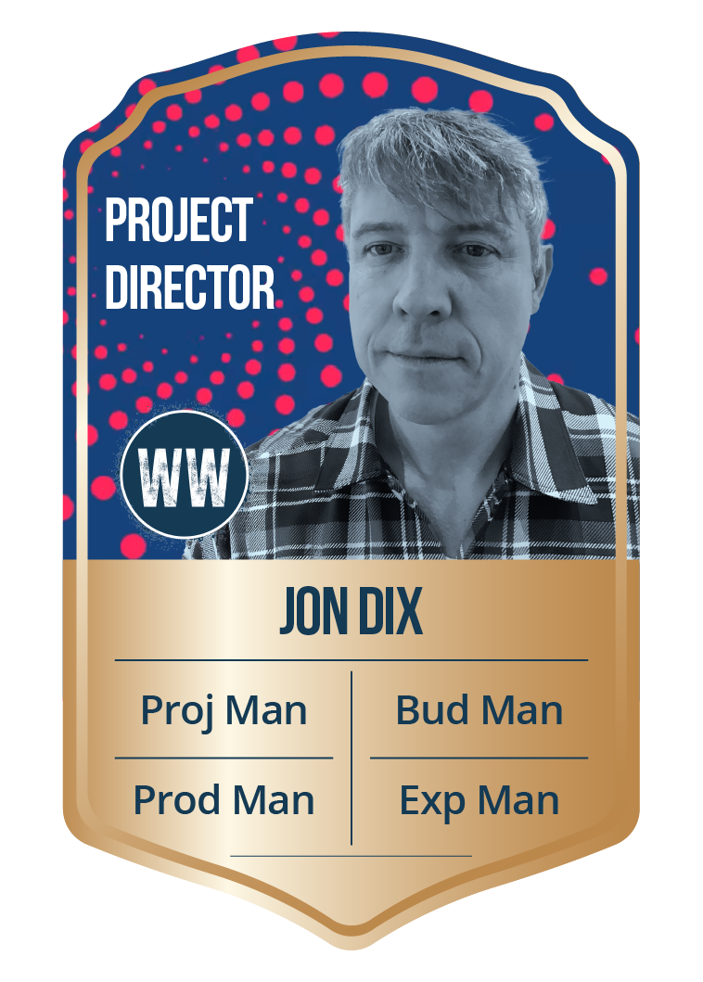

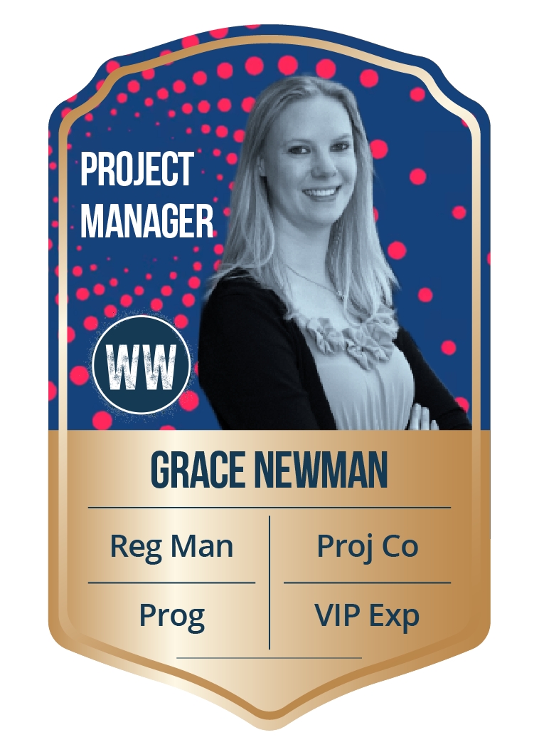
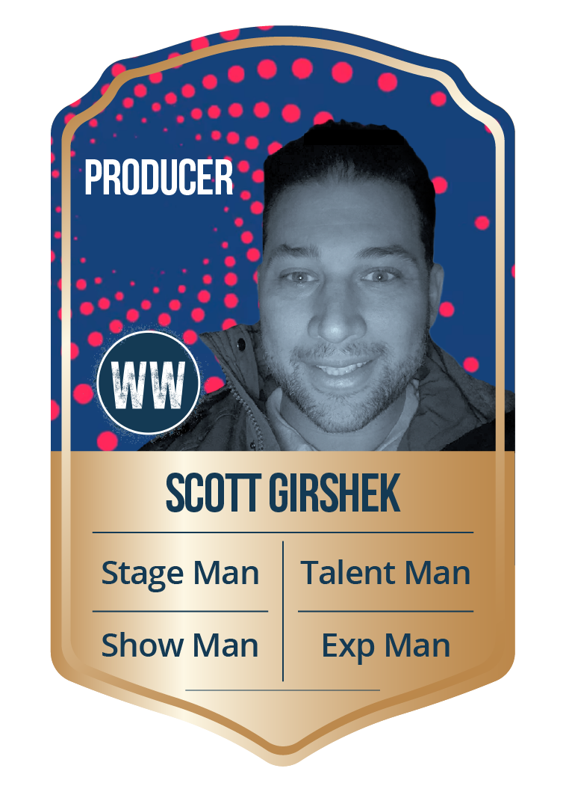
THE GALACTICOS

Slide 10
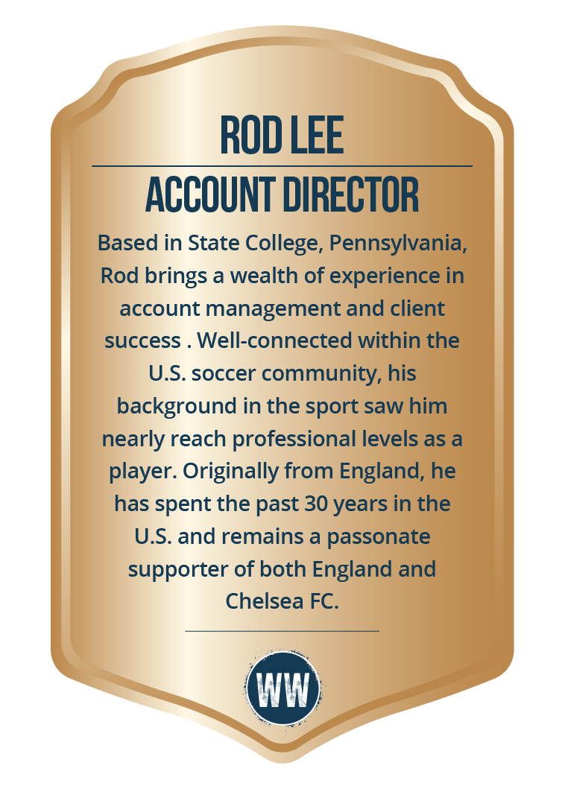
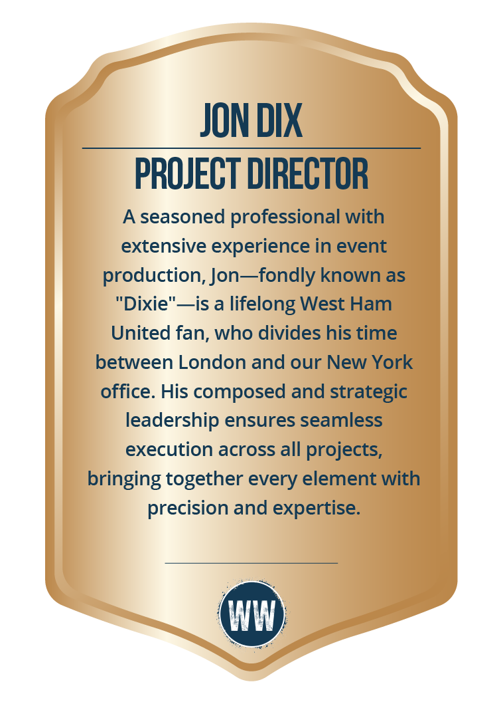
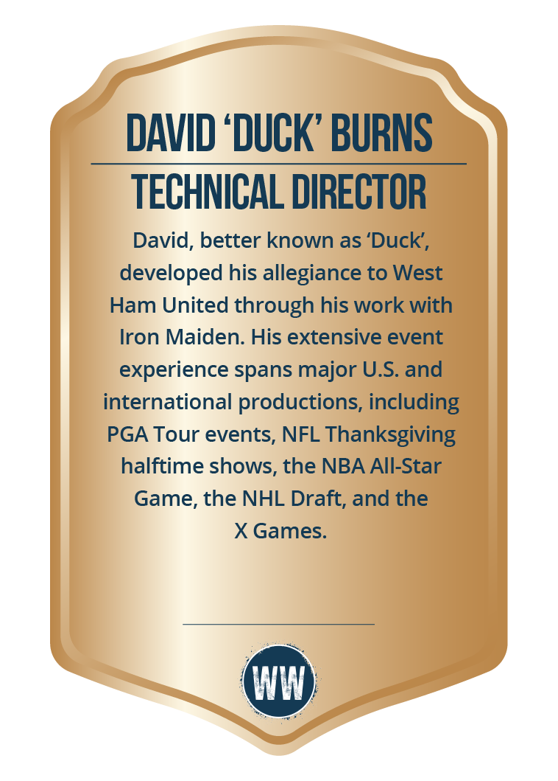
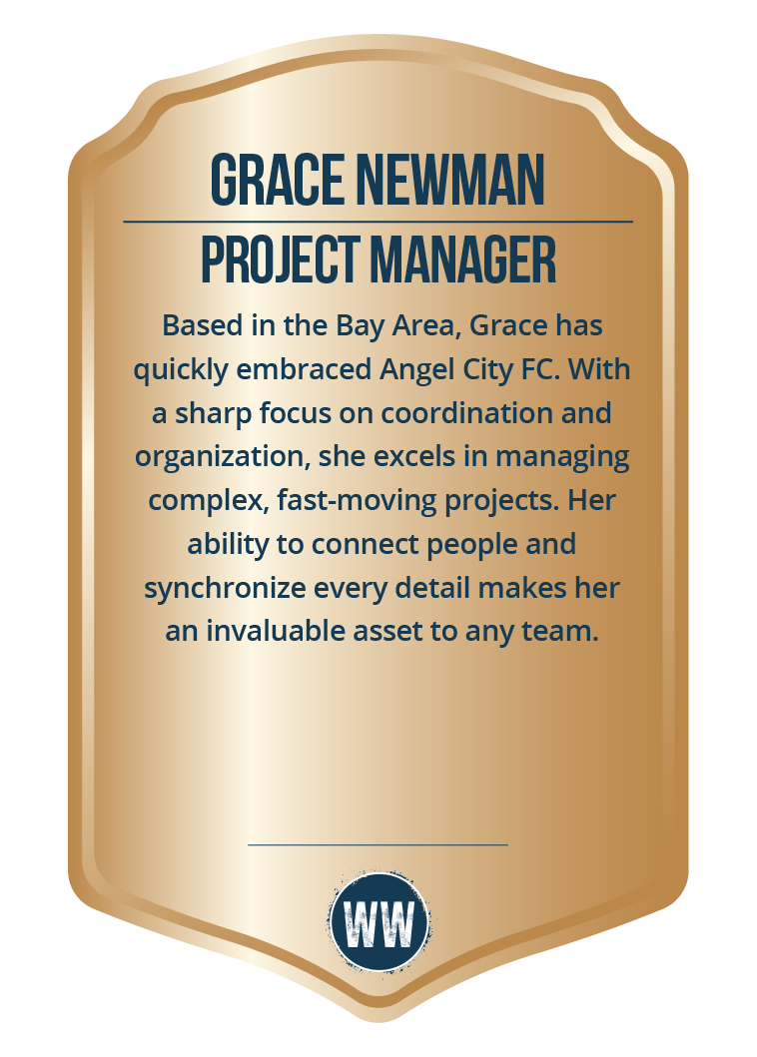
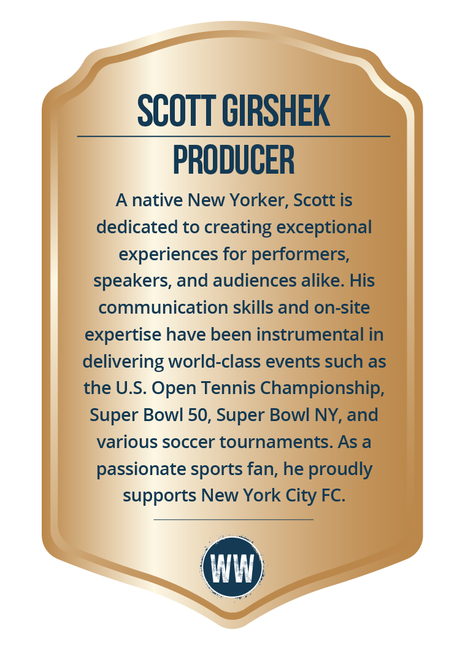
THE GALACTICOS

Slide 11
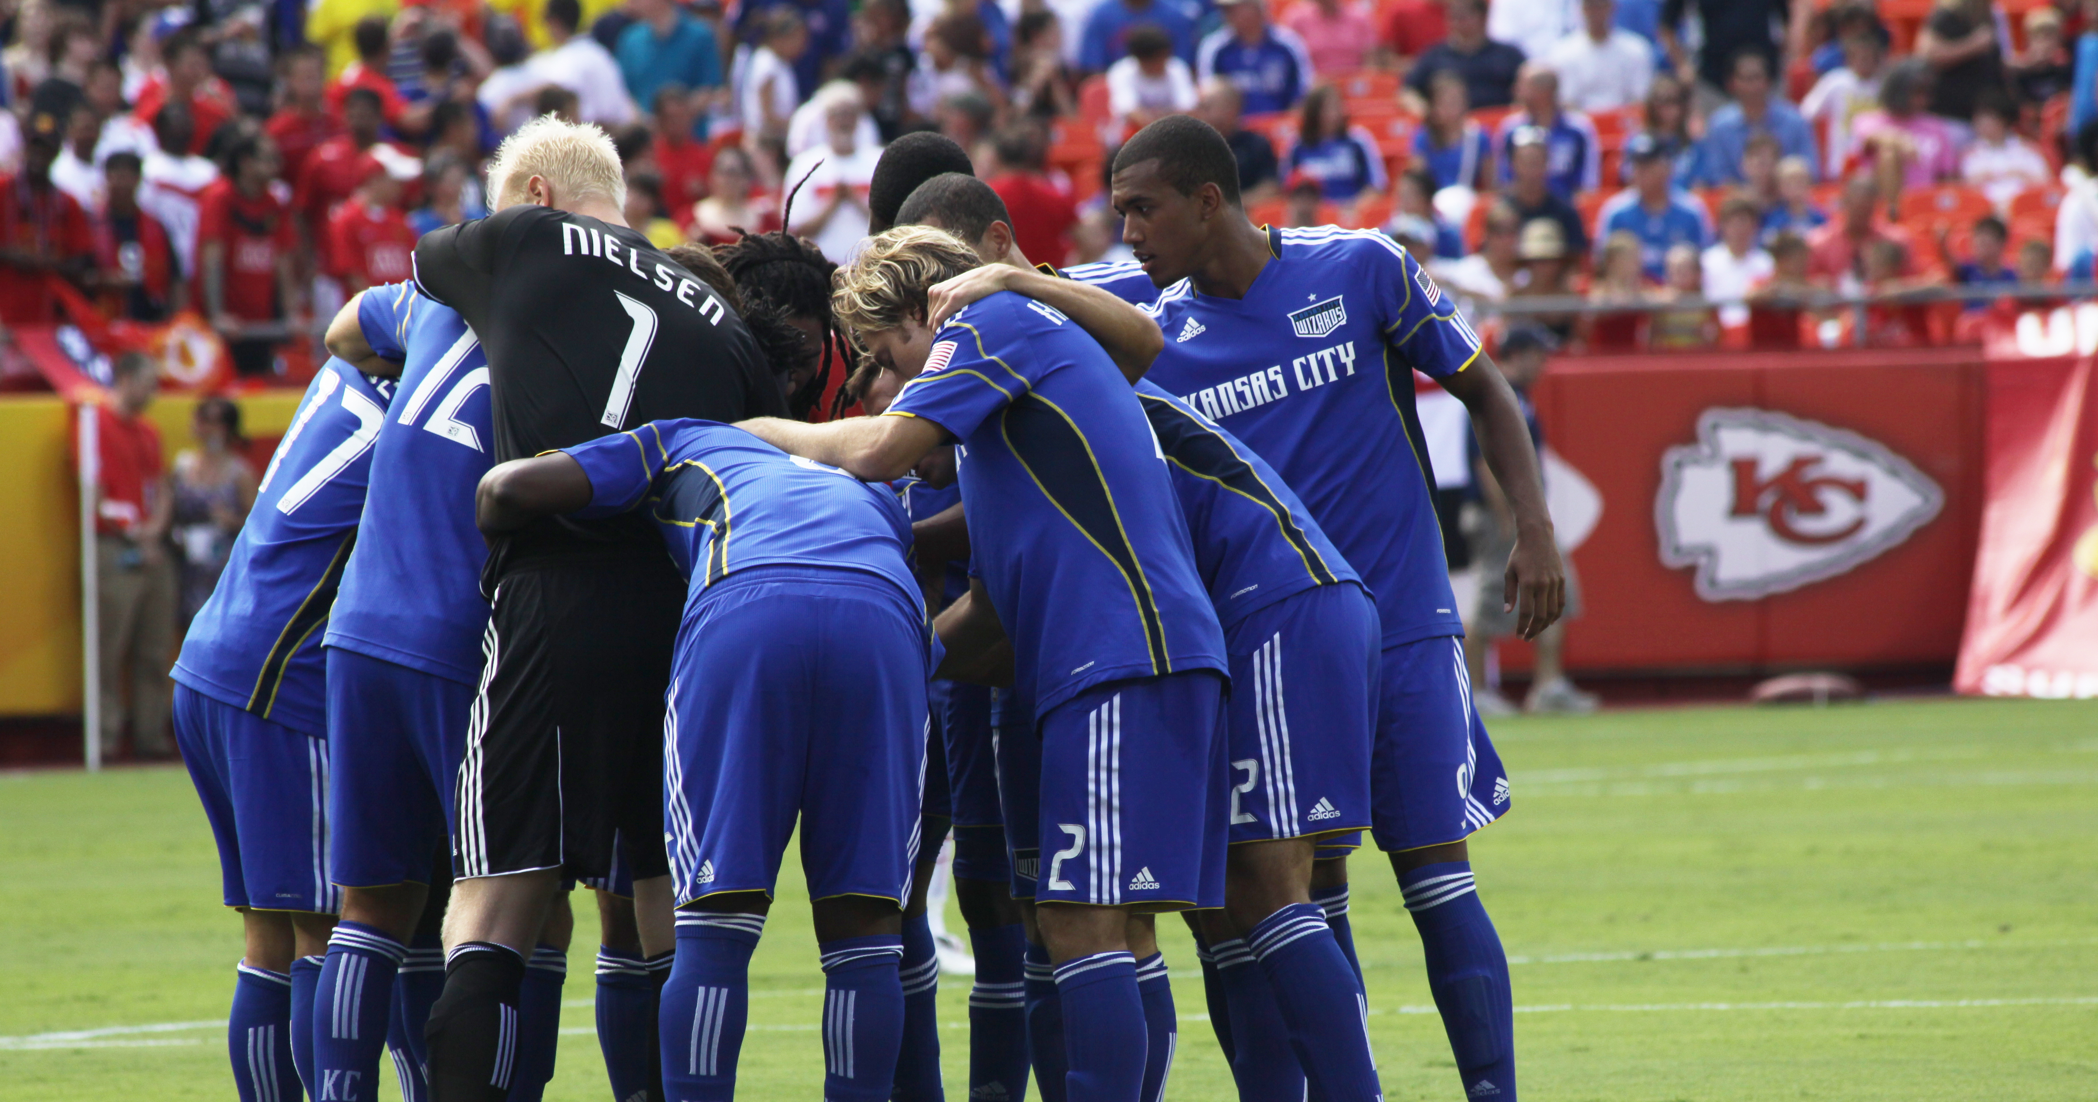
this is just
the beginning . . .

Slide 12
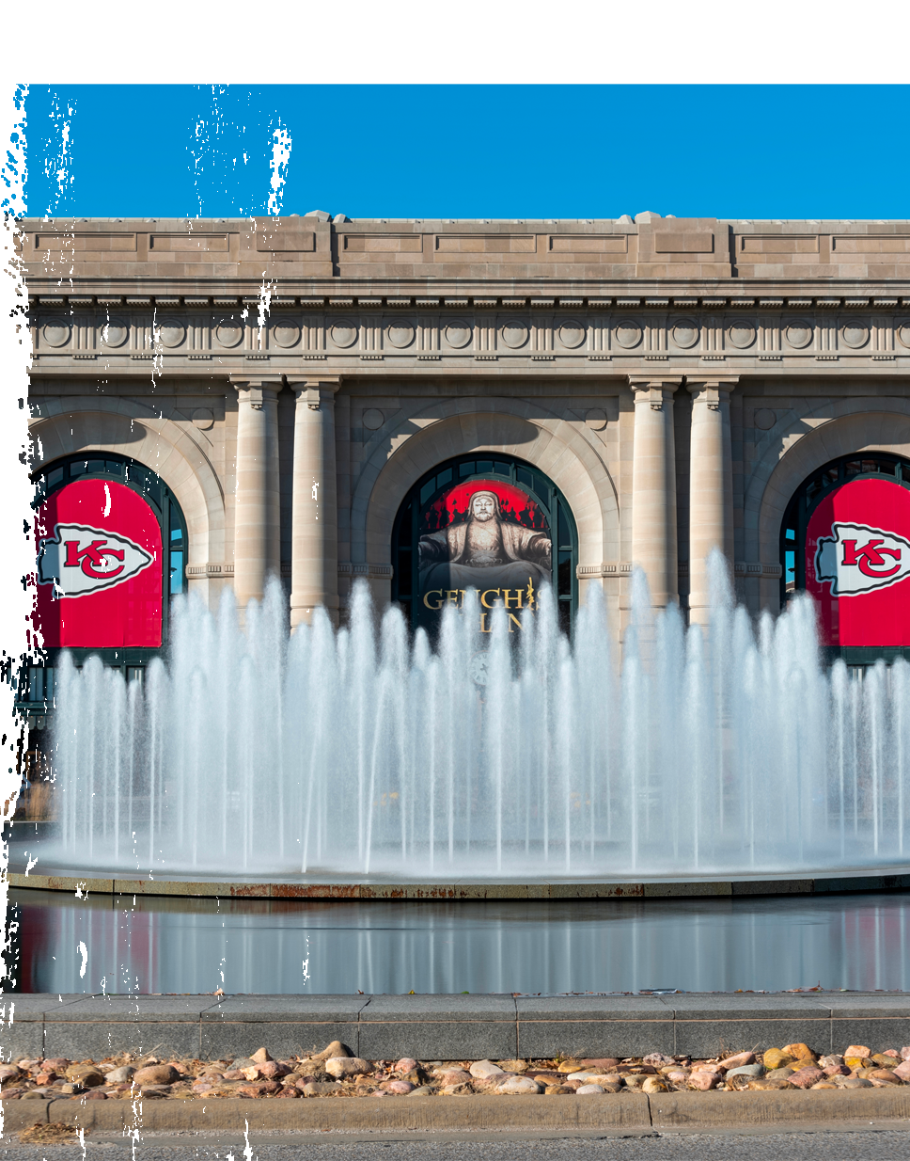
this is just the beginning . . .
”One Kick, One City” is just the first major milestone event leading up to FIFA World Cup 2026™.
Inspires Community Engagement – Engages Kansas City’s diverse neighborhoods.
Economic Boost – Creates jobs, increases foot traffic & boosts local businesses.
A Global Soccer City – Establishes Kansas City as an international soccer hub.
But one kick has the potential to go far . . .

Slide 13
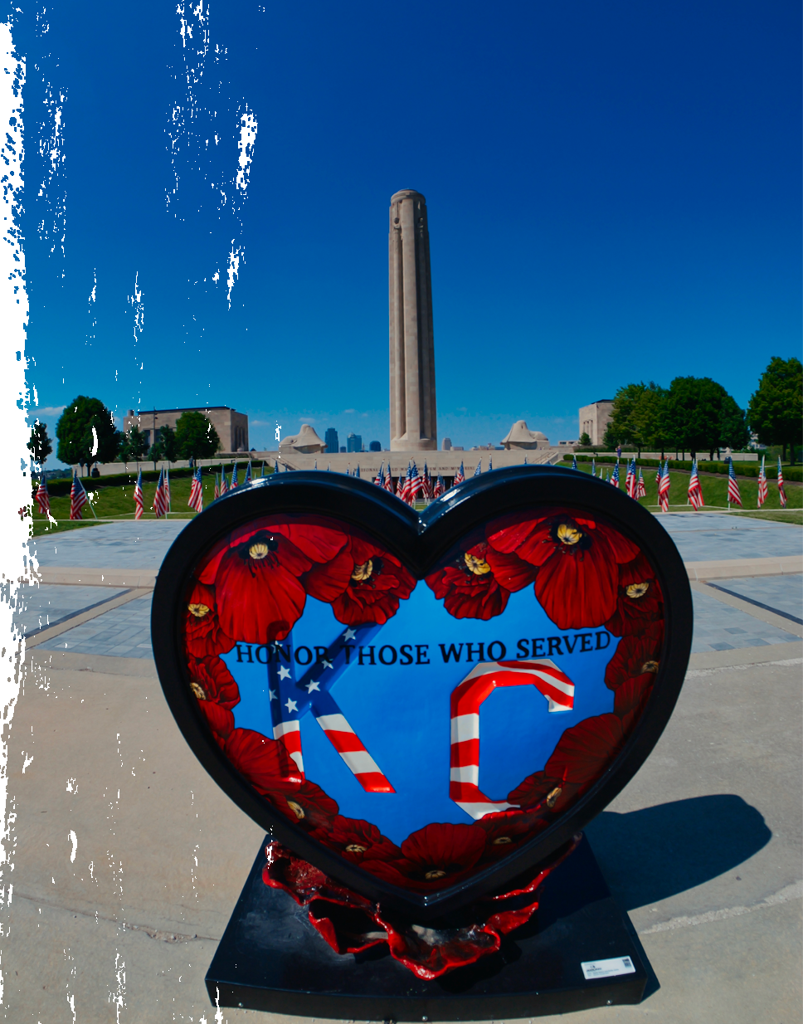

Kansas city WELCOMES THE WORLD
IN 2026
Kansas City’s journey towards World Cup 2026 starts here.
Let Whitewall help you win hearts and minds, creating your city’s very own superfans and a legacy for the future.

Slide 14
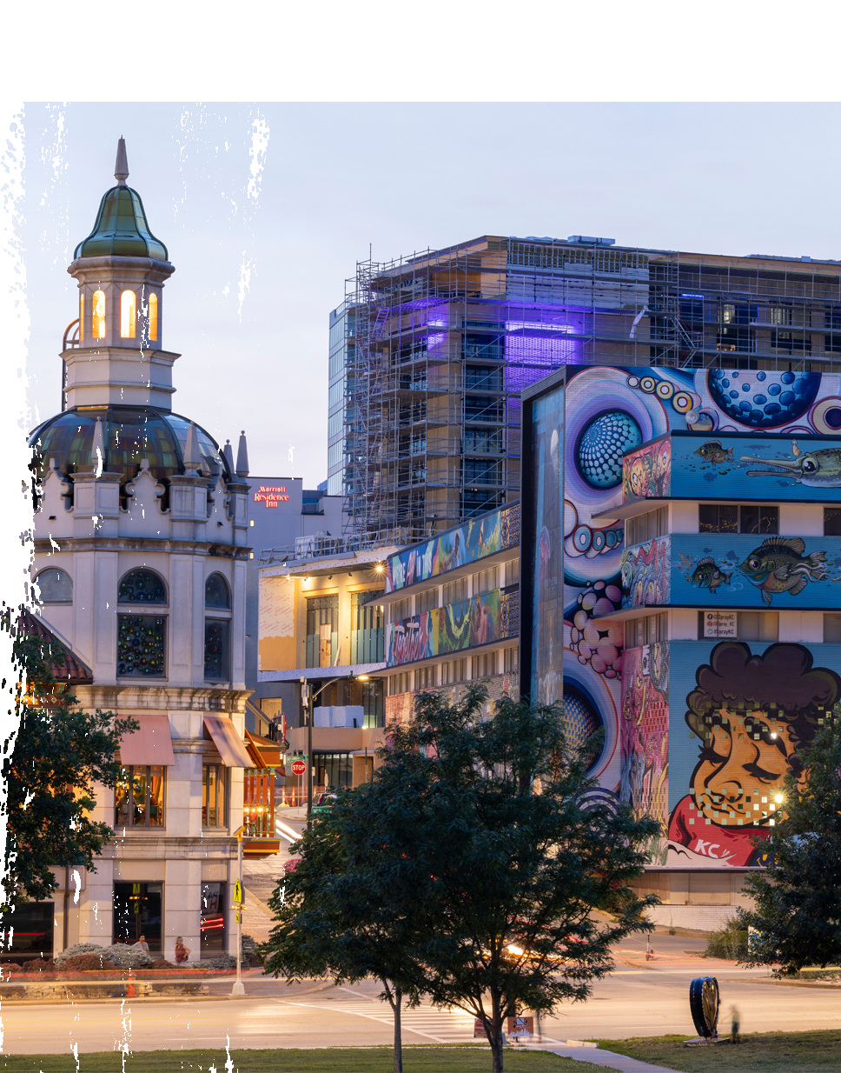
A time to shine
Stop someone on the street in Europe and ask what Kansas City means to them, and you might get a few bars of a certain song from “Oklahoma!”, but they probably wouldn't know the real you.
That’s certainly no bad thing – but with its rich history, diverse population and wealth of glorious attractions to explore, shouldn’t the Kansas City World Cup story be a little bolder?

Slide 15
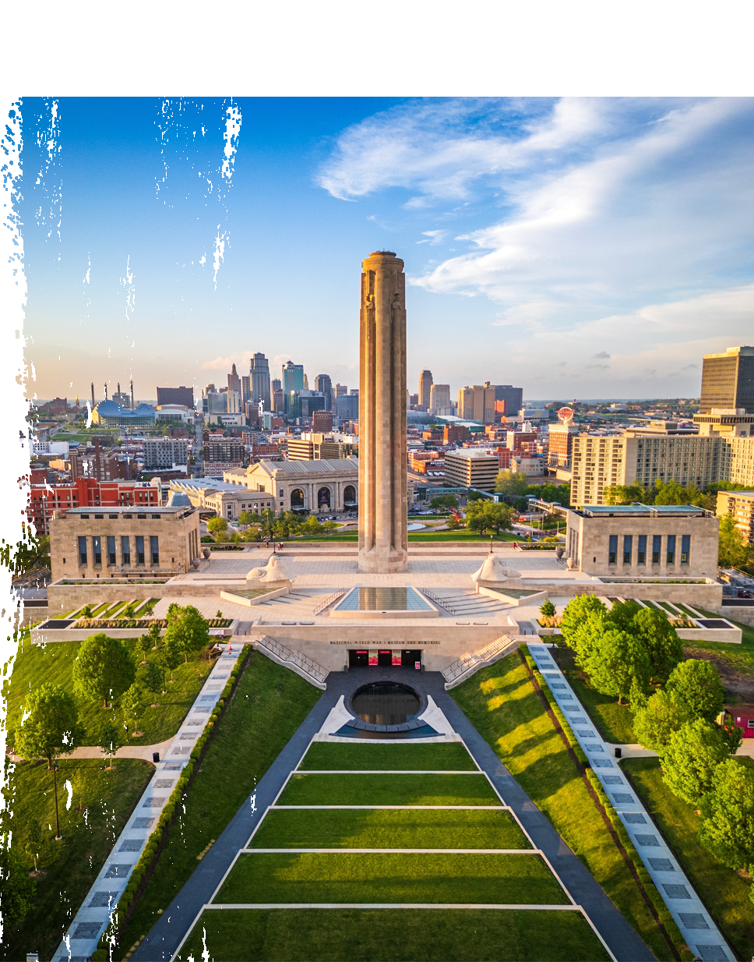
THE WORLD COMES TO Kansas City
Whitewall proposes #CITYUNITED, a multi-faceted engagement program designed to make the FIFA World Cup 2026™ a citywide celebration, ensuring that every Kansas Citian feels part of this historic moment.
Inspired by the transformative Olympic legacies of Barcelona (1992) and London (2012), this initiative will harness both live experiences and digital platforms to create a lasting impact on Kansas City's communities, culture, and economy.
Our Goal: To unite Kansas City under the shared excitement of hosting the FIFA World Cup, ensuring that its legacy is felt long after the final whistle.

Slide 16
WHAT IS #CITYUNITED
A citywide engagement campaign designed to ensure that every Kansas Citian feels part of FIFA World Cup 2026™ , uniting communities, businesses, and fans in an inclusive and unforgettable experience.
Why a Campaign Approach?
Sustained Engagement – Instead of a one-off event, #CITYUNITED delivers continuous activations leading up to and beyond FIFA 2026.
Citywide Reach – Activates neighborhoods, businesses, cultural spaces, and digital platforms, ensuring everyone can participate.
Legacy Building – Fosters long-term benefits through economic impact, community programs, and cultural storytelling.
Digital & Physical Integration – Combines live activations, social media movements, and digital experiences to maximize engagement.
#CITYUNITED is more than a celebration—it’s a lasting movement that ensures FIFA World Cup 2026™ leaves a powerful legacy for Kansas City.

Slide 17
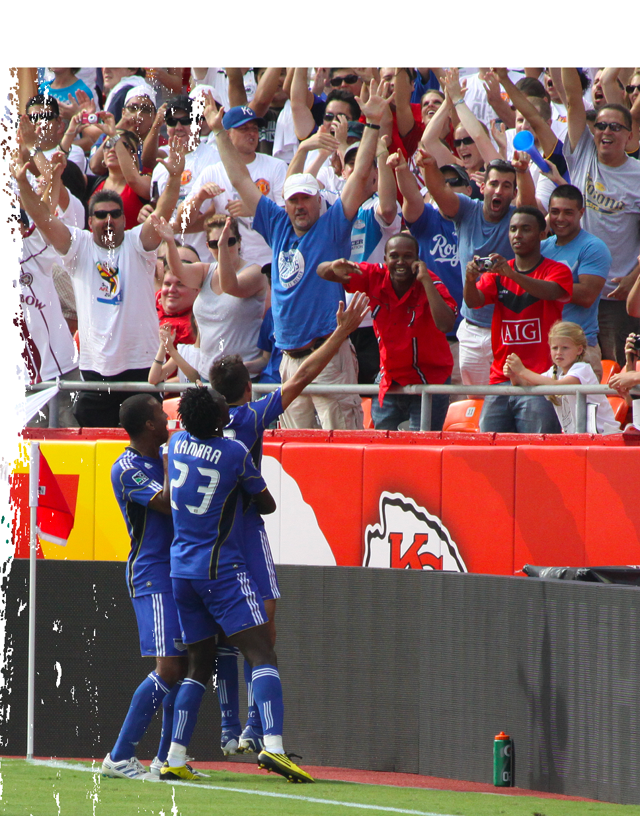
ways to engage
Kansas City Fan Zones – Designated city spaces for fans to gather, watch matches, and enjoy cultural programming.
Business Engagement Programs – Workshops and networking opportunities to help local businesses capitalize on World Cup foot traffic.
Sports Franchise Collaboration – Partnerships with Sporting KC, the Current, Chiefs, Royals, and others to amplify engagement.
Community Legacy Projects – Investment in youth soccer programs, infrastructure, and sustainable city initiatives.
International Promotion – Digital and social media campaigns showcasing Kansas City as a top World Cup host city.

Slide 18
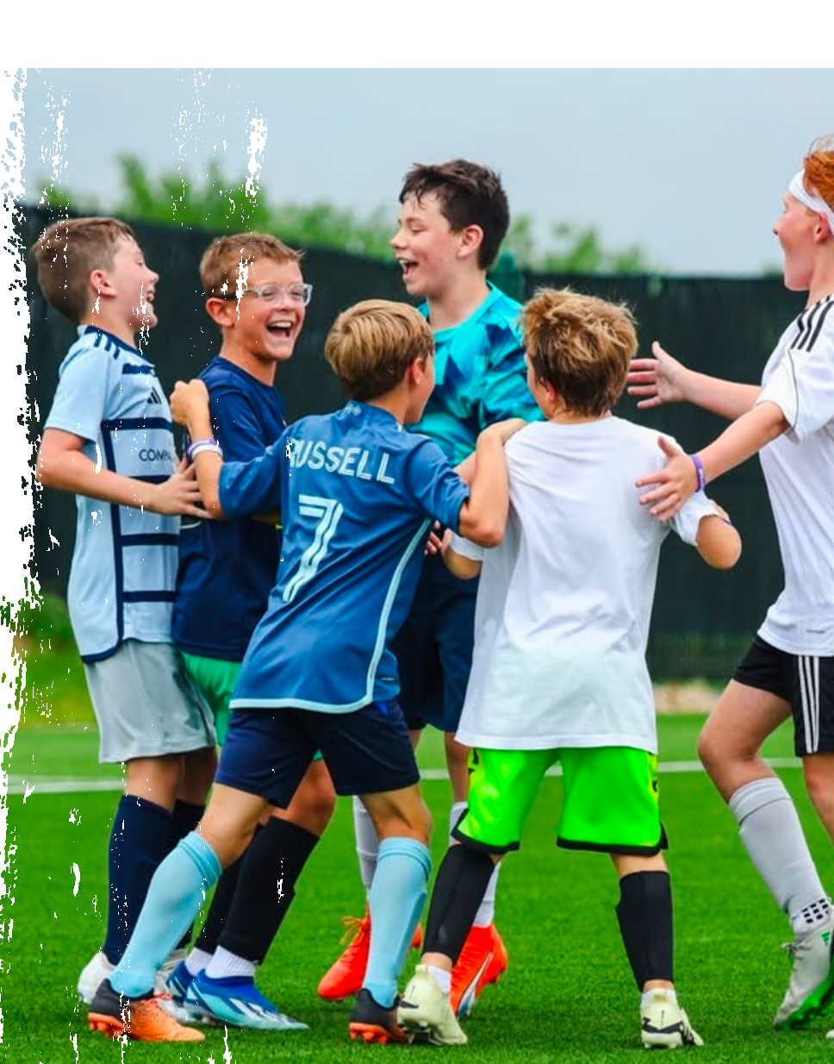
ACTIVATION EXAMPLE 1: SOCCER HUBS
Designate five key Kansas City neighborhoods. as soccer hubs, each featuring:
  Mini-soccer tournaments for adults and kids & freestyle football shows
  Local food markets
  Live music & cultural performances
Rotating events in underserved neighborhoods to ensure inclusivity.

Slide 19

A CITY UNITED digitally
#CITYUNITED Digital Hub – Centralized website and app with event information, schedules, and citywide participation guides.
FIFA World Cup 26™ Sonic IDs – “Amplify” the Kansas City Sonic ID created by Tech N9ne, to bring awareness of local musical and cultural flavor through music and sound .
Influencer & Ambassador Program – Partnering with athletes, celebrities, and influencers to promote Kansas City globally.
Social Media & Digital Ads – Targeted international campaigns showcasing Kansas City as a top destination.
Broadcast Integration – Collaborations with media partners to feature Kansas City during World Cup coverage.

Slide 20
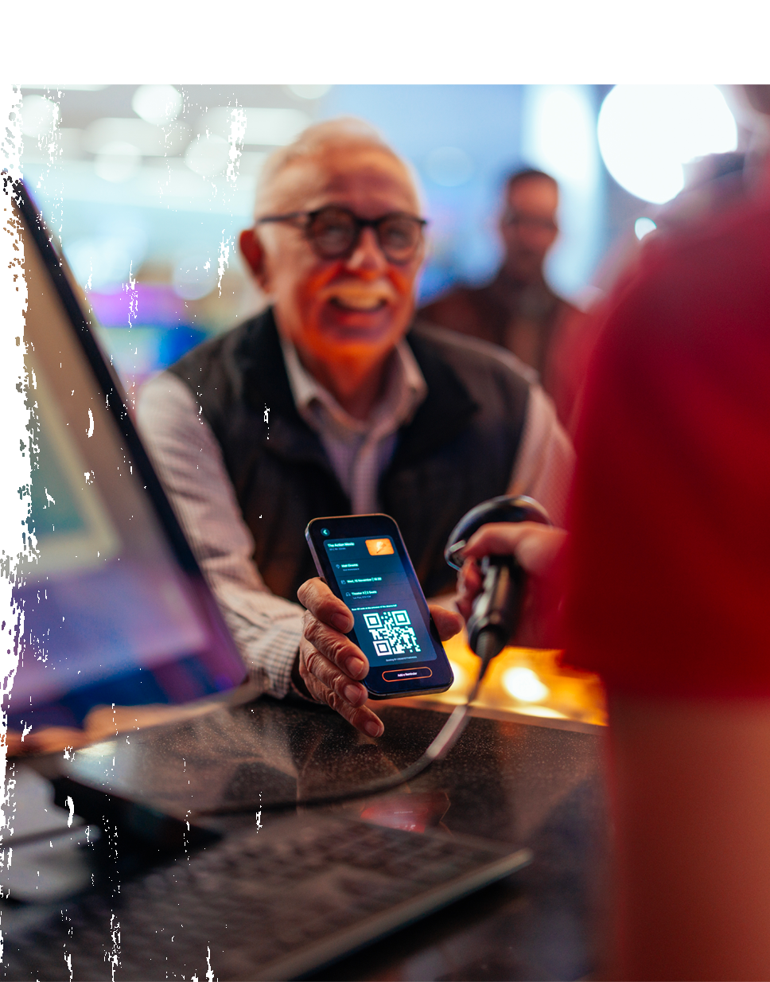

ACTIVATION EXAMPLE 2:
DIGITAL PASSPORTS
A mobile-friendly engagement platform rewarding residents for participation in city activations.
Fans earn points for attending events, visiting soccer hubs, and posting content.
Redeemable for merchandise, exclusive experiences, and VIP event access.

Slide 21
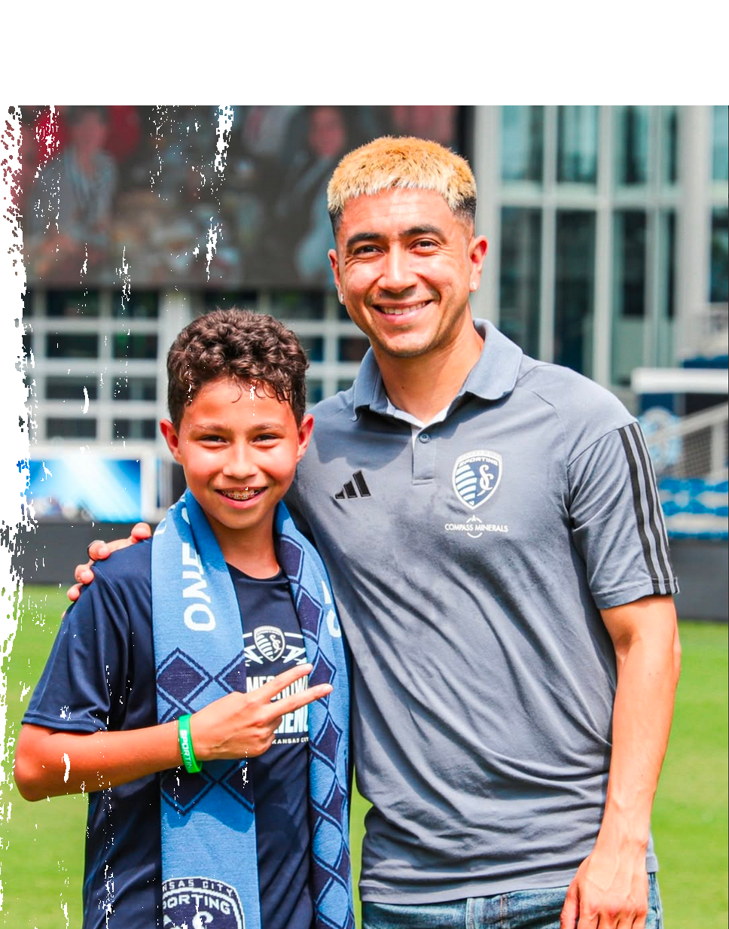
GET ENGAGED
Let us Help Make Kansas City’s 2026 World Cup Moment Unforgettable!
Align with key city stakeholders to finalize activation plans.
Develop public-private partnerships to maximize investment and sponsorship opportunities.
Engage local businesses, sports franchises, and community groups to ensure widespread participation.
Launch marketing and digital presence to promote #CITYUNITED leading up to 2026.

Slide 22
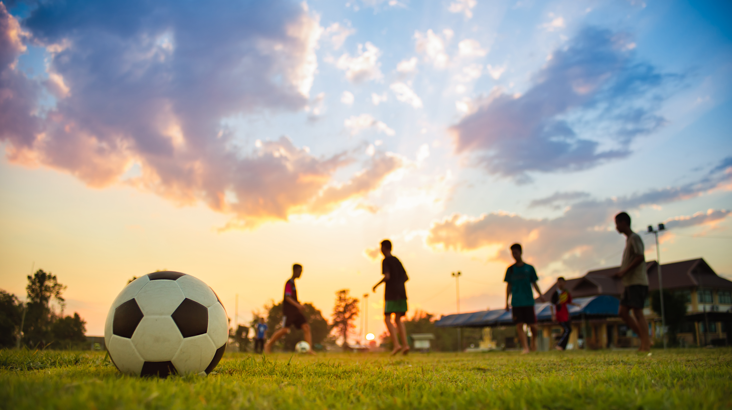
Rod Lee
Cell: 814-692-7945
Email: rod@whitewallcreative.com
Website: https://www.whitewallcreative.com

