Slide 1
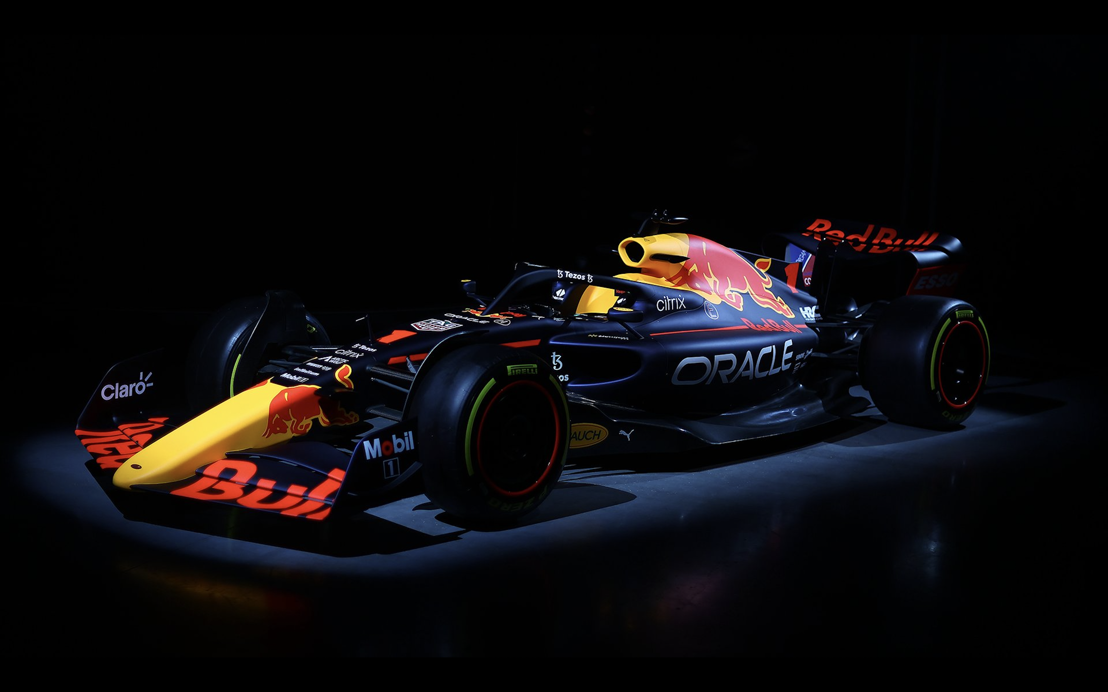
DATA-DRIVEN DECISION-MAKING - LIVE! -
THE ULTIMATE F1 ANALYTICS EXPERIENCE

Slide 2
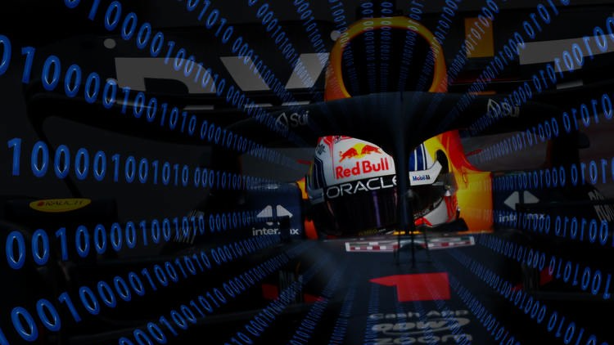
DATA-DRIVEN DECISION-MAKING IN ACTION
EXECUTIVE SUMMARY
Formula 1 (F1) represents a global phenomenon, attracting millions of fans across diverse demographics. Hosting an F1 watch party in collaboration with Whitewall and The Smedley Group provides a unique opportunity for tech companies to connect with customers through a shared passion, while showcasing their data analytics capabilities. This partnership taps into the synergy of data-driven storytelling, high-octane sports entertainment, and premium customer engagement.
OPPORTUNITY OVERVIEW
F1 offers unparalleled engagement opportunities for tech companies specializing in data analytics due to the sport's inherent reliance on cutting-edge technology and analytics. Every lap, pit stop, and strategic decision in F1 is powered by data, making it a natural fit to showcase your technology’s ability to derive insights and drive outcomes. The watch party offers a dual benefit: connecting with customers on an emotional level through shared excitement while demonstrating real-world applications of analytics in an exciting and accessible way.

Slide 3

DON’T JUST WATCH IT, LIVE IT!
INTRO
Want to turn audiences into fans? Live experiences are bigger than ever – and participants’ expectations are sky-high for what they should deliver.
Combining the power and insight of Oracle Analytics with the speed and energy of F1, this is an experience like no other: a chance for your customers to be so close to the action, they’re practically in the driver’s seat.
CONCEPT
This F1 Watch Party combines an engaging live, in-person event held 48 hours before the race with an innovative virtual experience during the race itself.
By leveraging historic and real-time data, this format builds excitement and provides attendees with unique insights, culminating in a race-day commentary featuring Rob.

Slide 4
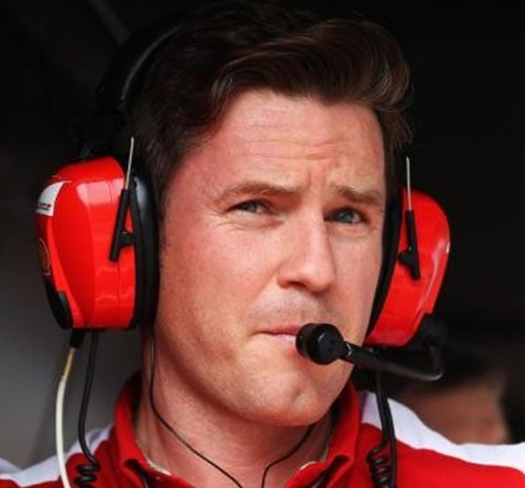
YOU ARE IN THE DRIVING SEAT,
WITH A CREW LIKE NO OTHER
EXPERIENCE . . .
How F1 Analytics data performs in real-time, when the stakes couldn’t be higher
How the pit crew leverages the power of that data to make split-second decisions on tactics and execution
How data-driven decision-making can make the difference between the checkered flag and disaster
How data analytics inform smarter, more efficient and more effective performance from man and machine
ROB SMEDLEY
One of the most respected and experienced individuals in F1, Rob is leading the way in the development and application of analytics to power the next generation of F1 champions.
His insight into the power of analytics in unparalleled; understanding not just the science behind the analysis, but able to show how and why the data is informing decision-making in a high-pressure environment.

Slide 5

PRE-RACE LIVE EVENT
Purpose: Deliver an immersive, expert-led experience where attendees gain exclusive insights into F1 strategy, historic data analysis, and predictive analytics for the upcoming race.
Audience Size: 50–200 attendees (scalable).
Venue: A high-tech space such as a data center, interactive tech hub, or luxury venue with advanced AV capabilities.

Slide 6
PRE-RACE LIVE EVENT
Welcome & Networking Session: Kick-off the event with refreshments and an F1-themed networking activity, such as virtual pit-stop challenges or an F1 trivia quiz.
Keynote by Rob Smedley: Rob shares his unique perspective on how data analytics drives success in F1.
  Insights from his time with top F1 teams and how these strategies translate into other industries.
  Anecdotes from his career to captivate and inspire the audience.
Historic Data Review with Rob and Your Analytics Team: Analyze data from previous races at the same circuit, focusing on:
  Team strategies.
  Key decisions and their impact on race outcomes.
  Insights into how analytics influenced critical moments.

Slide 7
PRE-RACE LIVE EVENT
  Predictive Analytics Showcase:
      Rob collaborates with your analytics team to simulate race-day scenarios.
      Predict likely strategies for drivers and teams, comparing different approaches and potential outcomes.
  Interactive Fan Predictions with Rob:
      Attendees make their predictions for the upcoming race using a custom app or portal.
      Rob engages with audience members, offering his take on their predictions.
Bonus Activity:
  "Pit Wall Simulation": Attendees step into the shoes of an F1 strategist, using live data and predictive models to make decisions.

Slide 8
VIRTUAL RACE-DAY EVENT
Purpose: To deliver an immersive race-day experience to attendees, keeping them engaged with live commentary and exclusive insights during the F1 event.
Platform: A custom virtual platform or app that provides a seamless blend of race footage, live analytics, and expert commentary.
Key Features:
  Live Commentary with Rob: During pivotal race moments, Rob provides exclusive commentary focusing on:
      Real-time strategic decisions by teams and drivers.
      Analytics-backed insights that explain why certain moves were made.

Slide 9
VIRTUAL RACE-DAY EVENT
  Data Visualizations in Real Time:
    Integrate real-time race data feeds to show:
      Lap-by-lap analytics.
      Live leaderboards and team performance metrics.
    Compare predictions made during the live event to real-time outcomes.
  Interactive Polls & Q&A: Enable attendees to ask questions or vote on likely outcomes during the race.
  Social Integration: Encourage attendees to share their experience on social media with event-specific hashtags.
Audience Reach: Thousands of participants globally, thanks to the virtual, scalable format.

Slide 10
EXAMPLE SCHEDULE
Pre-Race Analytics Event:
6:00 PM: Welcome and Networking.
6:30 PM: Historic Race Data Breakdown.
7:15 PM: Predictive Analytics Showcase.
8:00 PM: Interactive Fan Prediction Activity.
8:30 PM: Closing Remarks & Q&A.
Race-Day Virtual Experience:
Start Time: Live 15 minutes before the race begins.
Key Features:
    Pre-race setup with predictions recap.

Slide 11
KEY BENEFITS OF THIS FORMAT
Leverage Rob Smedley’s Expertise and Star Power
  Rob’s involvement elevates the credibility and appeal of the event, making it a must-attend experience for fans and industry professionals alike.
  His ability to translate complex data into compelling stories demonstrates the practical value of your analytics solutions.
Unique Two-Touch Engagement Model
  Pre-Race Event: Builds excitement with face-to-face interactions and exclusive insights.
  Virtual Race-Day Experience: Keeps the momentum going with immersive, real-time engagement.
Seamless Scalability
  The live event serves as a high-touch experience for select clients and partners.
  The virtual component allows for global participation, potentially reaching thousands of attendees.
Positioning Your Brand
  Associating your analytics platform with F1’s cutting-edge technology through Rob’s expertise reinforces your positioning as a leader in innovation and data-driven decision-making.

Slide 12
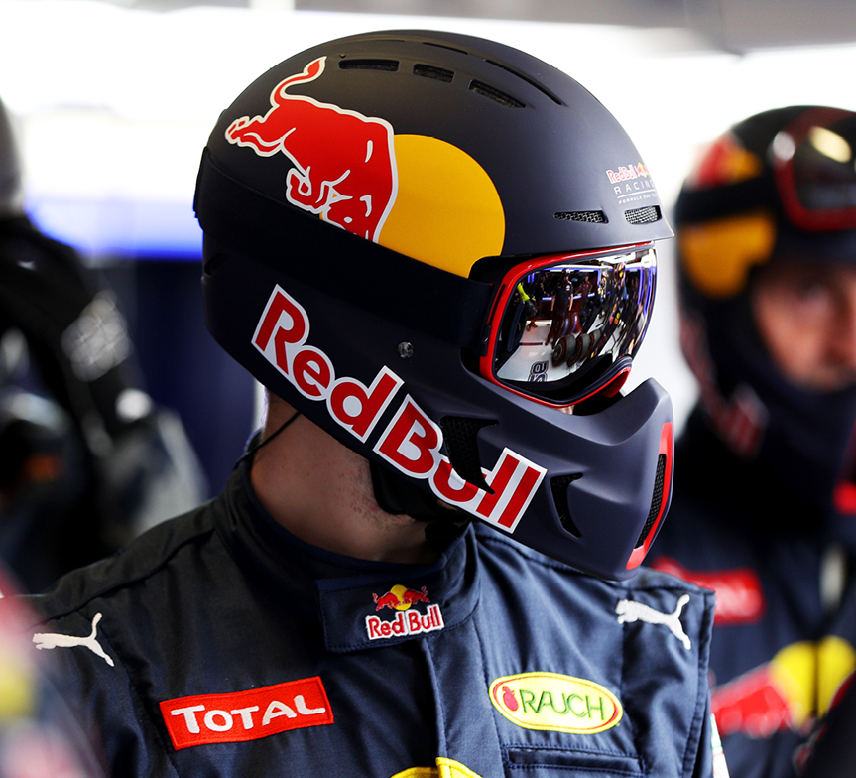
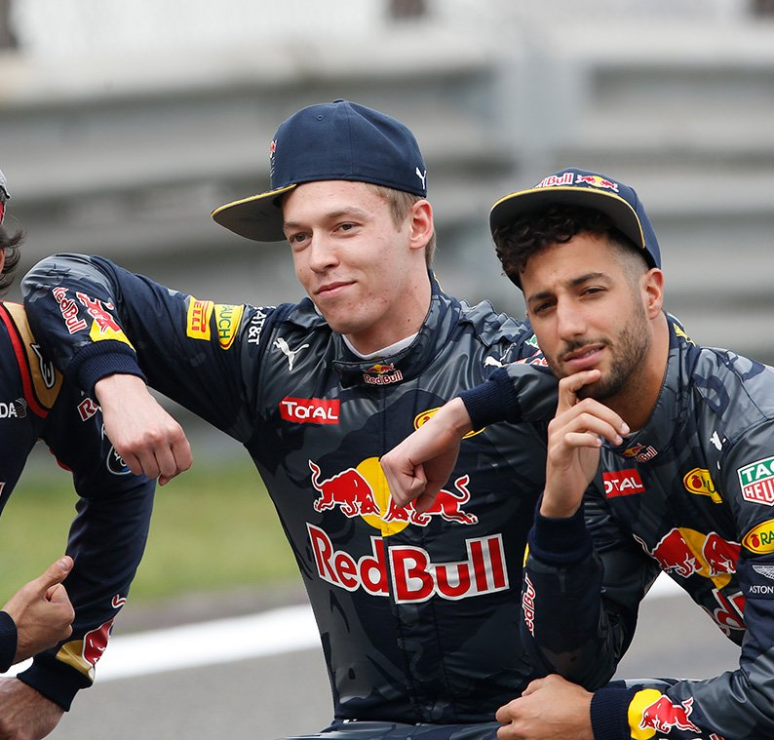
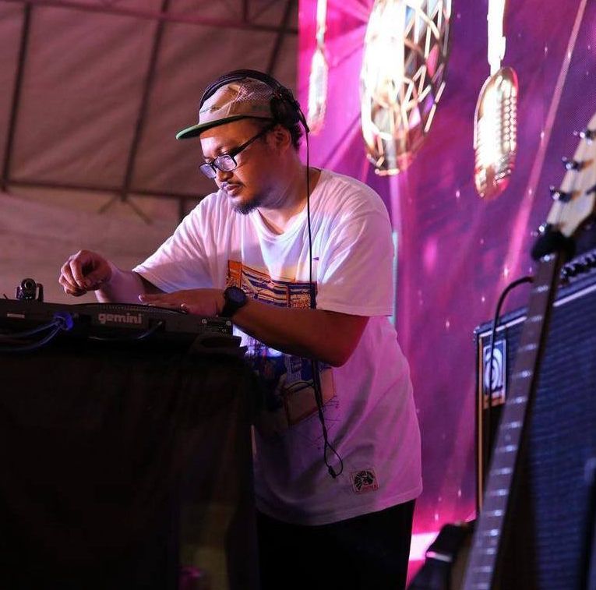
WANT A TRULY IMMERSIVE F1 EXPERIENCE?
“THE PADDOCK"
We can create a physical environment that brings the roar of the racetrack to you
Using stunning sound and awesome visuals, you’ll experience every moment
Our uniformed crew are on hand to ensure a great atmosphere
Music from our in-house DJ brings a touch of trackside to the event
Wouldn’t be a Grand Prix without some souvenirs – and our swag bags are always first across the finish line

Slide 13

MAKING EVERY F1 MOMENT COUNT
YOUR PERFECT PARTNER
Whitewall has worked with for over 20 years designing and delivering hundreds of on- and off-line experiences around the world
As an global agency, we are already on-board and raring to go
We can cover all the logistical and production elements, experience engineering, design and content - and we can do all that anywhere on Earth
Our passion is turning audiences into fans – let us take your customer relationships to the next level!

