Slide 1
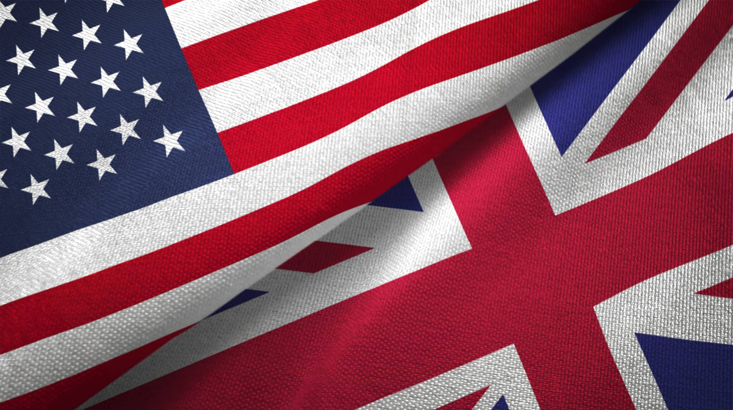
COMING TO AMERICA?
FIND OUT MORE

Slide 2
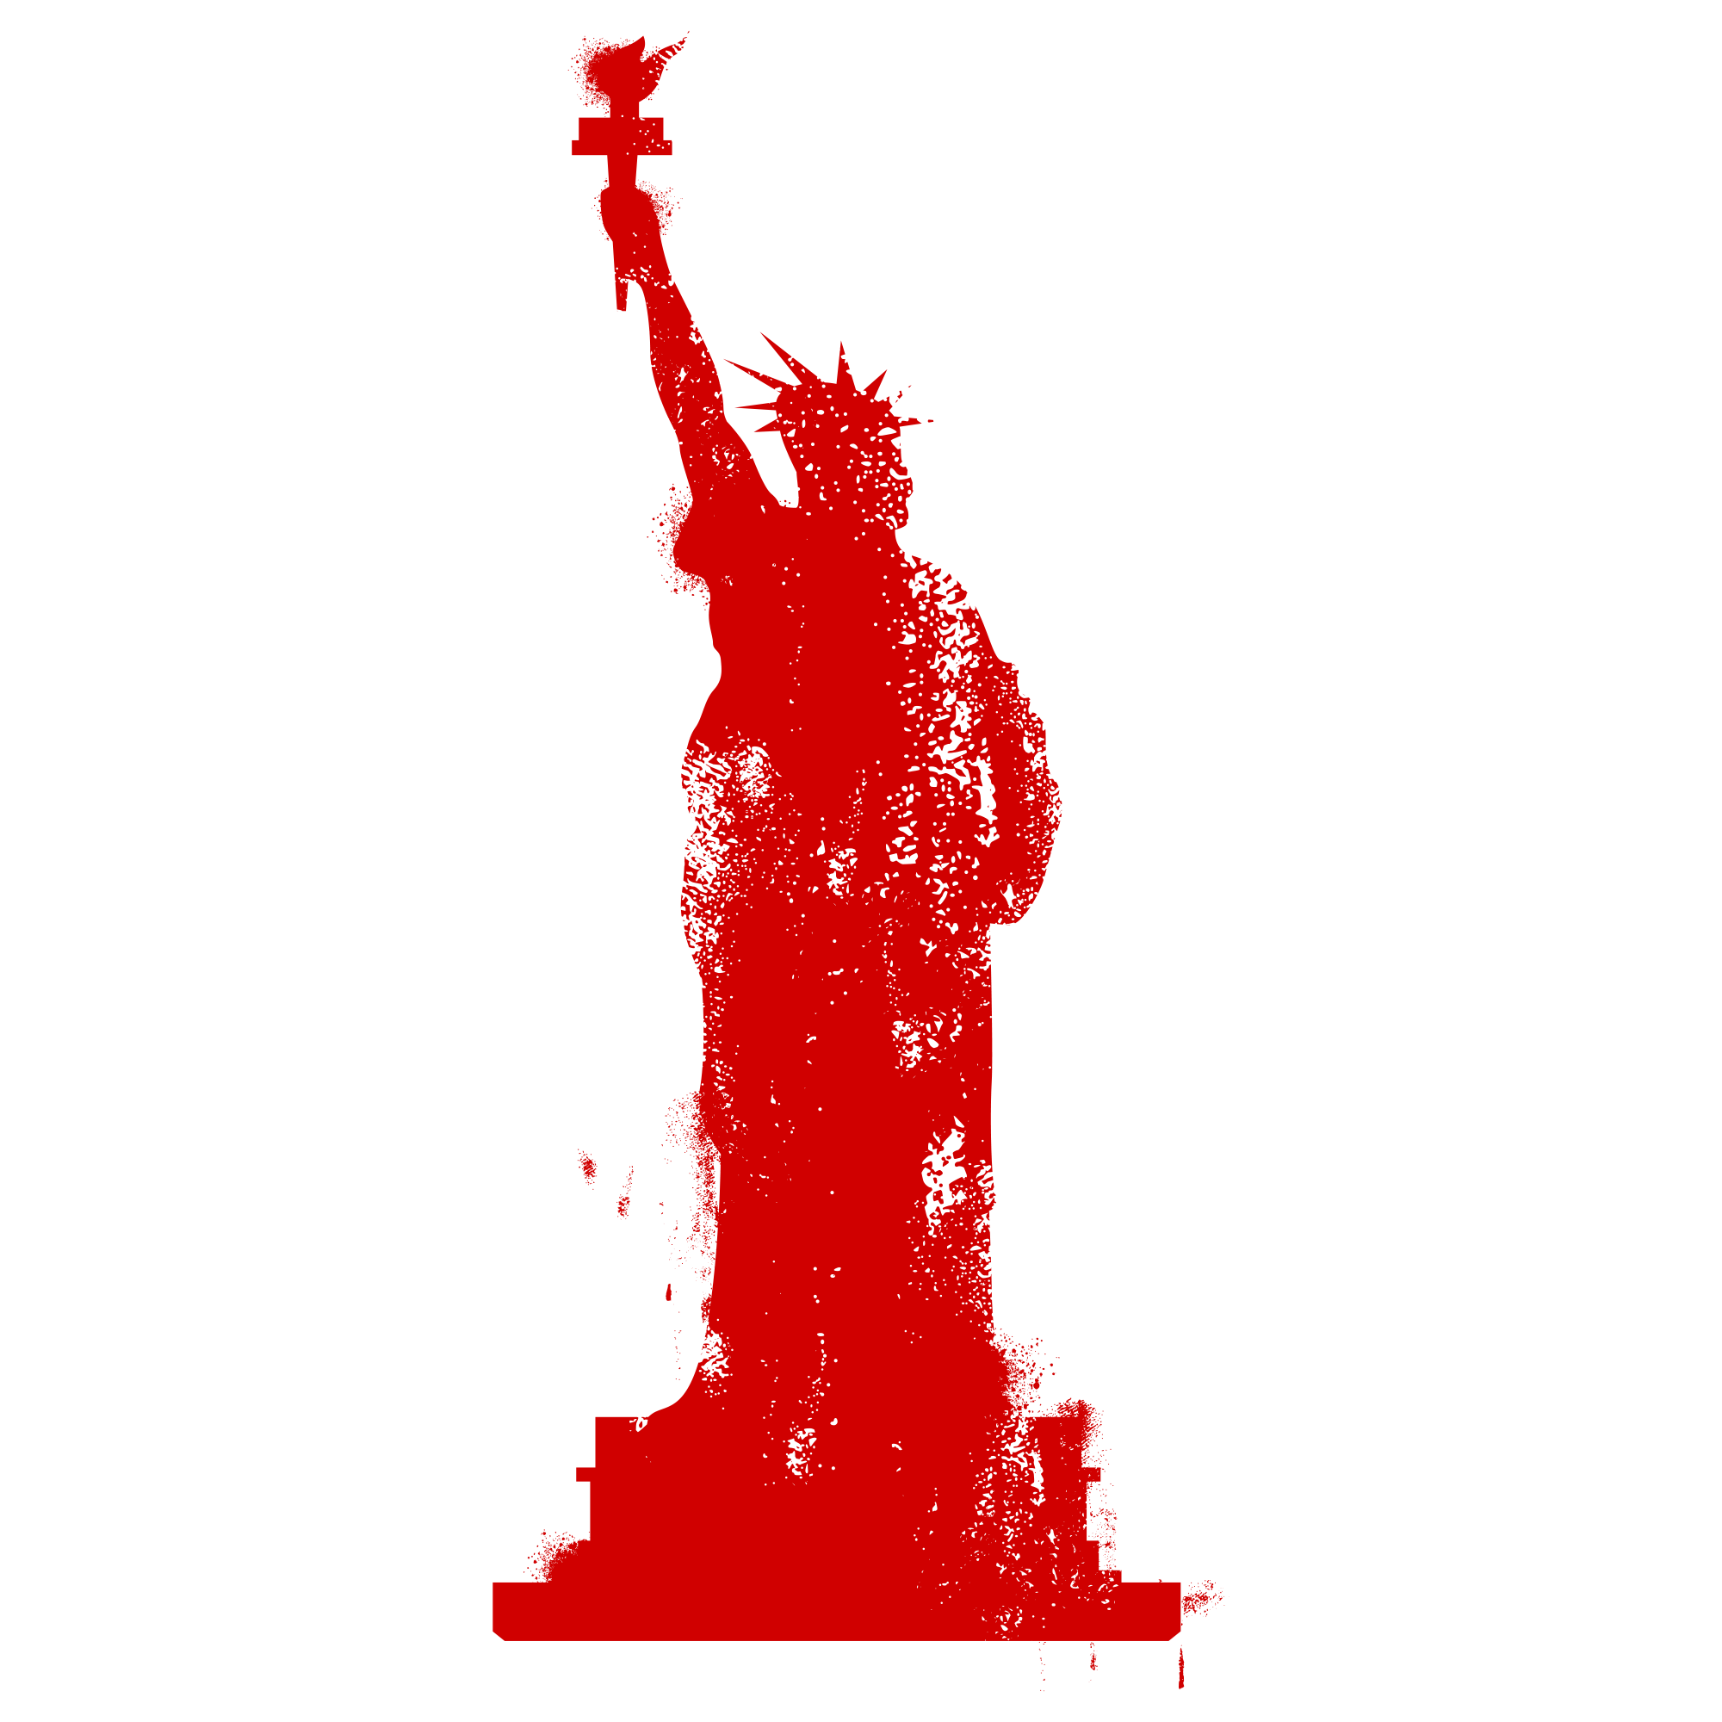
YOU NEED SOMEONE WHO SPEAKS THE LANGUAGE!
Q: How hard could it be? A: You have no idea.
Take it from a company that’s done it; expanding your business into the US is no small feat. To succeed, you’ll need a creative agency partner who understands the pitfalls, possibilities and peculiarities of this exciting but challenging economic landscape.
For 10 years, Whitewall has succeeded where others have failed. More than that, we’ve helped many UK businesses to find their feet and their American accent; maximising their chances of success, enhancing their reach and driving business growth.
YOU NEED U.S.

Slide 3
YOUR STARTER PACK INCLUDES:
Logo & Branding Development
Your brand identity is critical to making a great first impression.
Professional Logo Design: Tailored to your vision, ensuring it stands out in the US market.
Branding Package: Including a simple color palette, typography, and brand guidelines to maintain consistency across all your materials.
Animated Brand Video
Tell your story to customers and investors with a short, animated film.
Optimizing Social Media Profiles: For Linked-In, Instagram, X and more.
Branded Templates: For consistent, on-brand social media posts and engaging content.
Investor/Pitch Deck
If you need to pitch to potential customers, partners or investors, Whitewall will design an eye-catching, professional pitch deck that clearly communicates your business vision, goals, and market fit.

Slide 4
OUR NY25 OFFER FOR YOU . . .
Because we know we can get you where you need to be, we have a special NY25 offer for you. The estimated value of the Starter Pack is $80k – but until the end of January 2025, it’s yours for just 10% of that. Trust us: no other US-based vendor will be able to match that.
With Whitewall, you get:
Experience You Can Trust: A trusted creative partner for high-quality design by people who know the US market.
Expert Guidance: Everything you need to know from an agency that has successfully launched in the US.
Comprehensive Branding Solutions: Ensuring your company makes a memorable entrance in the US.
Let Whitewall help you succeed in the US market by creating the right collateral to establish your brand and drive growth.
Contact us today for a personalized consultation on how we can support you.
YOU NEED U.S.

Slide 5
CONTACT US
WHITEWALL
Whitewall leverages the power of content and people to give its clients ‘creative agency’: using our skills, experience and insight to improve and energize output with the power to get results.
Rod Lee
SVP, Customer Success
T: +1 (814) 692-7945
E: rod@whitewallcreative.com
www.whitewallcreative.com

