Slide 1
DRAFT Key Messages for 2025 GMQ:
OAC continues growing massively via FDI
FDI adopters do not evaluate it vs. ABI tools, as the business value is differentiated
OAC is a key part of Oracle’s new Data Intelligence platform
Oracle Data Intelligence = D&A Ecosystem + AI + D&A&AI content
Oracle’s TOTAL Ecosystem is by far the most the capable of any cloud hyperscaler
As the CC and Bake-Off showed, OAC is one of the strongest ABI tools available
AI innovation in OAC goes on, with new functionality added since the last MQ
OAC Data Actions mean it is arguably the most actionable of all ABI platforms
Adaptive Intelligent Apps are a key part of how OAC will reach more buyers
FDI Intelligent Apps are real world Decision Intelligence
The OA user AND partner community is growing, while others are plateaued

Slide 2
Data/Info we need
We'll need to speak to momentum and specifically follow-up on the increased investment we spoke about last year - 4x investment, Sprints, etc. We'll need to show how this is moving the needle now this year...
X-hundred Sprints this year
Y% Sprint growth
Z-growth in FDI business ($ / Customers)
3-5 self-reported customer FDI testimonials
Logo slide of big names adopting OA (FDI and thus, OAC)
Competitive wins (from Matt) vs. other ABI vendors and why
3X growth for FDI verification
FDI to vanilla OAC growth
Cross pillar usage – any stories (Daimler?)
Evaluation route for FDI
NS customer number and growth
Govt. size Albania/Saudi – country size deployments
Connect with Brett/Santosh re vision IDL

Slide 3
Overall flow (45 mins)
Assuming Gartner ask for the same info…
Intro:
  2 Minute animated intro video delivering key messages re vision and momentum
Momentum section:
  OAC Roadmap update
    Bake Off win – with actual data -
  Proof of FDI/HDI/NS (and so OAC) growth - address suspicion word directly, “Fact is…”
    (avatar of Kurt ”one of these isn’t real! Guess which?’)
  Ecosystem power:
    MQ of MQs OR animated data story (both using CC data)
    5 to 10 voxpops/quote slides on HOW FDI is selected
    Community/Partner growth
    We want this – frictionless, and no race to the bottom on price
Vision section
  Overall Data Intelligence Story
  Intelligent Apps AND Decision intelligence thinking
  Approach to AI in OAC
Summary

Slide 4
Oracle Data Intelligence – DRAFT top level story
>>I can wordsmith this more, but the concept is clear, I think.
Data is effectively infinite. Time to use it isn’t.
Decisions have deadlines. Some short, some long.
But in every case, to make the most effective decision the time available needs to be used to its maximum efficiency: more iterations through data, more AI models run, more context added, more collaboration, more best practices applied, more hypotheses tested, more questions asked.
That’s why most data and analytics ecosystems, most data intelligence offerings, aren’t doing enough – because at best they only speed up part of what organizations need.
Only Oracle Data Intelligence can help your organization use the finite time window to the utmost.
Why?
Because only Oracle Data Intelligence combines data, analytics and AI platform capabilities AND data, analytics and AI SaaS applications.
This unique combination powers the rapid building and deployment of customized data products AND supplies the advantages of deep prepackaged content - fast time to value, best practice knowhow and role-specific AI.

Slide 5

>>Example from Penske interview last week.
FDI is “embedded into our HCM processes... It was not an isolated evaluation process, it was part of our HR technology selection, and analytics was part of our requirements.”

Slide 6
Data Intelligence v2
Write 3 defining characteristics for both the DI platform and DI apps, and then add a benefit statement for each
Win the race to value
No need to duplicate effort across
Chose your path to value
Data Intelligence Apps
Characteristics | Benefits
Role specific AI powered Intelligent Analytics & Apps with certified, industry proven KPIs & Metrics, dashboards and AI use cases. | Reach a much wider range of roles in organizations and so impact more decisions, with business relevant, in context insights.
Timely cross pillar/functional insight, with prebuilt hierarchies, snapshots, buckets, calculated metrics. | Total visibility across the entire data value chain. No blind spots when making business decisions. So you don’t miss your window of opportunity
Connected & continuous, self-adapting Data & Analytics as a service, with fully managed data pipelines, in an open data lake. | Zero downtime, backward & forward compatibility, doesn’t break when underlying op systems change. Much lower cost of deployment.
BUY
Prebuilt for job roles, tasks, workflows and industry needs
People can see/visualize the outcome/impact before making taking action (simulation twin)
Closed loop decisions with direct ties to operational action
Data Intelligence Platform
Characteristics | Benefits
Common platform and integrated user experience across end to end data, analytics and AI. Unified metadata, data catalog, integration, governance and data science. | Speeds the time to transform data into value, increase teams’ productivity and ability to deploy customized data products. Safe guardrails for usage and compliance. AI ready data safe for use. Transparent monitoring for usage & a cost advantage.
Modern, best-in-class, AI enabled analytics. Self-service and governed analytics, in one platform. | Gives business people the ability to model, explore, understand and collaborate quickly and easily around human or AI found insights, leading to better, faster decisions.
Seamless developer experience for data engineers and scientists. No-code UI for data integration and transformation. | Familiar and easy to use data environment increases speed of adoption and efficiency when developing and deploying data, analytics and AI to the business.
BUILD
Single, integrated data ecosystem working from the moment data is born (in Apps) to when it’s applied to decisions & action
Enables all types of data, analytics and AI workflows
Full visibility and traceability without having to move data around and redefine metadata
Notes:
Oracle’s data intelligence strategy mirrors our overall cloud strategy. We have application products as well as platform products.
We have Data Intelligence Apps for Fusion, NetSuite, Health, and other Industries.
And we have a Data Intelligence Platform in OCI that consists of Data Lake, Data Warehouse, Analytics and AI services.
Our Data Intelligence Apps are all built on the platform, and you can extend these apps using the full power of the platform.
You can also build custom data intelligence solutions from the ground up using the platform.
For example, you could be Oracle Red Bull Racing and collect all sorts of data about your race cars and drivers, store all that data in our data lake, create AI/ML models to optimize engine and driver performance, analyze the data with OAC and ADW, etc.
We are the only technology vendor with this dual strategy of data intelligence apps and platforms.

Slide 7




Oracle Data Intelligence
Simplified version
Broad Horizontal Data, Analytics & AI Content
Deep Industry
Analytics & AI Content
Data Intelligence Applications
Data Intelligence Platform
Powerful Data Management Capabilities
Insightful
Analytics & AI
Capabilities
Notes:
Oracle’s data intelligence strategy mirrors our overall cloud strategy. We have application products as well as platform products.
We have Data Intelligence Apps for Fusion, NetSuite, Health, and other Industries.
And we have a Data Intelligence Platform in OCI that consists of Data Lake, Data Warehouse, Analytics and AI services.
Our Data Intelligence Apps are all built on the platform, and you can extend these apps using the full power of the platform.
You can also build custom data intelligence solutions from the ground up using the platform.
For example, you could be Oracle Red Bull Racing and collect all sorts of data about your race cars and drivers, store all that data in our data lake, create AI/ML models to optimize engine and driver performance, analyze the data with OAC and ADW, etc.
We are the only technology vendor with this dual strategy of data intelligence apps and platforms.

Slide 8

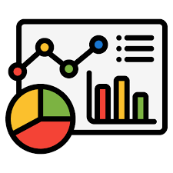

Data Intelligence
Build – adds value and differential between OAC & FDI.
OAC is an empty canvas
The race to value
Broad Horizontal Data, Analytics & AI Content
Deep Industry
Analytics & AI Content
Data Intelligence Applications
Data Intelligence Platform
Powerful Data Management Capabilities
Insightful
Analytics & AI
Capabilities
Notes:
Oracle’s data intelligence strategy mirrors our overall cloud strategy. We have application products as well as platform products.
We have Data Intelligence Apps for Fusion, NetSuite, Health, and other Industries.
And we have a Data Intelligence Platform in OCI that consists of Data Lake, Data Warehouse, Analytics and AI services.
Our Data Intelligence Apps are all built on the platform, and you can extend these apps using the full power of the platform.
You can also build custom data intelligence solutions from the ground up using the platform.
For example, you could be Oracle Red Bull Racing and collect all sorts of data about your race cars and drivers, store all that data in our data lake, create AI/ML models to optimize engine and driver performance, analyze the data with OAC and ADW, etc.
We are the only technology vendor with this dual strategy of data intelligence apps and platforms.

Slide 9


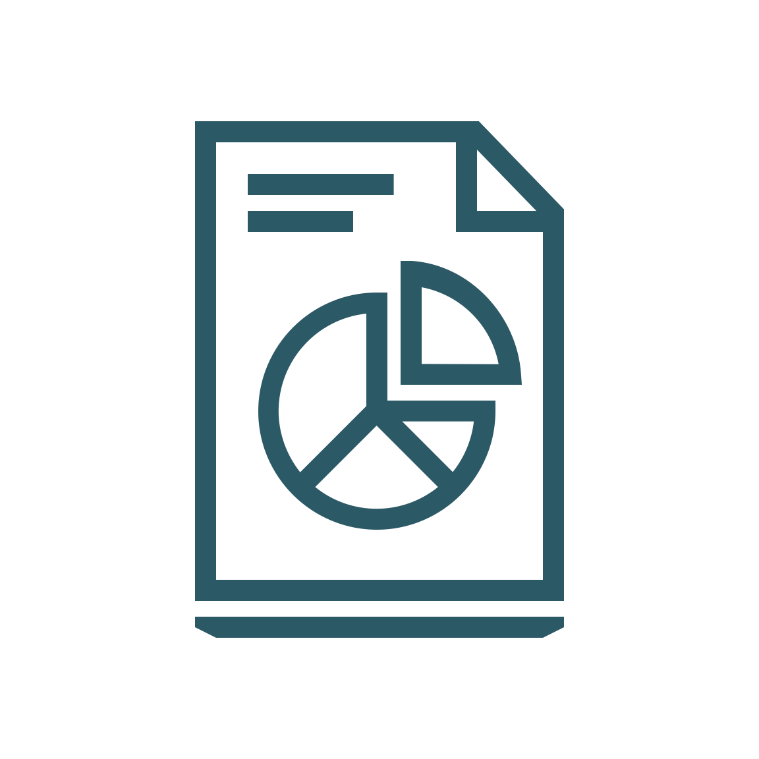





Oracle Fusion Data Intelligence
New chart – ONLY shows actual products on price list – we could show one for each domain (like TK’s keynote with app thumbnails)
Fusion ERP Analytics
Fusion SCM Analytics
Fusion CX Analytics
Fusion HCM Analytics
Data Intelligence Apps
Data Intelligence Platform
Intelligent
Data Lake*
Autonomous Data Warehouse
Analytics
Cloud
OCI AI
Services
*IDL will enter Limited Availability in the first half of 2025
Notes:
Oracle’s data intelligence strategy mirrors our overall cloud strategy. We have application products as well as platform products.
We have Data Intelligence Apps for Fusion, NetSuite, Health, and other Industries.
And we have a Data Intelligence Platform in OCI that consists of Data Lake, Data Warehouse, Analytics and AI services.
Our Data Intelligence Apps are all built on the platform, and you can extend these apps using the full power of the platform.
You can also build custom data intelligence solutions from the ground up using the platform.
For example, you could be Oracle Red Bull Racing and collect all sorts of data about your race cars and drivers, store all that data in our data lake, create AI/ML models to optimize engine and driver performance, analyze the data with OAC and ADW, etc.
We are the only technology vendor with this dual strategy of data intelligence apps and platforms.

Slide 10
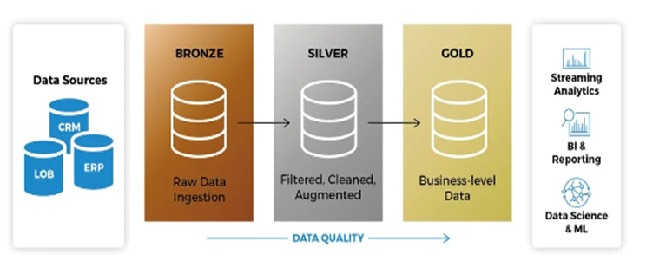
Benefits of Building with Oracle Data Intelligence Platform
No need to move data around, data copy:
So what? Avoid latency, additional costs, lose data fidelity
Data lineage, traceability, explain-ability, governance:
So what? Data transparency, compliance
Unified catalog with medallion architecture by design [data quality zones (bronze, silver, gold)]:
So what? Ensure high data trust and data quality
Metadata carried across, no need to redefine:
So what? Avoid cascading/compounding human errors
1 user experience to manage all your data pipelines:
So what? Less tools to learn, accelerate productivity
AI services already available, pre trained, just need to spin them up
So what? No just empty canvas, ready to use AI models
AI and GenAI with business context
So what? Not AI & GenAI in a jar, directly applicable to business use case
1 place to manage/control cloud services cost
So what? Avoid exploding/exponential cloud computing costs
Data centers around the globe with multi cloud partnerships with the 3 other hyperscalers
Government cloud with FedRAMP certification

Slide 11
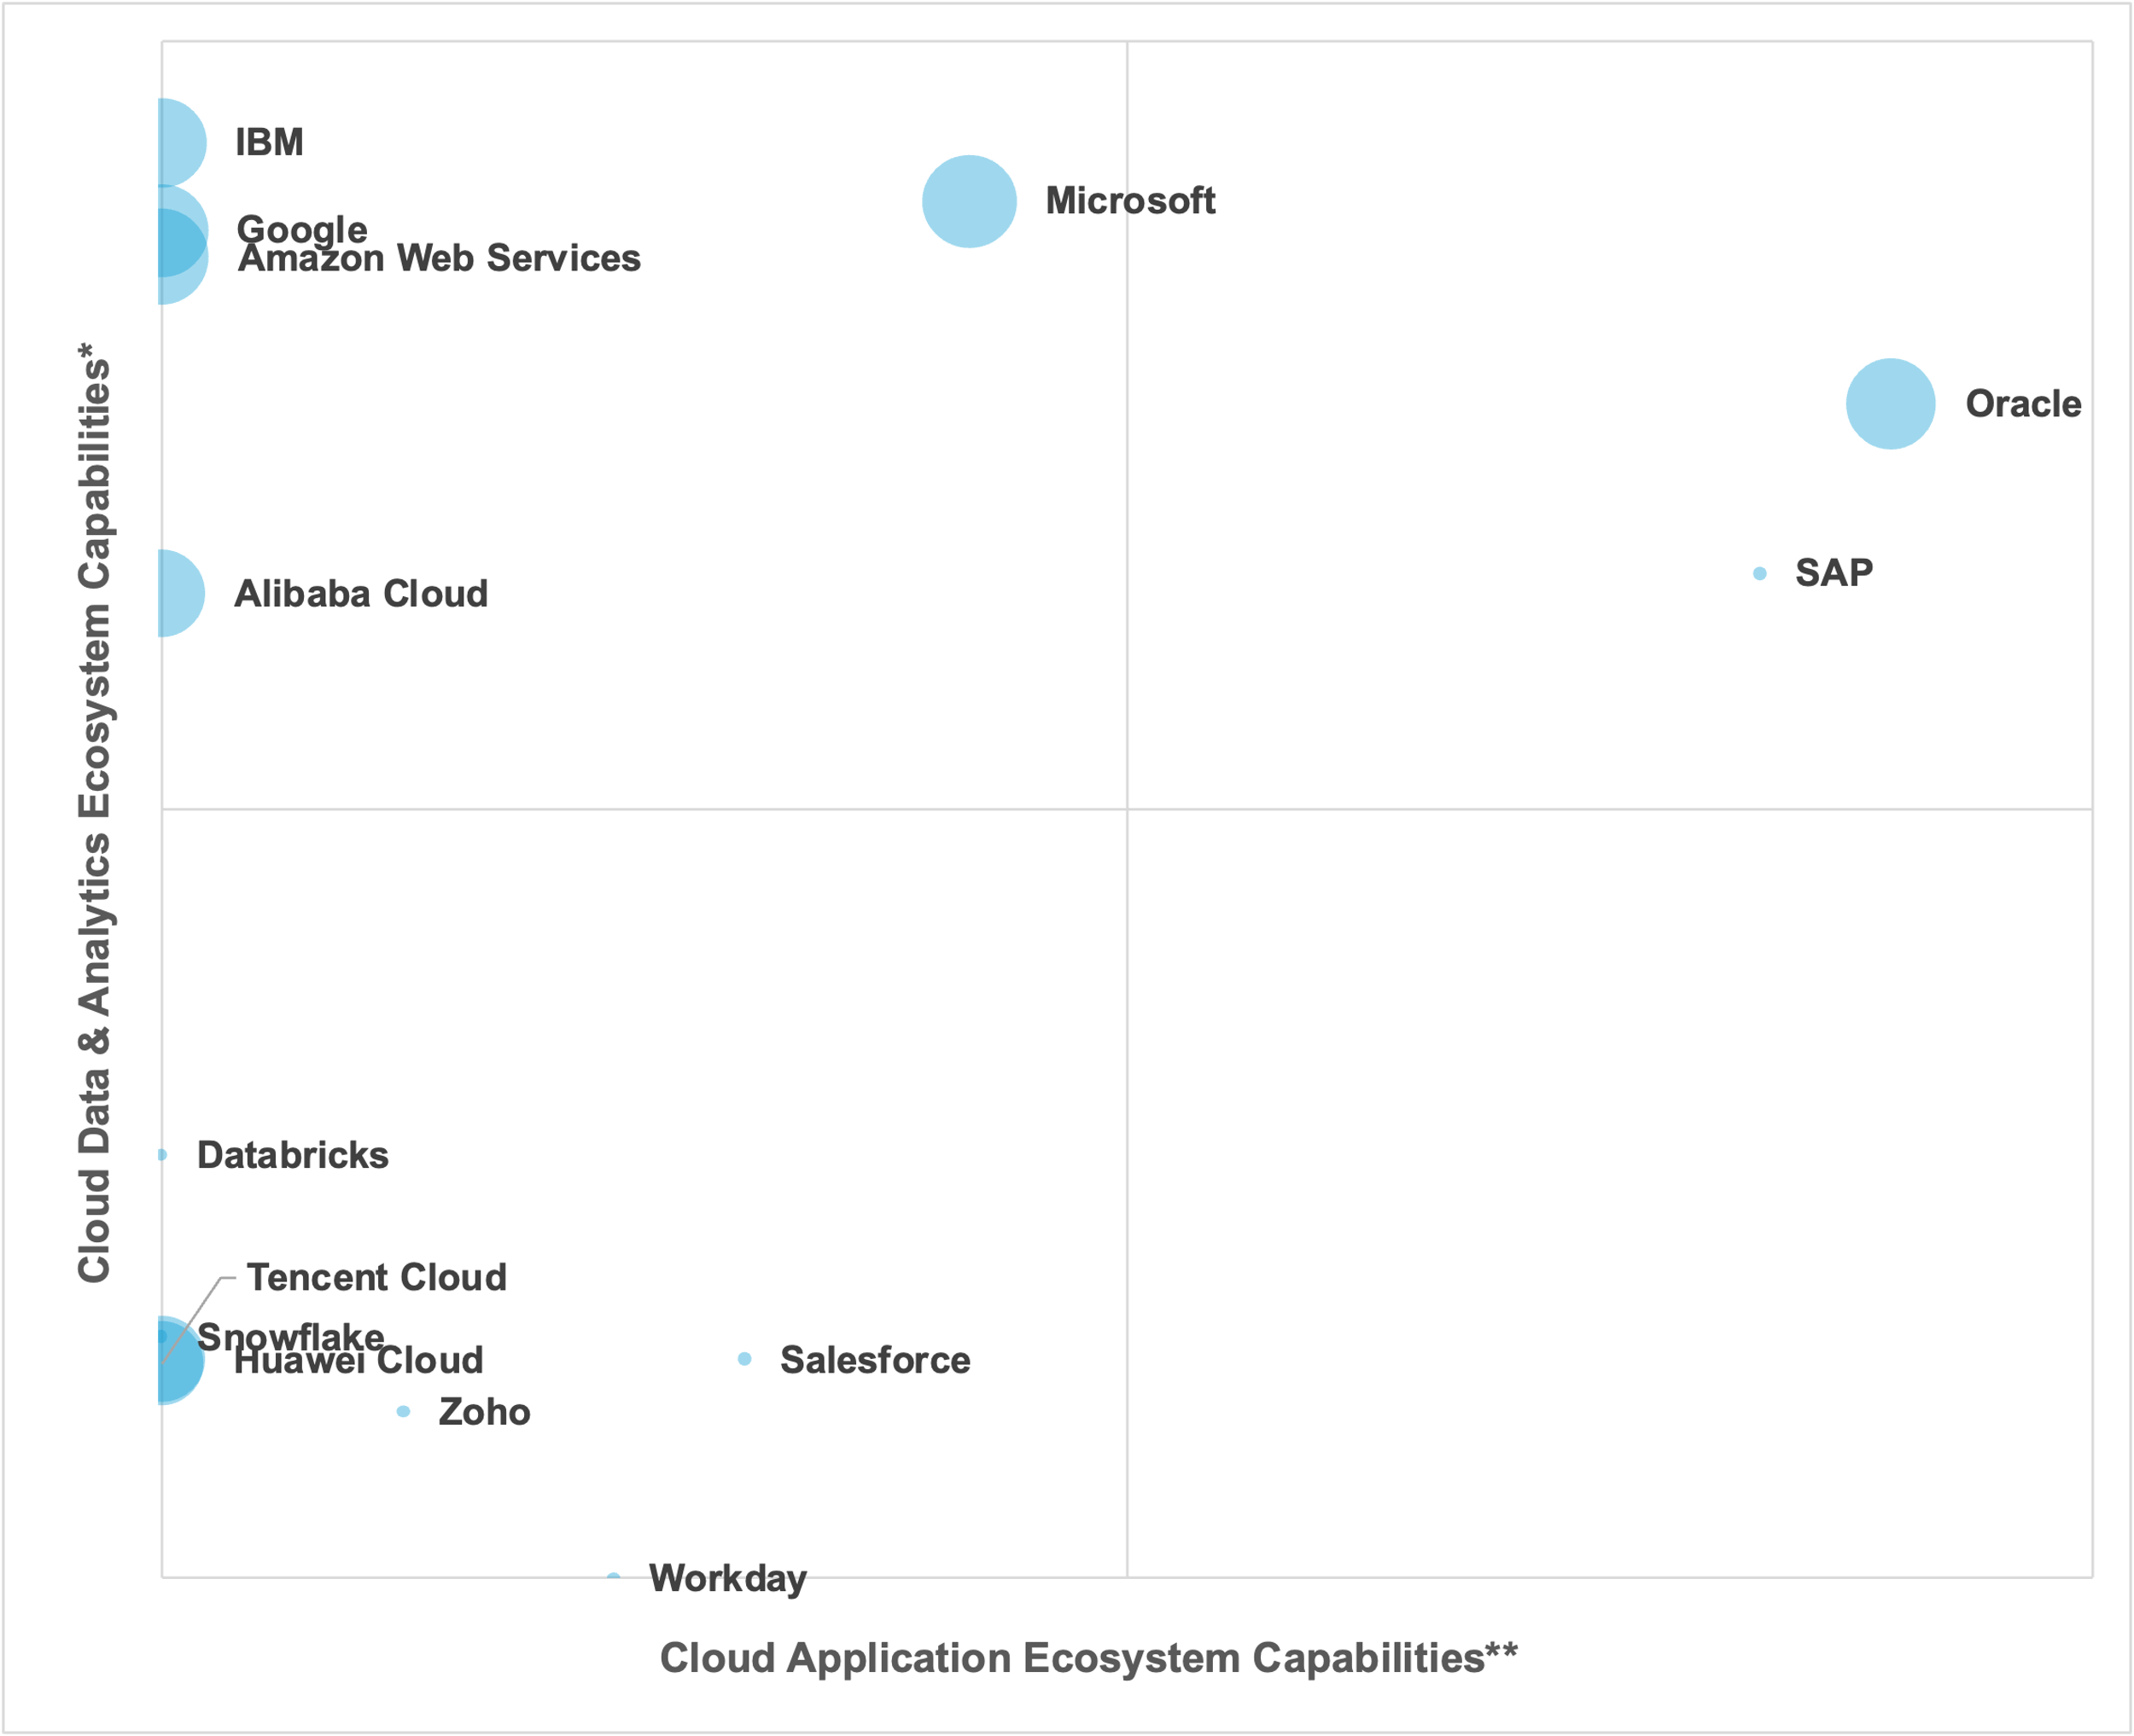
Cloud Data & Analytics Ecosystem Capabilities*
Comprises sum of absolute scores in latest Gartner Critical Capabilities reports:
Augmented Data Quality Solutions
Data Integration Tools
Cloud AI Developer Services
Cloud Database Management Systems for Analytical Use Cases
Analytics and Business Intelligence Platforms
Cloud Database Management Systems for Operational Use Cases
Data Science and Machine Learning Platforms: Core Data Science
Cloud Application Ecosystem Capabilities**
Comprises sum of absolute scores in latest Gartner Critical Capabilities reports:
Cloud ERP for Product-Centric Enterprises
CRM Customer Engagement Center
Supply Chain Planning Solutions
Cloud HCM Suites for 1000+ Employee Enterprises
Cloud ERP for Service-Centric Enterprises
Customer Data Platforms
Enterprise Low-Code Application Platforms
Bubble size
Absolute score: Critical Capabilities for Strategic Cloud Platform Services

Slide 12
Shows ALL vendors that appear in MORE THAN ONE report mentioned below.
Cloud Data & Analytics Ecosystem Capabilities*
Comprises sum of absolute scores in latest Gartner Critical Capabilities reports:
Augmented Data Quality Solutions
Data Integration Tools
Cloud AI Developer Services
Cloud Database Management Systems for Analytical Use Cases
Analytics and Business Intelligence Platforms
Cloud Database Management Systems for Operational Use Cases
Data Science and Machine Learning Platforms: Core Data Science
Cloud Application Ecosystem Capabilities**
Comprises sum of absolute scores in latest Gartner Critical Capabilities reports:
Cloud ERP for Product-Centric Enterprises
CRM Customer Engagement Center
Supply Chain Planning Solutions
Cloud HCM Suites for 1000+ Employee Enterprises
Cloud ERP for Service-Centric Enterprises
Customer Data Platforms
Enterprise Low-Code Application Platforms
Bubble size
Absolute score: Critical Capabilities for Strategic Cloud Platform Services

Slide 13
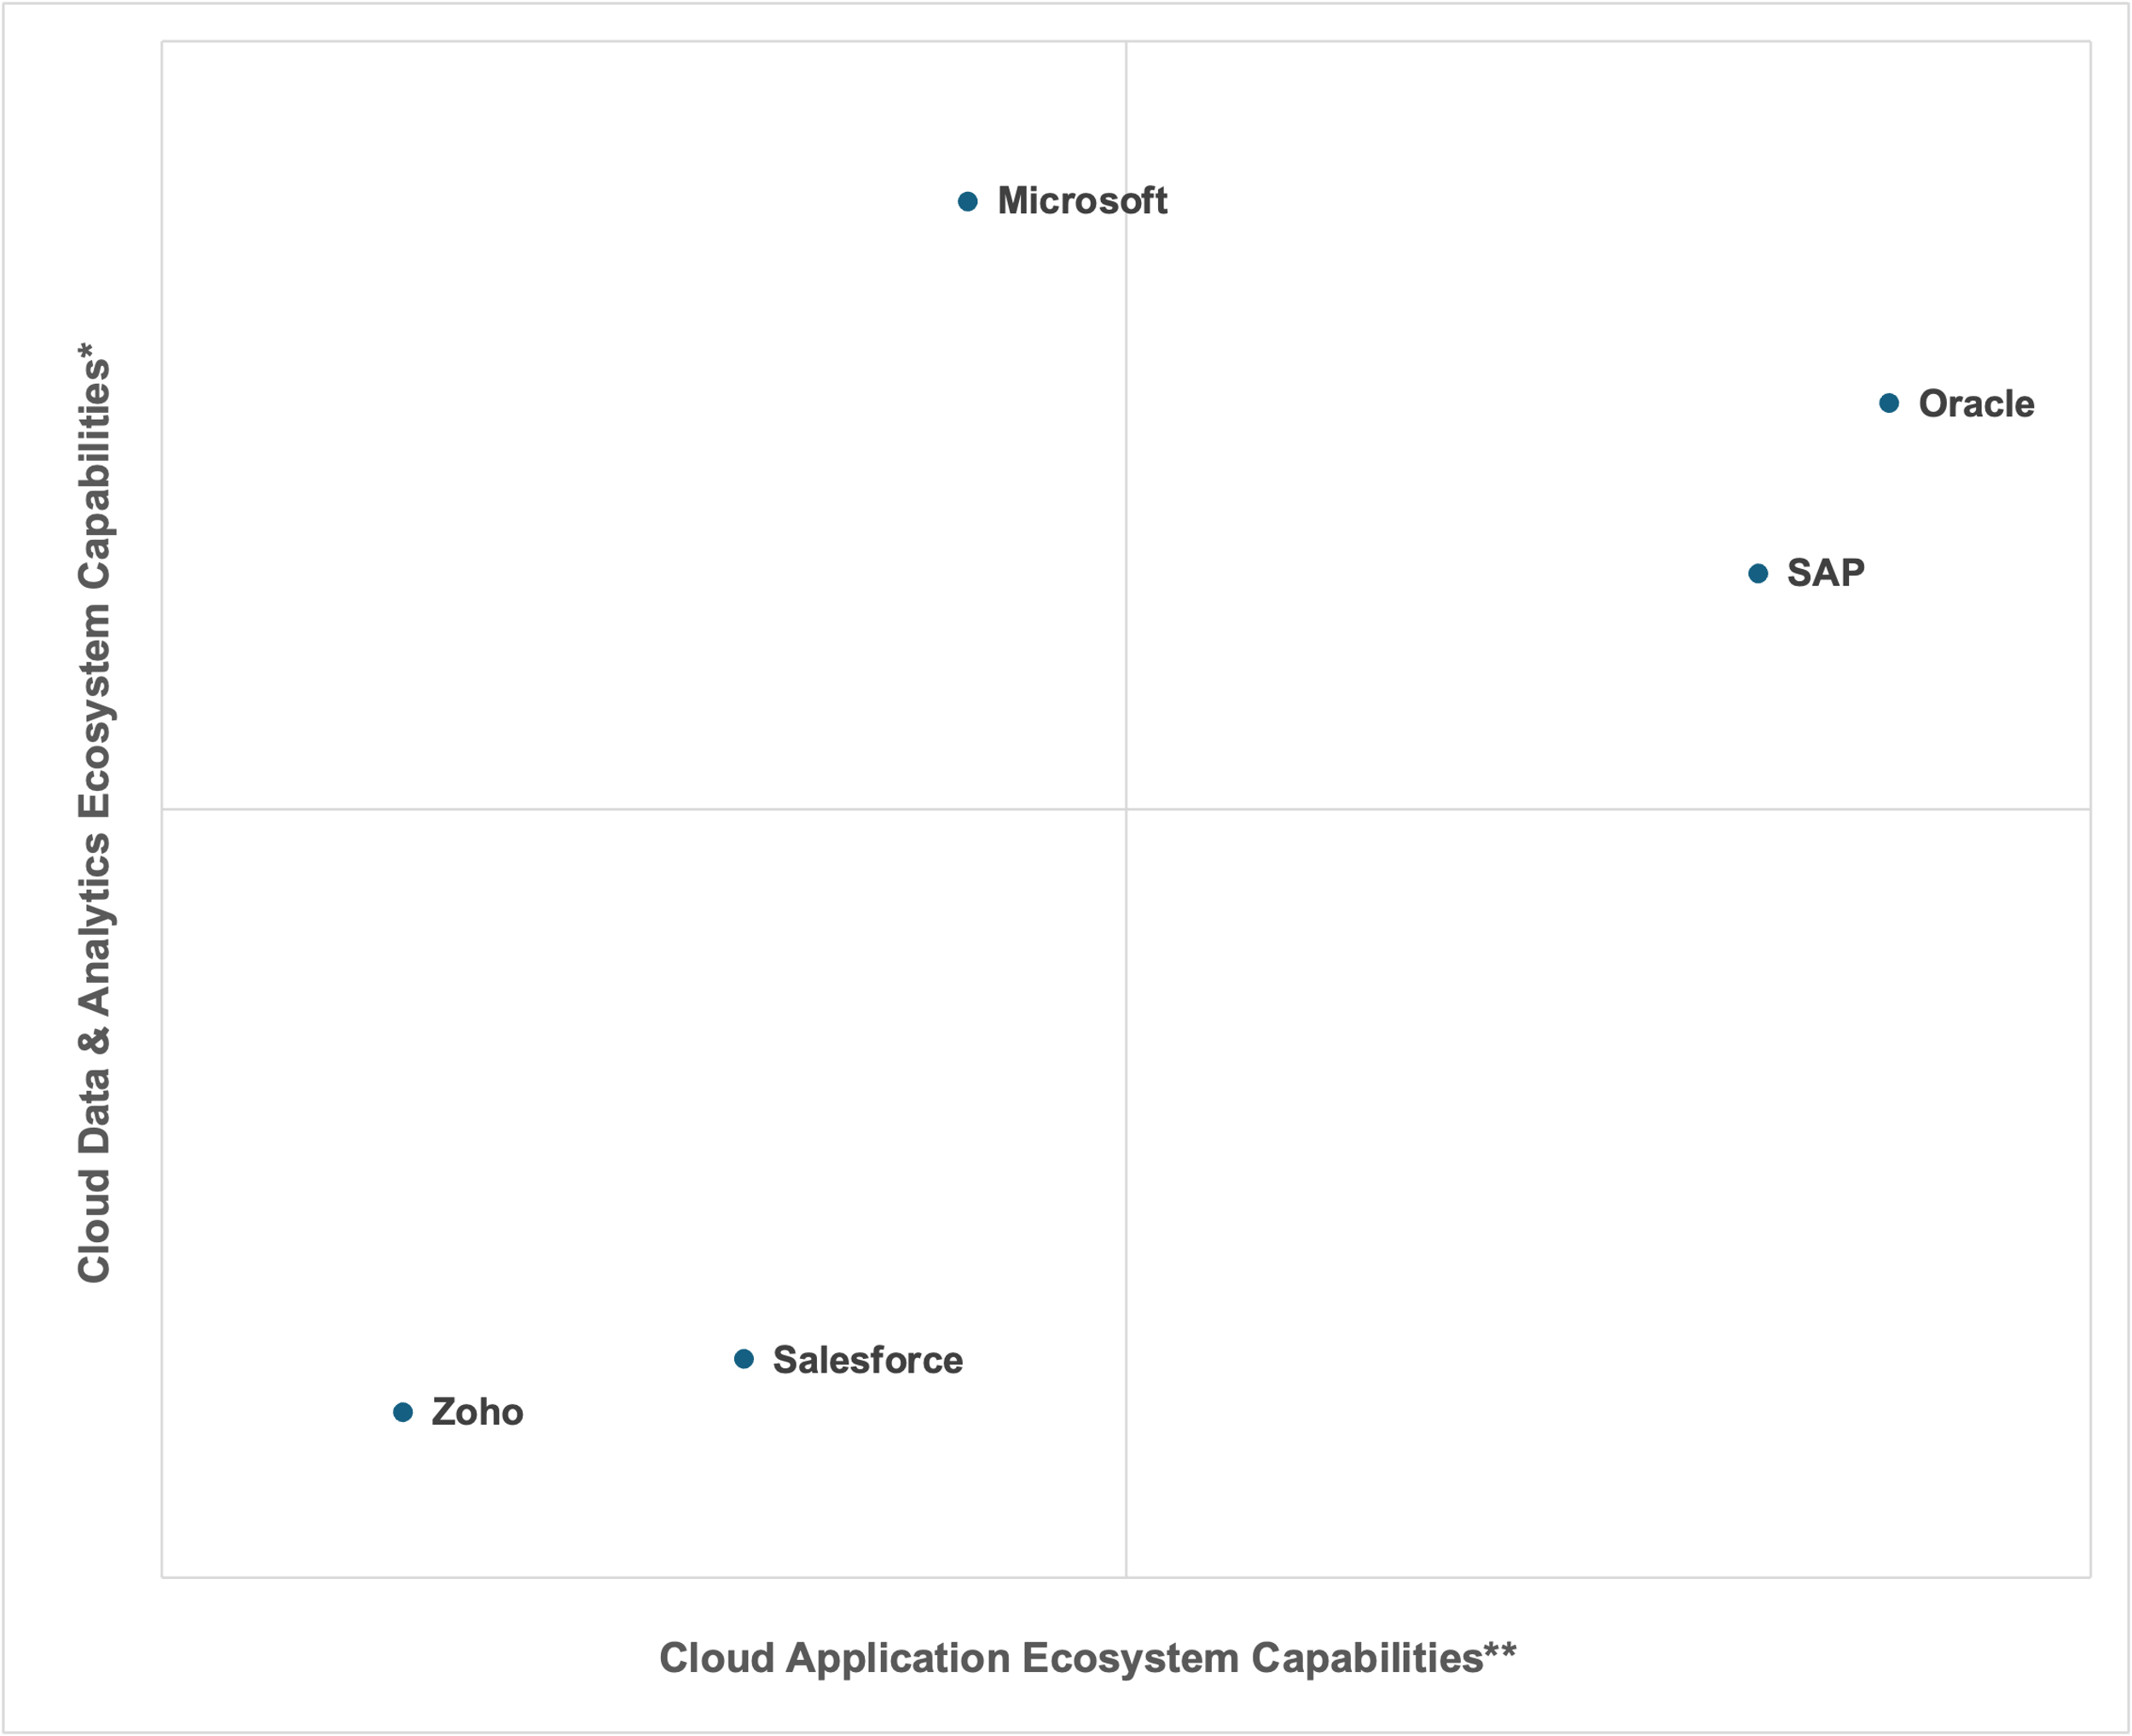
Shows ONLY vendors that score in both D&A AND apps CC research below.
Cloud Data & Analytics Ecosystem Capabilities*
Comprises sum of absolute scores in latest Gartner Critical Capabilities reports:
Augmented Data Quality Solutions
Data Integration Tools
Cloud AI Developer Services
Cloud Database Management Systems for Analytical Use Cases
Analytics and Business Intelligence Platforms
Cloud Database Management Systems for Operational Use Cases
Data Science and Machine Learning Platforms: Core Data Science
Cloud Application Ecosystem Capabilities**
Comprises sum of absolute scores in latest Gartner Critical Capabilities reports:
Cloud ERP for Product-Centric Enterprises
CRM Customer Engagement Center
Supply Chain Planning Solutions
Cloud HCM Suites for 1000+ Employee Enterprises
Cloud ERP for Service-Centric Enterprises
Customer Data Platforms
Enterprise Low-Code Application Platforms
Google, AWS, Databricks and Snowflake are not included in any apps research above.
Solid line = cloud hyperscaler: included in Critical Capabilities for Strategic Cloud Platform Services

Slide 14
Ecosystem story…

Slide 15
Gartner scores 125 vendors as offering either cloud based data and analytics or enterprise applications (sometimes both) in Critical Capabilities research…

Slide 16
…but only 27 of those have an ecosystem – that is they offer multiple cloud capabilities (and therefore feature in more than one Gartner report)…
Zoho
Workday
Tencent Cloud
ServiceNow
SAS
SAP
Salesforce
Qlik
Precisely
Pegasystems
Oracle
Neo4j
Microsoft
InterSystems
Informatica
Infor
IBM
Huawei Cloud
H2O.ai
Google
EDB
Databricks
Couchbase
Cloudera
Appian
Amazon Web Services
Alibaba Cloud

Slide 17
…of those just FIVE have an cloud ecosystem that includes BOTH data and analytics, and enterprise applications …
Zoho
SAP
Salesforce
Oracle
Microsoft

Slide 18
…lastly, only TWO can run in their OWN hyperscale cloud infrastructure…
Oracle
Microsoft

Slide 19
Alternative version…

Slide 20
Gartner included 20 vendors in the 2024 ABI Platforms MQ. Here are their Critical Capabilities scores…

Slide 21
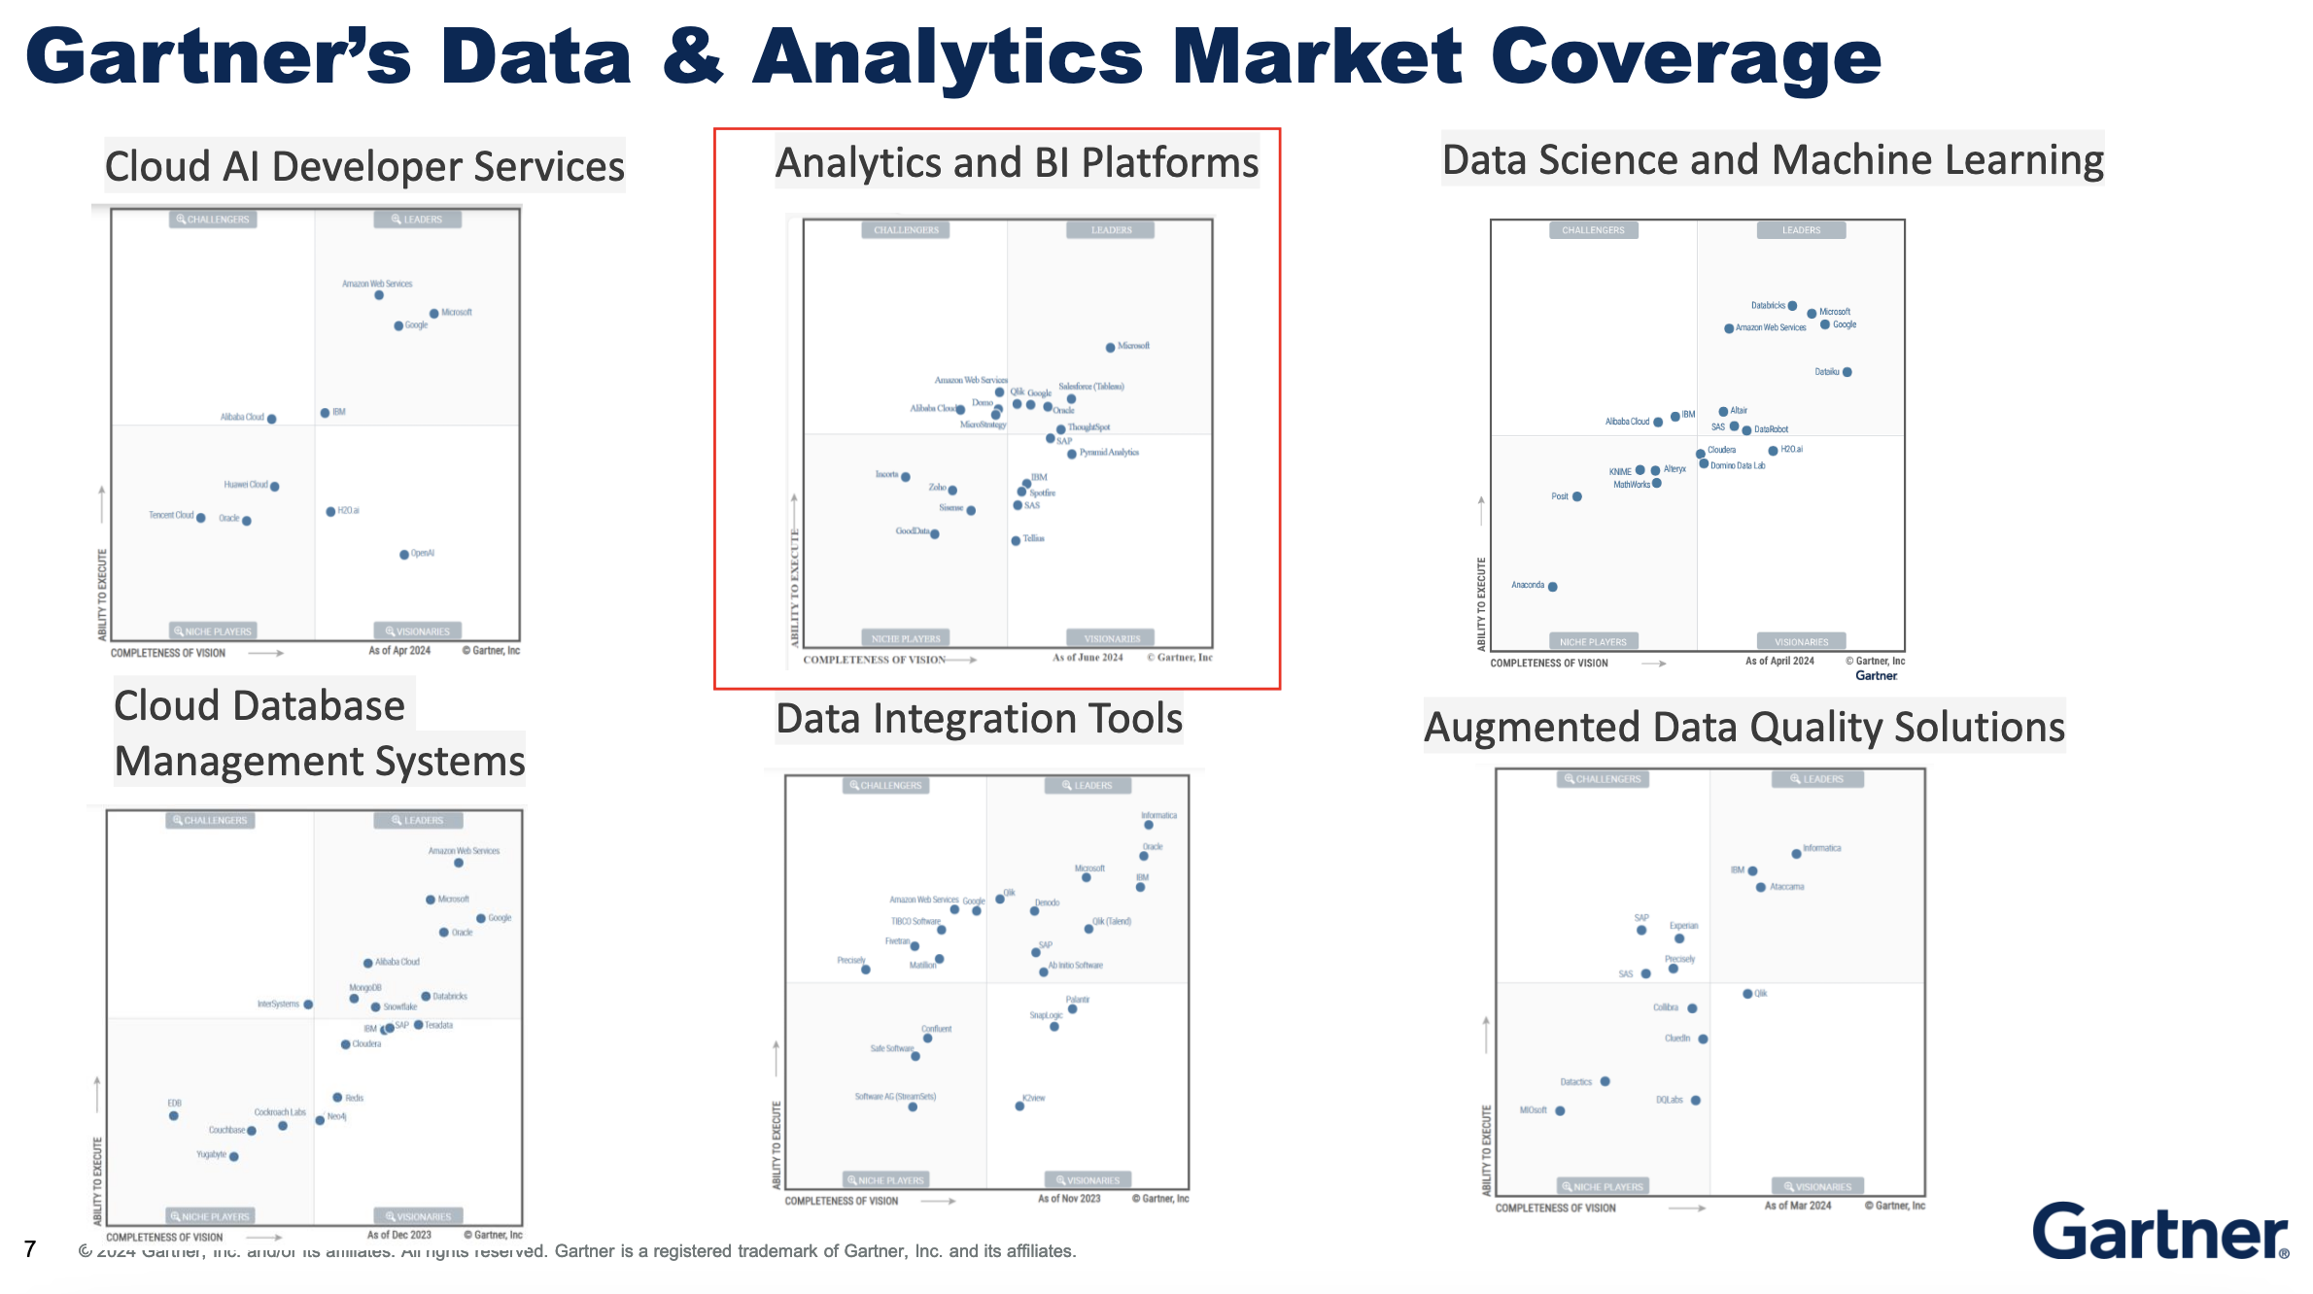
Gartner places ABI Platforms within wider D&A Ecosystems…

Slide 22
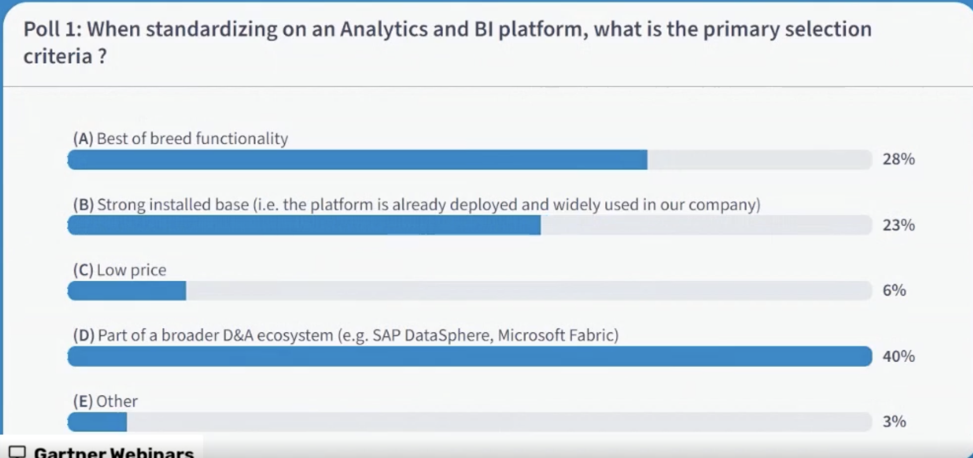
…and it’s evident that D&A ecosystems are influencing the ABI Platforms organizations choose to invest in

Slide 23
Here Gartner CC scores shows ABI vendors in their wider D&A Ecosystem Context…only 9 vendors really qualify, by offering more than ABI alone…

Slide 24
For enterprises though, vendor ecosystem considerations go beyond D&A, to include systems of record, workflow and process
Enterprise Resource Planning
CRM Customer Engagement
Supply Chain Planning
HCM Suites
Customer Data Platforms
Low-Code Application Platforms

Slide 25
Using Gartner CC’s scores lets put ABI Platform vendors in their wider Enterprise Application Ecosystem Context…only 5 ABI vendors offer apps

Slide 26
The power of Oracle’s total D&A and Enterprise Apps ecosystem is why organizations are selecting OAC without looking at competitor ABI tools

