Slide 1
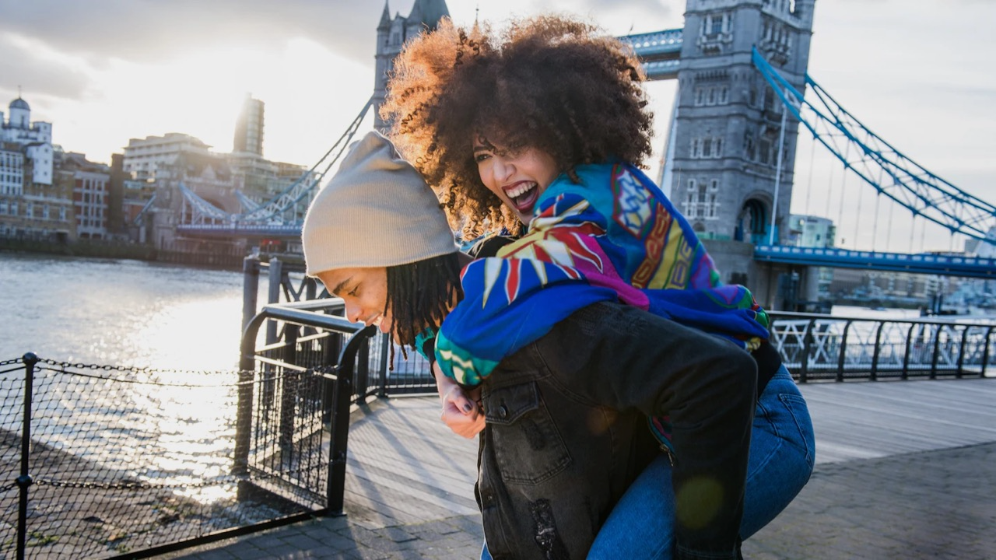
Welcomes you to London!

Slide 2
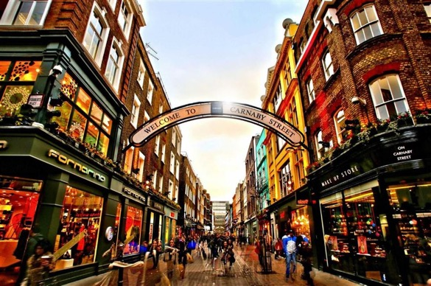
The United Kingdom is ripe with opportunity, no matter what your flavor of “football” is.
We hope you have a fantastic trip and are able to explore the eclectic offerings that are synonymous with London and the rest of the United Kingdom.
If you’d like to learn more about UK Government work in the Midwest or about UK companies making a splash in the US market, please reach out to Jan Bauer or Alexis Svenson.
Safe travels!
Richard Hyde
His Majesty’s Consul General
Central & Midwest USA
Jan Bauer
Head of UK Government Office
UK Government Office, Minnesota
Alexis Svenson
Senior Trade & Investment Officer
Creative, Media & Sport
Midwest & Colorado USA

Slide 3
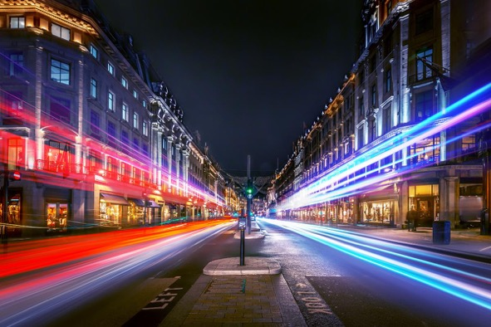
Whitewall welcomes you to London!
Whether you’re a first-time visitor or a regular traveller, London will always surprise you.
Phil frequently hops the pond from his day job running our West Coast US office, while Matthew takes care of business in London.
Both of us are passionate about creating amazing experiences – and London offers a playground like no other. You can often find us out on the town enjoying restaurants, the theater and other cultural attractions, as well as soaking up the rich history of this incredible city.
Enjoy your time in the UK – and look out for our WW logo on the places and activities you really won’t want to miss!
Phil White Matthew Canning-Wall
CEO CCO
Phil & Matthew's top picks
All these suggestions would enhance your London experience – our special favorites are highlighted just for you!

Slide 4
1. HISTORY BUFFS
2. DIVERSE-CITY
3. FOODIES
4. MUSIC LOVERS
5. GET IMMERSED
6. LIVING well
7. LOTS TO SEE
8. OCTOBER EVENTS
9. Business profiles
MENU

Slide 5
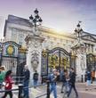
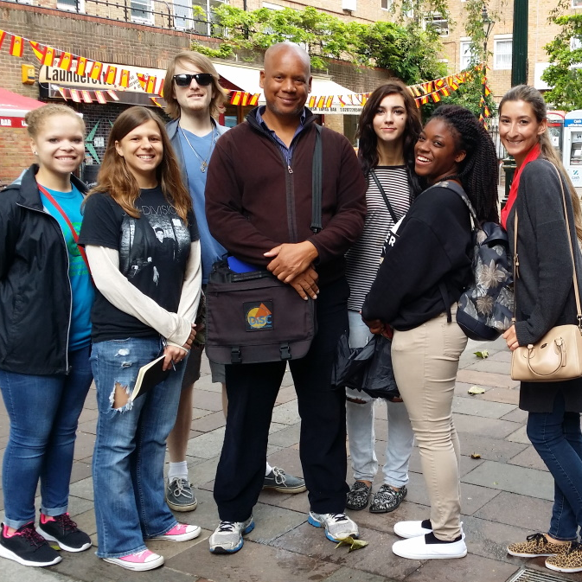
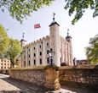
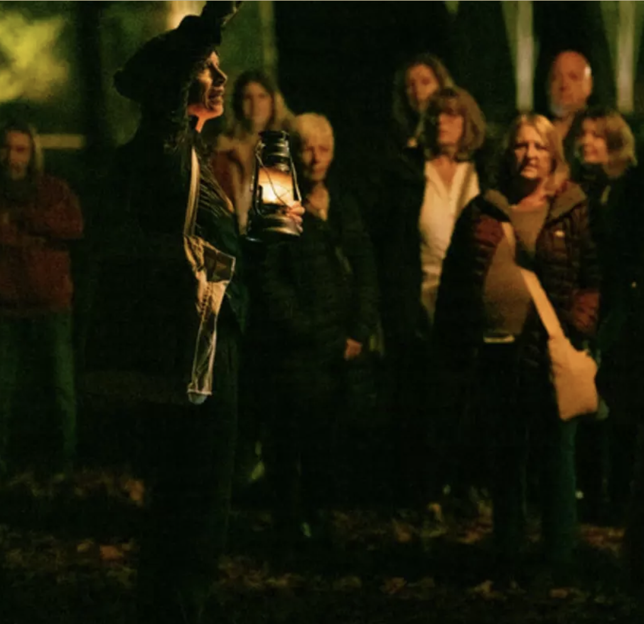
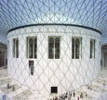
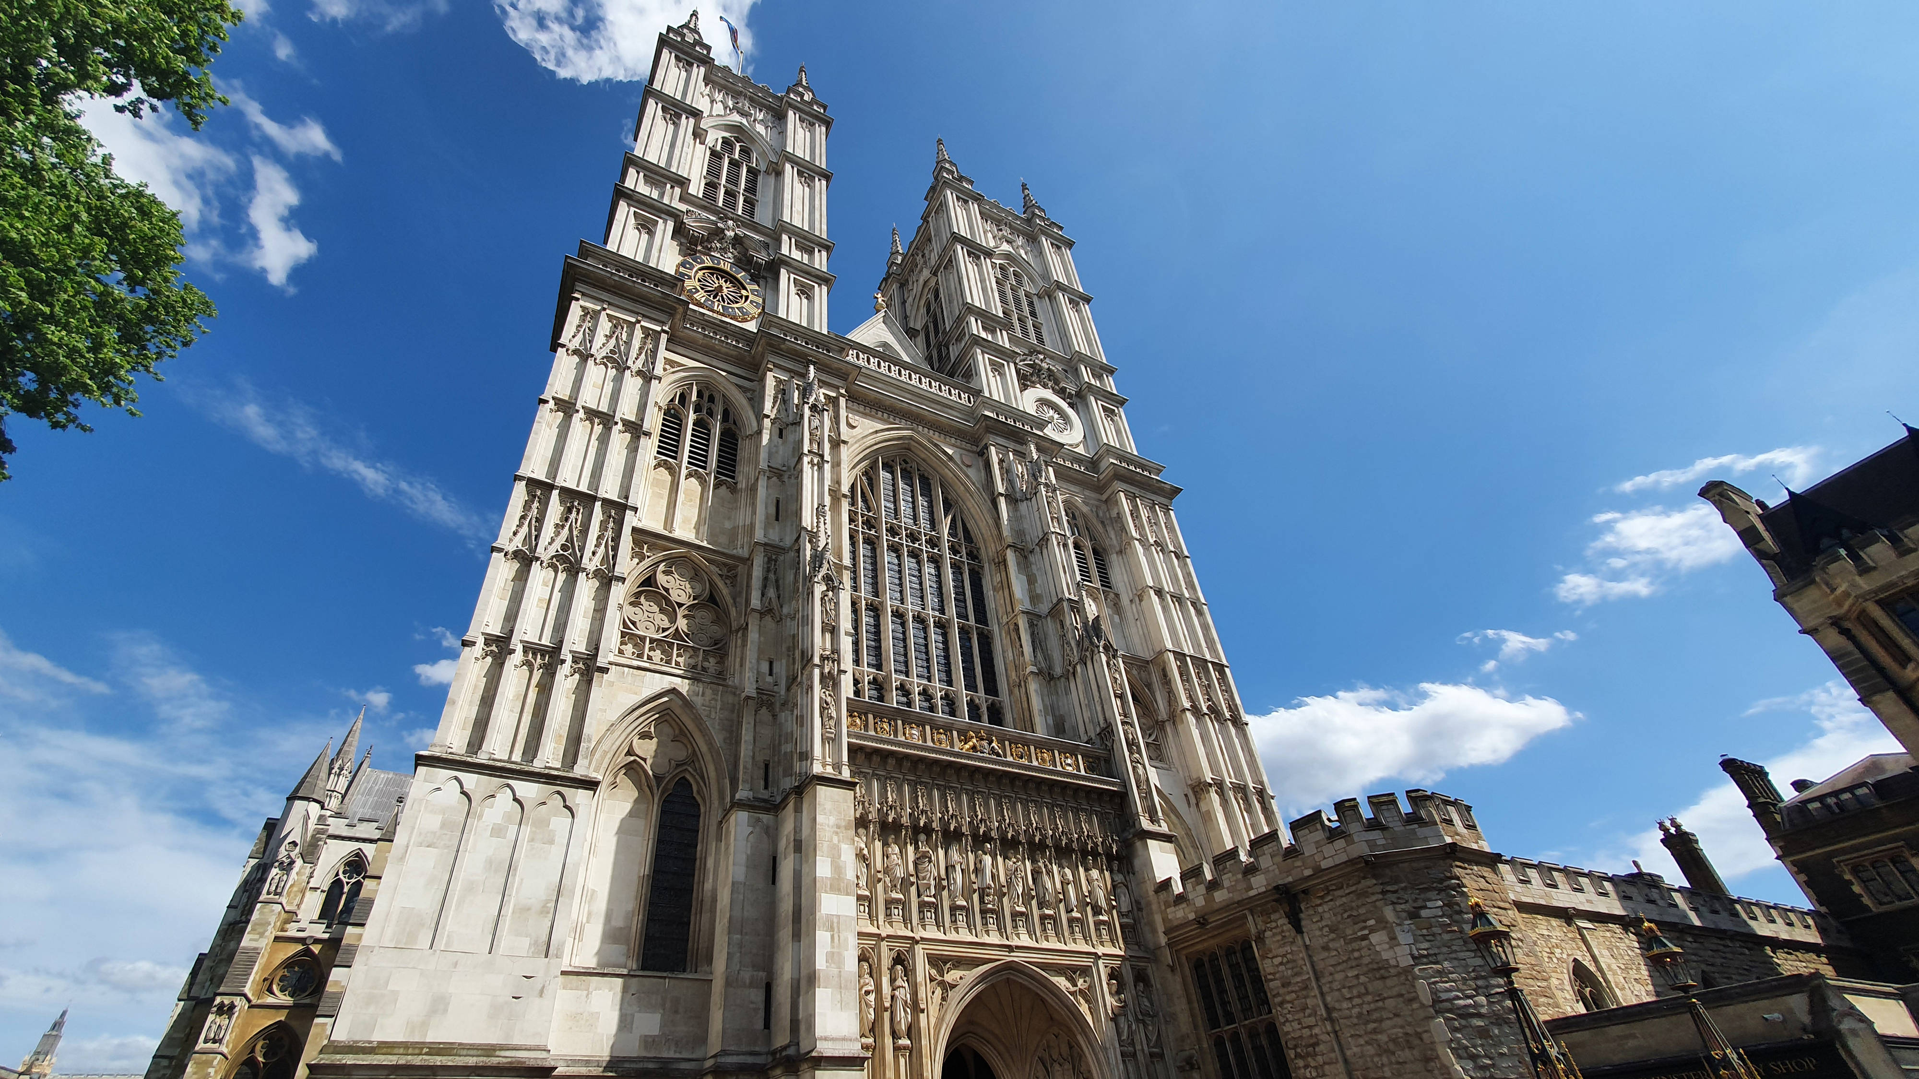
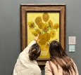
BUCKINGHAM PALACE, SW1
The home of the British monarchy and of The King’s Gallery: an intimate showcase for the masterpieces of the Royal Collection.
BLACK HISTORY WALKS
Black history and the history of London are one and the same; experience many of the places and people who made that history on these engaging walks.
TOWER OF LONDON, EC3
The Gunpowder Plot of 1605 saw Guy Fawkes and a band of ne’er-do-wells try to blow-up Parliament. Watch the plot come to life at the Tower Vaults.
ST. james’s park, sW1
Are you brave enough to experience the haunted past of this Royal Park? On October 3rd and 17th you have the chance to walk with the “Dead After Dark”.
BRITISH MUSEUM, WC1
For centuries, silks and spices traveled astonishing distances along the legendary Silk Road – explore this ancient superhighway through this stunning exhibition.
WESTMINSTER ABBEY, SW1
Marvel at a thousand years of history and make a special visit to Poet’s Corner: resting place of the UK’s literary giants from Chaucer to the present day.
NATIONAL GALLERY, SW1
Your once-in-a-century chance to see sublime masterpieces that span the history of Art: everything from Great Masters to modern trailblazers.
HISTORY BUFFS
Click the images to find out more!

Slide 6
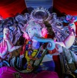
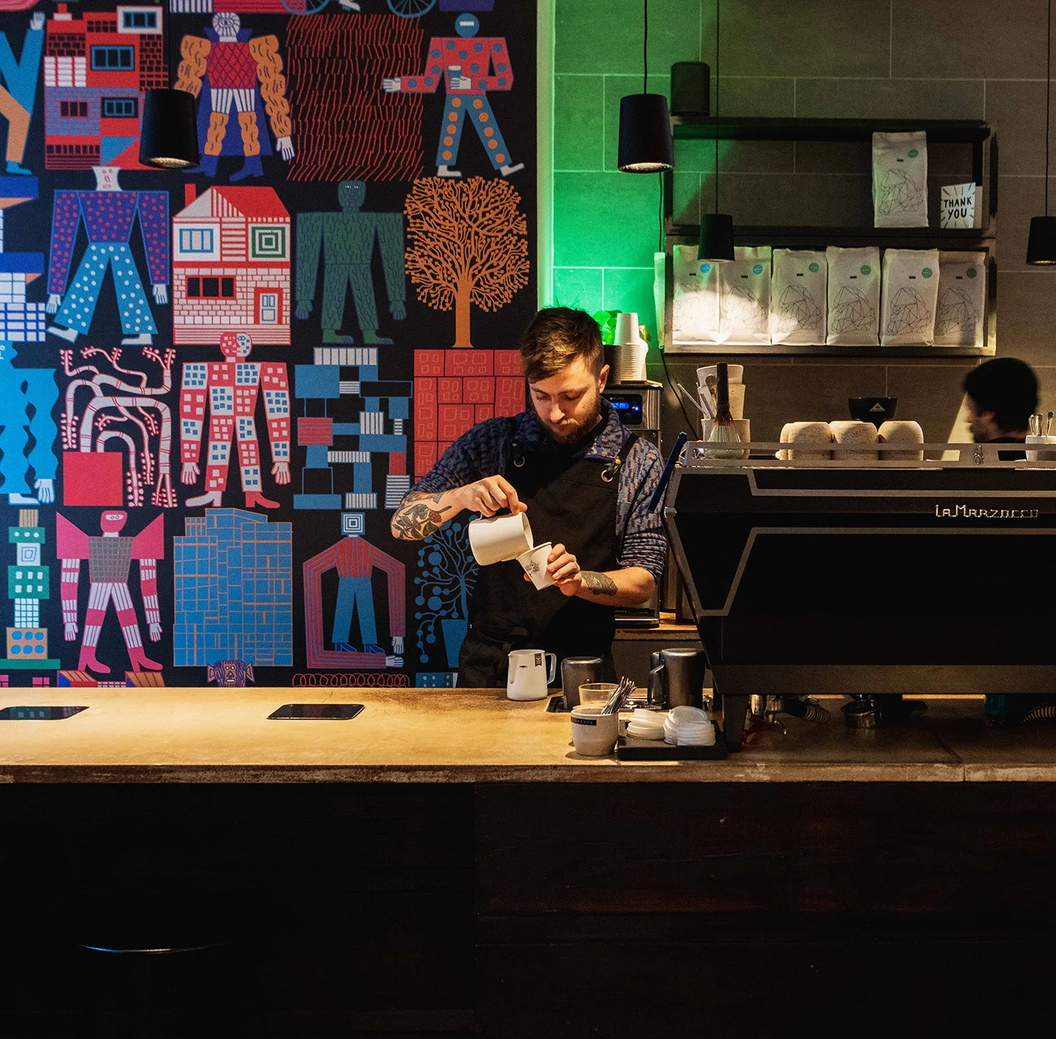
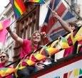
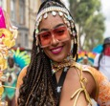
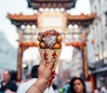
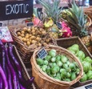
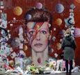
BRICK LANE, E1
Brick Lane in East London is a vibrant hub that showcases the rich heritage and cultural identity of the Bangladeshi community. A curry here is a must.
SHOREDITCH, E2
London’s trendy art district has something for everyone – from creative arts to cool bars and cafés like Origin Coffee!
OLD COMPTON STREET, W1
The beating heart of London’s amazing LGBTQ+ community. There are bars and clubs plus a wide array of shops – or simply soak up the buzzy atmosphere with pride!
NOTTING HILL, W11
Home to the world-famous carnival (and Hugh Grant of course), this is the place to explore the incredible market on Portobello Road. (*Julia Roberts not included!)
CHINATOWN, W1
A foodie paradise in the heart of Soho – we recommend saying hello to Mr Wing of Tao Tao Ju – a friendly welcome (and delicious dishes!) await you.
BOROUGH MARKET, SE1
Whitewall’s old stomping ground and home to the world’s greatest food market (we’re biased!) You’ll want to come hungry – you won’t leave that way!
BRIXTON, SW2
Sign up for a self-guided Music Tour of this vibrant and diverse neighborhood – music is in Brixton’s soul and its influence is everywhere.
DIVERSE-CITY
Click the images to find out more!

Slide 7
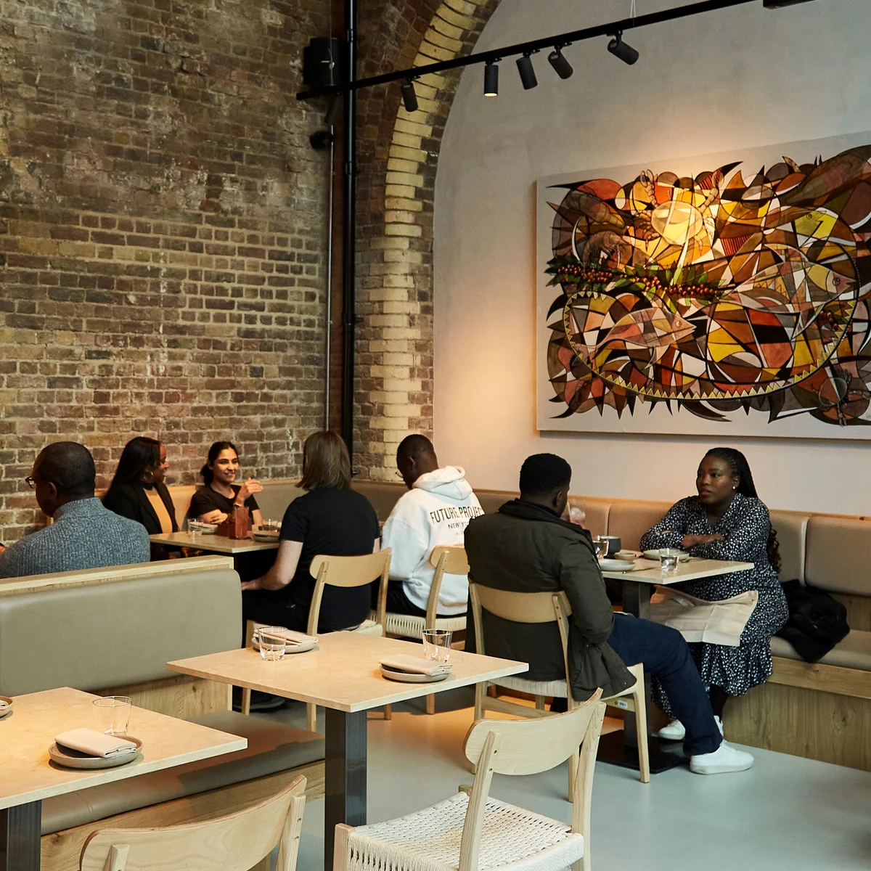
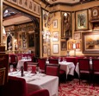
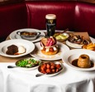
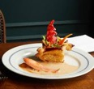
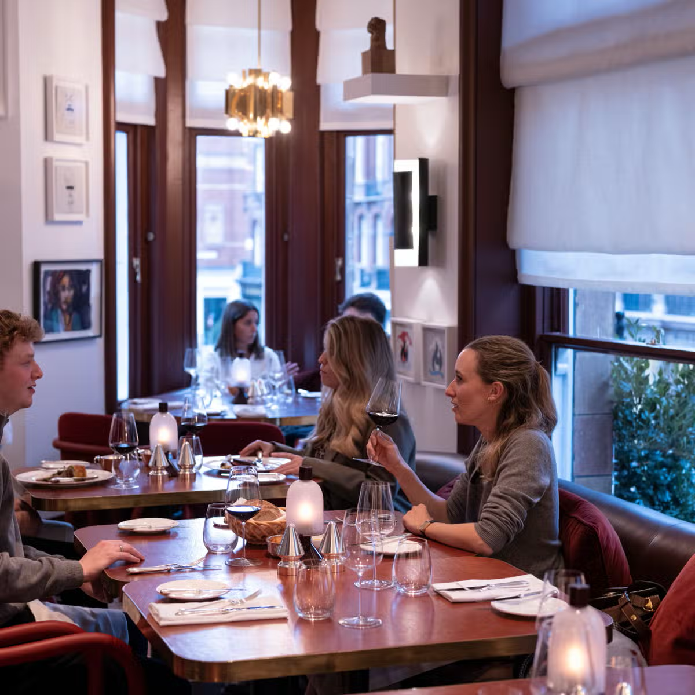
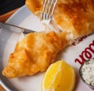
AKARA, SE1
Nigerian Akara Osu with the flavour-packed delights of Brazilian Acaraje is the star at this gem situated in Borough Market.
RULES, WC2
It doesn’t get more British than this – London’s oldest restaurant has been serving up the UK on a plate for a discerning clientele in Covent Garden since 1798.
THE DEVONSHIRE, W1
There are pubs, and then there’s the Devonshire! It may look like a typical London boozer, but its kitchen wizards elevate British classics beyond belief.
64 Goodge street, w1
Don’t be fooled by the plain exterior: inside, Chef Stuart Andrew is offering up superb interpretations of French classics “from an outsider’s perspective.”
MOUNT ST. RESTAURANT, W1
Be warned: it’s not a cheap night out, but boy does it deliver. A feast for the eyes and the palette at this divine dining experience.
DARJEELING EXPRESS, W1
Staffed by Bengali women with no formal training, this authentic little gem showcases the best of North Indian cuisine – and your tastebuds will be tingling.
GOLDEN UNION, W1
Pretentious it ain’t, but this no-frills fish bar in Soho serves up some of the capital’s best fish-and-chips; and what trip to London would be complete without that?
FOODIES
Click the images to find out more!

Slide 8
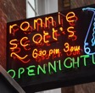
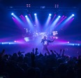
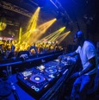
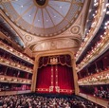
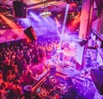
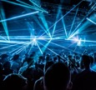
RONNIE SCOTT’S, W1
This legendary club is the home to London’s eclectic jazz scene – and has been since 1959. October 12th sees legend Booker T. Jones take the stage.
ELECTRIC BRIXTON, SW2
Fans of drum-and-bass will be heading to this iconic venue on October 5th for a one-off celebration of the vibrant musical genre that’s still going strong.
N7 LONDON, N7
Capture the spirit of the Balearics with a night of Ibiza house anthems on October 19th. The hottest tracks at the coolest venue.
ROYAL OPERA HOUSE, W1
Go behind the scenes at one of the world’s greatest opera houses with a backstage tour; uncover the secrets of bringing great music to life.
JAZZ CAFE, NW1
Great jazz performers from around the world, with “Best World Music Group” Divanhana bringing the world to Camden on October 24th.
The crazy coqs, w1
An intimate cabaret venue just a stone’s throw from Piccadilly Circus. On October 25th, viral jazz sensation Rachel D’Arcy sings “Songs for My Soho”.
Fabric, EC1
Many a fine time had at Fabric, which celebrates its 25th anniversary this year on October 11th – you won’t want to miss this chance to get your groove on.
MUSIC LOVERS
Click the images to find out more!
Notes:
Divanhan

Slide 9
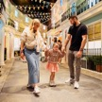
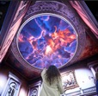
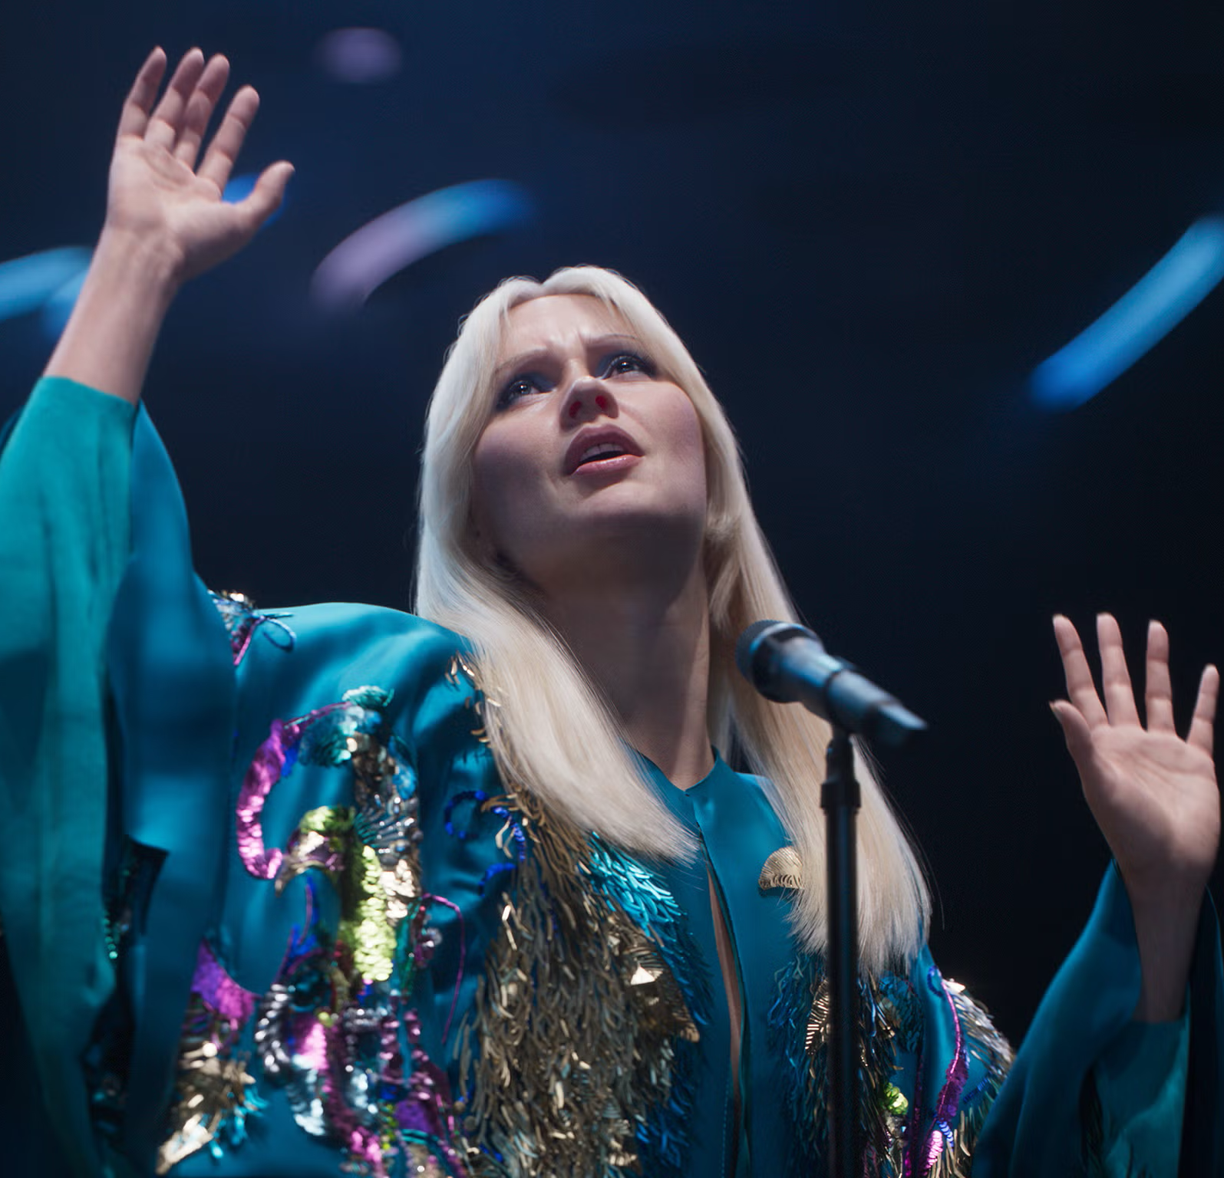
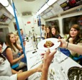
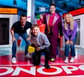
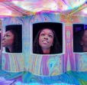
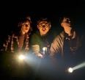
PADDINGTON BEAR EXPERIENCE, SE1
Everyone’s favorite bear is hosting his very own immersive experience, and you’re cordially invited. Expect the unexpected when Paddington’s around. Also, marmalade.
OUTERNET LONDON, W1
The UK’s most visited cultural attraction offers eye-popping visuals and interactive screens. A live music venue attracts big-name performers.
ABBA VOYAGE, E15
Take a chance on the most poptastic show in town, as mind-blowing technology recreates one of the world’s most famous bands. We dare you not to sing along!
SUPPERCLUB TUBE, E17
Ever fancied eating a Latin American-inspired meal on a decommissioned 1967 Tube carriage? Us neither, but this is a one-of-a-kind dining experience you’ll love!
Monopoly life-sized, W1
See all of London in one venue as you enter the world of the classic board game. Mr Monopoly himself guides you through this fast and fun experience.
TWIST MUSEUM, W1
Be prepared to be blown away by this incredible immersive space where nothing is quite what it seems. A mind-bending experience awaits.
STRANGER THINGS, W1
Whether you’re a fan of the Netflix smash hit or not, we defy you not to be enthralled by this imaginative and dynamic prequel, live on stage.
GET Immersed
Click the images to find out more!

Slide 10
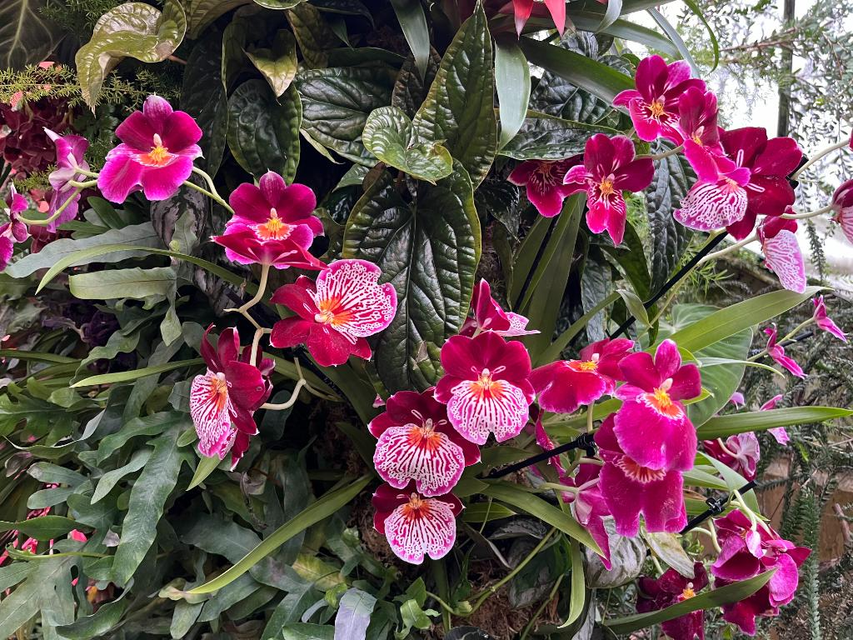
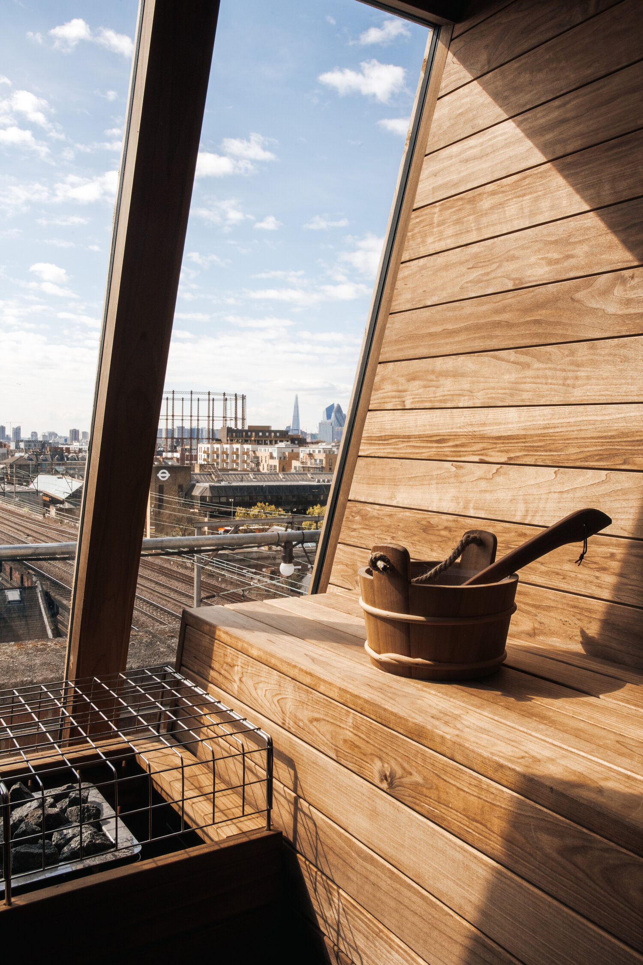
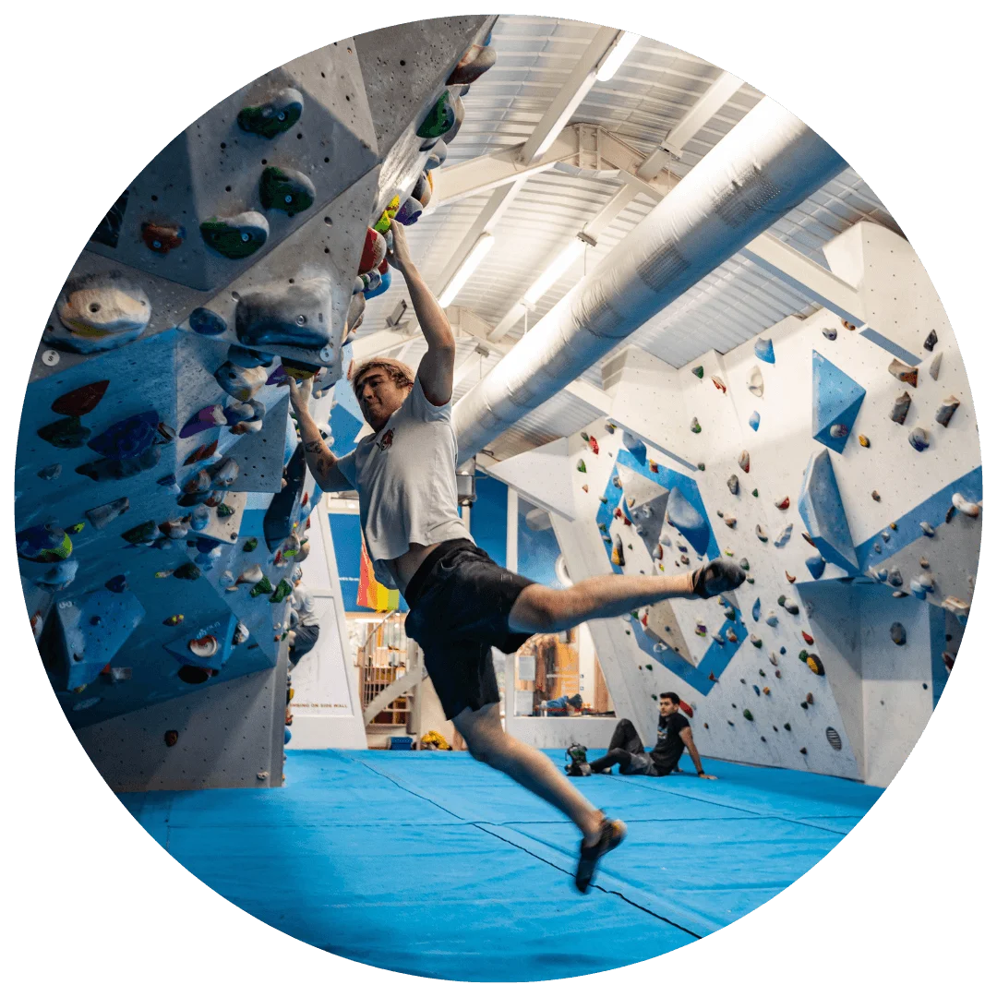
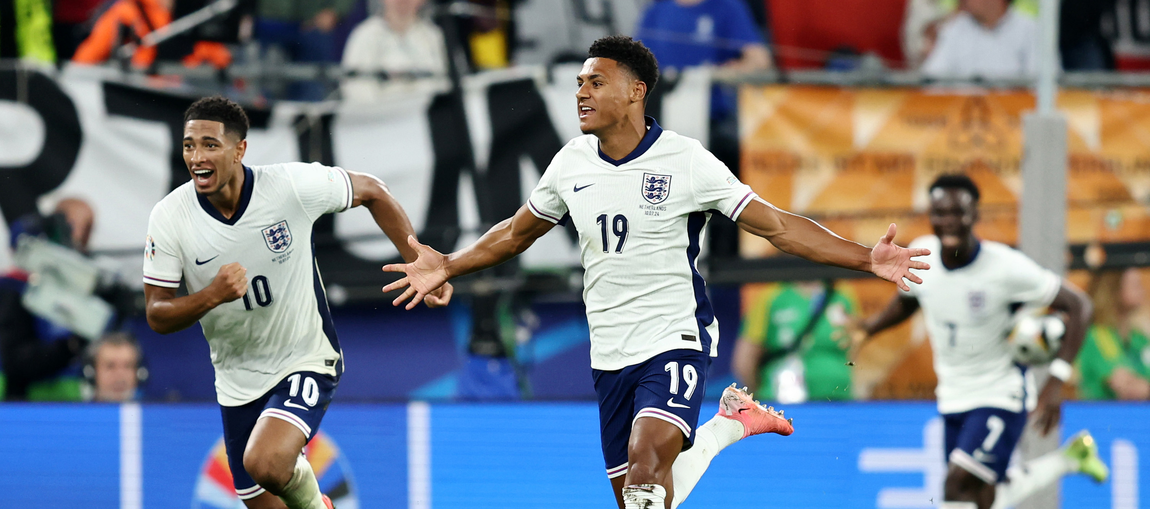
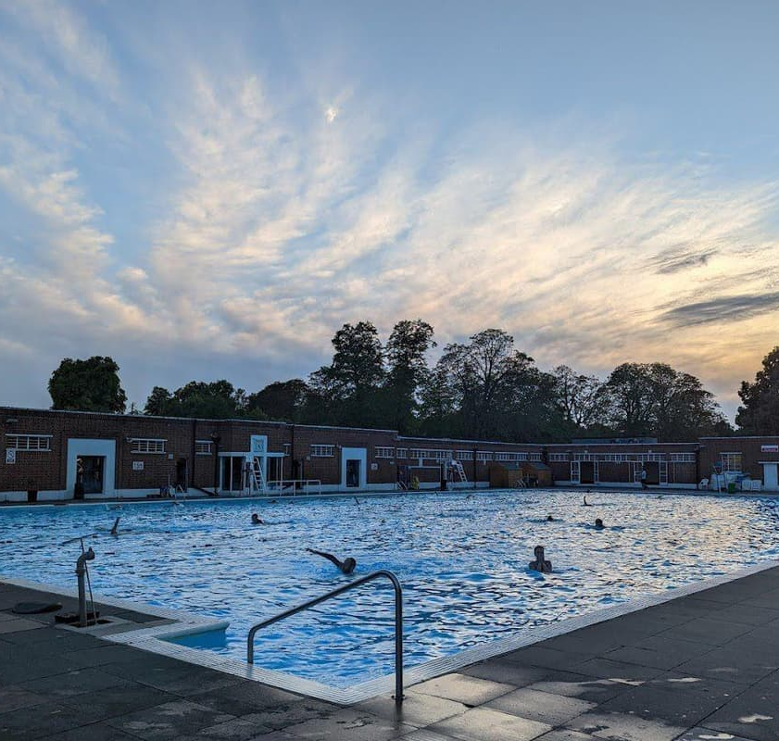
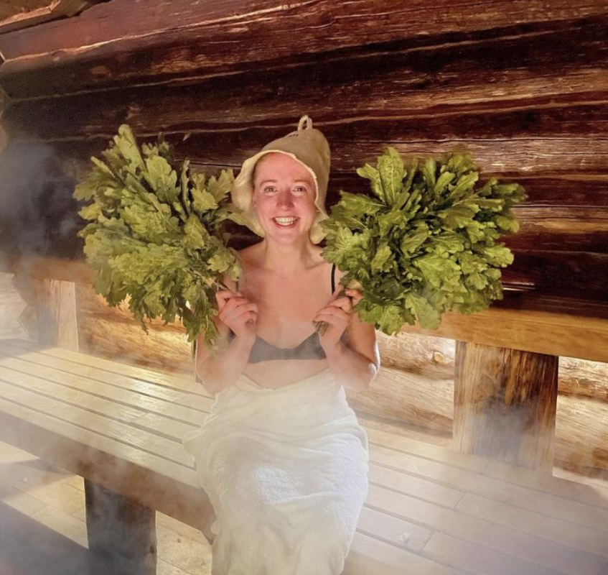
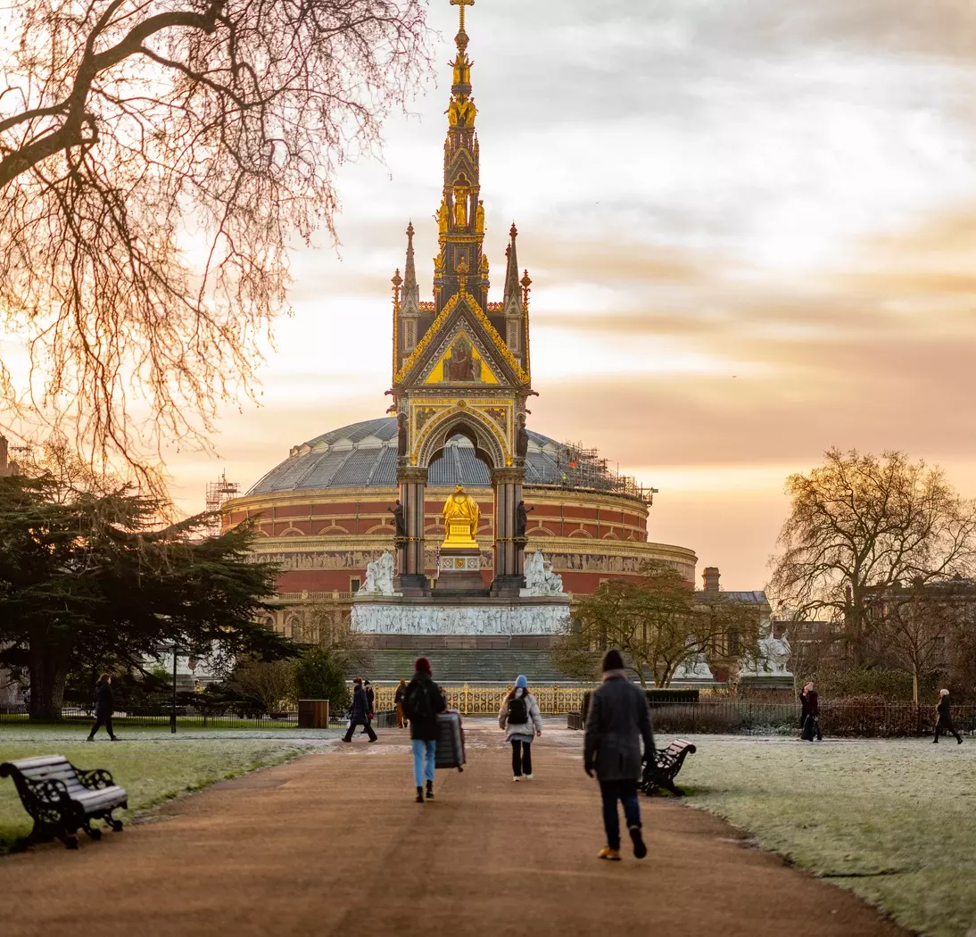
KEW GARDENS, TW9
More than just the world’s most diverse botanic collection, the Gardens offer a haven of peace and tranquillity to soothe the soul.
NETIL360, E8
For an elevated wellness experience like no other, head to East London for the Netil360 Rooftop Sauna. You’ll feel on top of the world.
VAUXWALL, SW8
Hundreds of climbs await the adventurous in the arches beneath Vauxhall Station. Beginners and experienced mountaineers welcome.
Wembley stadium, HA9
The ‘other’ football takes center stage on October 10th as England takes on Greece in the UEFA Nations League at the home of English soccer.
BROCKWELL LIDO, SE24
If cold-water swimming is your jam, this iconic outdoor pool offers the chance for a bracing dip before you head to the nearest pub to warm up!
BANYA NO.1, N1
This spa is not for the faint-hearted! Treat yourself to a traditional banya, an ancient spa ritual combining extremes of heat and cold.
KENSINGTON GARDENS, W1
Stretch your legs and your imagination on October 11th, as The Royal Parks presents a guided tour exploring the beautiful Albert Memorial.
LIVING well
Click the images to find out more!
Notes:
2

Slide 11
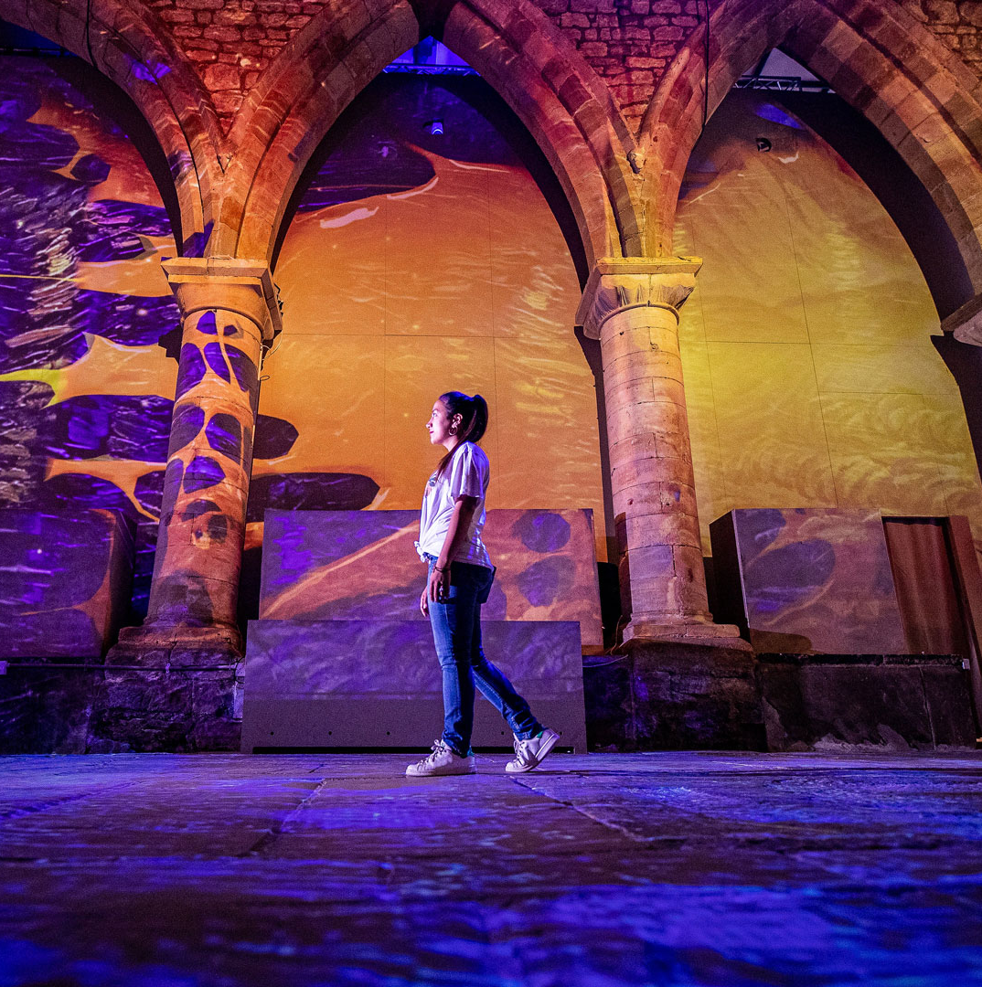
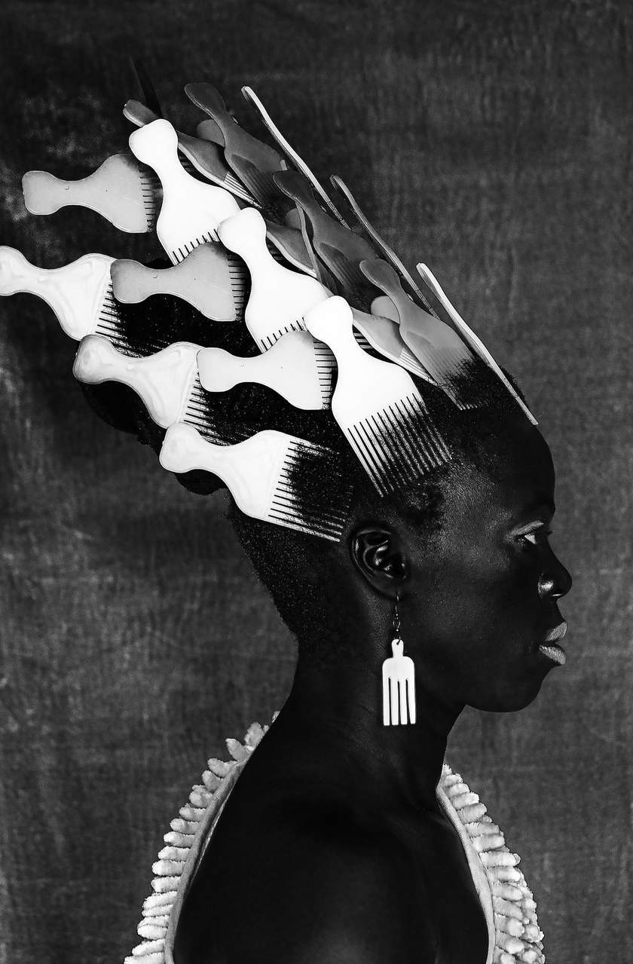
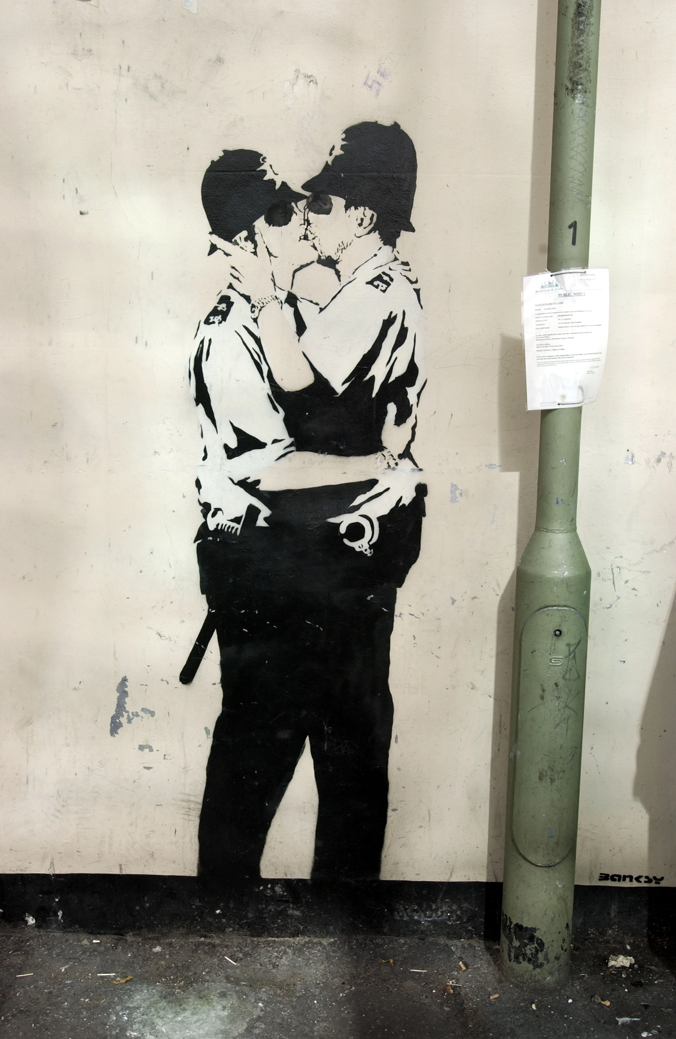
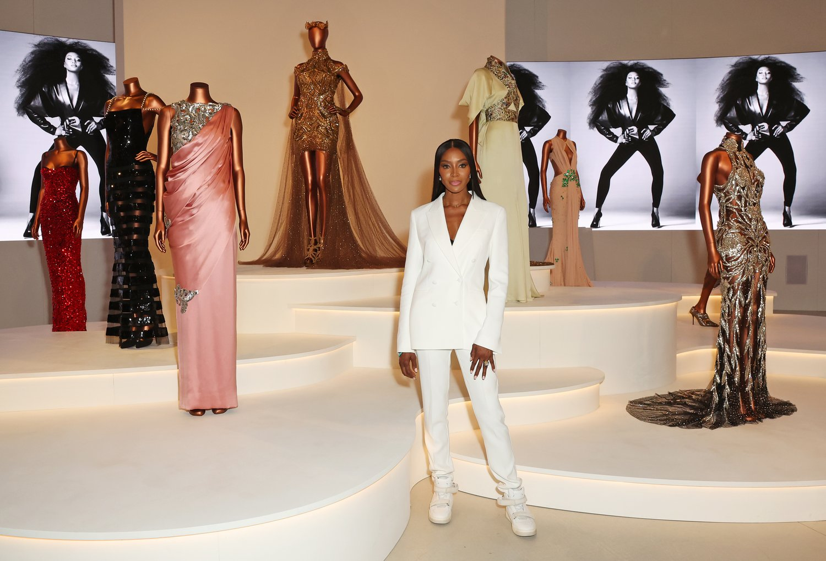
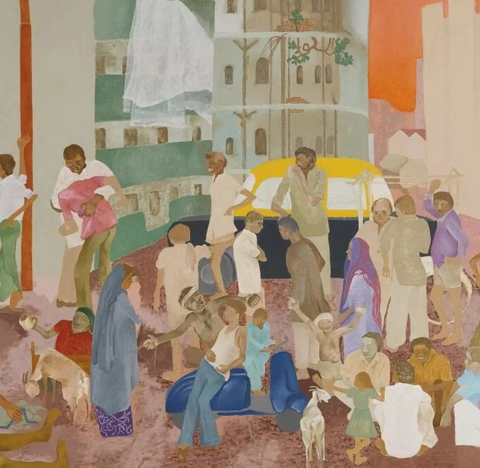
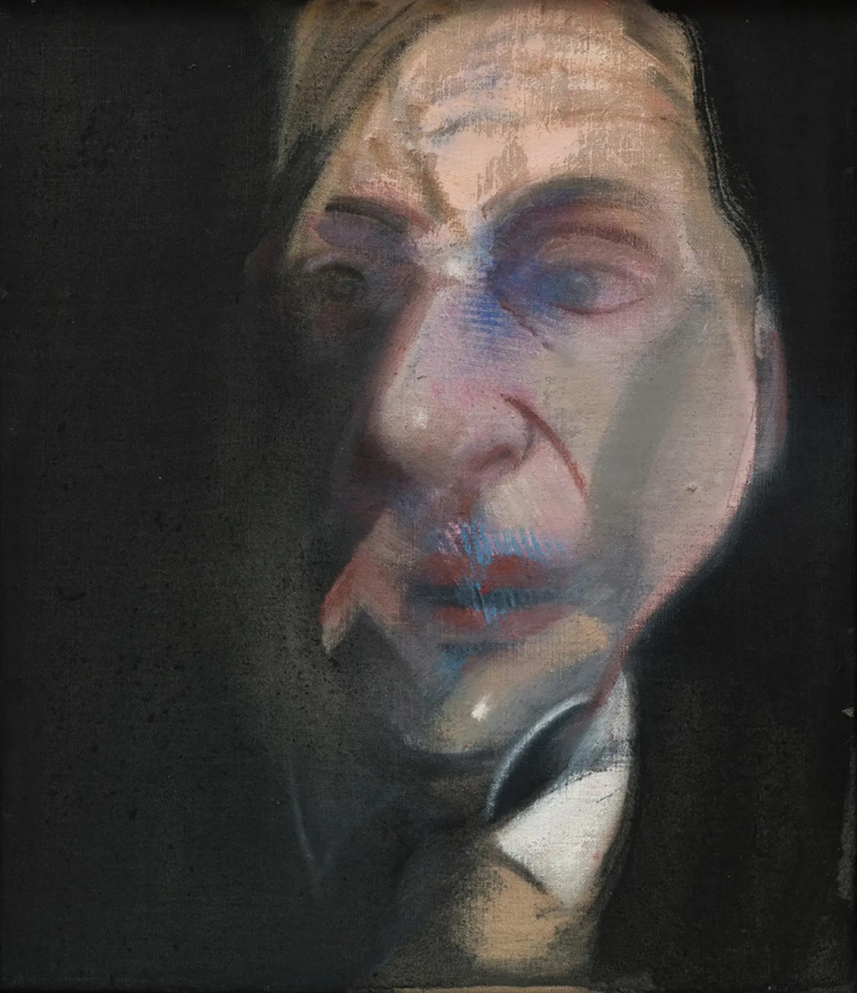
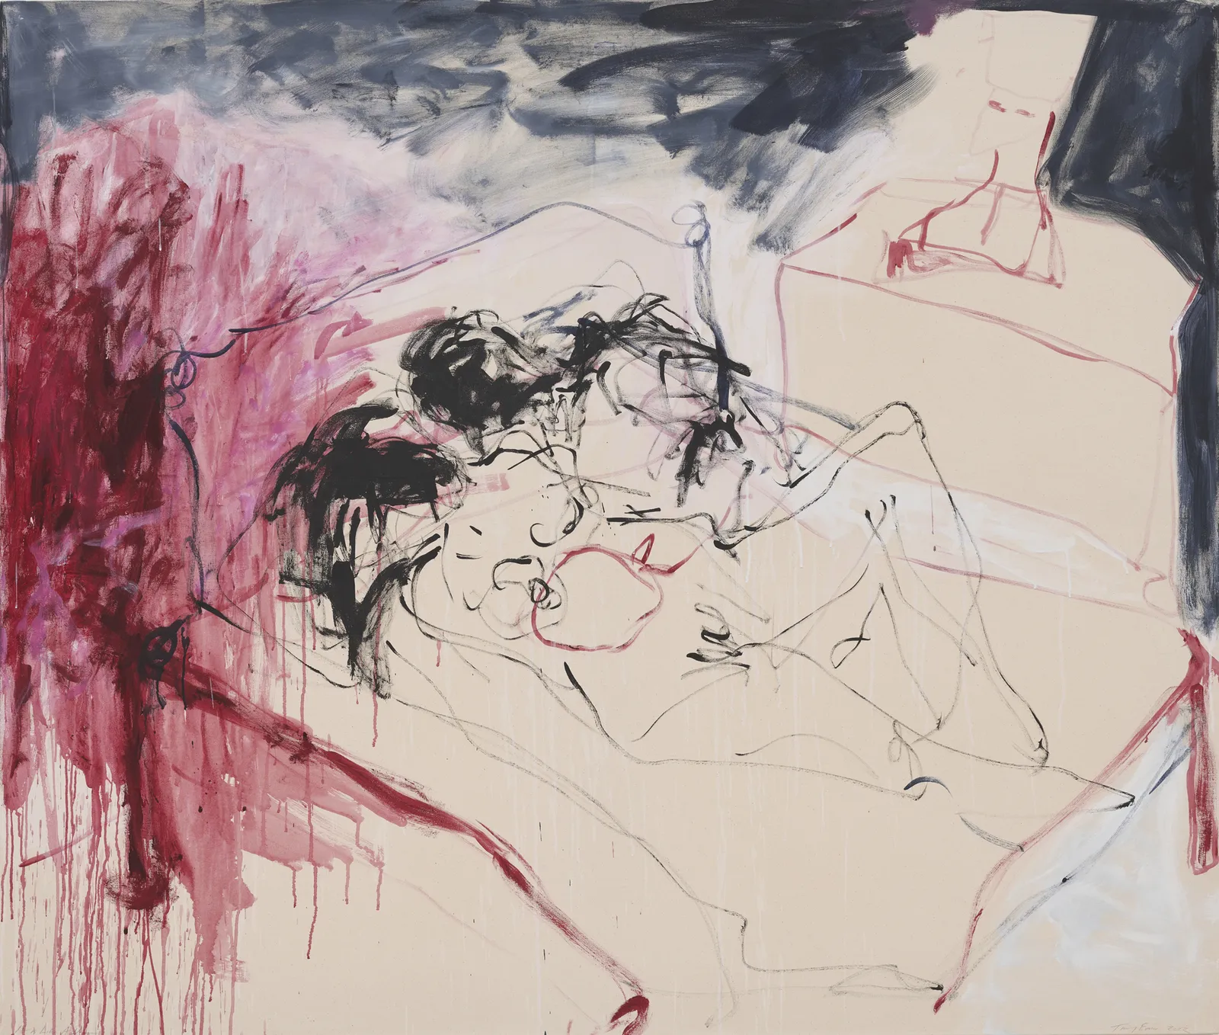
VAN GOGH: POETS & Lovers
Celebrate the National Gallery’s 200th birthday with this once-in-a-century opportunity to see Van Gogh’s most spectacular paintings from around the globe, together for the first time.
TATE MODERN, SE1
Zanele Muholi’s work explores the lives of South African members of the LGBTQIA+ community, and their vivid images are utterly compelling.
THE ART OF BANKSY, WC2
High art meets street art in this fascinating exhibition of the mysterious graffiti artist whose work has captivated the world.
V&A MUSEUM, SW7
The V&A has long celebrated fashion icons, so its blockbuster tribute to Naomi Campbell will be a visual feast for fashionistas.
BARBICAN, EC2
The panoply of Indian life from 1975 to 1998 is brought vividly to life in “The Imaginary Institution of India” exhibition, running throughout October.
NATIONAL PORTRAIT GALLERY, WC2
Stroll through centuries of British history, as told by the faces of the men and women who made it. October sees a special exhibition of the work of painter Francis Bacon.
WHITE CUBE, SE1
Once an enfant terrible and now a grande dame, Dame Tracey Emin’s one-woman show presents the ultimate artistic iconoclast working at her peak.
LOTS TO SEE
Click the images to find out more!
Notes:
2

Slide 12
BFI LONDON FILM FESTIVAL
Your chance to catch a world première or even rub shoulders with Hollywood royalty. Head to Leicester Square and you’ll be seeing stars!
BLOOMSBURY FESTIVAL
The literary heritage of authors like Virginia Woolf and E. M. Forster inspires this celebration of creativity, innovation and free-spirits everywhere.
BLACK HISTORY MONTH
October is Black History Month in the UK, and across the city you’ll find a huge variety of events and activities on the theme of “Reclaiming Narratives”.
LONDON RESTAURANT FESTIVAL
A feast for foodies as London celebrates the world’s best cuisines; from themed dinners to special tasting menus, this is London at its most delicious.
LONDON COCKTAIL WEEK
Know your mojito from your pisco sour as the capital gears up to celebrate the cocktail; with many venues hosting special events. Cheers!
JAPAN: MYTHS TO MANGA
The fabulous Young V&A is a museum for children of all ages: this comprehensive look at the far-flung influence of Japanese culture will be a blockbuster.
FRIEZE LONDON
Regent’s Park hosts the world’s leading contemporary art fair, featuring the work of household names and up-and-comers on the art scene.
October EVENTS
Click the images to find out more!

Slide 13
Click on the image or company name to visit their website.
Making Every Moment Count for Your Brand
At Whitewall, we are committed to transforming every brand experience into a memorable, impactful moment. We specialize in creating innovative and immersive design and experiences that captivate and resonate with audiences, ensuring your brand remains unforgettable. With offices in London, New York and San Francisco we design and deliver for brands and organizations across the globe.
Design
Whitewall ensures your brand thrives across multiple platforms. From campaigns and everyday digital communications to XR, VR, AR and the Metaverse, we create design that place your brand at the forefront of style and substance — making every digital interaction impactful and meaningful.
Digital
Our digital services are centered on making sure every touchpoint of your digital presence counts. We craft content that is both functional and captivating, ensuring your audience remains engaged at every step.
Experience
When it comes to experiential events, we don't just create moments — we turn them into movements. Whitewall delivers bespoke experiences that engage, inspire, and build lasting connections with your audience.
At Whitewall, we understand that every second is an opportunity to elevate your brand.
Let us make every moment count for you.
WHITEWALL

Slide 14
We hope you enjoy all that London has to offer.
If you would like to create a bespoke experience for your family and friends or colleagues, get in touch with Matthew at Whitewall.
As experts in “experience engineering”, we can curate your ideal London visit and leave you with memories to last a lifetime.
Matthew Canning-Wall
Chief Creative Officer
Whitewall
E: matthew@whitewallcreative.com
T: +44 (0)7976 739 967
W: www.whitewallcreative.com
This booklet is © UpStage Communications Ltd. No part of its contents may be reproduced in any form or by any means without the prior written permission of UpStage Communications Ltd. UpStage Communications Ltd disclaims any liability for the availability or non-availability of services and locations mentioned in this booklet.

