Slide 1
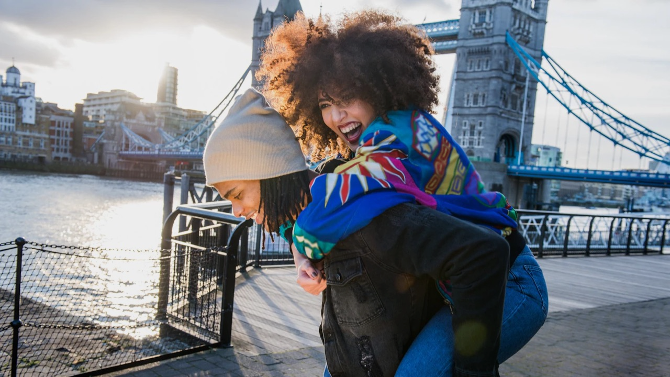


Welcomes you to London!

Slide 2

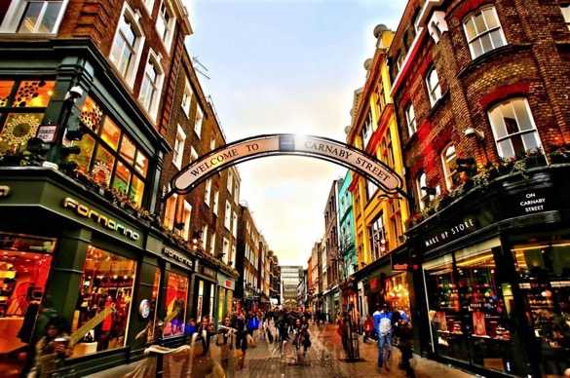

The United Kingdom is ripe with opportunity, no matter what your flavor of “football” is.
We hope you have a fantastic trip and are able to explore the eclectic offerings that are synonymous with London and the rest of the United Kingdom.
If you’d like to learn more about UK Government work in the Midwest or about UK companies making a splash in the US market, please reach out to Jan Bauer or Alexis Svenson.
Safe travels!
Richard Hyde
His Majesty’s Consul General
Central & Midwest USA
Jan Bauer
Head of UK Government Office
UK Government Office, Minnesota
e-mail: jan.bauer@fcdo.gov.uk
Alexis Svenson
Senior Trade & Investment Officer
Creative, Media & Sport
Midwest & Colorado USA
e-mail: alexis.svenson@businessandtrade.gov.uk

Slide 3
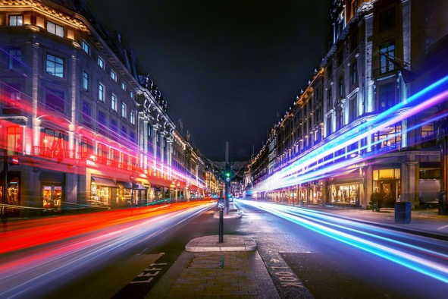


Whitewall welcomes you to London!
Whether you’re a first-time visitor or a regular traveller, London will always surprise you.
Phil frequently hops the pond from his day job running our West Coast US office, while Matthew takes care of business in London.
Both of us are passionate about creating amazing experiences – and London offers a playground like no other. You can often find us out on the town enjoying restaurants, the theater and other cultural attractions, as well as soaking up the rich history of this incredible city.
Enjoy your time in the UK – and look out for our WW logo on the places and activities you really won’t want to miss!
Phil White Matthew Canning-Wall
CEO CCO
Phil & Matthew's top picks
All these suggestions would enhance your London experience – our special favorites are highlighted just for you!

Slide 4
1. HISTORY BUFFS
2. DIVERSE-CITY
3. FOODIES
4. MUSIC LOVERS
5. GET IMMERSED
6. LIVING well
7. LOTS TO SEE
8. OCTOBER EVENTS
9. Business profiles
MENU

Slide 5
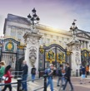
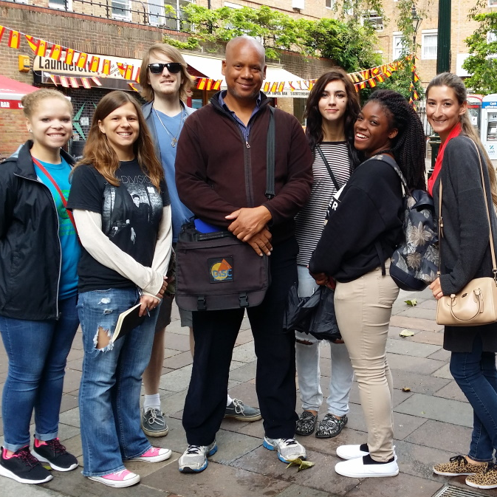
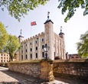
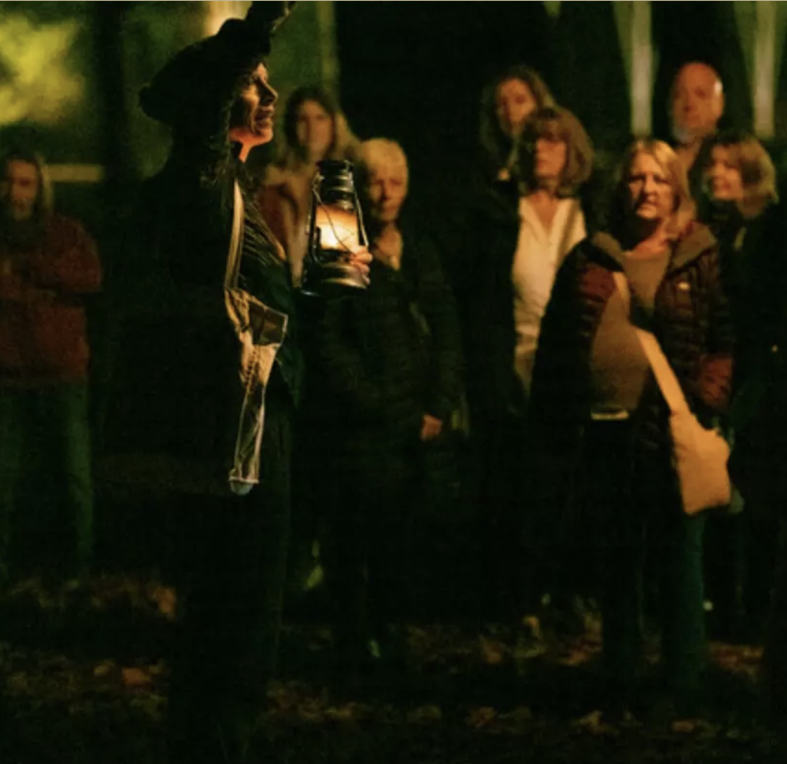

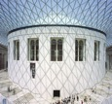
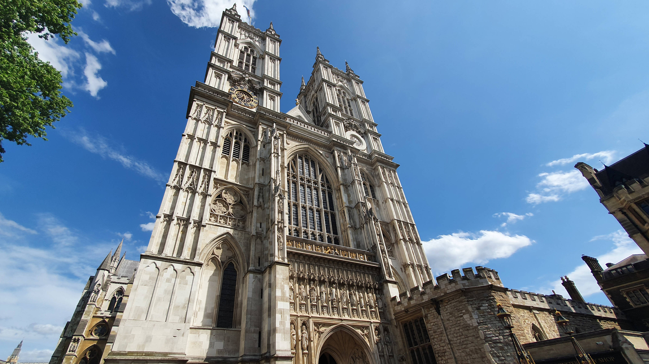
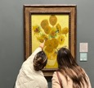
BUCKINGHAM PALACE, SW1
The home of the British monarchy and of The King’s Gallery: an intimate showcase for the masterpieces of the Royal Collection.
BLACK HISTORY WALKS
Black history and the history of London are one and the same; experience many of the places and people who made that history on these engaging walks.
TOWER OF LONDON, EC3
The Gunpowder Plot of 1605 saw Guy Fawkes and a band of ne’er-do-wells try to blow-up Parliament. Watch the plot come to life at the Tower Vaults.
ST. james’s park, sW1
Are you brave enough to experience the haunted past of this Royal Park? On October 3rd and 17th you have the chance to walk with the “Dead After Dark”.
BRITISH MUSEUM, WC1
For centuries, silks and spices traveled astonishing distances along the legendary Silk Road – explore this ancient superhighway through this stunning exhibition.
WESTMINSTER ABBEY, SW1
Marvel at a thousand years of history and make a special visit to Poet’s Corner: resting place of the UK’s literary giants from Chaucer to the present day.
NATIONAL GALLERY, SW1
Your once-in-a-century chance to see sublime masterpieces that span the history of Art: everything from Great Masters to modern trailblazers.
HISTORY BUFFS
Click the images to find out more!

Slide 6
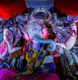
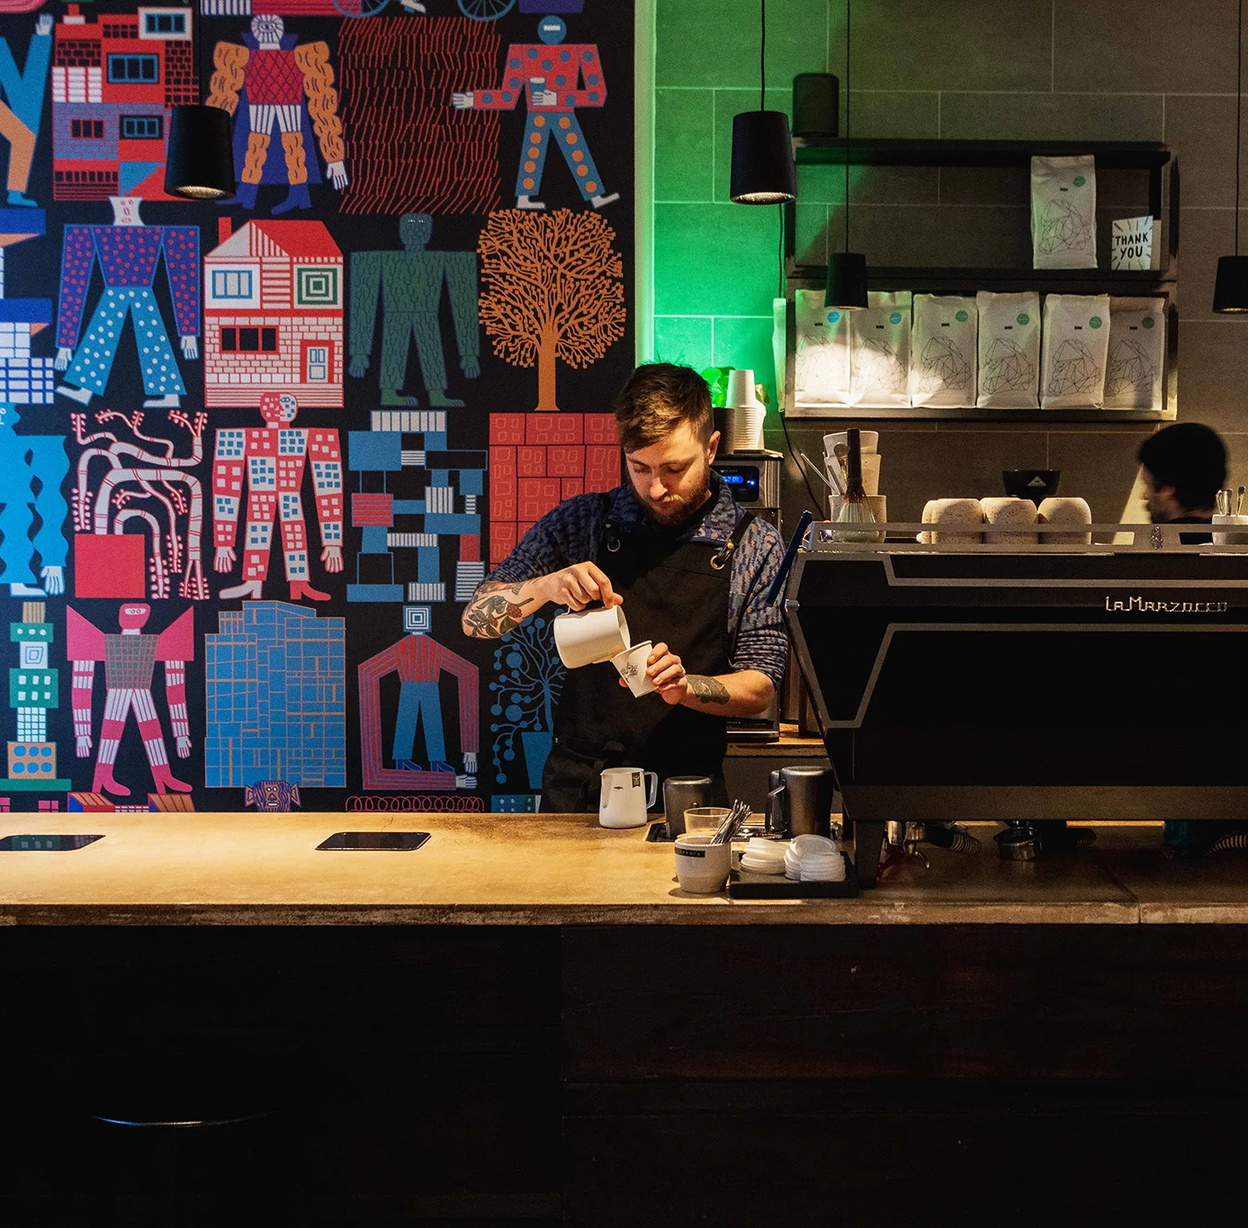
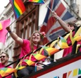
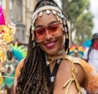
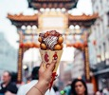

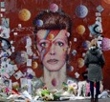
BRICK LANE, E1
Brick Lane in East London is a vibrant hub that showcases the rich heritage and cultural identity of the Bangladeshi community. A curry here is a must.
SHOREDITCH, E2
London’s trendy art district has something for everyone – from creative arts to cool bars and cafés like Origin Coffee!
OLD COMPTON STREET, W1
The beating heart of London’s amazing LGBTQ+ community. There are bars and clubs plus a wide array of shops – or simply soak up the buzzy atmosphere with pride!
NOTTING HILL, W11
Home to the world-famous carnival (and Hugh Grant of course), this is the place to explore the incredible market on Portobello Road. (*Julia Roberts not included!)
CHINATOWN, W1
A foodie paradise in the heart of Soho – we recommend saying hello to Mr Wing of Tao Tao Ju – a friendly welcome (and delicious dishes!) await you.
BOROUGH MARKET, SE1
Whitewall’s old stomping ground and home to the world’s greatest food market (we’re biased!) You’ll want to come hungry – you won’t leave that way!
BRIXTON, SW2
Sign up for a self-guided Music Tour of this vibrant and diverse neighborhood – music is in Brixton’s soul and its influence is everywhere.
DIVERSE-CITY
Click the images to find out more!

Slide 7

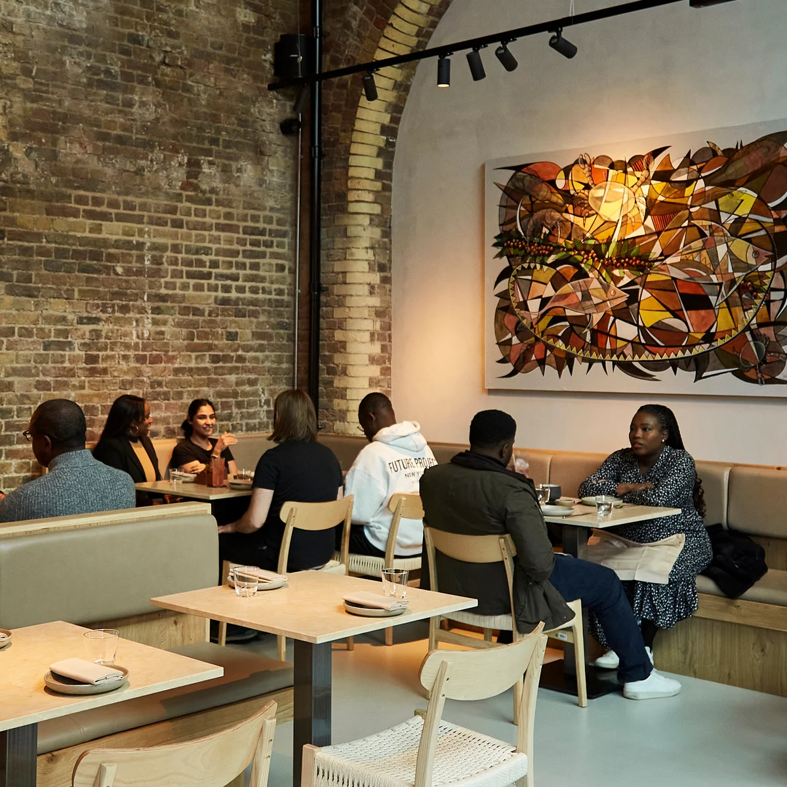
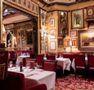
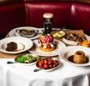
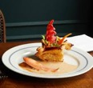
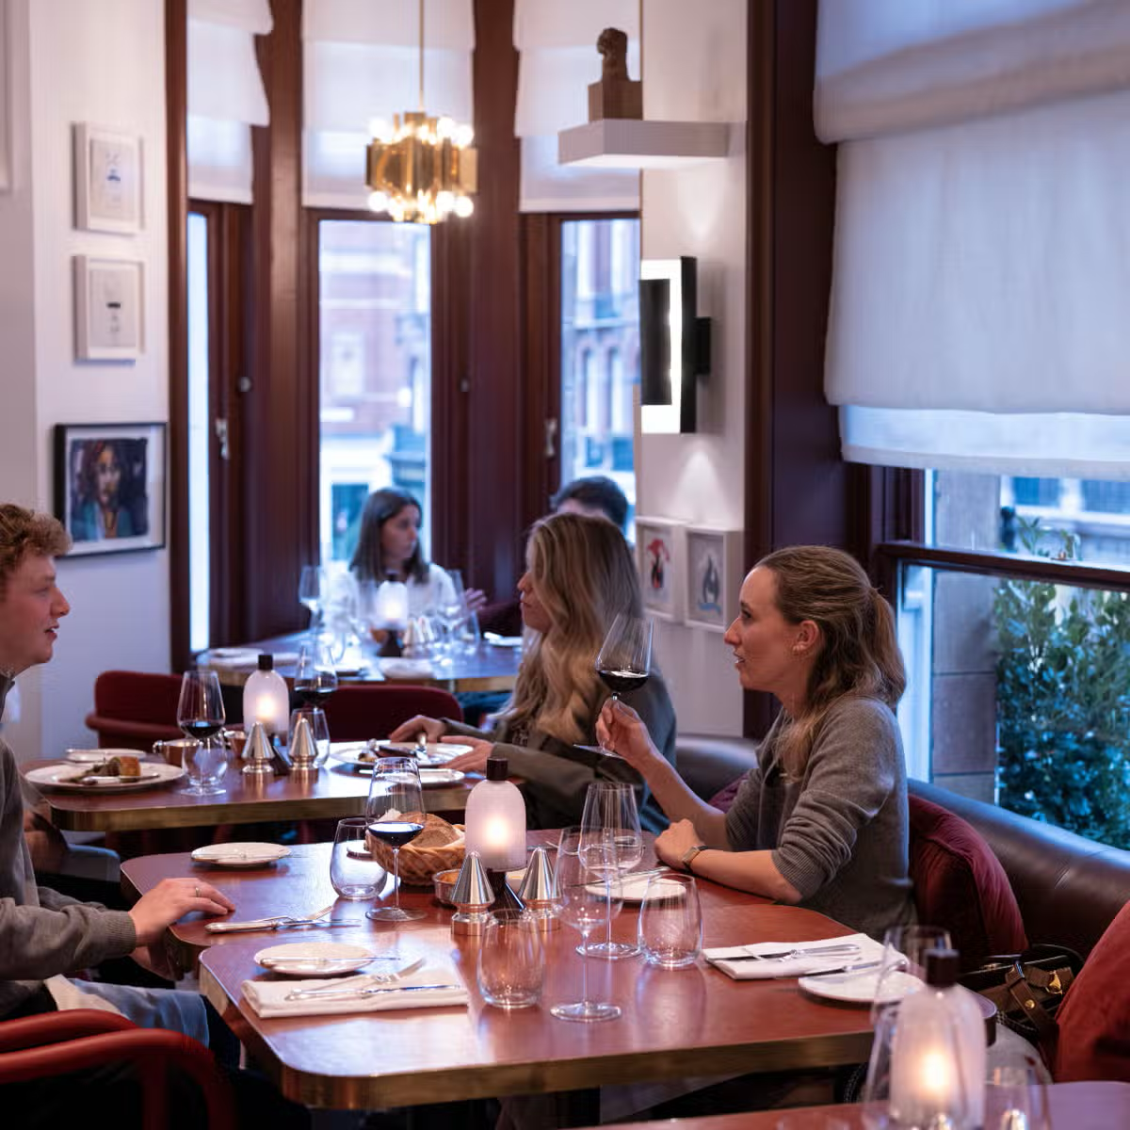

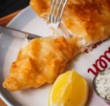
AKARA, SE1
Nigerian Akara Osu with the flavour-packed delights of Brazilian Acaraje is the star at this gem situated in Borough Market.
RULES, WC2
It doesn’t get more British than this – London’s oldest restaurant has been serving up the UK on a plate for a discerning clientele in Covent Garden since 1798.
THE DEVONSHIRE, W1
There are pubs, and then there’s the Devonshire! It may look like a typical London boozer, but its kitchen wizards elevate British classics beyond belief.
64 Goodge street, w1
Don’t be fooled by the plain exterior: inside, Chef Stuart Andrew is offering up superb interpretations of French classics “from an outsider’s perspective.”
MOUNT ST. RESTAURANT, W1
Be warned: it’s not a cheap night out, but boy does it deliver. A feast for the eyes and the palette at this divine dining experience.
DARJEELING EXPRESS, W1
Staffed by Bengali women with no formal training, this authentic little gem showcases the best of North Indian cuisine – and your tastebuds will be tingling.
GOLDEN UNION, W1
Pretentious it ain’t, but this no-frills fish bar in Soho serves up some of the capital’s best fish-and-chips; and what trip to London would be complete without that?
FOODIES
Click the images to find out more!

Slide 8
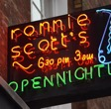
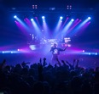
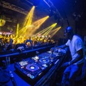
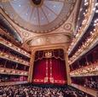
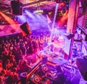


RONNIE SCOTT’S, W1
This legendary club is the home to London’s eclectic jazz scene – and has been since 1959. October 12th sees legend Booker T. Jones take the stage.
ELECTRIC BRIXTON, SW2
Fans of drum-and-bass will be heading to this iconic venue on October 5th for a one-off celebration of the vibrant musical genre that’s still going strong.
N7 LONDON, N7
Capture the spirit of the Balearics with a night of Ibiza house anthems on October 19th. The hottest tracks at the coolest venue.
ROYAL OPERA HOUSE, W1
Go behind the scenes at one of the world’s greatest opera houses with a backstage tour; uncover the secrets of bringing great music to life.
JAZZ CAFE, NW1
Great jazz performers from around the world, with “Best World Music Group” Divanhana bringing the world to Camden on October 24th.
The crazy coqs, w1
An intimate cabaret venue just a stone’s throw from Piccadilly Circus. On October 25th, viral jazz sensation Rachel D’Arcy sings “Songs for My Soho”.
Fabric, EC1
Many a fine time had at Fabric, which celebrates its 25th anniversary this year on October 11th – you won’t want to miss this chance to get your groove on.
MUSIC LOVERS
Click the images to find out more!
Notes:
Divanhan

Slide 9

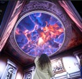
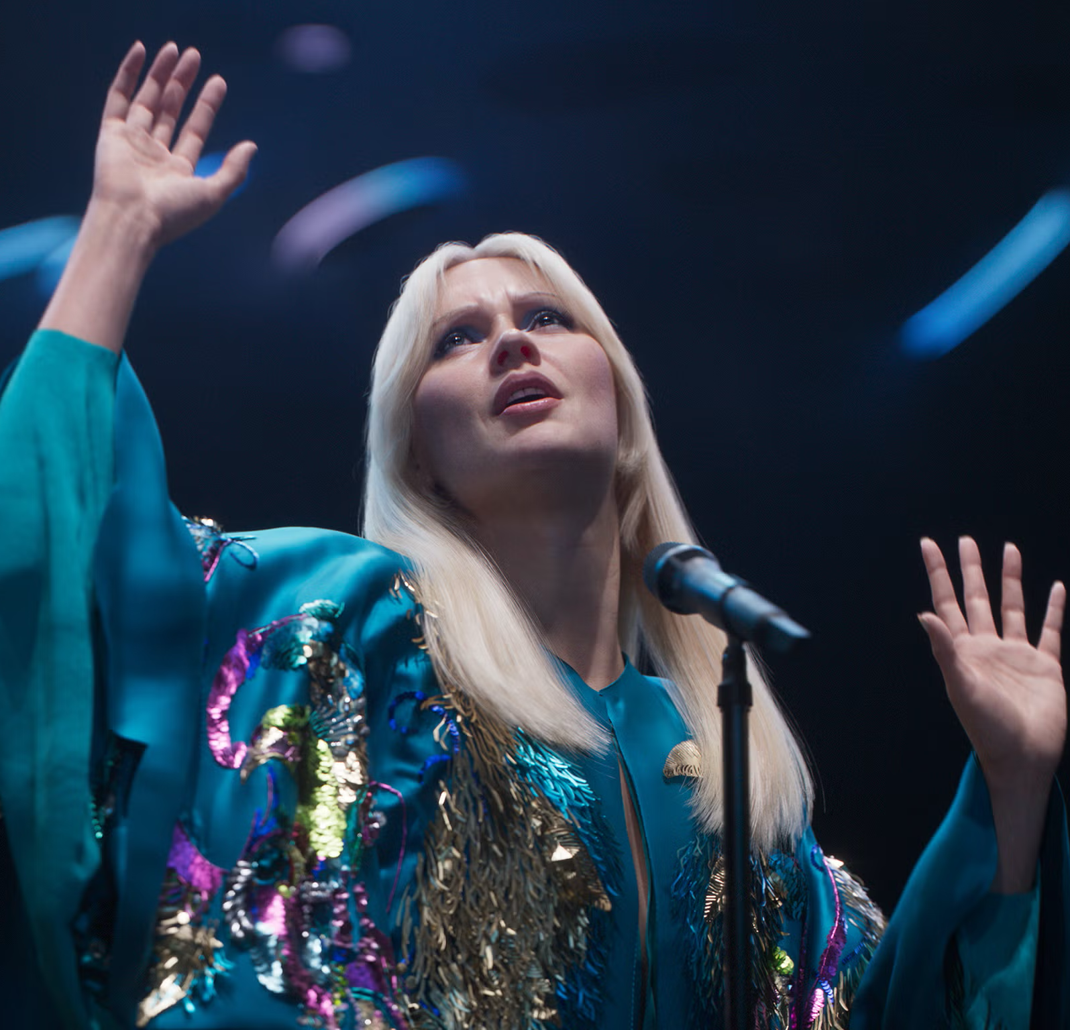
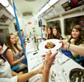
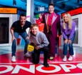
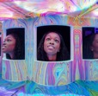

PADDINGTON BEAR EXPERIENCE, SE1
Everyone’s favorite bear is hosting his very own immersive experience, and you’re cordially invited. Expect the unexpected when Paddington’s around. Also, marmalade.
OUTERNET LONDON, W1
The UK’s most visited cultural attraction offers eye-popping visuals and interactive screens. A live music venue attracts big-name performers.
ABBA VOYAGE, E15
Take a chance on the most poptastic show in town, as mind-blowing technology recreates one of the world’s most famous bands. We dare you not to sing along!
SUPPERCLUB TUBE, E17
Ever fancied eating a Latin American-inspired meal on a decommissioned 1967 Tube carriage? Us neither, but this is a one-of-a-kind dining experience you’ll love!
Monopoly life-sized, W1
See all of London in one venue as you enter the world of the classic board game. Mr Monopoly himself guides you through this fast and fun experience.
TWIST MUSEUM, W1
Be prepared to be blown away by this incredible immersive space where nothing is quite what it seems. A mind-bending experience awaits.
STRANGER THINGS, W1
Whether you’re a fan of the Netflix smash hit or not, we defy you not to be enthralled by this imaginative and dynamic prequel, live on stage.
GET Immersed
Click the images to find out more!

Slide 10
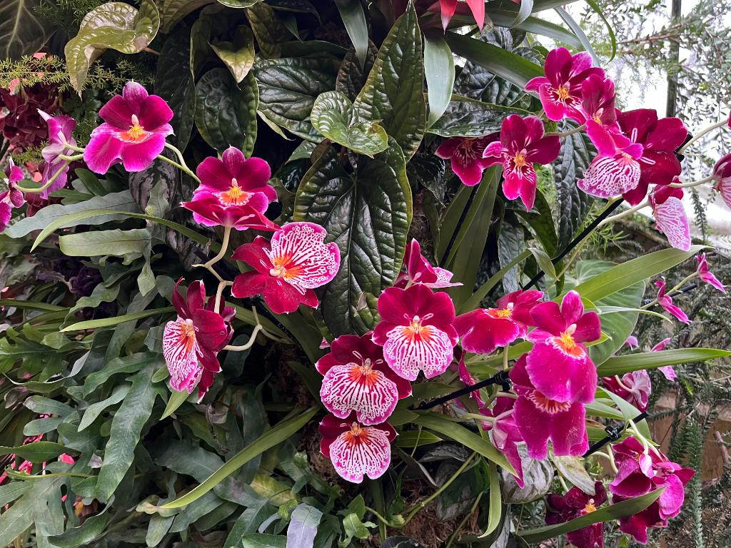
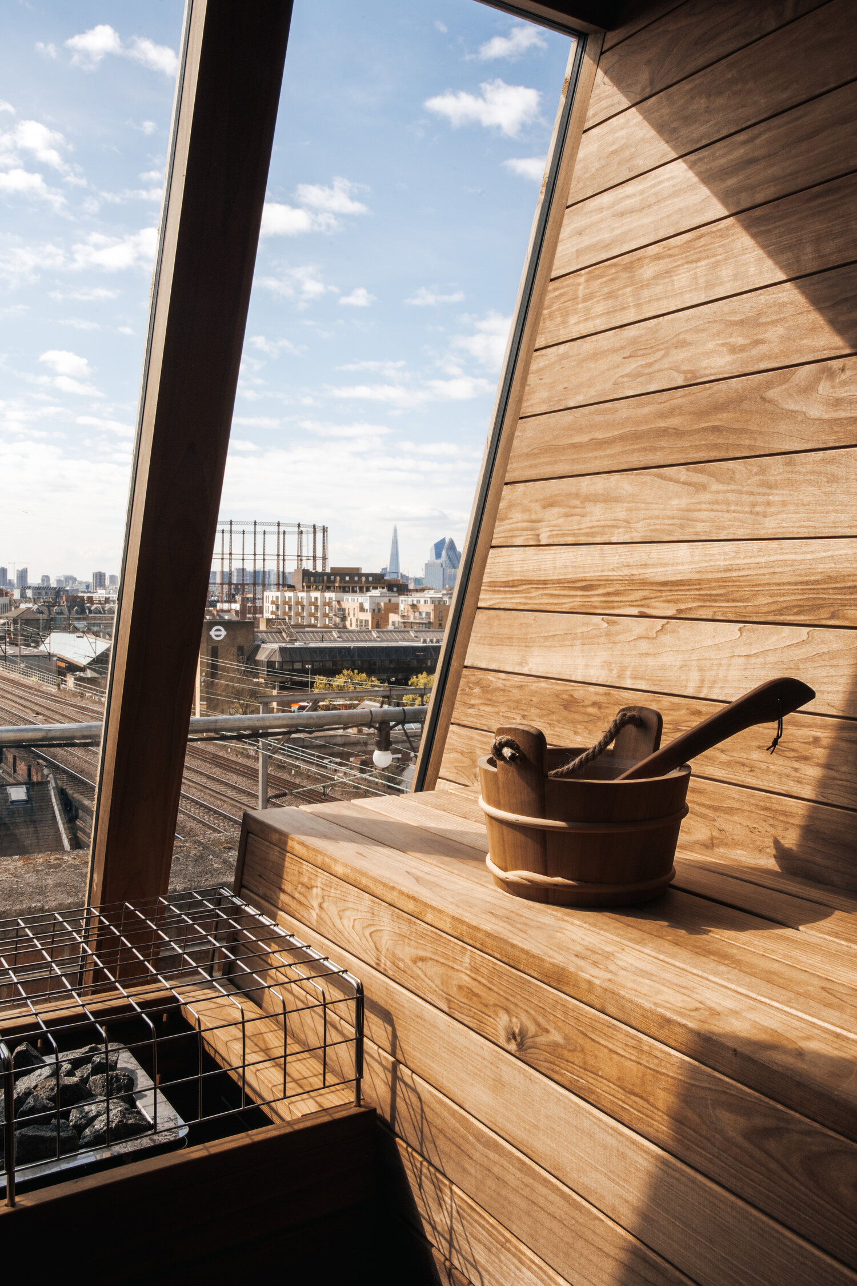
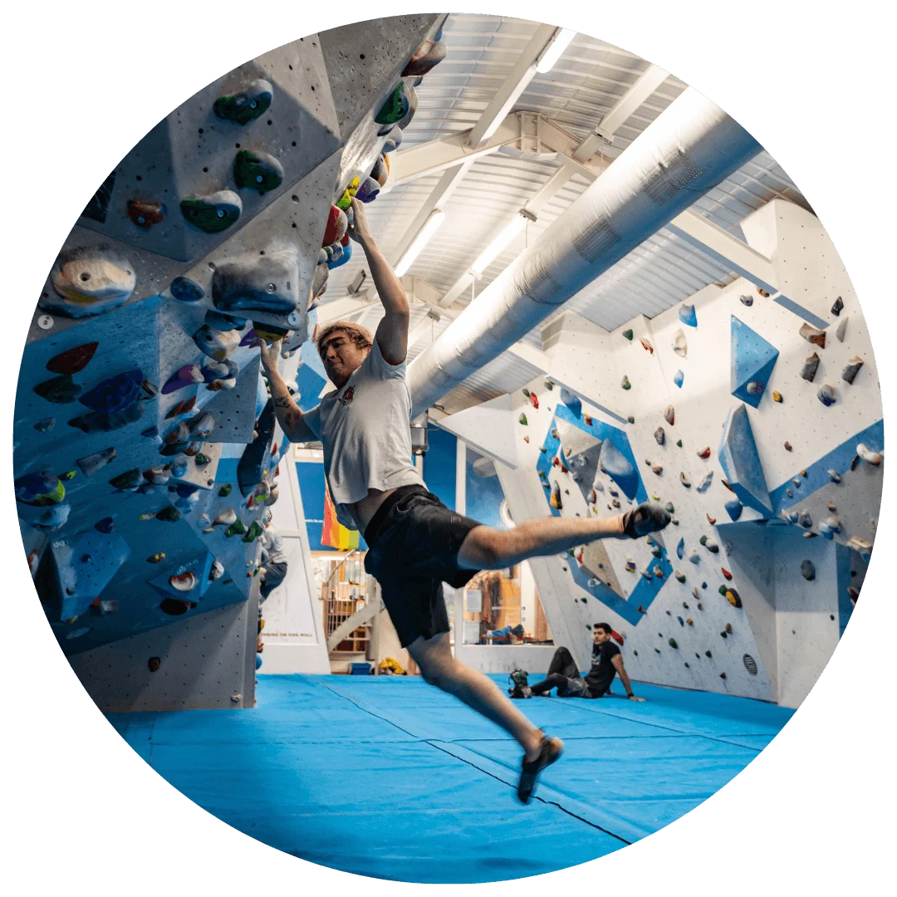
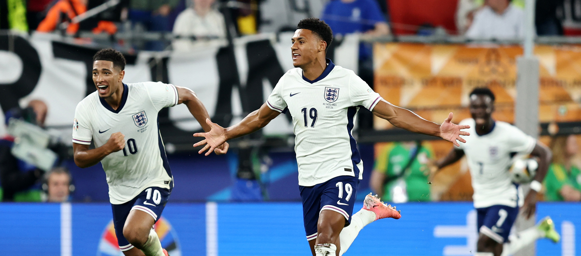
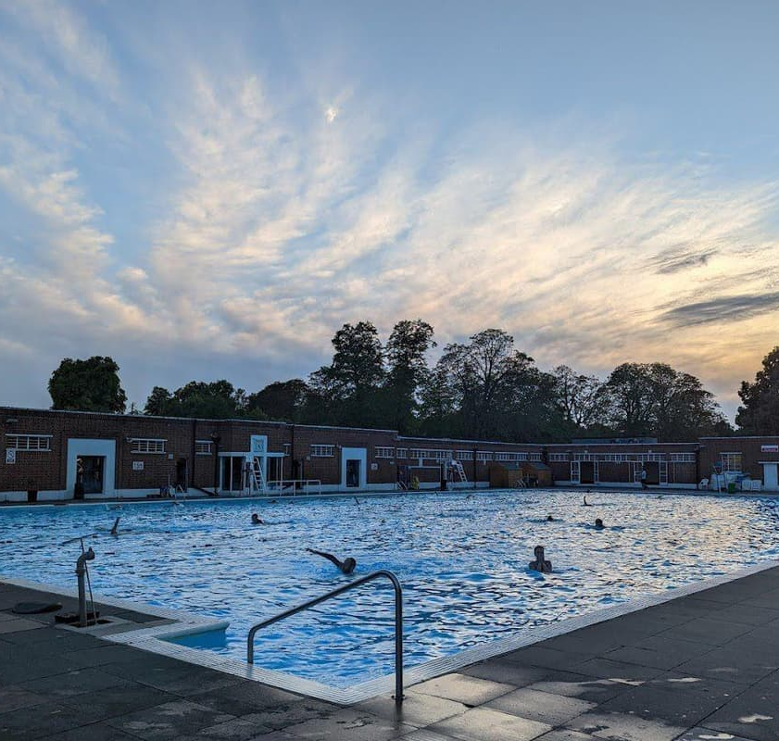
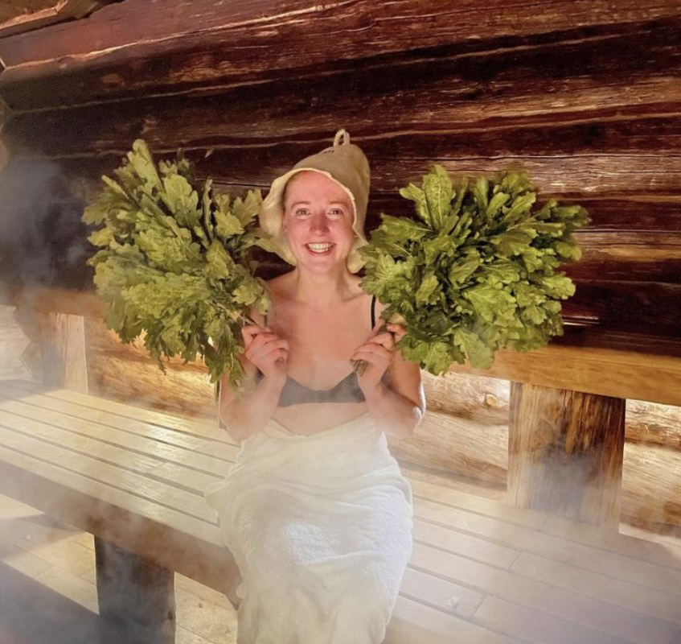
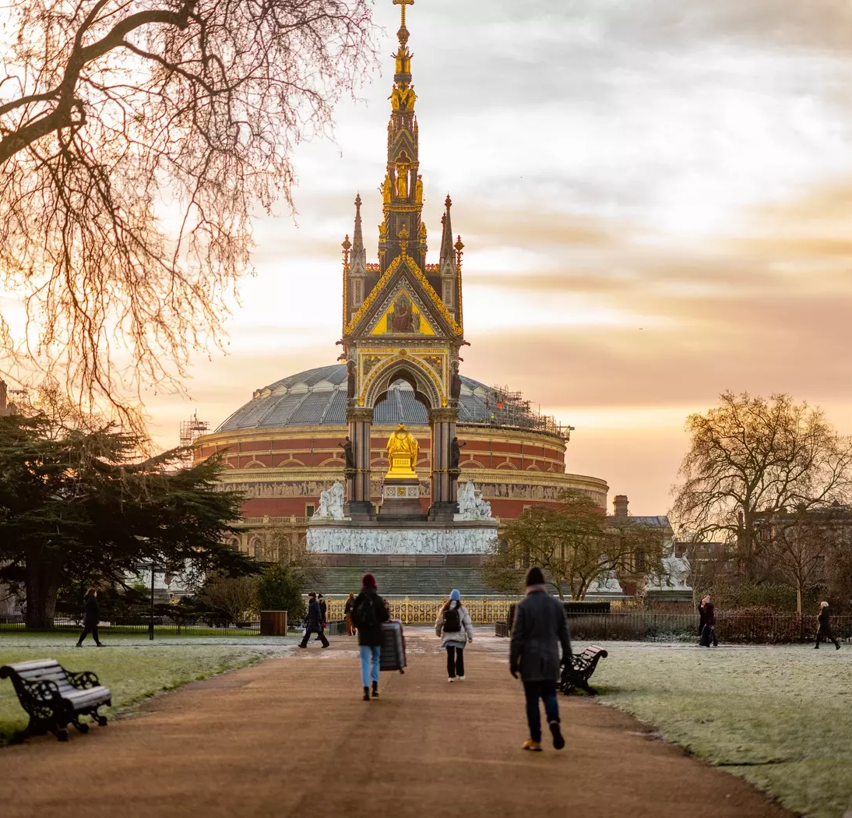
KEW GARDENS, TW9
More than just the world’s most diverse botanic collection, the Gardens offer a haven of peace and tranquillity to soothe the soul.
NETIL360, E8
For an elevated wellness experience like no other, head to East London for the Netil360 Rooftop Sauna. You’ll feel on top of the world.
VAUXWALL, SW8
Hundreds of climbs await the adventurous in the arches beneath Vauxhall Station. Beginners and experienced mountaineers welcome.
Wembley stadium, HA9
The ‘other’ football takes center stage on October 10th as England takes on Greece in the UEFA Nations League at the home of English soccer.
BROCKWELL LIDO, SE24
If cold-water swimming is your jam, this iconic outdoor pool offers the chance for a bracing dip before you head to the nearest pub to warm up!
BANYA NO.1, N1
This spa is not for the faint-hearted! Treat yourself to a traditional banya, an ancient spa ritual combining extremes of heat and cold.
KENSINGTON GARDENS, W1
Stretch your legs and your imagination on October 11th, as The Royal Parks presents a guided tour exploring the beautiful Albert Memorial.
LIVING well
Click the images to find out more!
Notes:
2

Slide 11
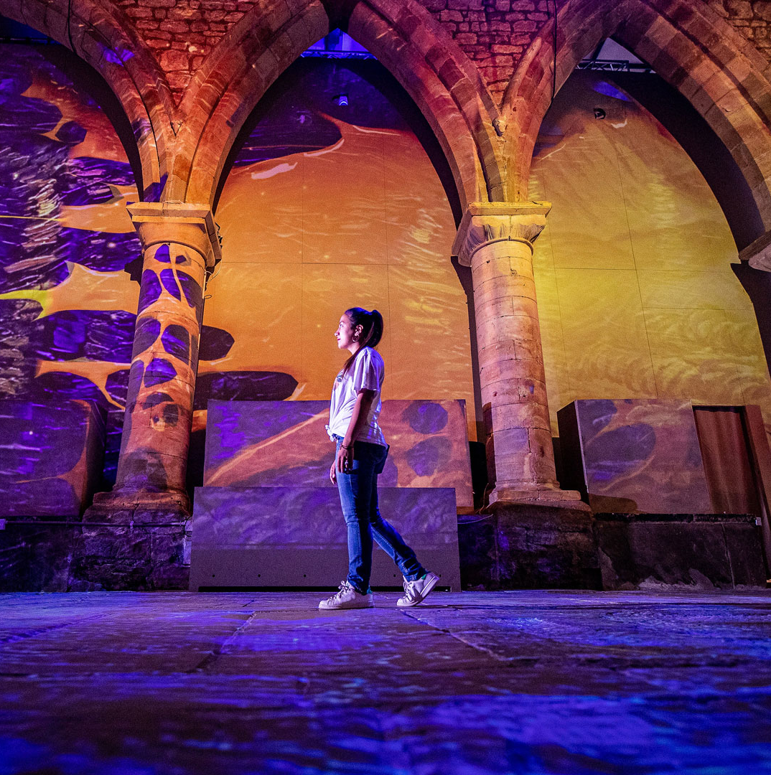
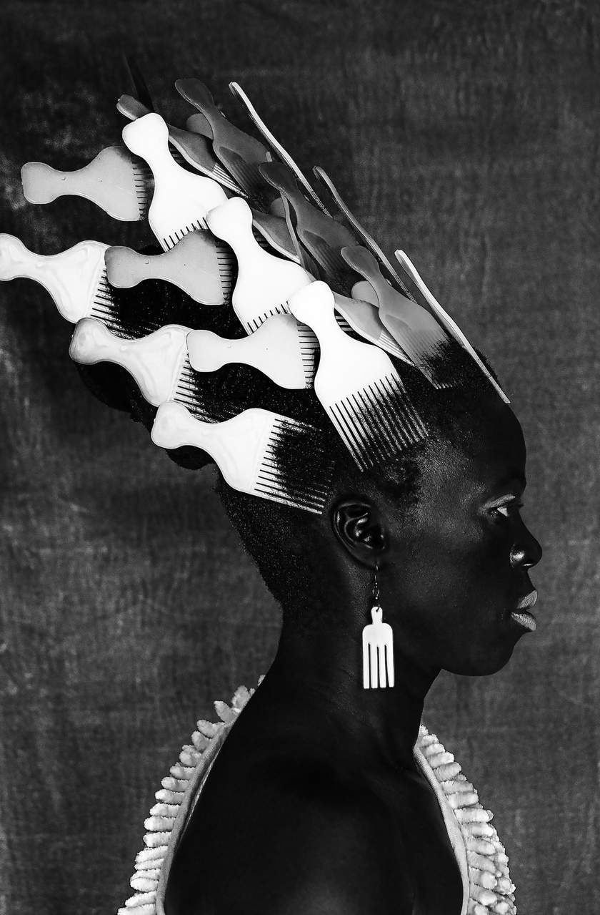
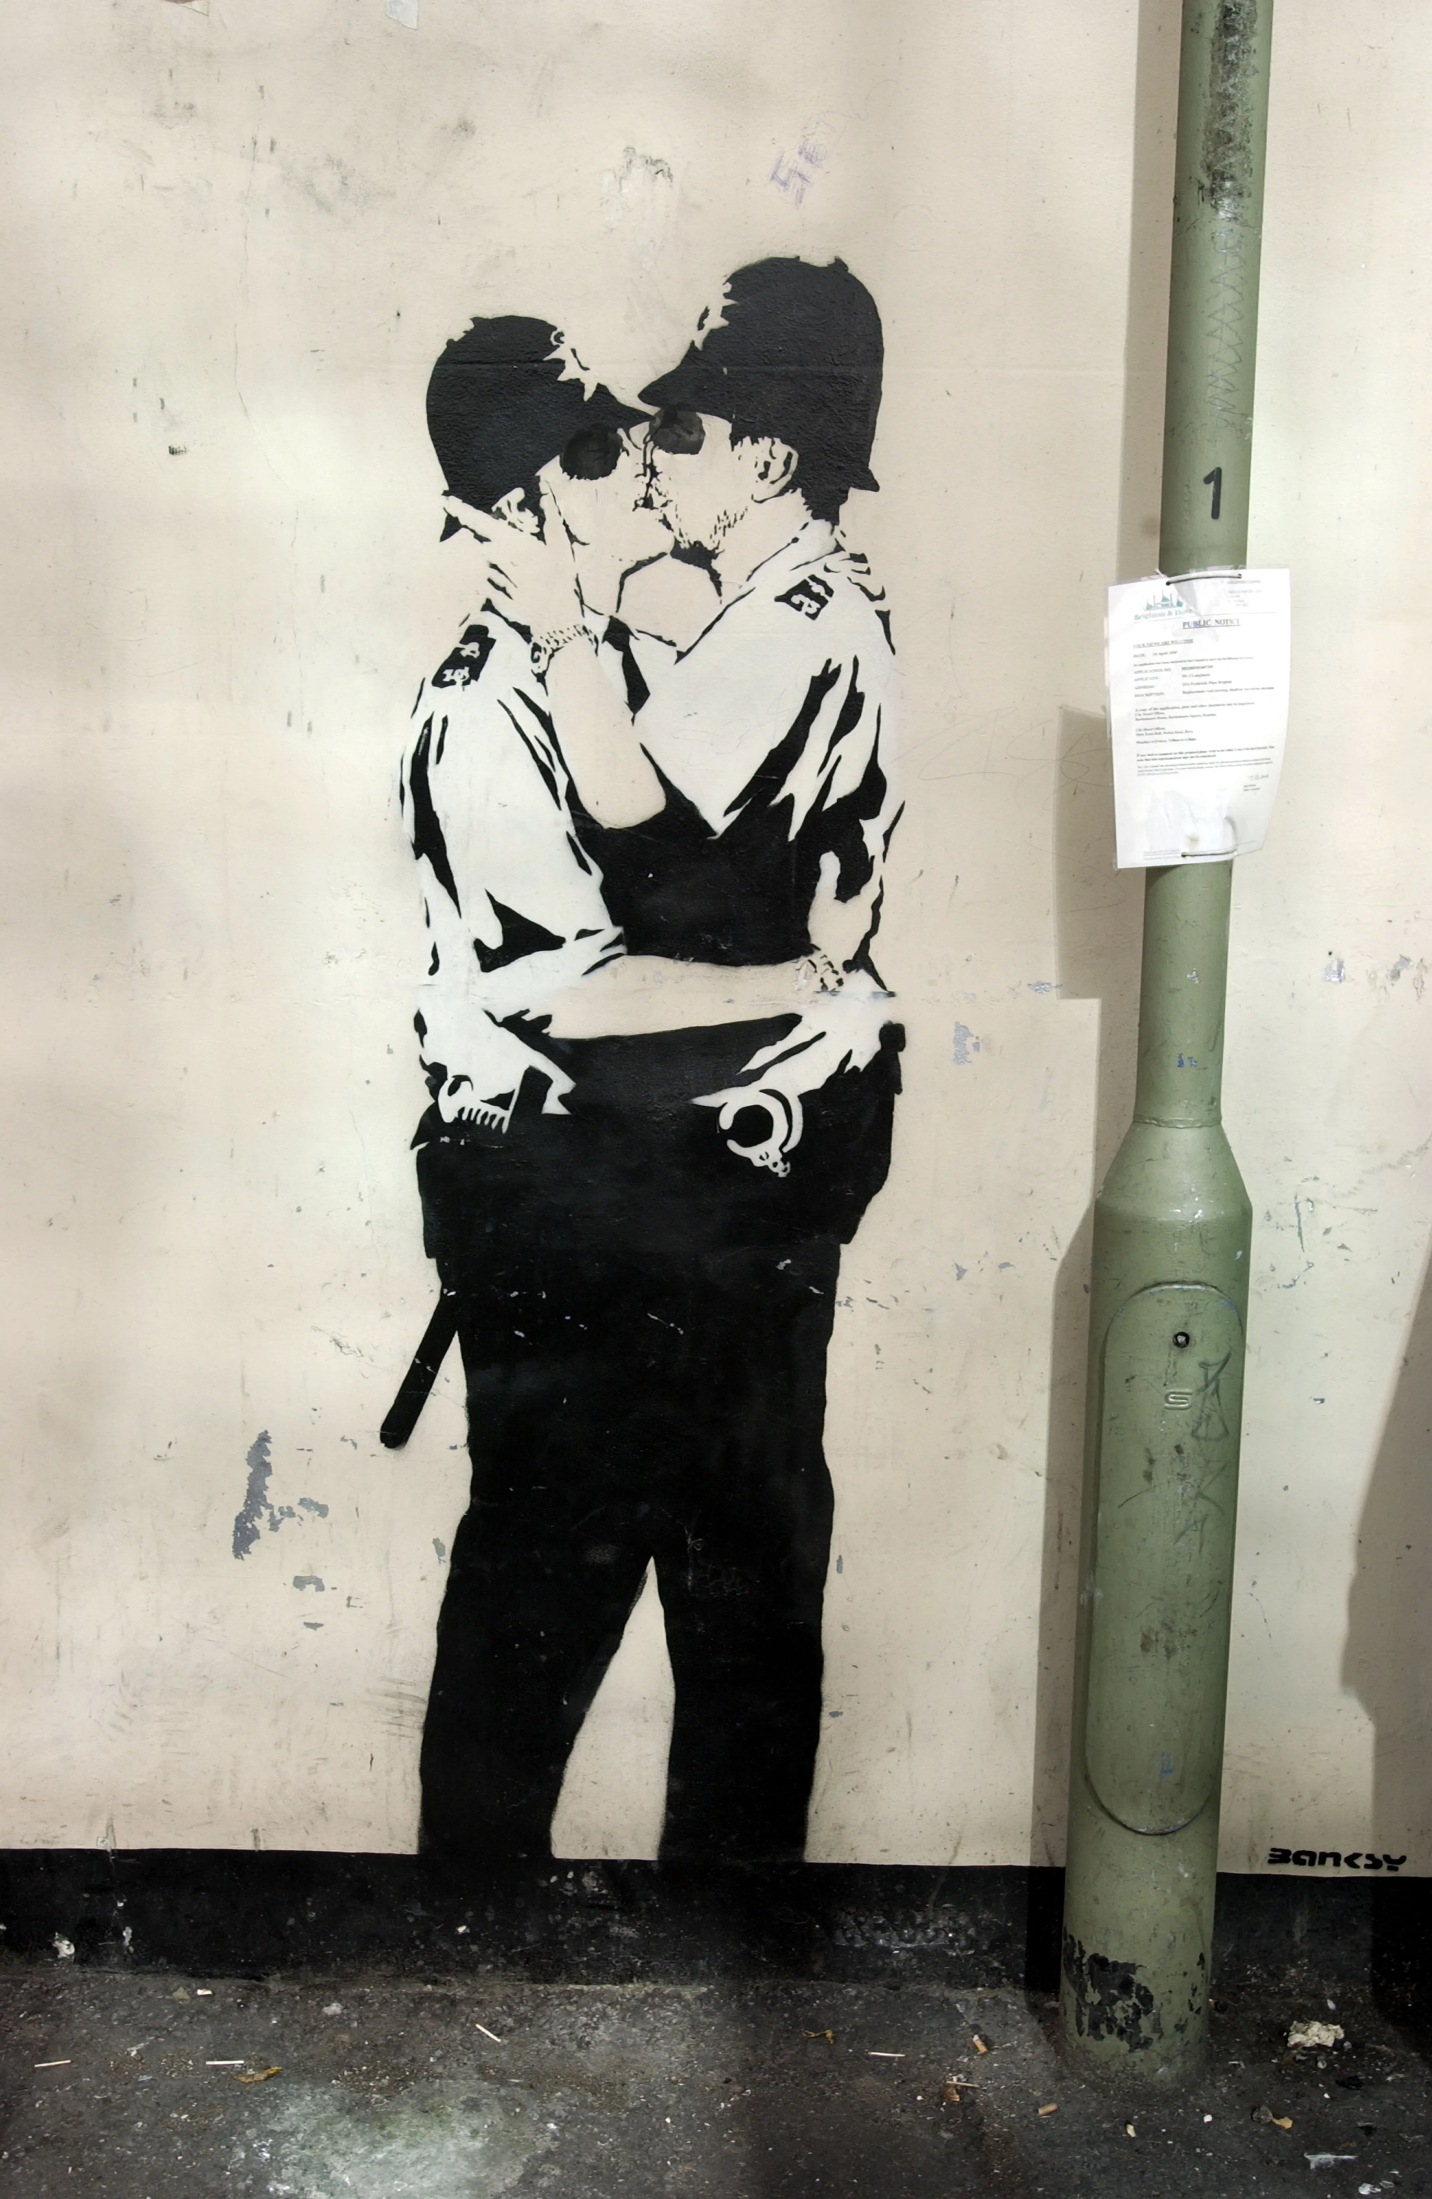
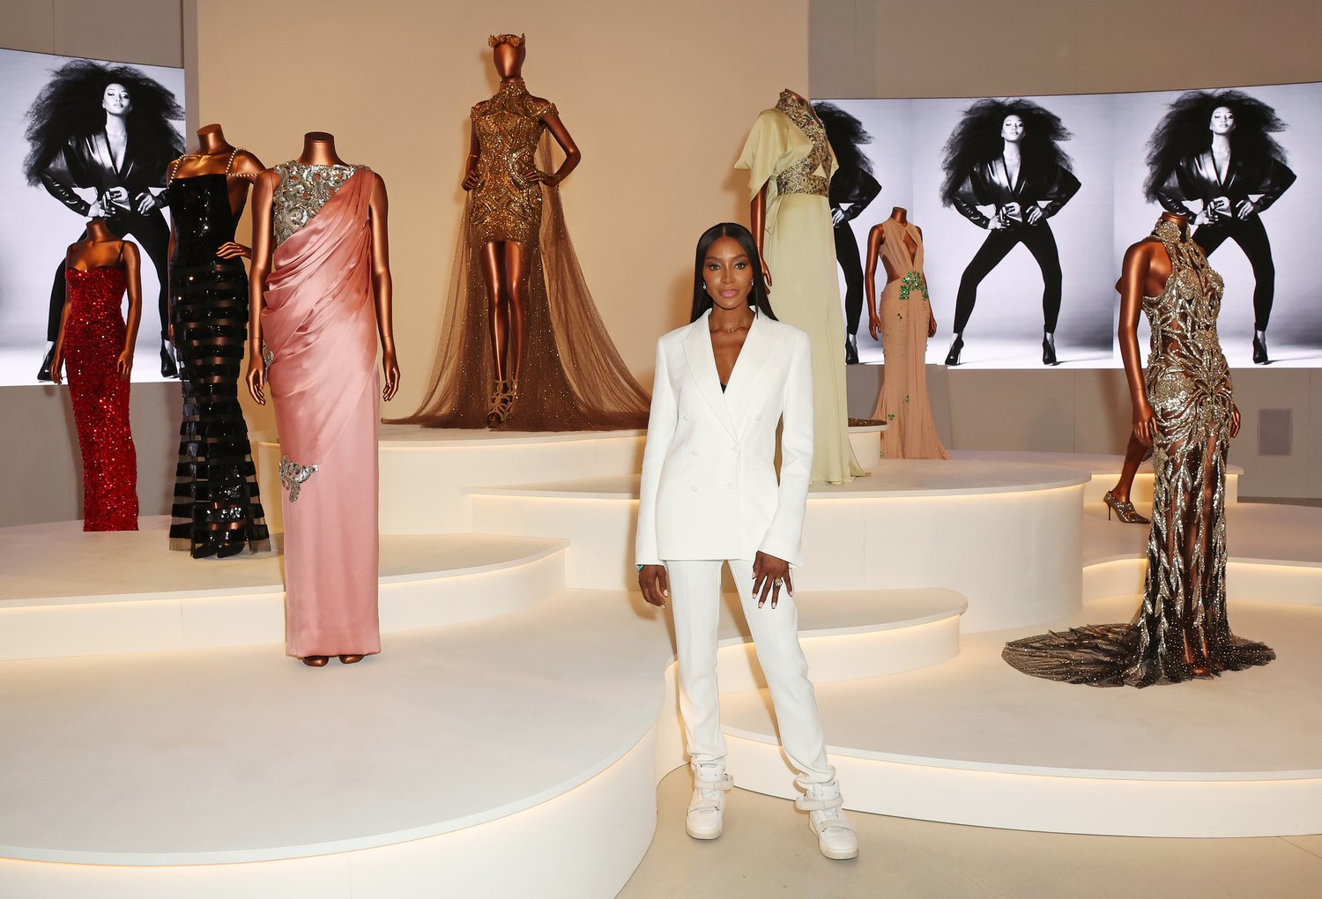
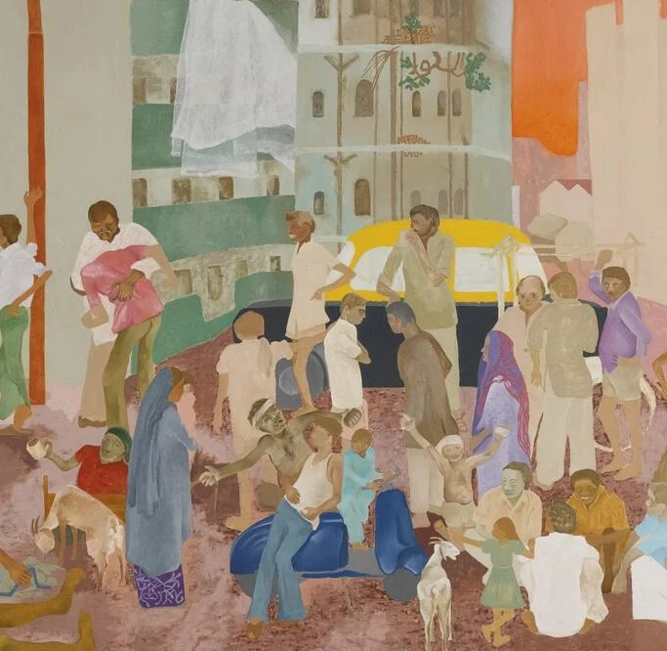
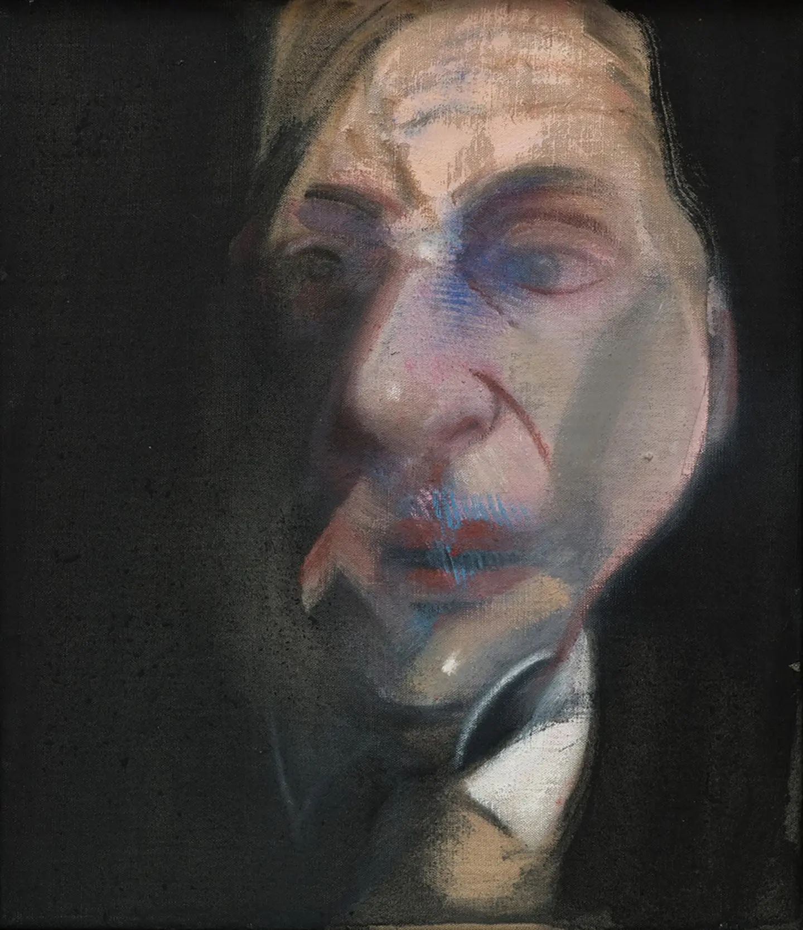
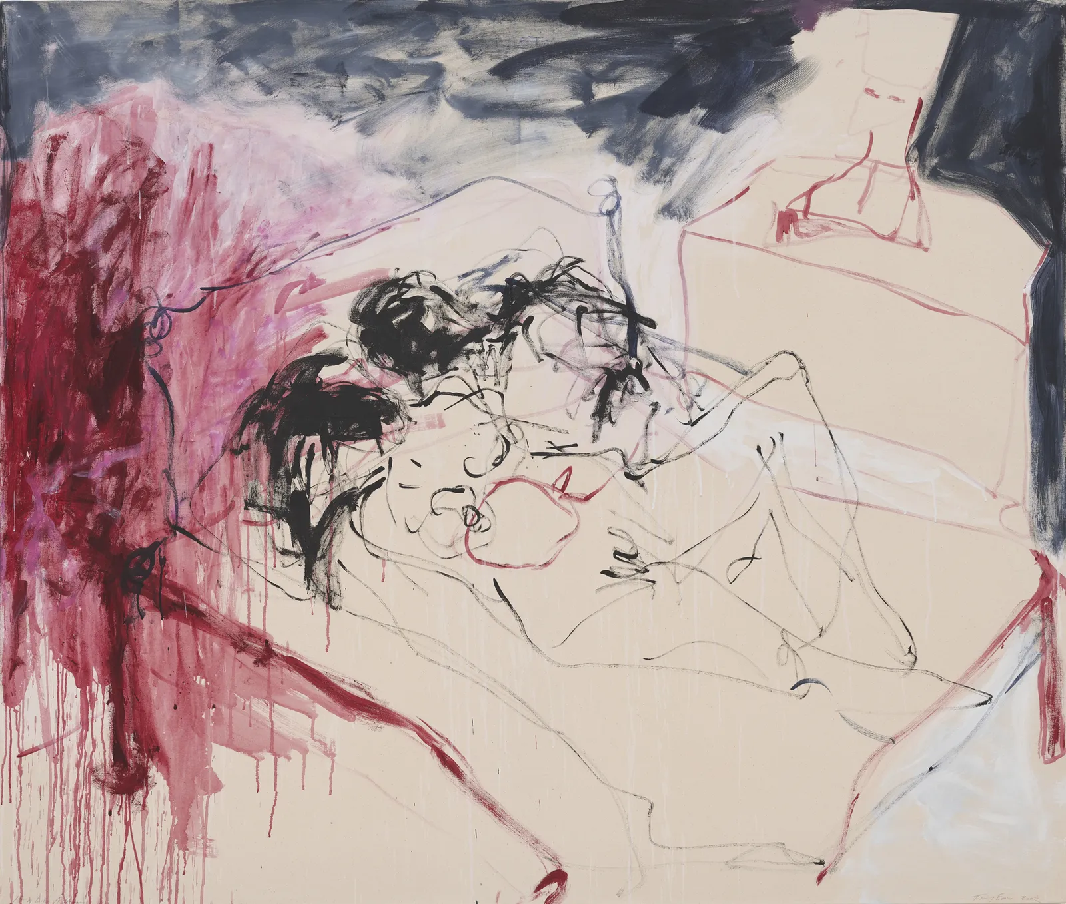
VAN GOGH: POETS & Lovers
Celebrate the National Gallery’s 200th birthday with this once-in-a-century opportunity to see Van Gogh’s most spectacular paintings from around the globe, together for the first time.
TATE MODERN, SE1
Zanele Muholi’s work explores the lives of South African members of the LGBTQIA+ community, and their vivid images are utterly compelling.
THE ART OF BANKSY, WC2
High art meets street art in this fascinating exhibition of the mysterious graffiti artist whose work has captivated the world.
V&A MUSEUM, SW7
The V&A has long celebrated fashion icons, so its blockbuster tribute to Naomi Campbell will be a visual feast for fashionistas.
BARBICAN, EC2
The panoply of Indian life from 1975 to 1998 is brought vividly to life in “The Imaginary Institution of India” exhibition, running throughout October.
NATIONAL PORTRAIT GALLERY, WC2
Stroll through centuries of British history, as told by the faces of the men and women who made it. October sees a special exhibition of the work of painter Francis Bacon.
WHITE CUBE, SE1
Once an enfant terrible and now a grande dame, Dame Tracey Emin’s one-woman show presents the ultimate artistic iconoclast working at her peak.
LOTS TO SEE
Click the images to find out more!
Notes:
2

Slide 12
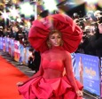
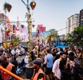



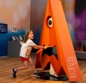

BFI LONDON FILM FESTIVAL
Your chance to catch a world première or even rub shoulders with Hollywood royalty. Head to Leicester Square and you’ll be seeing stars!
BLOOMSBURY FESTIVAL
The literary heritage of authors like Virginia Woolf and E. M. Forster inspires this celebration of creativity, innovation and free-spirits everywhere.
BLACK HISTORY MONTH
October is Black History Month in the UK, and across the city you’ll find a huge variety of events and activities on the theme of “Reclaiming Narratives”.
LONDON RESTAURANT FESTIVAL
A feast for foodies as London celebrates the world’s best cuisines; from themed dinners to special tasting menus, this is London at its most delicious.
LONDON COCKTAIL WEEK
Know your mojito from your pisco sour as the capital gears up to celebrate the cocktail; with many venues hosting special events. Cheers!
JAPAN: MYTHS TO MANGA
The fabulous Young V&A is a museum for children of all ages: this comprehensive look at the far-flung influence of Japanese culture will be a blockbuster.
FRIEZE LONDON
Regent’s Park hosts the world’s leading contemporary art fair, featuring the work of household names and up-and-comers on the art scene.
October EVENTS
Click the images to find out more!

Slide 13
And that’s not all…
We’ve compiled this guide to help enrich your experience here in London and develop an in depth understanding of just how much both London, and the UK have to offer.
The UK is a global hub for innovation, particularly in the creative industries, where companies are continuously redefining what’s possible. World-class institutions like the Royal College of Art and Central Saint Martin’s foster creative talent, driving groundbreaking advancements in areas like design, fashion, film, and digital media.
Government support through initiatives such as trade missions, Innovate UK funding, and an Export Academy empowers creative businesses to explore new ideas, while robust IP protection ensures their innovations are safeguarded.
This dynamic ecosystem makes the UK a leader in creative innovation, where businesses consistently push the boundaries of what’s possible.
Explore some of the incredible UK businesses who are leading the way in taking their clients to the next level.
UK MEANS BUSINESS!

Slide 14
BUSINESS PROFILES
1. WHITEWALL
2. ES GLOBAL
3. WHAT3WORDS
4. NEW SUBSTANCE & SKYMAGIC
5. TWO CIRCLES
6. ONEZONE
7. STATSPORTS
8. JOCKEYCAM
9. FILMILY
10. DIMENSION
11. KYMIRA
To return to the interactive London guide, click our logo.

Slide 15

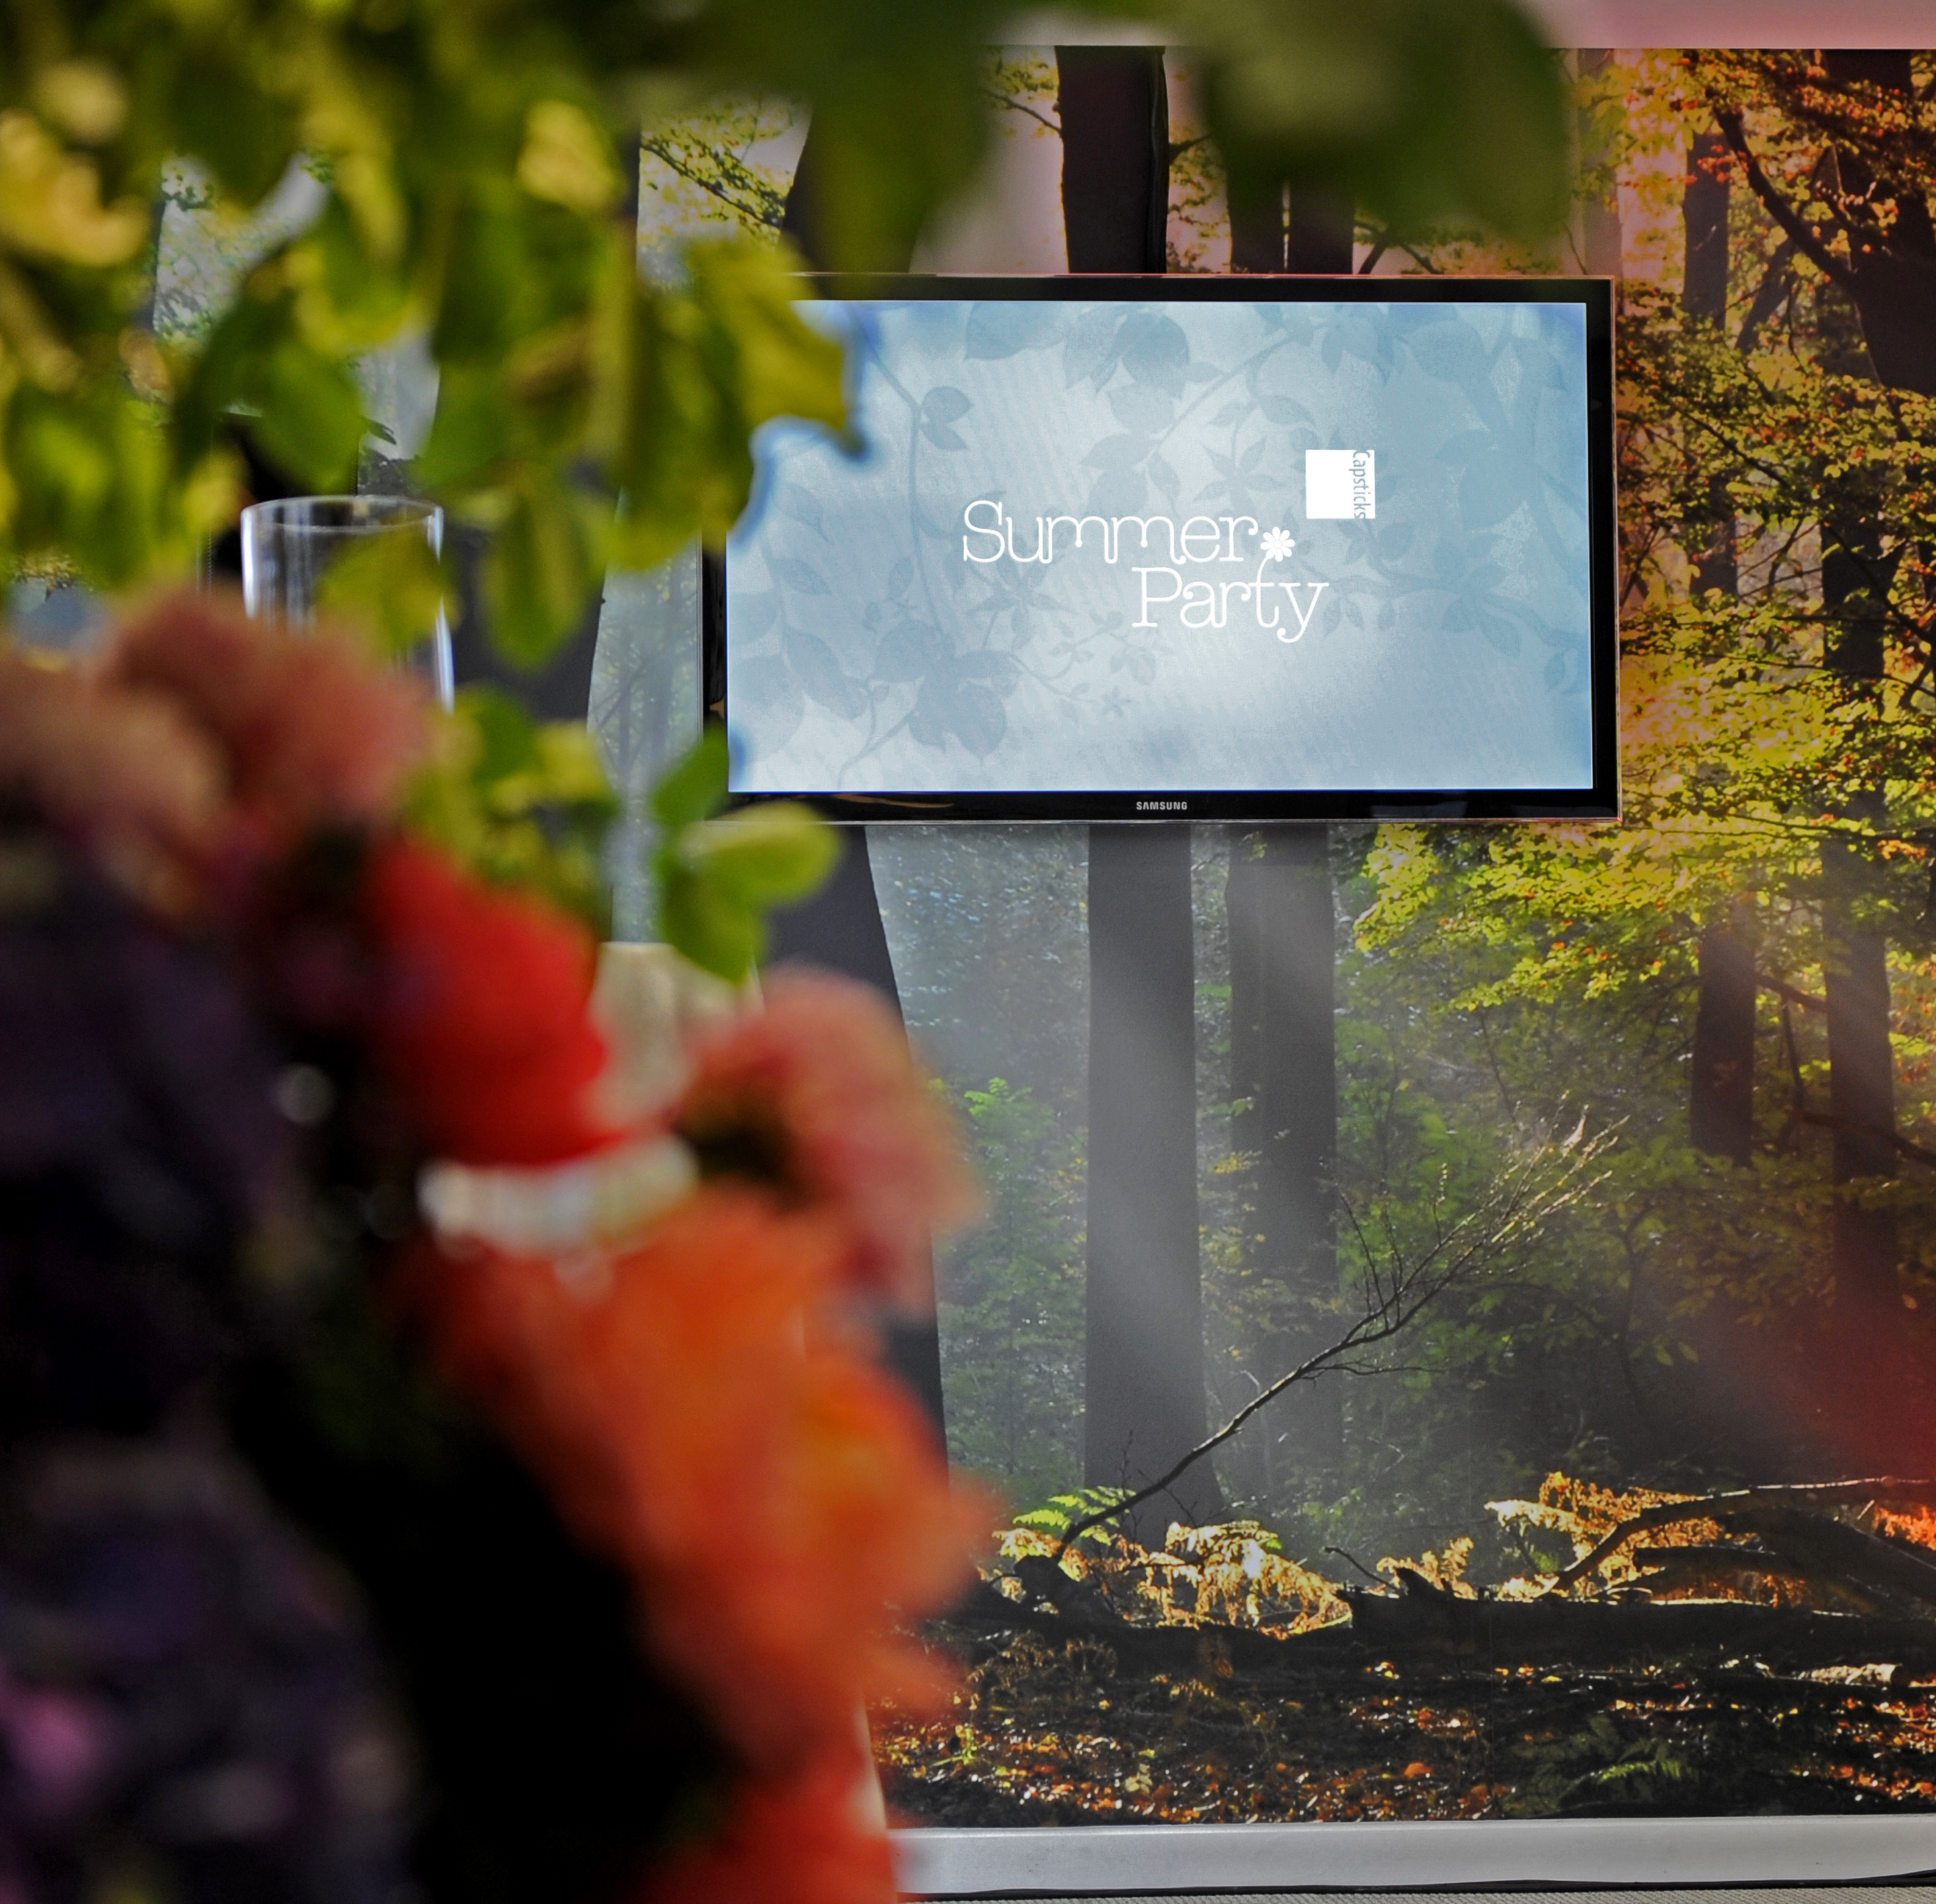


Click on the image or company name to visit their website.
Making Every Moment Count for Your Brand
At Whitewall, we are committed to transforming every brand experience into a memorable, impactful moment. We specialize in creating innovative and immersive design and experiences that captivate and resonate with audiences, ensuring your brand remains unforgettable. With offices in London, New York and San Francisco we design and deliver for brands and organizations across the globe.
Design
Whitewall ensures your brand thrives across multiple platforms. From campaigns and everyday digital communications to XR, VR, AR and the Metaverse, we create design that place your brand at the forefront of style and substance — making every digital interaction impactful and meaningful.
Digital
Our digital services are centered on making sure every touchpoint of your digital presence counts. We craft content that is both functional and captivating, ensuring your audience remains engaged at every step.
Experience
When it comes to experiential events, we don't just create moments — we turn them into movements. Whitewall delivers bespoke experiences that engage, inspire, and build lasting connections with your audience.
At Whitewall, we understand that every second is an opportunity to elevate your brand.
Let us make every moment count for you.
WHITEWALL

Slide 16


Click on the image or company name to visit their website.
ES Global is a lead contractor for major events and projects around the world, designing and delivering relocatable architecture and structures.
What they do:
  Project management, construction, consultancy, and design
  Relocatable architecture, venues, staging, structures and infrastructure such as Basecamps, Fan Zones, Athlete Villages, and more
What they’ve worked on:
  2024 Olympics (Paris)
  2022 ABBA Arena (London)
  2021 Soundforms (San Diego)
  2020 Olympics (Tokyo)
  2016 Olympics (Rio de Janeiro)
  2012 Olympics (London)
what3words divides the world into three-meter squares and gave each square a unique combination of three words. It’s the easiest way to find and share exact locations.
what3words is used by millions of people around the world and thousands of businesses.
Examples of their work:
LA Memorial Coliseum
The O2 Arena
Cannery Row
Goodwood Festival of Speed
ES GLOBAL
WHAT3WORDS

Slide 17

Click on the image or company name to visit their website.
New Substance is a multi-award-winning creative studio with over 20 years’ experience designing and delivering brave and ambitious projects that blur the lines of art, engineering, and technology across global live events, entertainment and art.
SkyMagic is a leading drone light show company, based in the UK, Singapore, and the USA.
Harnessing the abilities of drone light technology, they conjure stories in the sky, moving and entertaining audiences across the globe.
New substance & SKYMAGIC

Slide 18


Click on the image or company name to visit their website.
Two Circles is an international sports marketing agency that leverages data to help sports organizations grow their revenue and know their fans best:
From nine international offices (Bern, Cologne, Kansas City, London, Los Angeles, Melbourne, Miami, New York, Paris), Two Circles grows revenue for the biggest names in sports - using data to create strategies, deliver proprietary technology solutions, package and sell sponsorships, and design and market compelling, scroll-stopping content.
Clients Include:
Premier League
NFL
Wimbledon
UEFA
FIFA
Formula 1
Liverpool FC
Arsenal
onezone is a discovery platform that curates the best restaurants, cafes, bars and hotels in cities around the world.
In a world of content and information overload, onezone is committed to providing inspirational, trusted, authentic recommendations which their community is looking for.
onezone champions female-founded, black-owned and sustainable businesses alongside community heroes through its beautifully curated restaurant lists, encouraging their community to show their support.
Free to download
on iOS and Android.
Two circles
onezone

Slide 19


Click on the image or company name to visit their website.
STATSports is a sports technology company that specializes in the development of wearable monitoring devices for athletes across every level of sport. The company was founded in 2008 and is based in Northern Ireland, with additional offices in the US, Australia, and Qatar.
STATSports produces a range of GPS-based tracking devices and associated software, from elite tier to grassroots products, that allow coaches and sports scientists and aspiring athlete’s to monitor various aspects of a player’s performance across multiple speed and volume metrics.
Clients Include:
Manchester United
Manchester City
Liverpool
Arsenal
PSG
US Soccer
Washington Commanders
JockeyCam Ltd is a dynamic and innovative media and video production company, specializing in POV sports broadcasts.
They provide first-person live video footage from a range of sports, from horse racing to rugby union - in the UK, USA and across the world.
Working directly with broadcasters and sport's governing bodies, their miniature state-of-the-art cameras and transmitters are worn by athletes and officials, giving viewers a unique and unparalleled perspective, heightening fan engagement while also supporting training and analysis.
Clients Include:
NBC Sports
ITV
Royal Ascot
Fan Duel Racing
Six Nations
STATSPORTS
JOCKEYCAM

Slide 20


Click on the image or company name to visit their website.
Filmily is an AI-based SaaS platform that captures content from a Rights Owner’s global fan base.
Filmily's AI filters through 1000s of clips, edit them and generate beautiful films, in minutes.
Dimension is a real-time 3D production studio and platform pioneering virtual worlds, virtual humans and virtual sports.
From game-changing coverage to live events and immersive moonshots, Dimension puts real-time technologies in your hands. The team’s artistry and ground-breaking technical solutions push the boundaries of virtual production and content creation, taking broadcast stories and fan experiences to the next level.
Clients Include:
Wimbledon Championship
Sky Sports’ The Hundred
Sky Sports’ The Open Championship­­­
Omega at Paris 2024
Eurosport Cube
NBA Launchpad
Filmily has been live at:
Paris 2024
Manchester City FC
Chelsea FC
Brit Awards
Coke Cola Music
Formula E
USTA
England Rugby
Generate social content.
Give each fan a unique to them memorable film.
Promote targeted sponsors with fans.
Bring remote fans into the stadium.
Created scrapbooks for each and every fan.
Create fan mosaics.
filmily
DIMENSION

Slide 21

Click on the image or company name to visit their website.
KYMIRA supplies their bio-responsive infrared products to the NFL, NCAA, EFL, MLB, NHL, and more.
KYMIRA’s products make the use of infrared phototherapy as simple as getting dressed. Usable anywhere, any time. KYMIRA products have powered Super Bowls, 33 medals in Paris and athletes around the world to get more out of the sports they love.
As well as their work in human performance, KYMIRA’s products are supporting countless individuals around the world to manage chronic medical conditions including circulatory issues, chronic pain issues and in aged care.
To return to the interactive London guide, click our logo.
KYMIRA

Slide 22


If you’d like to learn more about export and investment work between the US and UK, reach out to Alexis Svenson.
Alexis Svenson
Senior Trade and Investment Officer
Creative, Media & Sport, Midwest | USA
Department for Business and Trade
E: alexis.svenson@businessandtrade.gov.uk
T: +1 (312) 401-9215
W: great.gov.uk

Slide 23

We hope you enjoy all that London has to offer.
If you would like to create a bespoke experience for your family and friends or colleagues, get in touch with Matthew at Whitewall.
As experts in “experience engineering”, we can curate your ideal London visit and leave you with memories to last a lifetime.
Matthew Canning-Wall
Chief Creative Officer
Whitewall
E: matthew@whitewallcreative.com
T: +44 (0)7976 739 967
W: www.whitewallcreative.com
This booklet is © UpStage Communications Ltd. No part of its contents may be reproduced in any form or by any means without the prior written permission of UpStage Communications Ltd. UpStage Communications Ltd disclaims any liability for the availability or non-availability of services and locations mentioned in this booklet

