Slide 2
Make every moment count

Slide 3
Creative
Big ideas to shape your narrative in the best way possible
Design
Digital
Experience
Collateral, graphic animations and broadcast quality video to take your content to the next level
Transformative digital experiences that deliver results
Compelling storytelling and immersive live experiences, bringing audiences and brands together

Slide 4
At Whitewall, we GIVE HEALTHCARE & LIFE SCIENCES CREATIVE AGENCY
In Healthcare & Life Sciences, every moment counts.
Our dedicated team of professionals is here to create content and design experiences that get results; working with internal stakeholders to craft the format and delivery that will inform, engage and inspire.
Our commitment is to work with the client team to set the bar higher than ever before.
Whitewall is a creative agency dedicated to making every moment count.

Slide 5
We want to be THE creative agency of choice
It’s always nice to have friends in any location. Local knowledge is vital to any organisation that wants to not only ‘land’ but also ‘expand’.
With an established US presence, our HQ in London and a mix of US, UK and international employees, we have the team that understands the market – and speaks the language - on both sides of the Atlantic.
We help businesses tell their story to prospects, customers, partners, investors and stakeholders through every kind of media, and in a way that ensures they make every moment count.

Slide 6
OUR GLOBAL REACH

Slide 7
OUR HEALTHCARE & LIFE SCIENCES ROSTER

Slide 8
WE COMBINE HEALTHCARE & LIFE SCIENCES EXPERTISE,
CREATIVE THOUGHT PARTNERSHIP AND STRATEGIC DESIGN WITH TRUSTED EXECUTION AND DELIVERY.

Slide 9
HEALTHCARE & LIFE SCIENCES EXPERTISE
HEALTH & LIFE SCIENCES DYNAMICS
Experiences and content designed with patient and caregiver / HCP centricity
Partnering with marketing teams to support their patient and HCP engagement strategies
Telling powerful stories within Regulatory, Quality & Compliance environments
Scientific and technological storytelling around innovation and advancing the continuum of care
Awards and recognition tailored to purpose driven organizations

Slide 10
TRANSCREATION
Making the complex seem simple through our innovative, design-led solutions that can translate complex data into comprehensible formats for any audience.
Enhance presentations
Communicate with patients on their level
Simplify your solutions for a diverse audience
Empower your team with helpful visuals, diagrams and schematics
Take a look at our: Transcreation VT

Slide 11
MISSION & VALUES
We bring your mission and values to life through strategic digital, web and video content that reaches employees, patients, HCPs, investors and the public.
Mission and values identity design
Employee stories
HCP customer stories
Growth-focused investor stories

Slide 12
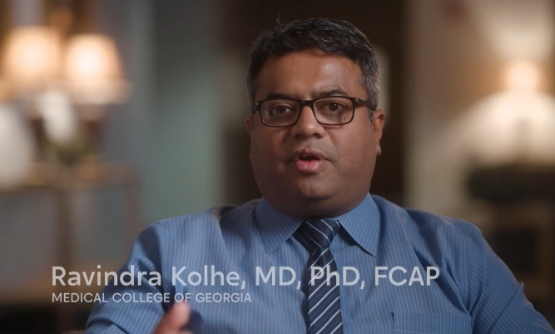
PATIENT STORYTELLING
We tell powerful stories of struggle, hope, and recovery through the voices of real patients whose lives have been transformed.
Patient empowerment
HCP customer engagement
Marketing message integration
Serial content production
Take a look at this Bionano Patient Story VT

Slide 13
PRODUCT STORYTELLING
We illuminate innovation through cutting edge video stories about medical technology that changes lives and helps HCPs improve care around the world.
R&D storytelling
Product launch hero videos
Marketing and advertising content
Content series design and production
Take a look at this Product VT- Pattern VT

Slide 14
MARKET SPOTLIGHT
SALES AND MARKETING EVENTS
Sales meetings
Marketing meetings
Sales enablement
Sales rep. story-telling
Reward and recognition
PRODUCT
LAUNCHES
Product hero spots
Product video series
Product microsite design
Patient story-telling
Patient mini-documentaries
Patient story campaigns
Patient and product experience stories
CORPORATE BRAND STORYTELLING
Brand hero spots
Corporate documentaries
YouTube and LinkedIn series development

Slide 15
MARKET SPOTLIGHT
Commercialization
EVENTS & CONTENT
Product launch and indication expansion events
INTERNAL MTGS & BROADCASTS
CEO town halls
ERG meetings
Innovation council meetings
R&D events
PATIENT ENGAGEMENT CAMPAIGNS
Patient storytelling, videos and microsites
Patient outreach campaign content
Employee engagement campaigns
Employee engagement program development
Employee video and content series
External series for talent acquisition

Slide 16
CASE STUDIES

Slide 17
PATTERN COMPUTER
HEALTH TECH COMPANY LAUNCH
Event strategy design
Live event production
Content strategy and production
Opening video experience
Company narrative and storytelling
See the opening VT Pattern VT

Slide 18
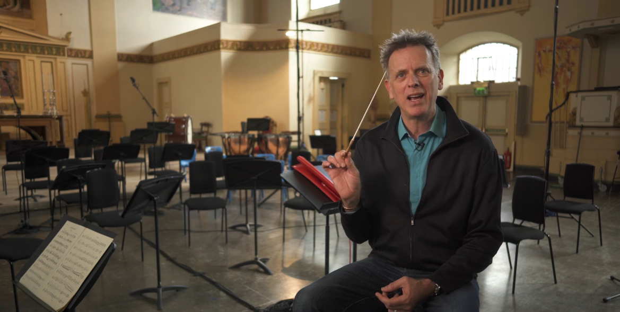
GSK
TRAINING, Development & ENGAGEMENT
Training & development series design and delivery
Curriculum development
Train-the-trainer programming
Partnership with renowned speaker David Pearl

Slide 19
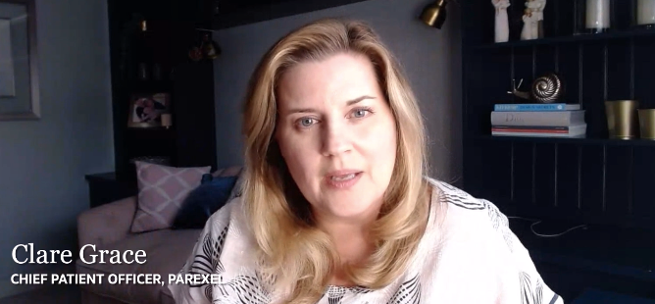
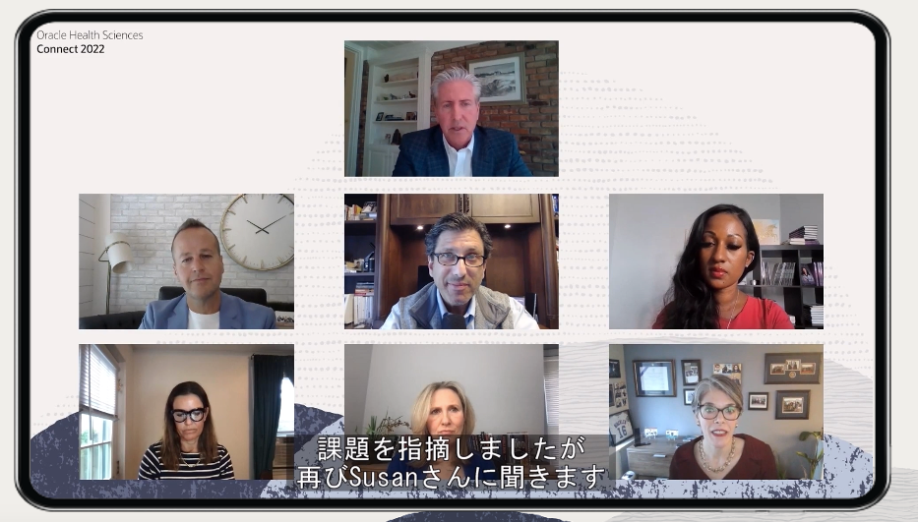
ORACLE HEALTH SCIENCES
GLOBAL EVENT SERIES DESIGN, PRODUCTION & CONTENT
Event strategy design
Virtual event production
Content strategy and production
Communications campaign development
Global virtual broadcast delivery
Here’s our Virtual XP- Oracle HS VT
Notes:
https://www.whitewallcreative.com/vt/vt-ocw-ww-hsgbu/

Slide 20
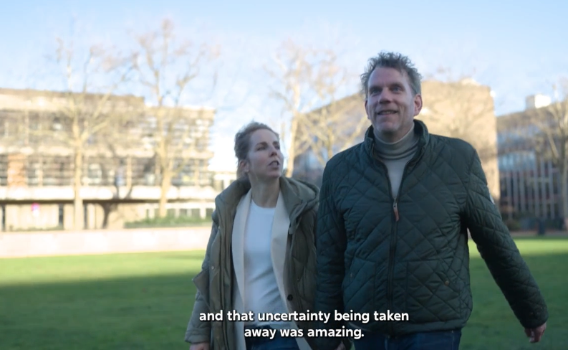
BIONANO
PATIENT STORYTELLING & EVENT PRODUCTION
Event strategy design
Live event production
Content strategy and production
Opening video – patient mini-documentary
Company narrative and storytelling
If you missed it take a look at this Bionano Patient Story VT

Slide 21
THANK YOU!

