Slide 2











OUR CLIENTS

Slide 3
OUR GLOBAL REACH

Slide 4
Make every moment count

Slide 5

SUPPORTING INTEGREON’S
DIGITAL MARKETING EVOLUTION

Slide 6
What we heard
DIGITAL OPPORTUNITIES
Here’s what we heard about Integreon’s digital journey and the opportunities ahead:
ROI from traditional conferences is hard to see
Investing in digital may drive better results from the marketing mix
Growing Integreon’s digital engagement and following will help grow its reputation overall
Design and content are covered in-house; virtual event elevation and video production could be interesting support areas in which we could partner

Slide 7


WHAT WE SUGGEST
We believe Integreon can build on its existing digital strategies and platforms to:
MAKE VIRTUAL EXPERIENCES MORE VARIED & INTERACTIVE.
Introduce new formats, elevated production values and more two-way engagement that help Integreon virtual events outperform competitors’.
INVEST IN ORIGINAL VIDEO & CONTENT SERIES.
Deliver new, original content series that deliver Integreon messages and strengthen thought leadership. Consider a bespoke content hub that strengthens the Integreon brand.
GENERATE A BRIGHTER DIGITAL HALO.
Through the above, and some social sharing and promotion, increase brand affinity through a swell of enhanced digital marketing activity.

Slide 8
HOW?

Slide 9


NEW VIRTUAL EXPERIENCES
ELEVATE. ENHANCE. ENGAGE.

Slide 10
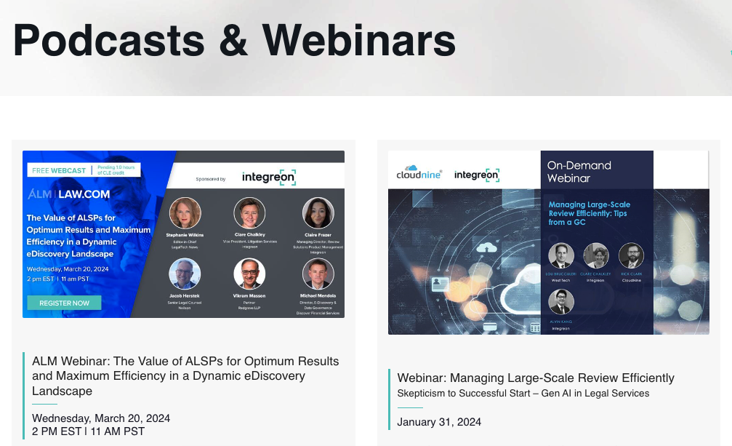
VIRTUAL EVENT ELEVATION
EVOLVING WHAT’S ALREADY WORKING
Integreon already has an established webinar and virtual event series. We can help up-level this series through creative ideas, some production tips and enabling more attendee interaction.
Here are a few creative ideas for how to elevate these series, as well as what a professionally produced series could look like.
We have also included a case example of how we have done this before for a global brand.
Notes:
Ask JG re weblinks page for OA.

Slide 11
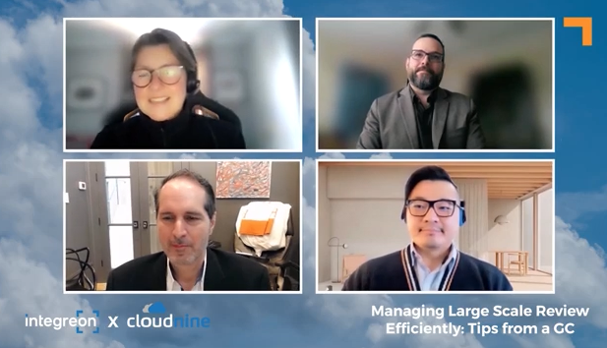
VIRTUAL EVENT ELEVATION
We can help up-level and evolve Integreon’s established webinar series through ideas like:
Professional host or facilitator
New, varied GFX packages
B roll to support speaker commentary
Webinar structure featuring short, buzzy segments
Live polls, chat and interaction with customer voices
Video for interstitial promotions and announcements
Notes:
Ask JG re weblinks page for OA.

Slide 12
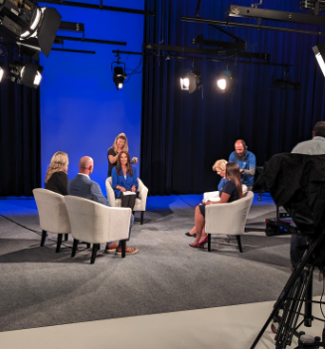
Webinar Series Ideas
LIVE ON-SET WEBINAR RECORDING(s)
video or podcast series
Most competitors in this field feature webinars, but few to none are professionally produced. In a single day of professional production, we can record 5-7 webinars professionally, with a set, multiple cameras, lighting and a professional host.
That difference will sing on screen and set Integreon apart.
A new format for each webinar can improve watchability and reach:
(Series intro)
Intro and top news
Guests intro
Topic 1
Messaging break
Topic 2
Messaging break
Topic 3
Looking ahead
Close
Notes:
Ask JG re weblinks page for OA.

Slide 13

ELEVATING: AN EXAMPLE
For Oracle’s Women’s Leadership program, we designed and delivered a virtual event series that featured creativity, connection and resources, all on a single, branded platform.
Featuring a blend of live and pre-recorded footage, the series engaged as well as informed. Group activities, panel discussions, networking and more made the OWL events lively, inspiring and fun.
Crucially, using a virtual platform enabled Oracle to reach a much bigger and broader audience, as well as providing useful content that could be repurposed for other uses.
Notes:
Ask JG re weblinks page for OA.

Slide 14
HOW?

Slide 15
VIDEO & CONTENT MARKETING
STORYTELLING WITH PURPOSE

Slide 16
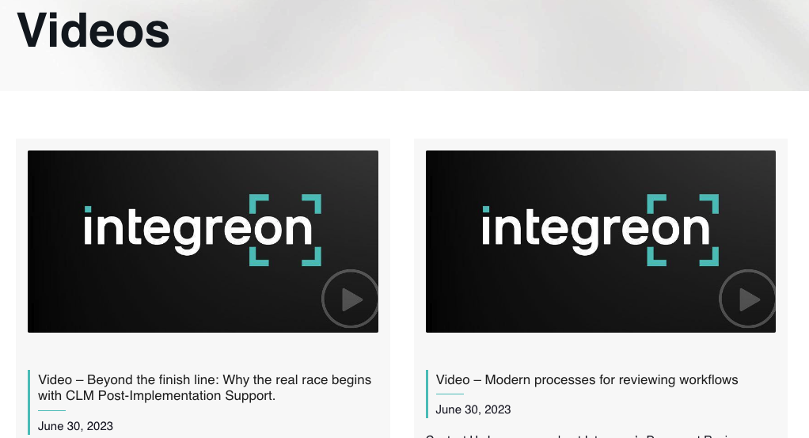
NEW
EVOLVING INTEGREON’S VIDEO MARKETING
Video has become the cornerstone of digital marketing today, making storytelling and message delivery more dynamic, shareable and scalable. And today, it is easier and more affordable to produce than ever.
We can help Integreon enter a new phase of content marketing through creative ideas and even production support. The more creative, catchy and sharable these videos, the brighter the Integreon digital brand halo will be.
Here are some examples of our creative thinking around Integreon video and other content series ideas.
Notes:
Ask JG re weblinks page for OA.

Slide 17

Content Series ideas
Claire(s) from legal
video or podcast series
A conversation video series (or podcast) in which current topics in the legal support field are discussed with personality and hilarity by our two Claires.
Example format:
(Series intro)
The Claires’ intro and agenda review
The Rundown
  The month’s news in all things legal and tech
Industry Power Rank
  The Claires rank the top three issues facing the industry at this moment
Culture Clips
  The Claires share their favorite clips from pop culture that satirize the office, legal, compliance or tech industries
Close
Notes:
Ask JG re weblinks page for OA.

Slide 18

Content Series ideas
SIXTY SECOND SIGHT
ANIMATED VIDEO series
This monthly video series is a one-minute news style update on trends and insights from Integreon’s unique perspective on the industry. Supported by B roll and graphics, it doesn’t impact execs’ schedules, and can be tailored to support immediate marketing priorities.
Example format:
:05 “Welcome to Sixty Second Sight from Integreon. I’m (NAME), and here is our outlook for May 2024.”
:10 Industry news – major headline (1)
:20 Integreon news (i.e. new leadership hires, new launches)
:30 Tip / insight / thought starter from an Integreon leader
:40 Promote the next webinar, article or video
:50 Promote any new content on Integreon.com
Notes:
Ask JG re weblinks page for OA.

Slide 19

Content Series ideas
TRUE CONTRACT CRIMES
Podcast series
This idea takes a tip from one of the most popular podcast genres – true crime – with a legal services spin.
In the style of a true crime podcast, two Integreon hosts tell stories from general world and legal history (say, 50-100 years ago) in which companies got into trouble through failures in the areas Integreon offers services (contracts, compliance, doc review. etc.).
These should be amusing stories, from towns small and large, about merchants across industries. It’s a quirky, wonky, amusing and entertaining take on true crime, and a nice way to message Integreon solutions organically as part of the creative content.
Notes:
Ask JG re weblinks page for OA.

Slide 20
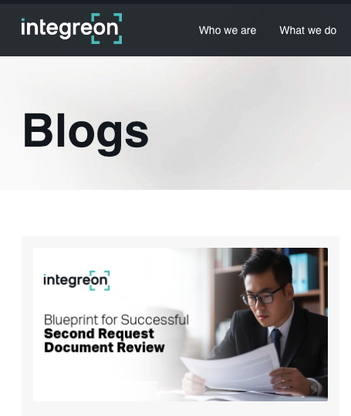
Content Series ideas
CULTURE-FOCUSED TOPICAL STORYTELLING
ARTICLE series
Let’s tie Integreon’s activity, services and key messages to current topics in the media and corporate life that are cultural and interesting. Ideas like:
Legal discovery in the movies: best and worst examples, ranked
Cyber incidents in the modern world: the top three biggest events of the past decade and what to learn from them
Doc review time machine: in this thought experiment, we snapshot what doc review looked like 30 years ago; what it looks like today; and what it might look like 30 years from now
Notes:
Ask JG re weblinks page for OA.

Slide 21
HOW?

Slide 22
CONTENT HUB
A SOPHISTICATED CENTER FOR
CONTENT and connection

Slide 23

Click here to see
our work in action

Slide 24

CONTENT HUBS
CENTRALIZED & PURPOSE DRIVEN
What are the major streamers’ sites and apps but content hubs? Integreon (along with its competitors) has as “resource center,” but none have what we consider a true “content hub,” with the contemporary dynamic feel of a brand’s one-stop digital shop.
A content hub makes more effective and long-term use of content through strategic display, organization, searchability, new versioning, as well as the opportunity to make connections with the brand and other customers. Integreon has an established library of content and resources, so why not maximize it?
Here is an example of what an Integreon content hub could look like, as well as a few examples of how our work in this space has helped organizations make their content work harder for their brand.
Notes:
Ask JG re weblinks page for OA.

Slide 25
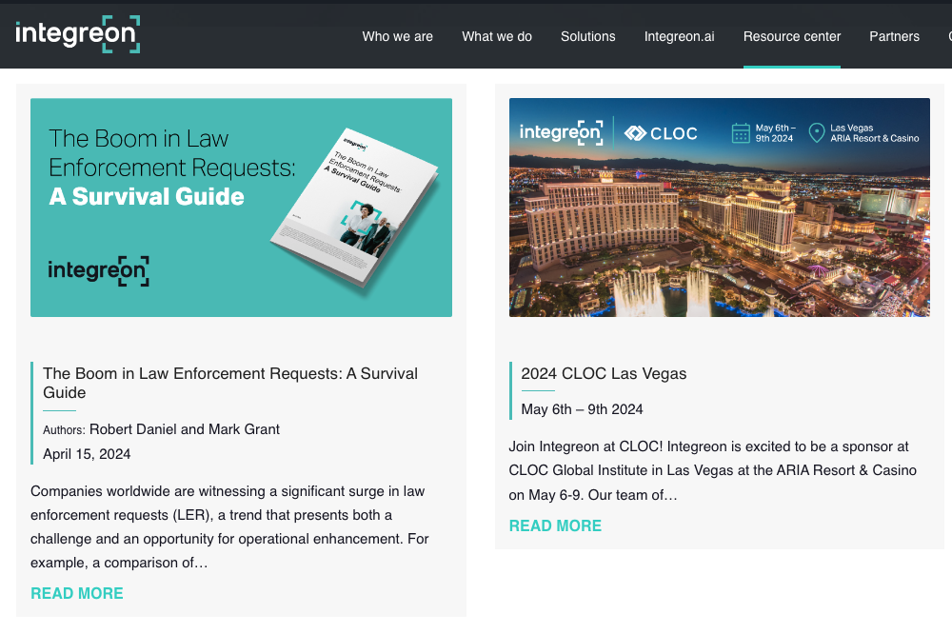
AN INTEGREON CONTENT HUB
A HUB THAT TELLS THE INTEGREON STORY
One evolution of Integreon’s Resource Center could be a content hub, which would feature all content and resources on a single page, with supporting pages for all of its existing content. A new menu could look something like:
Coming Up: an always-populated promotion for Integreon’s next event
Events: enhanced virtual events listings, past recordings and live watch capabilities
Video: new and original video series
Articles, Blogs and Resources: all editorial content and other resources
Connections: connect with Integreon leaders and subject matter experts, and foster connections between clients, prospects and other stakeholder groups.
Notes:
Ask JG re weblinks page for OA.

Slide 26
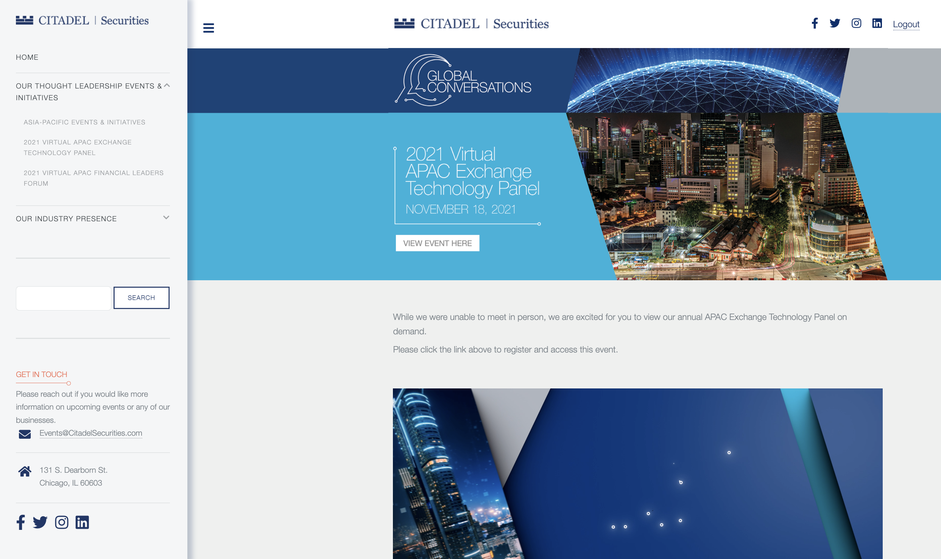
CITADEL
In the financial services space, Citadel is a major player. It regularly attracts world-renowned speakers and SMEs to its live and virtual events. But once the event was over, that content was quickly forgotten.
We built a bespoke content hub; searchable, user-friendly and full of incredible Citadel content, allowing those unable to attend in-person events to miss none of the action.
Notes:
In the financial services space, Citadel is a major player. It regularly attracts world-renowned speakers and SMEs to its live and virtual events. But once the event was over, that content was quickly forgotten.
We built a bespoke content hub; searchable, user-friendly and full of incredible Citadel content, allowing those unable to attend in-person events to miss none of the action.
Ask JG re weblinks page for OA.

Slide 27
Supporting Integreon’s digital journey

Slide 28
INTEGREON’S DIGITAL JOURNEY
We think Integreon has an opportunity to differentiate itself from its competitors in a concrete way as it evolves its digital marketing strategies, and would love to play a supporting role. The bedrock is already there – the series, events and content are established. It’s now about building on them.
We would love the chance to share these and other ideas live. Serving as our clients’ creative thought partner, before any work is done, is our first goal.
By elevating virtual events and growing engagement in original video series that delivers Integreon messaging in new and clever ways, we believe Integreon can grow its digital brand halo and overall reputation.

Slide 29
THANK YOU

