Slide 2
Why Whitewall?
Whitewall has been proud to partner with the Global Tech team to help deliver the program in FY24.
Our team has been inspired and energized by these bright and talented young people, and by the passion and commitment of the Oracle GT team to give them the best possible start to their careers.
It is with that sense of excitement that we approach FY25, in the hope that we can continue building on our partnership with you to make an even bigger impact in the coming year.
With a team you know and trust, a comprehensive and integrated solution, plus our commitment to go above and beyond, we are the creative and delivery partner who can make FY25 the best year yet.
We very much hope to continue our partnership with you on this important program, and invite you to review our ideas and ambitions for FY25.
We can't wait to help you Make Every Moment Count!

Slide 3
MAKE
EVERY MOMENT
COUNT

Slide 4
The Big Three!
There are many reasons why Whitewall is the perfect partner for the FY25 program, but here are our top three that Make Every Moment Count:
RED THREAD – the theme that connects and unifies the program; building excitement and driving engagement
OUR PEOPLE – you know and trust them, and they are passionate about going above and beyond in FY25
AN INTEGRATED EXPERIENCE – all elements of the program work together to take Oracle Global Tech FY25 to the next level
Are you ready to D.R.I.V.E?

Slide 6
Four Drivers
A strong and cohesive theme is the most powerful tool to ensure that the program delivers against all its objectives, as well as providing fun and engaging activations that support the key learnings. Our "Red Thread" will keep the motor running throughout the 12-month program and provide the connective tissue that will make FY25 an integrated and immersive experience. Our solution will bring the red thread to life through four key Milestones:
DISCOVER
ROADMAP
INDIVIDUAL VALUE
EMPOWERMENT
You can’t go for a D.R.I.V.E. without Drivers – and we have four powerful components for this journey to success:
Milestones – the live experiences: time to get together to learn, share and grow, while also giving something back through CSR activations
Virtual Experiences (aka GPS1 & 2) – the on-line audience will feel very much part of the program, with content delivered in powerful and meaningful way
Waystations – stages along the journey to get a tune-up; fun and engaging activations to keep the energy and inspiration going
Video – with this group of participants, video is key, and we'll use all our skills and experience to create content that gets noticed and makes an impact
Each driver contributes something new and different; keeping the program on track and the pedal to the metal.

Slide 7
Four key Drivers for one amazing program

Slide 8
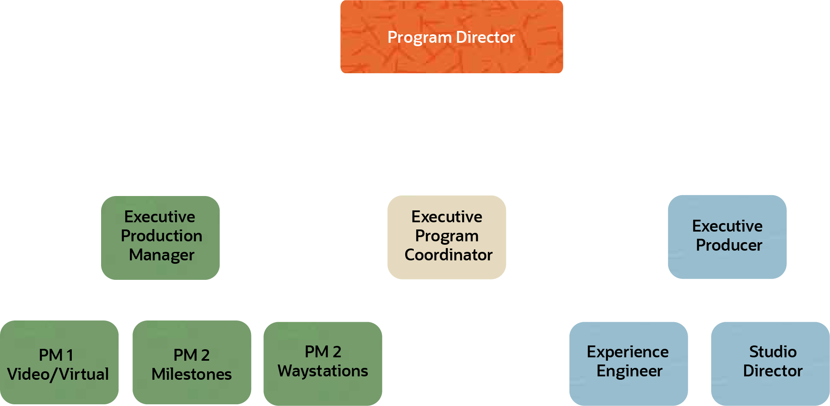
One trusted team to deliver the 12-month program

Slide 9
An integrated solution
So many elements go into the Global Tech program: everything from live and virtual events to video and digital content.
To create the most impactful program, an integrated approach is essential; ensuring that each element is not only effective in its own right, but also reinforces the impact of the overall program.
Whitewall's approach is to ensure that the individual elements form part of the larger whole - driving the theme and messaging, connecting the participants and providing the optimal environment in which participants can network, learn, share, explore and grow.
We have four Milestone get-togethers for the live experience, two engaging Virtual Experiences, not to mention some fantastic Videos like "Drive to Thrive" and "Truths from the Track". To keep the engines running we have amazing activations in our Waystations: everything from Roadside Cafés to Service Stations.
The Global Tech program gives new starters the best possible beginning for their future with Oracle.
By adopting an integrated approach across all elements of the program, we will be setting all participants up for success.

Slide 10
Timeline
Click the link to see the proposed project timeline

Slide 11
PRESS PLAY
To see Aanya's personal Global Tech FY25 journal.

Slide 12
So how do we get there?
Now we would like to take you through the components of the FY25 program.
Don't worry! We won't tell you everything but wanted to give you a month-by-month peek at the highlights of how we'll D.R.I.V.E. the delivery of the best Global Tech program yet!

Slide 13
May ‘24
Start the ignition. Feel the hum of the engine. Get ready – because the drive of your life is about to begin!
The first part of the journey is coming to a screen near you, with an inspiring and impactful >virtual launch> that takes you into the program and off on the road with confidence, purpose and a clear sense of where you're headed.
You'll be introduced to your Digital Diary, the TripTik; an on-line journal for you to record the highs and lows of your journey and provide valuable material to help guide you along the way.

Slide 14
June ‘24
You're on your way and in the driver's seat – the motor's running and your sights are set on the horizon.
But first, a little pit stop at the >Big Max Roadside Café>. Refresh yourself by joining other travelers, Oracle colleagues and the GT roadside support team; there every step of the way as you continue your D.R.I.V.E.
To help you on your journey we're presenting >"Truths from the Track"> - a series of videos with all kinds of useful information to help you on your way to your destination: tips and strategies to navigate the road ahead.

Slide 15
July ‘24
"Discover"
Set off on your journey to success by discovering more about Oracle, your peers and yourself.
It's time to hit the gas and move into high gear!
There are two great July activities: bringing both live and virtual audiences into the heart of the program.
For some of you, you'll experience D.R.I.V.E. on-line as you participate in >GPS1 (Global Tech Prepares you for Success!)>, a dynamic and engaging virtual experience full of incredible content, conversation and challenge.
Or maybe you'll be driving into a Milestone event at one of our D.R.I.V.E. locations; getting together with peers to >DISCOVER> more about Oracle and about yourselves.
Everyone knows that tunes are the best part of any road trip, so prepare to get psyched as our guest rapper drops some incredible beats that any journey playlist would be proud of!
GPS
Suggested
Run-of-Show
Milestones Suggested Run-of-Show

Slide 16
August ‘24
You've made a great start to the program and realized there is so much more to this journey than you imagined.
We all need a little help navigating our way, so now is a great chance to stop into our >Service Station> get-together: reflect and journal about your goals using prompts provided by the program.
Adding to the fun is your first >Speedy Meet> - who will you be getting to know this month??
To stay on track, check out Episode 1 of >"Drive to Thrive”>, a unique miniseries in which you'll learn more about the program, get expert guidance from SMEs and see how your peers around the world are making the most of their D.R.I.V.E. experience.
You've tuned up and tuned in – time to hit the road again!
Don’t worry about missing an off-ramp; all the action can be viewed on GTTV’s "O Tube" channel!

Slide 18
September ‘24
The journey's picking up pace and there's so much to see and do along the way.
Summer's almost over, so what? The vibes are still going strong, and you're pumped for what's ahead: >Heidi's Hideout, Dave's Diner, and Big Max'>
At this next Roadside Café, you’ll connect with other participants about the program, work and life experiences.
Why not grab a snack or a coffee with a PM or some Execs while you're there?
Please update your ”TripTik” and share your experiences so far with other participants and accountability partners and complete your self-directed >Roadmap> activity in preparation for your next Milestone.
Don't get too settled in though, because you need to D.R.I.V.E. on.

Slide 19
October ‘24
It’s time for our next Milestone: >ROADMAP> – a plan of where you're going and how to get there.
Inspired by the video >Road Map for Success>, you'll discuss your career journey while interacting with PMs and Execs.
Importantly, learn that your roadmap won't always go to plan, but with a little time and attention, you'll avoid the hazards and reroute when you need to.
As part of this Milestone, you will also give back to your community through a bike-build activity.
Nothing's going to keep you from your destination now!
"Roadmap"
A successful journey means having a clear sense of direction, and the ability to navigate all the possibilities.

Slide 20
November ‘24
Well, who would have thought it? You're halfway through your GT journey already!
Sure, this is a busy time and juggling all the demands on your time isn't easy, but you've can still have a little fun, right?
That's the spirit!
We all sing-a-long in the car, so put those pipes to good use in Oracle's very own version of the classic >Carpool Karaoke>!
Pick your favourite 'D.R.I.V.E. - themed song and show your peers that Oracle's got talent!

Slide 21
December ‘24
A bit of a downshift in December provides a perfect opportunity to visit the Service Station, collect your thoughts on the closing year, and forecast the upcoming one.
But it's not devoid of exciting activities. We know that Rudolf drives Santa's sleigh – but what drives you?
Explore that subject with our >"What Drives?”> video series, where our own Tracie Meier sits down with some of the most influential people in the industry to find out >“What Drives?”> them.

Slide 22
January ‘25
The New Year brings new opportunities – how will you take advantage of what the New Year has to offer?
A great place to start is with our self-directed >StrengthsFinder> online assessment.
We'll give you the tools to determine what you're best at and what may need some maintenance.
This activity will help set you up perfectly for next month's Milestone: Individual Value.
Don’t forget the end of the month is the deadline for your Carpool Karaoke submission. Come on, join the fun!

Slide 23
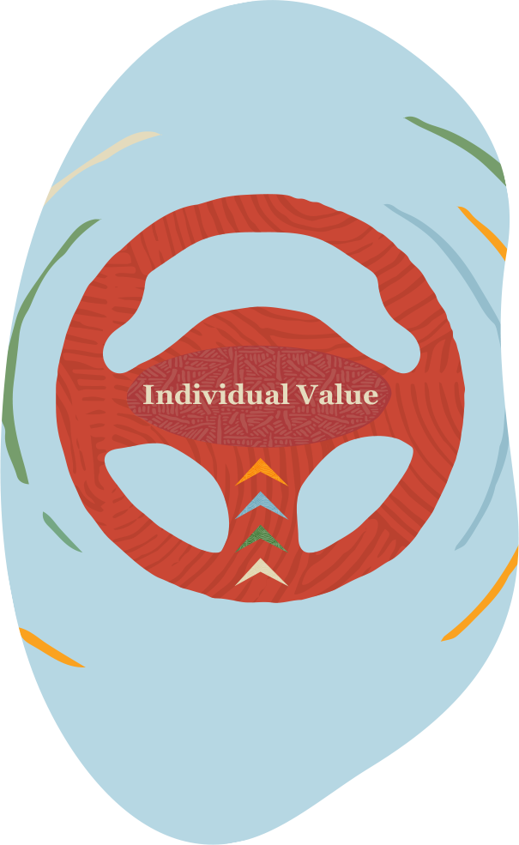
February ‘25
Wait – Milestone three already?!? How did that happen?
This one is all about >INDIVIDUAL VALUE> - the fundamentals of what makes you you.
You’ll deep-dive into the strengths you bring to Oracle via StrengthsFinder.
There's another episode of >Truths from the Track>, focusing on values, and the chance to find out more about yourself and those around you.
As well as all the key learnings and personal development, there's a real feel-good activation as you work with your colleagues to build green cars for local schools.
That felt good, didn't it?
"Individual Value"
A journey is a great way to learn about yourself and those around you, and to realize what’s really important.

Slide 24
March ‘25
Spring is in the air, and the road stretches out before you.
Take time to stay on track with another stop at the Service Station.
Well, that would be great, but how about a compilation of the best of our >Carpool Karaokes?> (PS - the Greatest Hits video is being produced this month and we can’t wait for you to see it.)
What could be nicer than another >Speedy Meet>?
Okay, you win – you get both!!

Slide 25
April ‘25
Are we there yet? You know what – we nearly are!
But there are plenty of adventures before we reach our destination.
You can top up your energy with a caffeine infusion at >Kayla's Kafé> - one of our fabulous Roadside Cafés.
Are you ready for your final Milestone experience?

Slide 26
May ‘25
"Empowerment"
Skills and knowledge will only get you so far, and now is the time to act with confidence and purpose to drive future success.
The end of the journey is always bittersweet – but our last Milestone is not an ending: it's only the beginning.
To set you up for the next part of your journey, we're all about >EMPOWERMENT> and how you can head off on into the future with confidence and purpose.
Virtual attendees (at the >GPS2 Virtual Experience>} and in-person participants will both access vital information about what they can do today to be one of the leaders of tomorrow.
Carpool Karaoke: Greatest Hits will amaze you!
The season finale of >"Drive to Thrive”> will inspire you for your next adventure.
Phew. The road was long. The journey took you places you never dreamed. But you're ready for what comes next, and what you've learned in the Global Tech FY25 program will fuel the next stage of your journey to success.

Slide 27
Down to the nitty-gritty
Delivering Oracle GT requires a skilled and dedicated team, but also a comprehensive ability to manage all the multiple workstreams
Let us take you through the components that will make up our solution and make Global Tech FY25 come to life

Slide 28
Four Drivers - we’ve got you covered…

Slide 29
Milestones
Staffing​
Technical Production & Management
Experienced, professional facilitator at each location
Whitewall Technical and Stage Managers
Technical Support
Professional show laptop for each location
Partnership and co-ordination of in-house IT and AV staff
Content
Design & delivery of content and engagement ​at each Milestone​
Additional materials and props for each Milestone-specific activation
Milestone Events
Provision and delivery of interactive, engaging content at all Milestones
External speaker / activities
Give-back activity (Milestones 2 and 3)

Slide 30
Virtual Experiences
Staffing​
Dedicated Whitewall Producer for each location​
Experienced, professional facilitator to deliver content and drive engagement​
Whitewall Technical Director to oversee content and studio delivery
Whitewall Technical Manager to manage broadcast process
Whitewall Room Manager to manage and control access to Zoom call​
Technical Support
Broadcast quality virtual studio for vision mix of all content ​
Stream and record of content, including up to three pre-record sessions
Rehearsal sessions
Show delivery for US and Indian virtual participants (July ‘24 and May ‘25​)
Delivery via Whitewall virtual studio into Zoom
Interactive zoom chat, survey and engagement app (Pigeonhole)​
Full contingency plan, to include back-up stream
Content
Preparation and delivery of content and engagement​
Design and delivery of interactive virtual activities (i.e. maze and mosaic)

Slide 31
Waystations
Staffing​
Onsite co-ordinator to execute Roadside Cafes​
Meeting Technician to assist & organize Service Stations and Roadside Cafes​
Data Technician – organize & supply information gathered from Digital Diaries​
Technical Support
Data collection and analytics software
Content
Design, creation and delivery of original Waystation content.
Management & correlation of client’s analytical data capture​

Slide 32
Video
Staffing​
Whitewall Line Producer to oversee capture and delivery​
Media management of all required assets
Source and brief professional film crew for each location​
Whitewall team to manage organization and direction of ancillary video assets
Whitewall graphics team for full video editing process​
Equipment
Filming set up to include lighting, sound, and video capture at each location
Hard drives for storage and back up
Upload of all footage​
Content​
Capture and editorial for appropriate video assets
Capture of 4 x Milestone events
Capture of B-Roll and participant engagement
Frame IO software for client review and approval process
Editing and delivery of video content
OTUBE co-ordination and upload

Slide 33
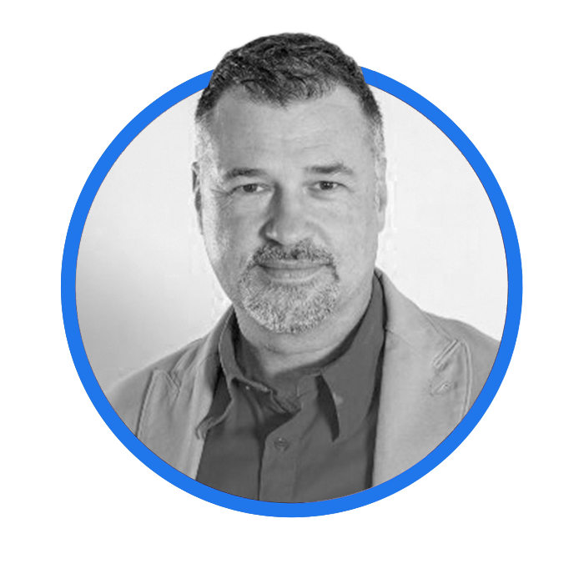
A team you know and trust – dedicated, passionate and experienced. It's all about people.
Karl
Grace
Rod
Jon
Monique
Sam
Bruce
John

